Slide 1


On the Safety and Efficiency of Virtual Firewall Elasticity Control
Hongda Li†, Juan Deng†, Hongxin Hu†, Kuang-Ching Wang†,
Gail-Joon Ahn‡, Ziming Zhao‡ and Wonkyu Han‡
†
‡
NDSS 2017

Slide 2
Outline
Introduction
Overview of VFW Controller
Our Approach
Dependency Analysis and Semantic Consistency
Flow Update Analysis
Buffer Cost Analysis
Optimal Scaling
Implementation and Evaluation

Slide 3





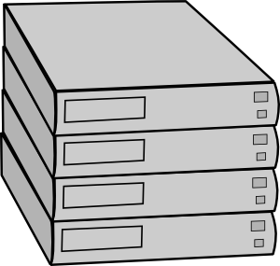
Traditional Hardware-based Firewall
Fixed location
Constant capacity
Internal Networks
External Networks
Notes:
1) Firewall is a widely deployed NF that protects networks against suspicious traffic.
2) Traditional hardware-based firewalls are deployed at fixed network entry points and have a constant capacity.
So it’s hard to use traditional hardware based firewall to protect the emerging virtualized environments.

Slide 4
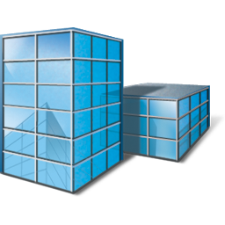
Virtualized Environments
Blur & Fluid Perimeters
Virtualized Network Zones
Zone₂
Zone₃
Zone₁
Service
Migration
Datacenter₂
Datacenter₁
Datacenter₃
Infrastructure
Notes:
1) Firewall is a widely deployed NF that protects networks against suspicious traffic.
2) Traditional hardware-based firewalls are deployed at fixed network entry points and have a constant capacity.
So it’s hard to use traditional hardware based firewall to protect the emerging virtualized environments.

Slide 5
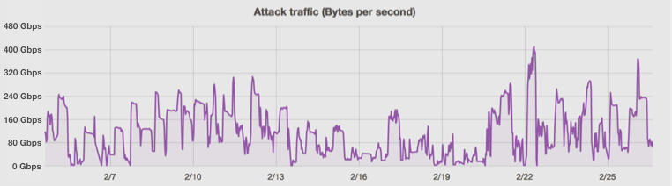
Traffic Volume Variation
Expensive option:
capacity ≥ peak traffic load
Gbps
DDoS attack on Feb. 2016
400
320
240
Significant Variation
160
80
0
2/19
2/22
2/25
Time
Source: https://blog.cloudflare.com/a-winter-of-400gbps-weekend-ddos-attacks/
Notes:
0> Another problem is that it’s hard to decide the capacity of firewall.
1> For example, this figure shows a significant traffic volume variation for ddos attack.
2> To fully protect our networks an expensive option is to let the capacity greater than the peak traffic load.

Slide 6
New Trends
Network Function Virtualization (NFV)
Create and destroy software instances dynamically
Software-Define Networking (SDN)
Dynamic traffic steering
Virtualization Platform
SDN Switch
Virtual Firewall
NFV
SDN
Notes:
0> Recently, there are two emerging network paradigms.
1> One technology is Network Function Virtualization. it can implement middleboxes as software instances that can be created or destroyed dynamically.
2> Another technology is Software-Define Networking, it enables dynamic traffic steering.
3> So, NFV plus SDN push forward a new type of firewalls we call virtual firewall, which is flexible and elastic to protect networks.

Slide 7





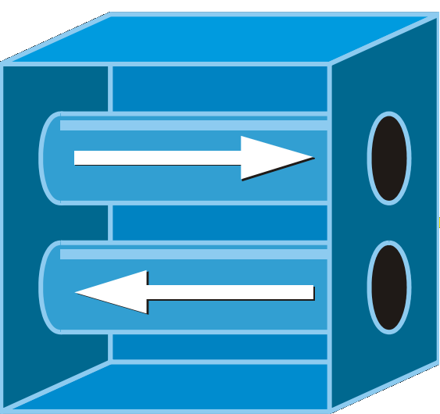
Firewall as a Service
Virtual firewall in commercial virtualized environments
Amazon AWS
VMware vCloud
VCE Vblock
Microsoft Azure
Google Cloud Platform
Virtual firewall used to protect traditional enterprise networks
Middlebox Outsourcing [SIGCOMM’ 12]
Cloud Provider
Internet
Notes:
0> Virtual firewall can enable FWaaS because it has been included in many commercial virtualized environments.
1> virtual firewall can also be used to protect traditional enterprise networks.

Slide 8
Elastic Virtual Firewall Scaling
elastic scaling out
Overload →
Underload →
elastic scaling in
Overload
(packet loss)
Underload
SDN Switch
Safe, Efficient and Optimal
Notes:
0> One important feature of virtual firewall is that it can scale dynamically.
1> When a Virtual Firewall instance is overloaded,
2> a new instance can be created quickly and partial traffic is redirect to the new instance.
3> When the Virtual firewall instances are underload,
4> some instances can be destroyed
5> To fully utilize the virtual firewall benefits, the scaling of virtual firewall must be safe, efficient and optimal.

Slide 9
Policy Migration in VFW Scaling
Copy
Seq | Src_ip | Dst_ip | Action
v1 | A | B | Deny
v2 | C | D | Allow
… | … | … | …
Seq | Src_ip | Dst_ip | Action
v1 | A | B | Deny
v2 | C | D | Allow
… | … | … | …
VFW₁
VFW₂
Split
Split
Seq | Src_ip | Dst_ip | Action
Seq | Src_ip | Dst_ip | Action
v1 | A | B | Deny
… | … | … | …
v1 | A | B | Deny
v2 | C | D | Allow
… | … | … | …
Virtual Firewall Performance VS. Rule Size
VFW₁
VFW₂

Slide 10
Challenges - Semantic Consistency
Sequence | Src_ip | Dst_ip | Action
v1 | 10.10.1.5 | 192.1.1.* | Deny
Sequence | Src_ip | Dst_ip | Action
v2 | 10.10.1.* | 192.1.1.9 | Allow
… | … | … | …
Dependent
… | … | … | …
VFW₁
VFW₂
SDN
Switch
Safety Problem:
Allow illegal traffic
Flow Table
Sequence | Src_ip | Dst_ip | Action
f1 | 10.10.1.* | 192.1.1.9 | To VFW₂
f2 | 10.10.1.5 | 192.1.1.* | To VFW₁
… | … | … | …
Sequence | Src_ip | Dst_ip | Action
f1 | 10.10.1.* | 192.1.1.9 | To VFW₁
f2 | 10.10.1.5 | 192.1.1.* | To VFW₁
… | … | … | …
10.10.1.5 → 192.1.1.9

Slide 11
Challenges - Correct Flow Update
Sequence | Src_ip | Dst_ip | Action
v1 | 10.10.*.5 | 192.1.2.* | Allow
v2 | 10.10.*.6 | 192.1.1.* | Deny
Sequence | Src_ip | Dst_ip | Action
v3 | 10.10.*.7 | 192.1.1.* | Allow
v4 | 10.10.*.8 | 192.1.1.* | Deny
… | … | … | …
… | … | … | …
VFW₁
VFW₂
Not exactly mached
Incorrect delivery
SDN
Switch
Flow Table
Seq | Src_ip | Dst_ip | Action
f1 | 10.10.1.* | 192.1.1.* | To VFW₁
f2 | 10.10.1.* | 192.1.2.* | To VFW₁
… | … | … | …
To VFW₂
10.10.1.5→ 192.1.2.9
10.10.1.6→ 192.1.1.9
10.10.1.7→ 192.1.1.9
10.10.1.8→ 192.1.1.9

Slide 12
Challenges - Buffer Overflow Avoidance
Not enough buffer
VFW₁
(Packet loss)
VFW₂
R/S
How much buffer is required?
In-flight Traffic
SDN
Switch

Slide 13
Challenges - Optimal Scaling
Goal: minimum resource consumption
Scaling-out: least new instances
Scaling-in: most killed instances
Constraints
Satisfy SLAs
Minimize Update
Avoid Buffer Overflow

Slide 14
Overview of VFW Controller
VFW Controller
Resource
Condition Detection
Virtual
Firewall
Migration and Update Control
Dependency Analysis
Virtualization Layer
Provision Control
Servers
Flow Update Analysis
Buffer Cost Analysis
SDN Switches
Optimal Scaling Calculation

Slide 15
Dependency Analysis
Group
Indirect Dependency
Direct Dependency
Packet Space:
Intra-dependency
<src_ip, dst_ip, src_port, dst_port, protocol>
r1:<10.10.1.*, 192.1.1.9, any, any, TCP>
PS(r₁)
Direct dependency
r2:<10.10.2.*, 192.1.1.*, any, any, TCP>
Indirect dependency
PS(r₂)
Direct dependency
r3:<10.10.2.5, 192.1.2.*, any, any, TCP>
PS(r₃)

Slide 16
Dependency Analysis
Inter-dependency
Relation between firewall and flow rules
Congruence
Flow Rule Group (F)
Firewall Rule Group (V)
Superspace
Subspace
Intersection

Slide 17
Semantic Consistency
Group-based Migration
Causes of semantic inconsistency
Group
Group₁
Group₂
Group is broken
VFW₁
VFW₂
Group
Group₁
Group₂
Order is not preserved
VFW₁
VFW₂

Slide 18
Flow Update Analysis
V: firewall rule group to be migrated
F: flow rule group inter-dependent with V
Congruence
Superspace
V
or
F
“CHANGE” all
F
V
Subspace
Intersection
or
V
“CHANGE” or “INSERT”
V
F
F

Slide 19
Flow Update Analysis
For each
or
No Update
“CHANGE”
or
“INSERT”
where

Slide 20
Buffer Cost Analysis
1.Transfer(vspace)
VFW
Controller
1.Accept(vspace)
4.ACK
4.ACK
3.Migrate(vspace)
VFW₂
VFW₁
2.Update₁(fspace)
5.Update₂(fspace)
Buffer
SDN Switch
:bandwidth
:transmission delay
: sending rate of the affected flows

Slide 21
Optimal Scaling Calculation
are indicators
Goals
Constraints
Scaling-out
firewall rule group
is moved to instance
→
min
Minimize extra instances
Solved by
Integer Linear Programming
Scaling-in
instance
is merged on instance
→
max
Maximize merged instances
Satisfy SLAs
Minimize Update
Avoid Buffer Overflow

Slide 22



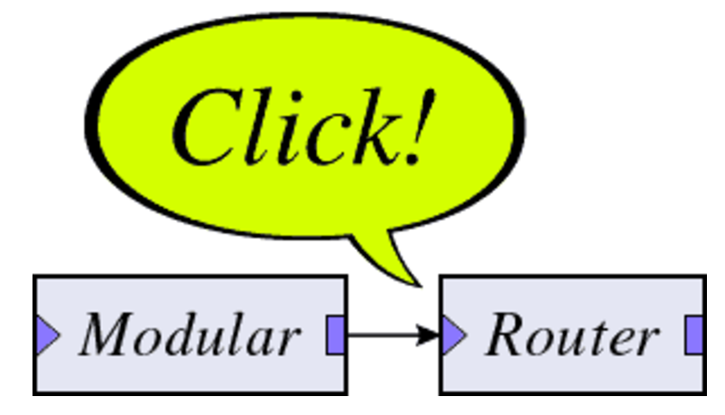

Implementation
Implementation
Xen-4.4.1, ClickOS [NSDI’14]
Floodlight, Open vSwitch
Simple stateful firewall: 7 new Click elements, ~3000 lines of C++.
VFW Controller: python interface, based on Hassel Library [NSDI’12]
Testbed
CloudLab (https://www.cloudlab.us/)
Experiment profile is available:
https://www.cloudlab.us/p/SeNFV/Firewall-VLANs

Slide 23
Evaluation
Intra-dependency in real-world firewall policies
Policy | Rule(#) | Group(#) | Largest Group Member (#)
A | 12 | 2 | 3
B | 18 | 3 | 5
C | 25 | 3 | 6
D | 52 | 7 | 7
E | 83 | 9 | 7
F | 132 | 10 | 9
G | 354 | 10 | 12
H | 926 | 13 | 18

Slide 24
Evaluation
Capability to quickly scale
Split with UDP flow overload
Split with TCP flow overload
< 1 second

Slide 25
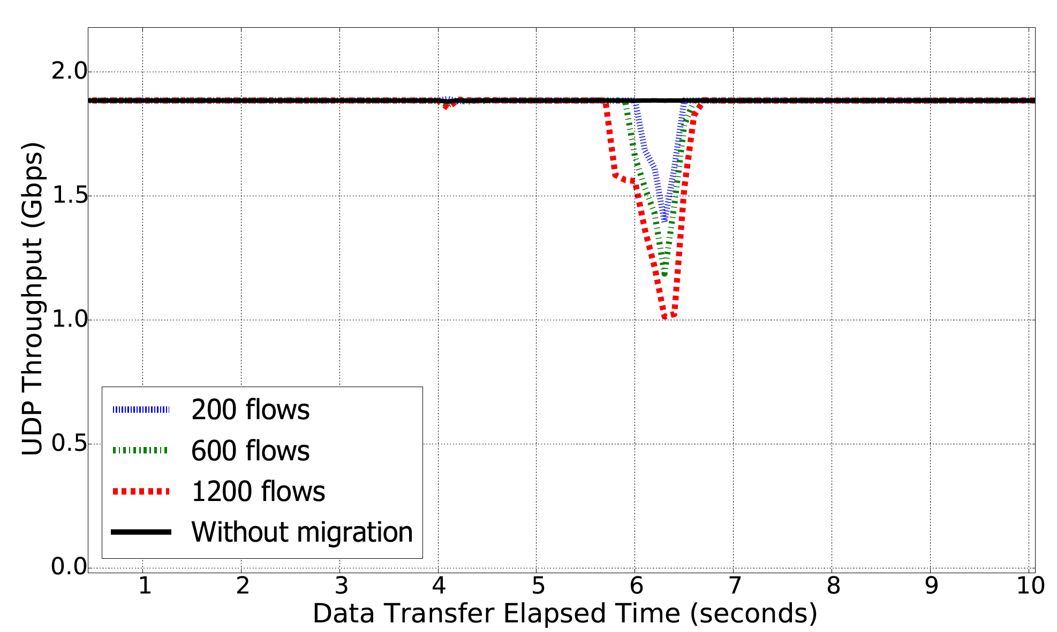
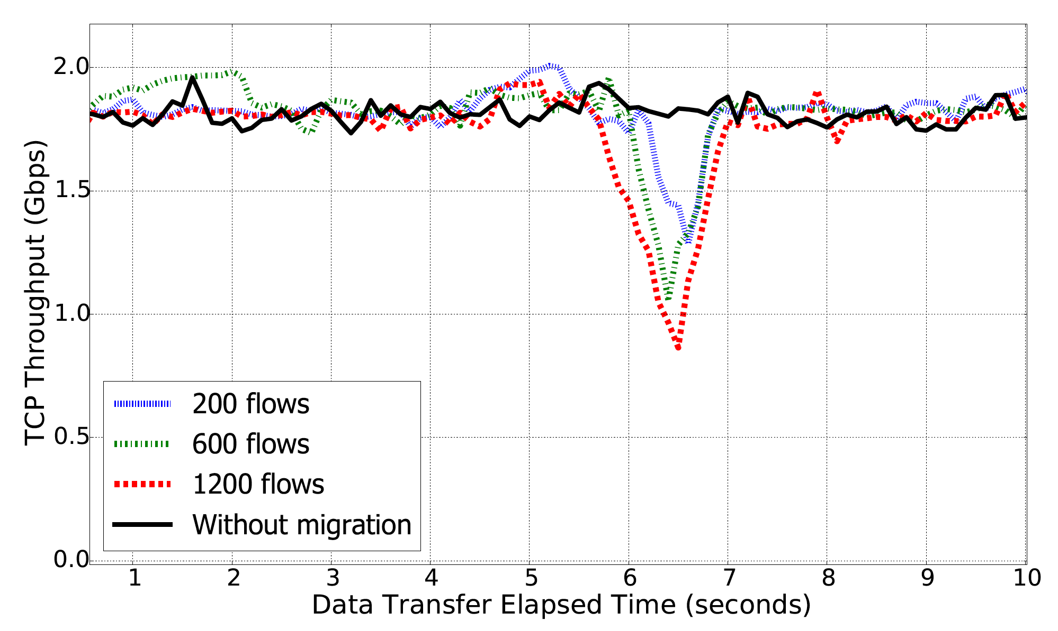
Evaluation
Migration impact on throughput
Throughput Degradation
Throughput Degradation
Impact on UDP throughput
Impact on TCP throughput

Slide 26
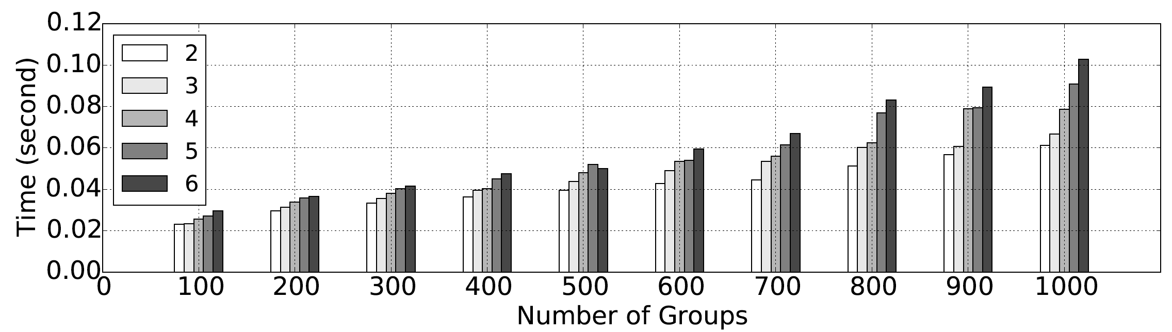
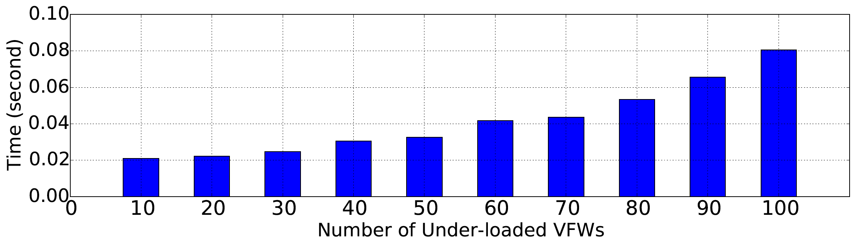
Evaluation
Performance of optimal scaling calculation
6 addition virtual firewall instances,
1000 firewall rule groups to split
Scaling-out calculation
100 underloaded virtual firewall instances
Scaling-in calculation

Slide 27
Conclusion
NFV+SDN push forward a new
breed of firewalls, virtual firewalls
VFW Controller enables safe, efficient and optimal virtual firewall scaling
Implementing and evaluating VFW Controller
…
Virtualization Platform

Slide 28
Q & A
This work was partially supported by grants from National Science Foundation (NSF-ACI-1642143 and NSF-ACI-1642031)

Slide 29
State Of The Art
Safe Migration
Split/Merge [NSDI’13]
OpenNF [SIGCOMM’14]
NFV and SDN for security
Bohatei [USENIX Security’15]
SDN Firewall
FlowGuard [HotSDN’14]
Firewall policy deployment [S&P’07]
Distributed firewall [CCS’00]
Notes:
1>
Existing work on safe migration.
Both Split/Merge and OpenNF have laid the groundwork for supporting the elastic scaling of a variety of virtual network functions.
However split/Merge can cause lost or re-ordered network functions state updates.
OpenNF achieves a safe migration on generic network functions but fails to consider firewall-specific problems, the semantic consistency can correct flow update.
It also assumes the buffer for in-flight traffic is infinite and overlooks the optimization of scaling.
2> FlowGuard proposes a framework for building SDN firewalls, to protect OpenFlow based networks.
The firewall policy deployment paper presents safe and efficient policy update algorithms of firewall policies. However, those algorithms can only applied on a single firewall.
3> There are also works discussing distributed firewalls:
However, the distributed firewalls have fixed location and capacity.

Slide 30
Evaluation
Rule size impact on performance

Slide 31
Challenges (Semantic Consistency)
Sequence | Src_ip | Dst_ip | Action
v1 | 10.10.1.5 | 192.1.1.* | Deny
v2 | 10.10.1.* | 192.1.1.9 | Deny
v3 | 10.10.1.* | 192.1.1.* | Allow
… | … | … | …
Sequence | Src_ip | Dst_ip | Action
v2 | 10.10.1.* | 192.1.1.9 | Deny
v3 | 10.10.1.* | 192.1.1.* | Allow
Sequence | Src_ip | Dst_ip | Action
v1 | 10.10.1.5 | 192.1.1.* | Deny
v1 | 10.10.1.5 | 192.1.1.* | Deny
… | … | … | …
v3 | 10.10.1.* | 192.1.1.* | Allow
… | … | … | …
VFW₁
VFW₂
Original VFW
Merged VFW
10.10.1.5 → 192.1.1.1
10.10.1.5 → 192.1.1.1
Semantic Consistency

