Slide 1

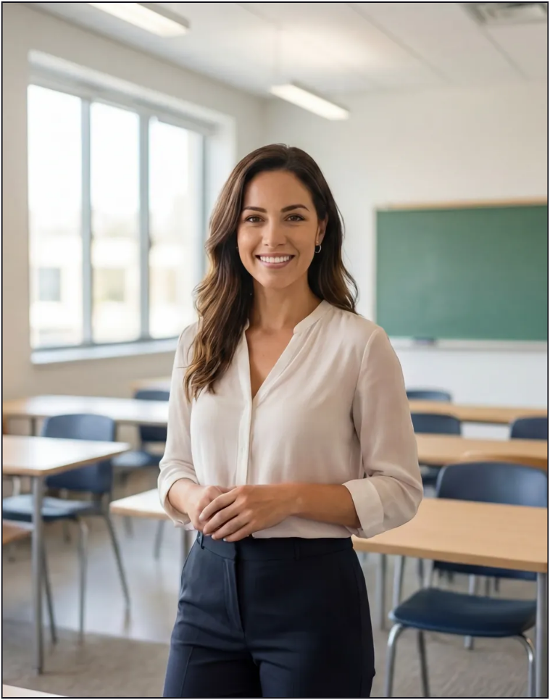

Online English Trial Lesson
Present by: Tutor Name
September 4, 2099

Slide 2









Lesson Aims
What we'll do together in today's lesson:
01
Get to know each other
Start with a relaxed warm-up chat.
02
Ask me anything
Ask any questions about English or lessons.
A simple roadmap for our trial class, from getting to know each other to planning your next steps.
03
A mini lesson
Try a short activity matched to your level.
04
Plan your course
Choose your focus and next steps.
02

Slide 3











Warm-Up Chat
Let's Get to Know Each Other
Let’s start with a few easy questions to help us feel comfortable.
Where are you
living now?
What do you do
each day?
What do you enjoy after work?
Tell me a little about your city, country, or neighborhood.
Share what your daily routine, work, or studies are like.
Talk about your hobbies, interests, or favorite ways to relax.
03

Slide 4









Your Learning Goal
What Brings You Here?
Let’s find the reason you want to improve your English.
What do you want to achieve?
Speaking confidently
Work & business
Travel
Exams (IELTS, TOEFL)
Study abroad
Just for fun
What's something you'd love to do in English one day?
I’d love to...
04

Slide 5








Ask Me
Now, Ask Me!
Your turn to ask anything you’re curious about.
Got any questions for me?
Hometown
Hobbies
Travel
Food
Work
Movies
Weekend
Languages
Daily Life
Technology
Family
Pets
05

Slide 6
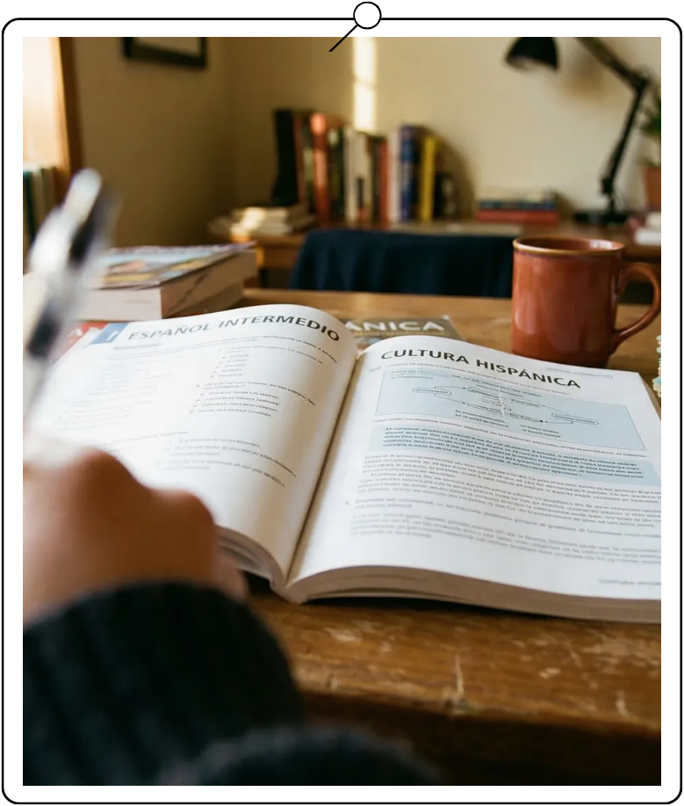


A Mini Lesson
Let's learn something together!
Tutor note: Adjust this lesson for Beginner, Intermediate, or Advanced learners.
06

Slide 7












Mini Lesson
Look & Talk
Describe what you see and share your first thoughts.
01
What do you see here?
02
What words come to your mind here?
03
Do you like it? Why or why not?
04
Does this remind you of anything?
05
What is this like in your country?
07

Slide 8









Mini Lesson
Read & Talk
Read a short story, then talk about the main idea.
Read the Story
Mina started learning English three years ago.
At first, she was too shy to speak, and she often stayed quiet in class. So she decided to try something new — she began watching movies without subtitles and practiced speaking to herself at home. She has made many mistakes since then, but she has never given up.
Last month, she traveled abroad alone for the first time. She ordered her own coffee in English, and the waiter understood her perfectly. It was a small thing, but it made her feel really proud.
01
What is this story about?
02
Why do you think Mina's English got better?
03
Have you ever felt shy speaking English?
08

Slide 9














Mini Lesson
Speaking Feedback
Let’s improve a few sentences together, step by step.
You said
Let's try
I never tried this
I've never tried this.
I arrived to the office late.
I arrived at the office late.
It was good.
It was really enjoyable.
I know him since 2020.
I’ve known him since 2020.
09

Slide 10












Mini Lesson
Grammar / Vocabulary
Learn a useful pattern you can use in real conversation.
Past simple
Present Perfect
(verb + -ed / past form)
(have / has + past participle)
A finished time
An experience, no set time
yesterday
last year
ago
ever
never
since
Example
Example
I visited Paris last year.
Have you ever been abroad?
10

Slide 11




Mini Lesson
Let’s Practice
Try a few quick questions to check your understanding.
01
I ▁▁ (visit) Paris last year.
02
Have you ever ▁▁ (be) to Paris?
03
She ▁▁ (call) me yesterday.
04
He ▁▁ (never / eat) sushi.
05
We ▁▁ (know) each other since 2020.
06
They ▁▁ (move) here two years ago.
Answers: visited · been · called · has never eaten · have known · moved
11

Slide 12










Course Planning
Let's Plan Your Course
Choose your focus, lesson style, and next steps.
Course Focus
How Often
What do you want to focus on?
How many lessons a week?
Vocabulary / Grammar / Fluency …
1 / 2 / 3+
How Long
Any Preferences
How long should each lesson be?
Topics or interests you'd like to focus on?
25 or 50 minutes
Work / Travel / Movies / Daily life ...
12

Slide 13
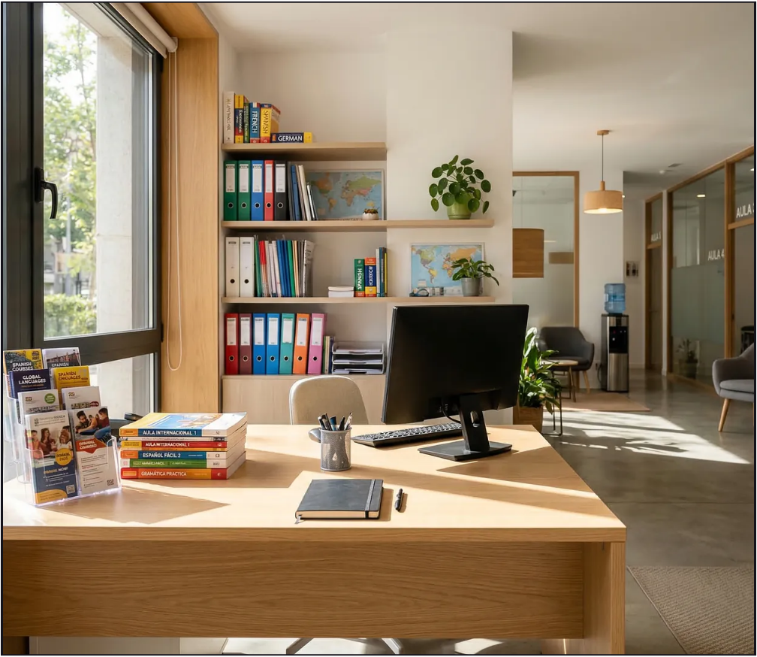




See You
in Class!
Let’s book your next lesson.
13

