Slide 1
Tutorial 1
Running JADE Under Eclipse
Dr. Fuhua Lin
School of Computing and Information Systems
Athabasca University, Alberta, Canada
Oct. 27, 2009

Slide 2
HelloWorld.java under a package jade.Tutorials
package jadeTutorials;
import jade.core.*;
import jade.core.behaviours.SimpleBehaviour;
public class HelloWorld extends Agent {
public void setup() {
SimpleBehaviour hello_behaviour = new SimpleBehaviour(this) {
boolean finished = false;
public void action() {
System.out.println("Agent Started: Hello World!" + getLocalName()+ getName());
Location l= here();
System.out.println("I am running in a location called:"+l.getName());
System.out.println("I am running in ID called:"+l.getID());
System.out.println("I am running in an address called:"+l.getAddress());
System.out.println("I am using a protocol called:"+l.getProtocol());
finished = true;
}
public boolean done() { return finished; }
};
addBehaviour(hello_behaviour);
} }

Slide 3
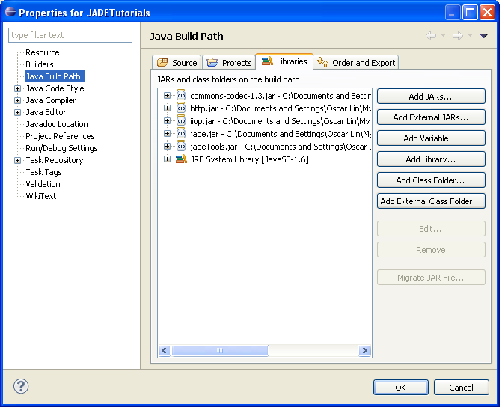
Project Properties
JADE can be run under eclipse “Run” as ‘Java Application’.
Before you setup the execution environment for JADE, you should add JADE’s .jar files to your project:
Go to Project → Properties
move to Java Build Path
in the “Libraries” tab, press “Add External JARs” button

Slide 4
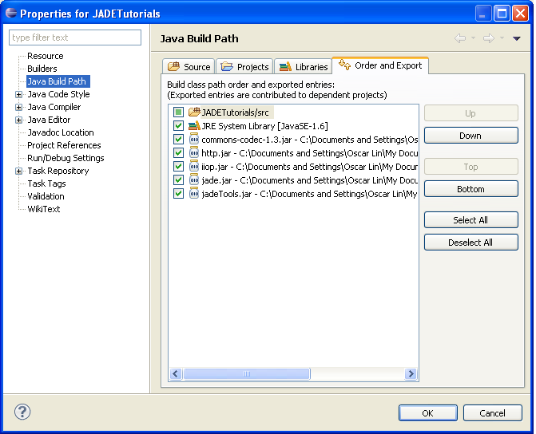
4. Select all the JADE’s jar files in “Orders and Export” tab

Slide 5
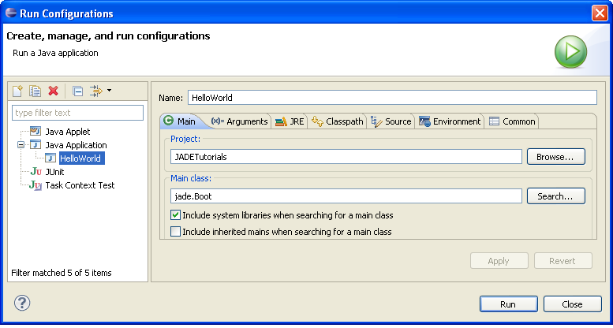
Once you setup the classpath for JADE, you can create a “Run Configuration” for running JADE:
Go to Run → Run Configurations
move to Java Application
in the “main” tab
specify your project name, and
main class is jade.Boot, and
check the Include libraries when searching for a main class

Slide 6
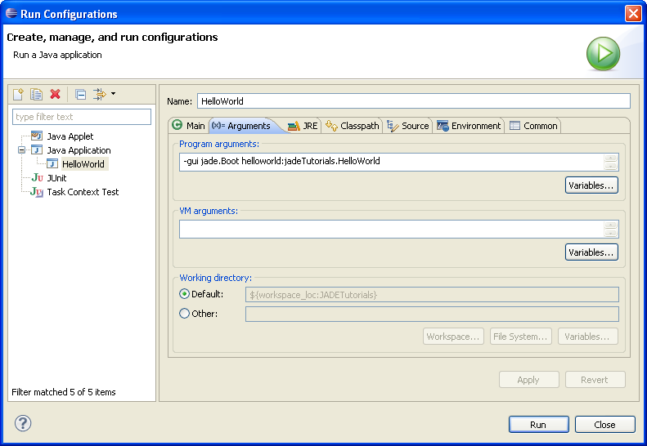
In the Tab “argument”, program arguments is the arguments
that would be used in command line, for example :
-gui jade.Boot [agent_nickname1:
java_package1.agent_class1 agent_nickname2:java_package2.agent_class2 ...]
Where the agent_nickname is the nickname for your agent,
java_package is the package of your agent, and agent_class is the java class name of your agent.
After that, press “Apply” .

Slide 7
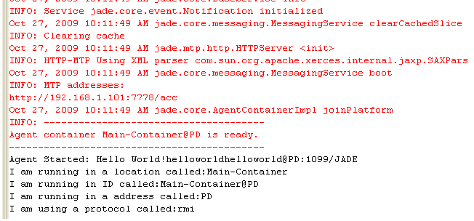
Running Result

Slide 8
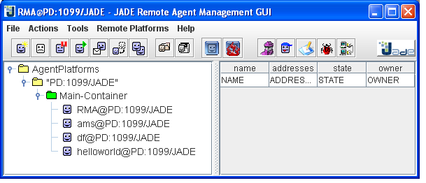
Running Result
To stop the application, File → Shut down Agent Platform;
Press “Yes” to question “Are you really sure to exit ?”
Warning: do not use “X” on the up-right of the window to exit the application in order to free the default port for running the platform.

Slide 9
Thanks. Please see Tutorial 2.

