Slide 1
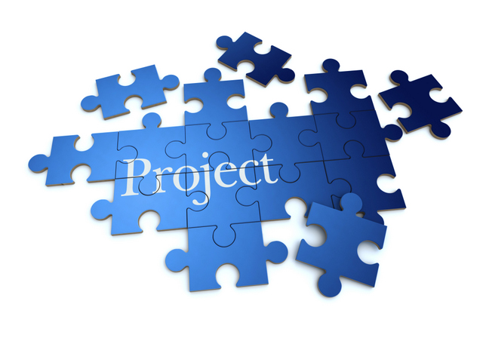
PROJECT PLAN
GROUP P3:
Duc Phan
Thao Huynh
Ajit Bahadur
Binh Trinh
Hung Nguyen
Hieu Do

Slide 2
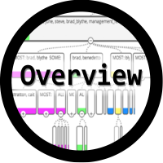
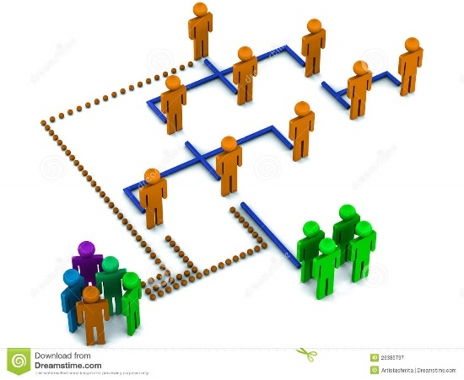

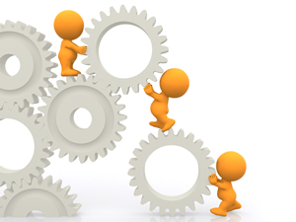
Contents
Project Overview
Management
Structure
Technical Process
Planning and Control

Slide 3
PROJECT OVERVIEW
1. REASONS
- Online trading in Turku is limited.
- We create app to connect both sellers and buyers.
2. FUNCTIONS
- Flea market: both sides can provided info freely and ask the questions.
- Supermarket product information: make the comparison between supermarkets to help users optimize their purchases.
Project Overview
Management
Structure
Technical Process
Planning and Control

Slide 4
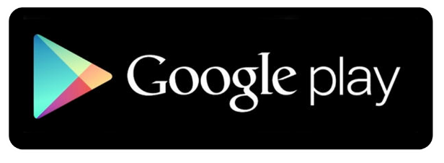


3. FURTURE SIGHT:
- Upgrade to cross-platform application.
- Support several languages.
4. DISTRIBUTION
- Google Play Store.
- Apple App Store.
- Windows Store.
5. MARKETING PLAN
- Advertise on social network.
Project Overview
Management
Structure
Technical Process
Planning and Control

Slide 5
MANAGEMENT STRUCTURE
1. MEMBERS ROLE:
MEMBERS | ROLES
Duc Phan | Team Leader, Programming Developer, Documentation, Tester
Thao Huynh | Design
Ajit Bahadur | UI design, Backend interaction, Documentation
Binh Trinh | Design, Documentation
Hung Nguyen, Hieu Do | Coding: XML, Java, SQLite, mongoDB, API server
Project Overview
Management
Structure
Technical Process
Planning and Control

Slide 6
2. RISK MANAGEMENT
RISKS | STRATEGIES
New programming languages | Experienced member will be in charged and try to teach the others
Unacceptable product quality due to ambiguous requirement | The requirements and decisions will be revised many times during development to make sure the plan keep in track.
Lack of time | Try to divide all the tasks efficiently and manage all deadlines.
Lack of publicity | Try to make connection with Facebook group or new contact.
Project Overview
Management
Structure
Technical Process
Planning and Control

Slide 7
TECHNICAL PROCESS
1. METHOD
Scrum
2. TOOLS
- Document Development: MS Word.
- Communication: Facebook group, Mail and OneDrive.
- Project Management: Youtrack website.
- Design: Adobe Photoshop.
- Programming: Android Studio, Robo mongo.
- Server: APIs server.
Project Overview
Management
Structure
Technical Process
Planning and Control

Slide 8
3. TECHNIQUES
- MS Word: for all documents related to this project.
- Facebook group, Mail, OneDrive: to communication between team members, sharing document.
- Youtrack website: to using the Scrum method.
- Adobe Photoshop: design or modify visual interface.
- Android Studio: to program XML, Java and SQLite.
- Robo mongo: creating a database.
- APIs server: all the database will be stored here.
Project Overview
Management
Structure
Technical Process
Planning and Control

Slide 9
PLANNING AND CONTROL
Our team choose to use YouTrack for planning and control.
Link: YouTrack website
Project Overview
Management
Structure
Technical Process
Planning and Control

Slide 10
Thank you
FOR YOUR ATTENTION

