Slide 1
Image Retrieval Based on Deep Hash
Group Member:
李帅
周展平
洪方舟

Slide 2
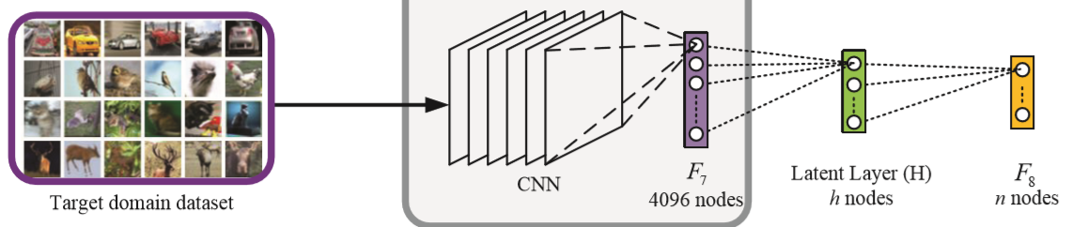
Net Structure
Pre-trained AlexNet + two fc (to be trained)
Lin, K., Yang, H. F., Hsiao, J. H., & Chen, C. S. (2015). Deep learning of binary hash codes for fast image retrieval. Computer Vision and Pattern Recognition Workshops (pp.27-35). IEEE.

Slide 3
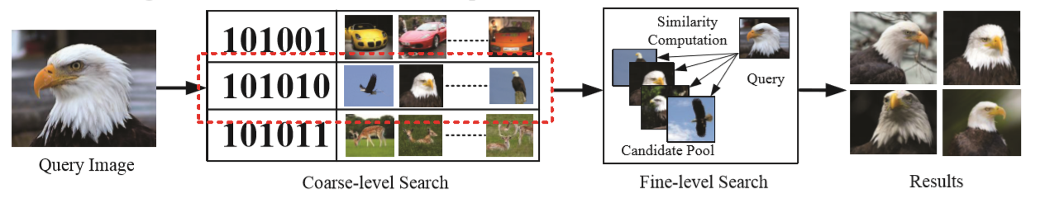
Query Process

Slide 4

Evaluation Method -> mAP
mAP: Mean Average Precision
$MAP=\frac{\sum_{q=1}^{Q}{AveP(q)}}{Q}$, where $AveP=\int_{0}^{1}{p\left(r\right)dr}$
Precision $p(r)$ is represented as a function of recall $r$

Slide 5
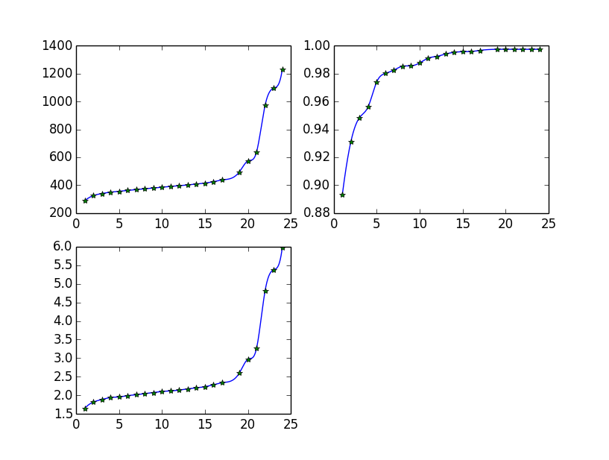
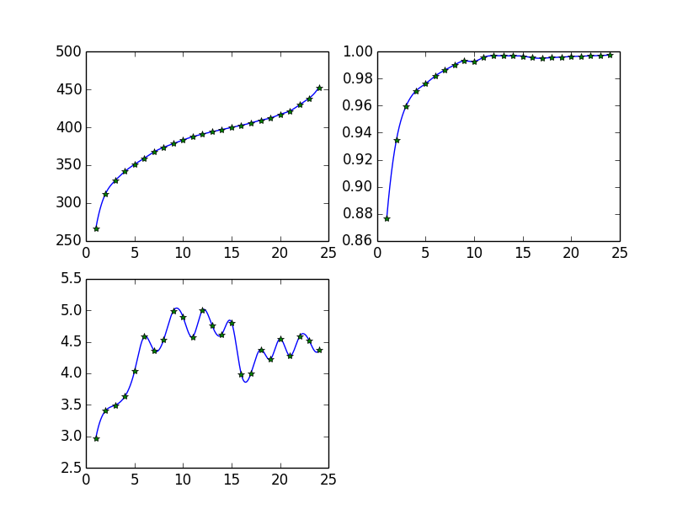
Analysis
48-bits
64-bits

Slide 6
Result
Bits of binary hash | 48-bits | 64-bits
mAP(%) | 83.8 | 87.1
Top 10 Accuracy(%) | 98.2 (Hamming Distance<=7) | 98.6 (Hamming Distance<=7)
Query Time(s/1000 queries) | 2.02 | 4.37

Slide 7
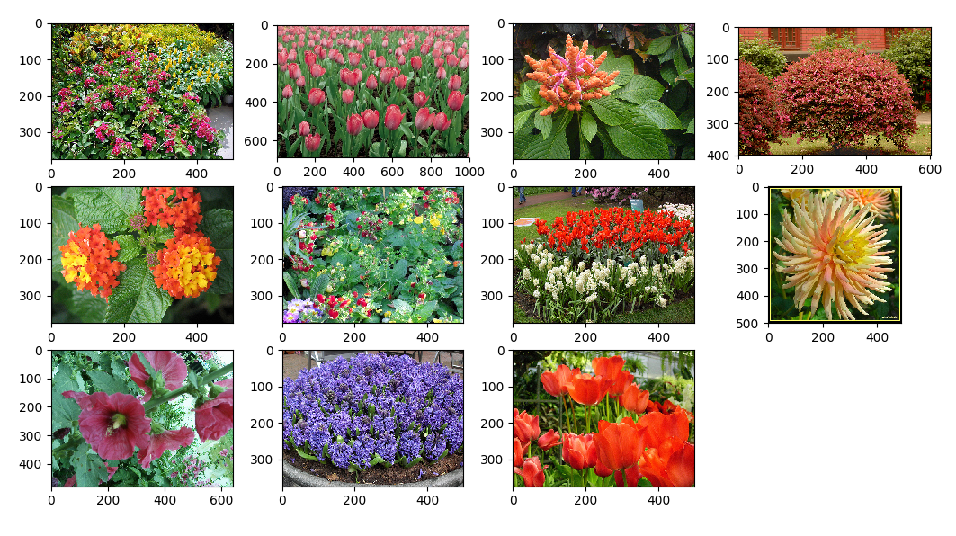
Some Examples

Slide 8
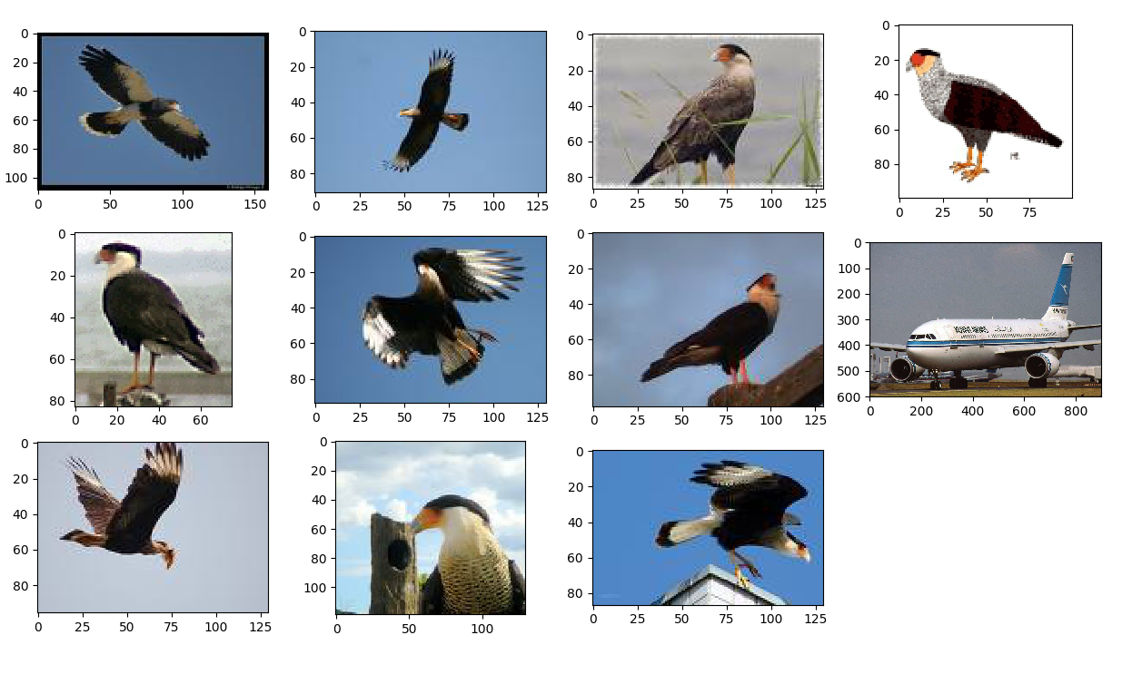
Some Examples

Slide 9
Thank you~
Q&A

