Slide 1




SoftMark: Software Watermarking via a Binary Function Relocation
ACSAC 2021
Honggoo Kang, Yonghwi Kwon,
Sangjin Lee, and Hyungjoon Koo
Notes:
Hello everyone, my name is Honggoo Kang from Korea University.
Today I am gonna talk about SoftMark. Software watermarking via a Binary function relocation.

Slide 2
Software Watermarking
Providing a digital fingerprint
Inserts certain information that represents its owner or distributor
Offers the traceability
Difference with code-signing?
Code-signing focuses on preventing unauthorized modification
Better to use both code-signing and software watermarking
Impossible to prevent all viable attacks, but a watermarking scheme should sufficiently discourage attackers
Notes:
Software watermarking aims to covertly insert certain information that represents its owner.
Then, the identifier in each copy, offers the traceability.
A program can be digitally signed to prevent unauthorized modifications,
but it does not provide, traceability of the binary.
It is reasonable and better, to assume to leverage,
both code signing and watermarking for better protection.
The adversary, may try to remove or tamper a watermark.
While, it is nearly impossible to prevent all viable attacks, a watermarking scheme should provide,
a sufficient level of stealthiness and resilience, that makes such attacks, extremely expensive to discourage attackers.

Slide 3
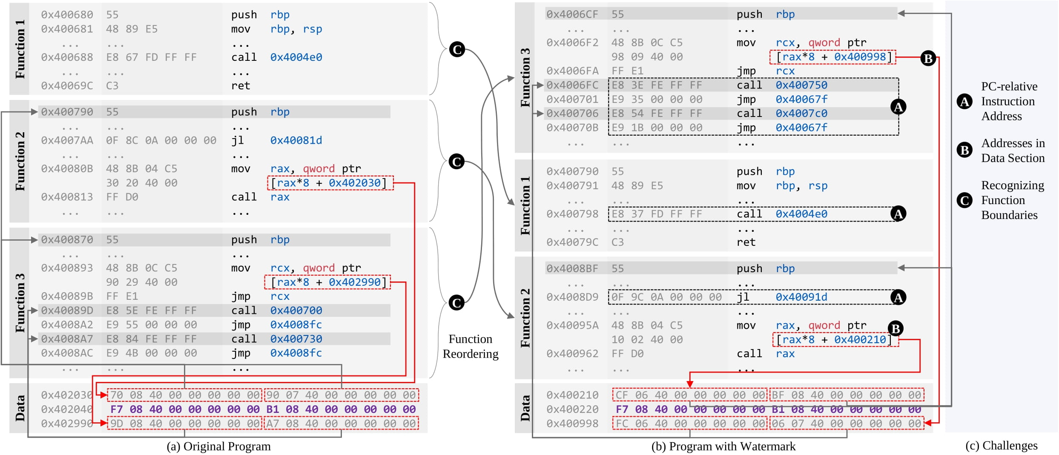
Motivation
Notes:
The example program has three functions. In our scheme, inserting a watermark means generating a copy with relocated functions.
It is possible to make 6 orders, by shuffling 3 functions,
so this program can represent two bits. Such code transformation involves, lots of instruction updates, such as immediate operands.
Direct call or jump instructions, can be updated by recalculating.
However, indirect call or jump instructions, require reference updates in a jump table in the data region, which is non-trivial.
If any exercising code pointer update, were failed, a runtime error would occur.
Also, a clear function boundary is required, for successful function relocation.

Slide 4
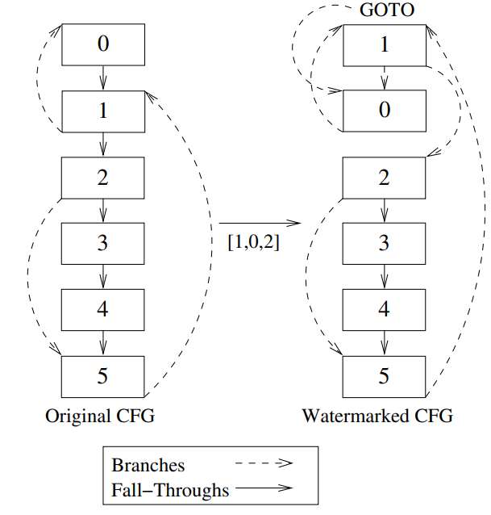
Prior Attempts
Reordering-based Approach
Reordering basic blocks, safe operands of mathematical equations
Limitations
Perceptive
Inserting GOTO statements ➔ easily detectable
Forgeable
Rearranging a structure can be accomplished easily
Fragile
Not resilient to arbitrary modifications at the instruction level
[Figure Ref]
- Myles, G., Collberg, C., Heidepriem, Z., and Navabi, A. 2005. The Evaluation of Two Software Watermarking Algorithms. Software Practice and Experience
Notes:
In previous studies on reordering-based approach,
there are some studies like
inserting a signature by relocating a group of pre-selected basic blocks,
or reordering safe operands of mathematical equation in source code.
These studies suffer from three limitations.
First, they are perceptive. The watermark is implemented by
inserting a large number of GOTO statements, to maintain the original control flow, so it could be easily detected.
Secondly, they are forgeable. They are mostly implemented in source code or Java Bytecode level,
so rearranging a structure, is not difficult.
In third, they are fragile. The attackers can easily modify the watermark embedded in source code level.

Slide 5
Advantages over Prior Attempts
Introducing no supplementary structure
No size overhead, negligible performance overhead
Gives a lower chance for attackers to recognize the presence of a watermark with statistical analysis or inference
Can reach up to an increasingly large number of encodings
Depends on the number of reorderable functions
Notes:
Our function reordering based watermark approach offers some advantages. First, our tool does not introduce any additional structure,
so there is no size overhead,
and the impact, on the performance overhead, is negligible.
Also, there is no chance for attacker, to statistically analyze or inference,
the presence of a watermark. Secondly, it is possible to represent increasingly large number.

Slide 6
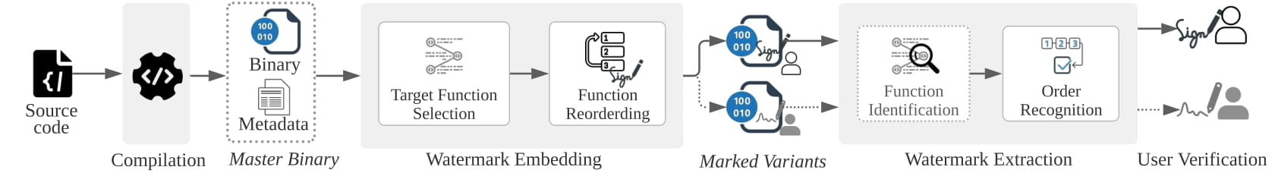
Overview
SoftMark
A software watermarking system that leverages a function relocation
The order of functions implicitly encodes a hidden identifier
Process
Generating a master binary ➔ Embedding a watermark & Recording a ledger
➔ Extracting a watermark from variant with a ledger ➔ Verifying an associated user
Notes:
We propose a SoftMark.
It is a software watermarking system, that uses a function relocation,
that the order of functions, implicitly encodes a hidden identifier.
First, we employ a special compiler toolchain,
to compile a given program from the source code.
During the compilation, the toolchain generates metadata, like locations of functions,
for reliable static binary instrumentation.
Second, we analyze the binary and choose reorderable functions.
Then, we generate a variant of the target program with a unique fingerprint,
via reordering functions.
We also record, the fingerprint and its associated identifier, in a ledger.
Third, we extract the watermark from a binary, by identifying the function order.
Finally, we can identify an associated user, by searching watermark in the ledger.

Slide 7
Reliable Binary Instrumentation
CCR(Compiler-assisted Code Randomization) (Koo, Hyungjoon et al., In 2018 IEEE S&P)
A reliable binary rewriter that leverages the metadata to generate variants
A modified compiler toolchain(LLVM and gold linker) produces transformation-assisting metadata including function boundaries, fixup locations, and jump table information
A set of metadata can be embedded into executables
➔ Leverage CCR for reliable watermark embedding & extracting at the binary level
Notes:
It is important for our scheme, to rewrite the binary correctly.
The reliable function relocation is possible, by using the CCR toolchain.
CCR is a binary rewriter, that uses the metadata, to generate variants.
A modified LLVM and gold linker, produce transformation-assisting metadata,
including function boundaries, fixup locations, and jump table information.
SoftMark leverages the CCR and metadata,
for reliable watermark embedding and extracting at binary level.

Slide 8
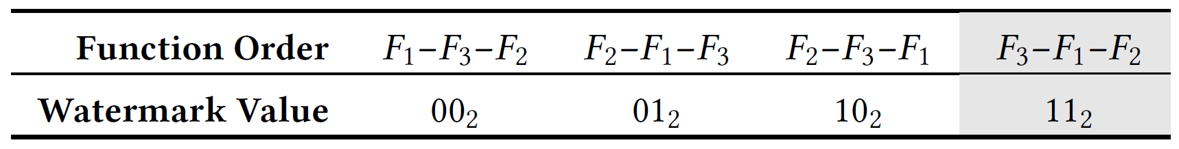
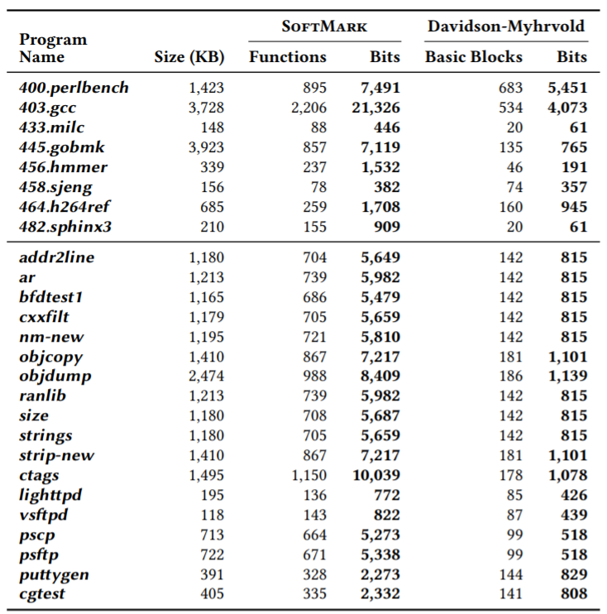
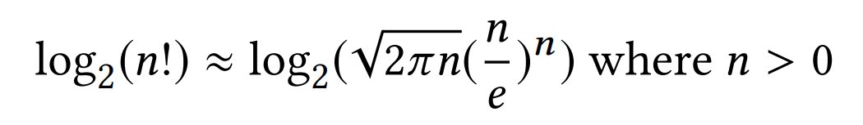
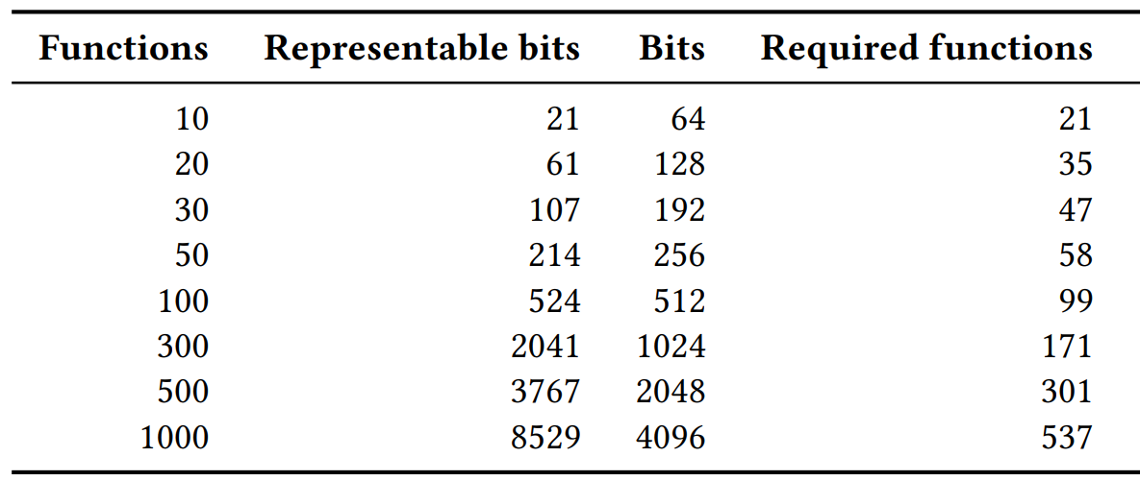
Strategies on SoftMark
One to one mapping (order, value)
Stirling’s formula:
Higher capacity
Notes:
Let's talk about our strategies, for credible and robust watermark.
SoftMark select a set of reorderable functions from all function candidates.
With three functions, we can represent up to two bits.
An individual watermark has, a one to-one mapping, with a particular order of functions.
The number of possible watermarking bits, can be approximated by Stirling’s formula.
The Table on below, summarizes the calculated results.
We compare the capacity of our approach with, the previous study,
that is based on basic block reordering.
As shown in the right Table, the data rate of SoftMark is significantly higher.

Slide 9
Strategies on SoftMark (2)
Unique function candidates
Do not use indistinguishable functions in watermark embedding
Desirable function set
Prefer a function that has a trampoline containing code pointers
(To give more challenge to an attacker)
Non-candidate functions
Randomly scatter all other functions
(To increase a resiliency against collusive attacks)
(To prevent ambiguous watermarks at extracting)
F1
F4
F2
F2? F3?
F3
F1
F4
F2? F3?
Notes:
Secondly, We do not use indistinguishable functions in our watermark embedding,
because our extractor, cannot distinguish the locations of identical functions.
So, we define a unique function, as the one that has, a unique combination of basic blocks,
where each block has, a unique sequence of instruction mnemonics.
Third, we carefully pick functions, that make static binary instrumentation challenging.
We prefer a function that has a trampoline, containing code pointers, to raise the bar.
Also, we randomly scatter, all other functions that are not used for a watermark,
this increases the resiliency, against collusive attacks.

Slide 10
Strategies on SoftMark (3)
Ledger (Bookkeeper)
Holds the list of functions and their locations, the property of each function (index, indirect call invocation), and the pattern of basic blocks
Basic block recognition with patterns:
Regular expression of byte values (Quick search)
Sequence of opcode mnemonics and sizes after disassembly (Deep investigation)
Fixups
Index, Basic block patterns
ex) FUNC#1 ['5bc30f1f4000', '5389fbb8[0-9a-f]{8}b9[0-9a-f]{8}’]
Index, Basic block patterns
ex) FUNC#1 [‘(push, 1)(push, 1)(push, 1)(sub, 7)(jnz, 6)’, … ]
Notes:
It is important that, an owner, must maintain a private ledger,
which holds, the list of functions and their locations ~ the property of each function ~ and the pattern of basic blocks, for further watermark extraction.
The ledger should be concealed and protected from adversaries.
As we deal with a stripped binary, it is required, to recognize function boundaries based on a ledger.
First, we confirm basic block patterns of, selected functions for a watermark,
and search all blocks with those patterns.
Then, a certain function can be identified, if a set of basic blocks, is present in the function.
A basic block, can be recognized with two ways.
First one is regular expression of byte values,
and second one is, the sequence of, opcode mnemonics and sizes after disassembly.
While extracting the embedded watermark,
if the target binary stays intact, it is straightforward to extract by quick search.
But if the binary has been corrupted, we need deep investigation.

Slide 11
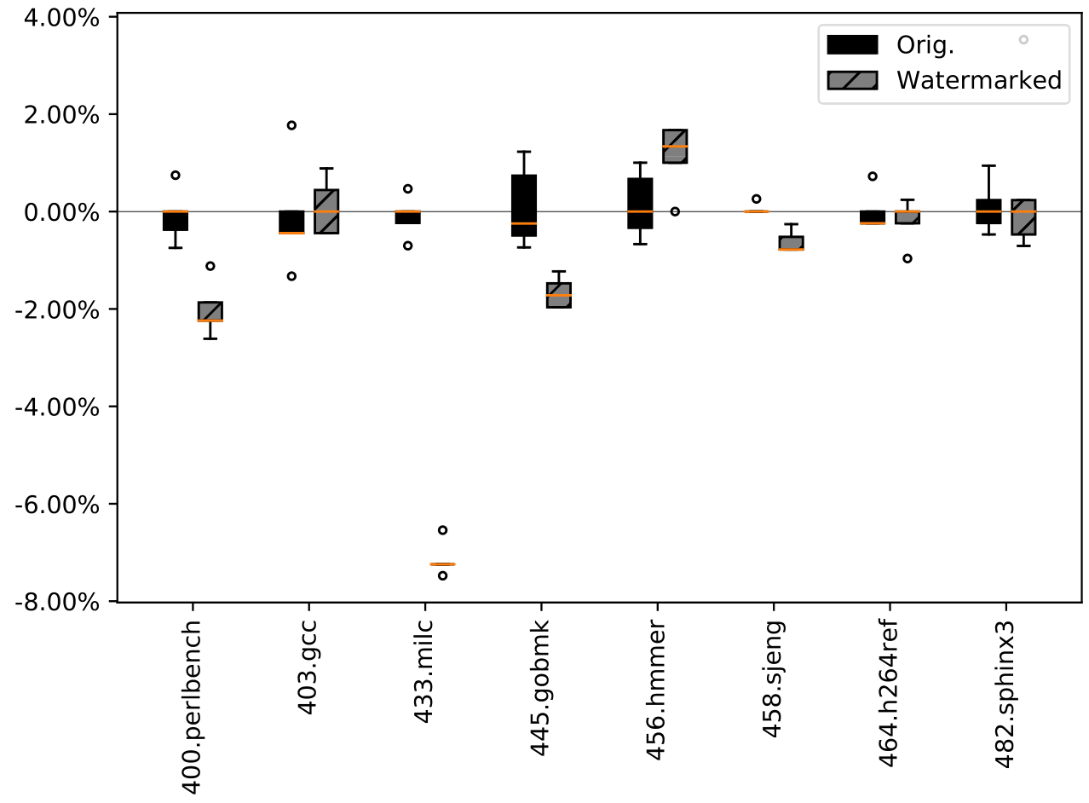
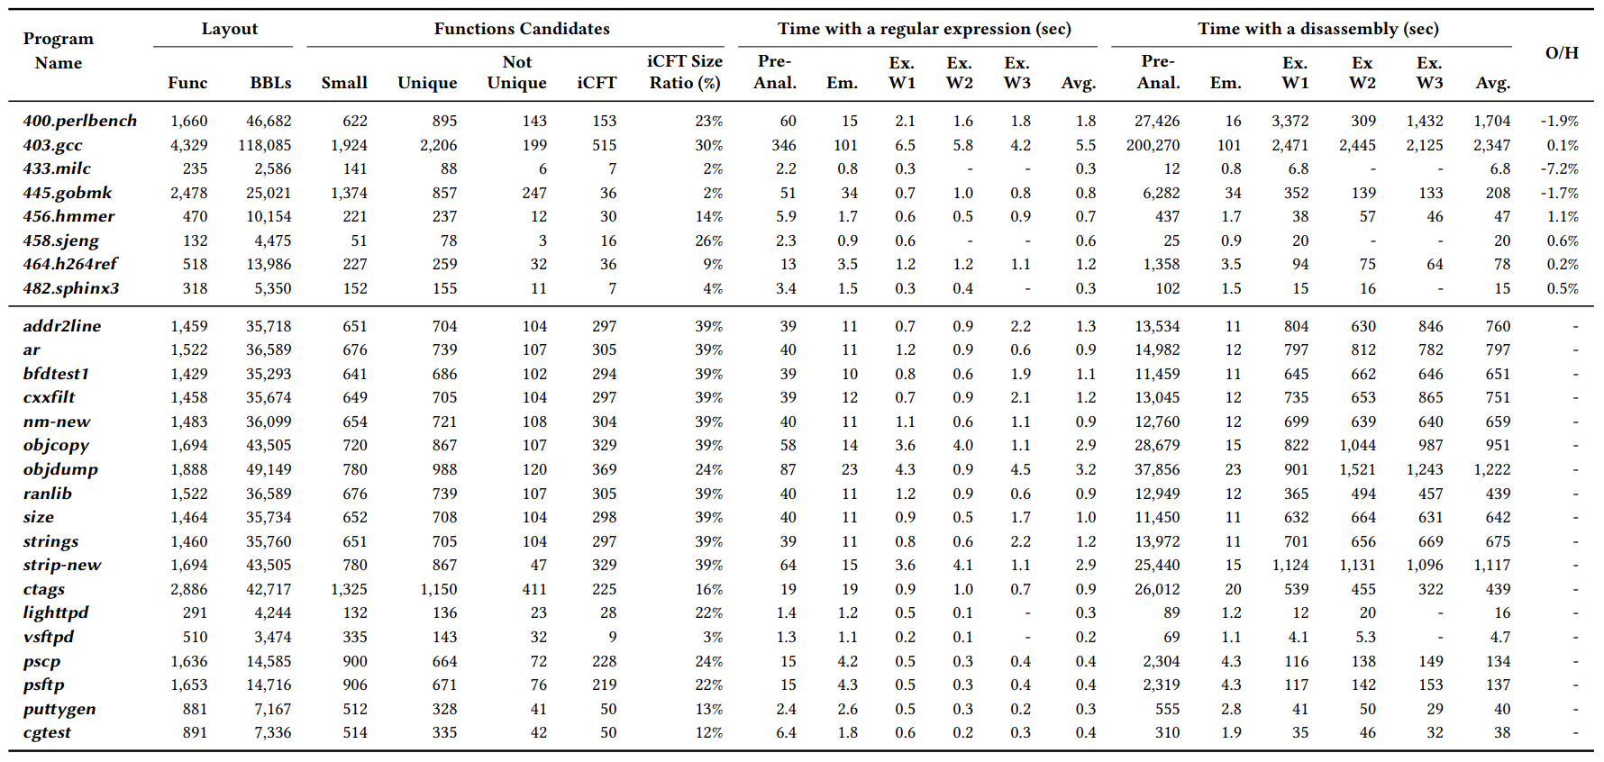
Evaluation
Size overheads = None
No additional structure
Performance overheads
Less than 1.1%
Notes:
We collect 26 binaries for evaluation including SPEC CPU2006, and Binutils.
We have excluded, applications that do not contain sufficient function candidates.
First, as previously mentioned, the size of a watermark-inserted binary, stays identical.
and Secondly, the performance overheads of SPEC binaries after embedding a watermark,
is negliglible. the largest overhead is 1.1%.

Slide 12
Evaluation (2)
Pre-analysis time
Examines the property of a function
Longer than embedding, extracting time
One-time process for each program
Deep investigation
Takes longer time than a quick search
Quick search Deep investigation
Notes:
We operate two different modes, for a watermark extraction.
Both cases refer a ledger, to identify the location of every function,
but SoftMark search blocks differently.
The table shows pre-analysis ~ embedding ~ and extraction time of, three different watermarks.
A pre-analysis process, examines the property of a function, such as its uniqueness and indirect branches within.
A pre-analysis process takes longer time, than embedding and extraction.
It takes quite much time in, deep investigation with a disassembly,
but it is a one-time processing per each binary, that the impact on overall efficiency is relatively low.
Except for three programs, an embedding process takes less than 20 seconds.
Besides, an extraction process can be done within a few seconds for quick search.
It is recommended to, try a deep search with full disassembly when,
only needed for further investigation.

Slide 13
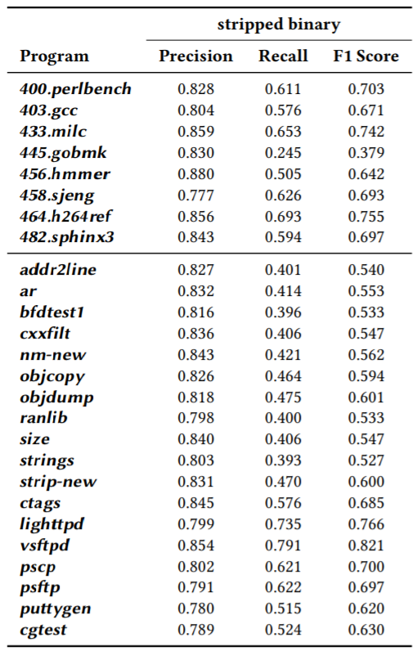
Evaluation (3)
May be susceptible to a distortion attack (semantic preserving code transformation)
Robust to operand distortion
Function Relocation
Significant challenges to adversaries in practice
(Function boundary detection on a stripped binary)
Notes:
Next, we can talk about resiliency.
As SoftMark operates at a binary level, we consider possible attacks focusing on machine code,
like reordering functions or modifying basic blocks.
Our scheme may, be susceptible to a semantic-preserving code transformation.
Those techniques do not change the location of a function,
but they may challenge a watermark extraction process.
However, our disassembly-oriented basic block search, is robust to operands distortion,
like register reordering and assignment.
SoftMark is susceptible to attacks, that can relocate functions.
However, the Table shows precision, recall, and F1 score of,
the function boundary detection of IDA Pro.
It shows that SoftMark successfully imposes, significant challenges to adversaries in practice.

Slide 14
What we have not talked about
Current limitations of SoftMark
Binary packing: unpack required
Semantic-preserving code transformation
Opcode distraction may lower a survival rate
Collision with a function relocation
Constraints on function relocation with CCR
Capacity of other existing techniques
Please read our paper!
Notes:
There are a lot of topics that we have not covered.
SoftMark has some limitations.
It is affected by binary packing,
and, some semantic-preserving code transformation may, corrupt a program's watermark.
We have considered the probability, of an accidential collision, with a brute-forcing attack.
There are some constraints, on function relocation with CCR.
We have discussed the capacity of other watermarking techniques.
(엔터)
If you are interested, please read our paper.

Slide 15
Conclusions
Stealthier and robust watermark scheme
Negligible performance overhead
Reasonable capacity
Practical and efficient in watermark embedding and extracting
Notes:
To wrap up, we have proposed SoftMark, which is a function reordering-based software watermarking technique.
It embeds a watermark, by mapping every order of certain functions, into a hidden identifier.
SoftMark does not introduce any additional code or data, thus it is stealthier than existing approaches.
It is resilient to varying attacks while maintaining a negligible performance overhead and reasonable capacity.
and We have evaluated, that SoftMark is highly practical and efficient in,
embedding and extracting a watermark.

Slide 16
Thank you
Honggoo Kang
Ph.D student in Korea University
honggoonin@korea.ac.kr
Notes:
This is my final slide of my talk. Thanks for your attention.

