Slide 1

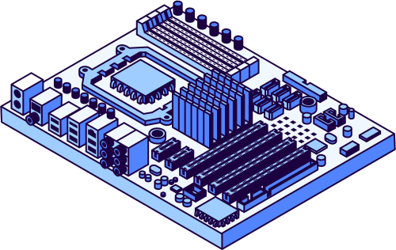
STACK
GROUP 9
Instructor: Th.S Vũ Đình Bảo
Students:
Nguyễn Hùng Dũng | 22134002
Trần Như Hoàng | 22134006
Trần Nguyên Phương Bình | 24133006
Phạm Ngọc Phúc | 22134010
Võ Hồng Quân | 22134012
1

Slide 2
Content
Introduction to Stack
02
Theoretical Background
03
Conclusion
01
PART
PART
PART
Basic concepts of Stack
Implementation methods
Complexity analysis
Practical applications
Results
Future Trends
2

Slide 3
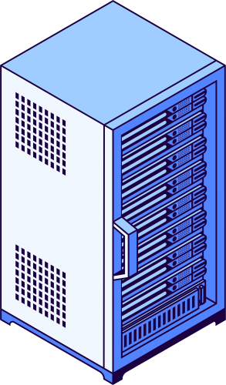




INTRODUCTION
3

Slide 4






1.1 Context of the Topic
Data Structures and Algorithms
Abstract Data Type (ADT)
Programming
Stack
It is a key field that supports and benefits many other tasks.
It is the “backbone” and “foundation” for building complex and efficient software:
Includes: List, Stack, Queue, Deque, Priority Queue, Set, Map/Dictionary, Disjoint Set.
Plays a core role in algorithm design and modern systems.
4

Slide 5
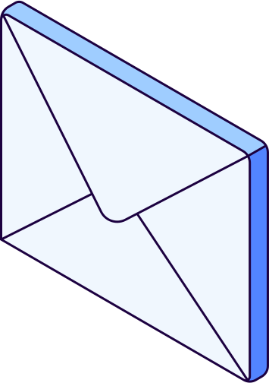


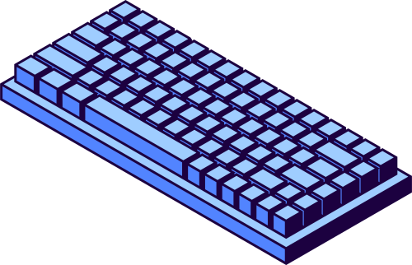
1.2 & 1.3 Objectives and Scope of Study
Clarify Fundamental Concepts: Stack (LIFO principle, basic operations).
Performance Analysis & Implementation: Array-based and linked-list-based implementations; source code in multiple programming languages.
Illustrate Practical Applications: Call Stack, expression evaluation, DFS, Undo/Redo.
Scope Limitations: Excludes other data structures (except basic Queue), Does not focus on hardware-level stack implementation.
5

Slide 6
1.4 Research Methods
Literature review method
Theoretical analysis & synthesis
Experimental method
Group collaboration method
6

Slide 7

Theoretical Background
7

Slide 8
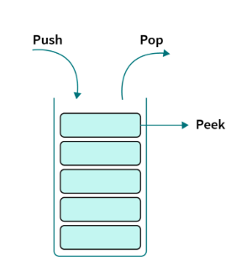
2.1 Concept
2.1.1 Definition and Basic Characteristics of Stack
A stack is a data structure that follows the LIFO (Last In, First Out) principle: the last element inserted is the first to be removed.
1.
2.
Main operations: push, pop, peek...
3.
Time complexity: O(1) for these operations.
8

Slide 9
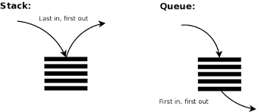
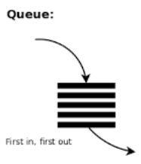
2.1.2 Comparison with Queue
2.1 Concept
Feature | Stack | Queue
Operating Principle | LIFO (Last In, First Out) | FIFO (First In, First Out)
Operations | push, pop, peek, isEmpty | enqueue, dequeue, front, isEmpty
Management Pointer | One pointer: top | Two pointers: front (head), rear (tail)
Applications | Recursive calls, backtracking, undo/redo, stack frame | CPU scheduling, BFS, I/O buffering, producer-consumer
9

Slide 10
2.1 Concept
2.1.3 Basic Operations with Stack
Push (Insert)
Purpose: Add a new element to the top of the stack.
Action: The stack size increases by 1.
Note: May cause Stack Overflow if the stack is implemented using a fixed-size array and is already full.
Example:
Before: [A, B] (Top = B)
Push(C)
After: [A, B, C] (Top = C)
10

Slide 11
2.1 Concept
2.1.3 Basic Operations with Stack
Pop (Remove)
Purpose: Retrieve and remove the top element of the stack.
Action: The stack size decreases by 1.
Note: May cause Stack Underflow if the stack is empty.
Example:
Before: [A, B, C] (Top = C)
Pop() → Returns C
After: [A, B] (Top = B)
11

Slide 12
2.1 Concept
2.1.3 Basic Operations with Stack
Peek / Top (View Top)
Purpose: View the value of the top element without removing it.
Action: Does not modify the stack.
Example:
Stack: [A, B, C] (Top = C)
Peek() → Returns C
Stack remains: [A, B, C]
12

Slide 13
2.1 Concept
2.1.3 Basic Operations with Stack
isEmpty (Check Empty)
Purpose: Check whether the stack has no elements.
Application: Must be checked before calling Pop() or Peek() to avoid errors.
13

Slide 14
2.1 Concept
2.1.3 Basic Operations with Stack
isFull (Check Full)
size (Stack Size)
Purpose: Check whether the stack (using a fixed-size array) has no remaining space.
Application: Must be checked before calling Push() to avoid overflow.
Purpose: Return the current number of elements in the stack.
14

Slide 15
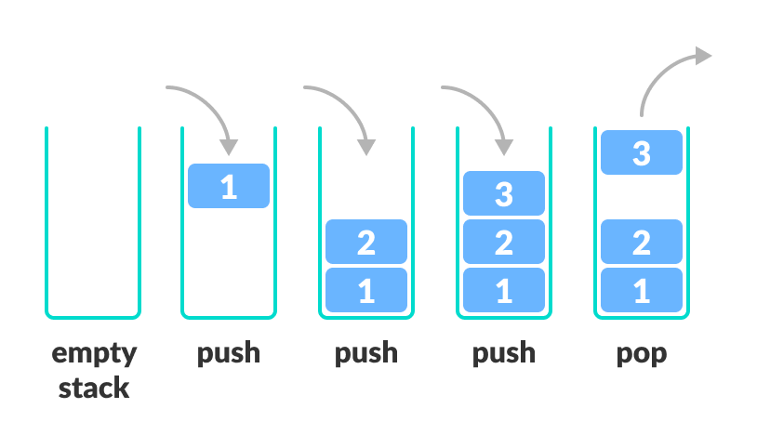
2.1 Concept
2.1.3 Basic Operations with Stack
15

Slide 16
2.1 Concept
2.1.4 Stack Implementation Methods
Array-based Implementation
Principle: Use a one-dimensional array + a top variable to manage the top element.
Push: Assign new value → increment top.
Pop: Take array[top] → decrement top.
Peek: Access array[top].
Advantages: Simple, fast.
Disadvantages: Fixed size, prone to overflow.
16

Slide 17
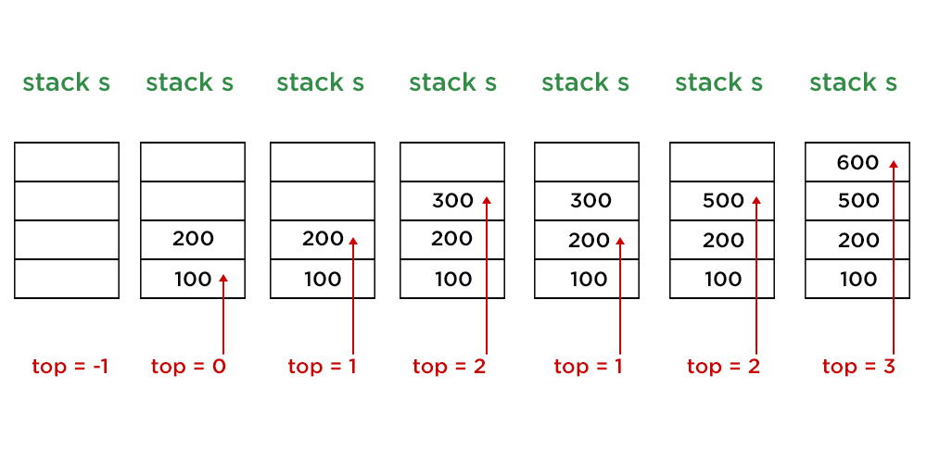
2.1 Concept
2.1.4 Stack Implementation Methods
Array-based Implementation
17

Slide 18
2.1 Concept
2.1.4 Stack Implementation Methods
Linked List-based Implementation
Principle: Each element is a node consisting of: data + next pointer (top = null initially).
Push: Create a new node → point to current top → update top.
Pop: Update top = top → next.
Peek: Return top.data.
Advantages: Flexible, dynamic size.
Disadvantages: Extra memory for pointers, poor locality.
18

Slide 19
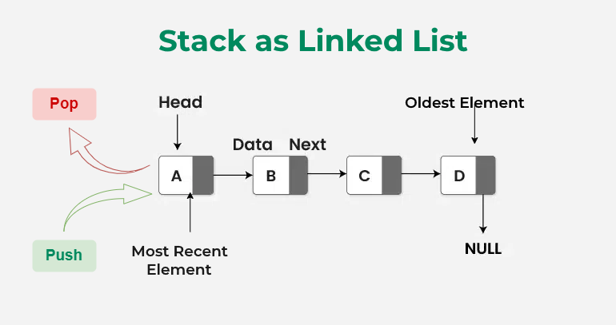
2.1 Concept
2.1.4 Stack Implementation Methods
Linked List-based Implementation
19

Slide 20
2.1 Concept
2.1.4.3 Comparison of Two Stack Implementation Methods
Criteria | Array-based | Linked List-based
Advantages | Simple implementation. Fast top access (good cache locality). | Dynamic size, flexible. No stack overflow (except when system memory is exhausted).
Disadvantages | Fixed size, risk of overflow or waste. Resizing is costly. | Extra memory needed for pointers. Poor locality, possibly slower access.
Best Use Cases | When the maximum number of elements is known in advance and high access speed is required. | When the number of elements changes frequently and can be large, requiring flexibility while accepting extra memory cost.
20

Slide 21
2.1 Concept
2.1.5 Complexity Analysis
2.1.5.1 Time Complexity
Push, Pop, Peek, isEmpty: O(1) (directly at the top).
Dynamic Array: Push is usually O(1), but resizing → O(n) (amortized O(1)).
Linked List: Also O(1), but practically slower due to memory overhead and poor locality.
21

Slide 22
2.1 Concept
2.1.5 Complexity Analysis
Time Complexity
Operation | Fixed-size Array | Dynamic Array | Linked List
Push | O(1) | O(1)/O(n) | O(1)
Pop | O(1) | O(1) | O(1)
Peek | O(1) | O(1) | O(1)
isEmpty | O(1) | O(1) | O(1)
22

Slide 23
2.1 Concept
2.1.5 Complexity Analysis
2.1.5.2 Space Usage
Feature | Fixed-size Array | Dynamic Array | Linked List
Memory Allocation | Pre-allocated array with size = maxSize | Allocated proportional to the number of elements, with extra “buffer” | Each element is a node consisting of: data + next pointer
Storage Complexity | Θ(maxSize) (reserves all memory in advance) | Θ(n), resizing when full | Θ(n) for data + Θ(n) for pointer overhead
Capacity Limit | Fixed by maxSize | Flexible, no need for isFull | Unlimited, only limited by available RAM
23

Slide 24
2.1 Concept
2.1.5 Complexity Analysis
2.1.5.2 Evaluation Methods
Method | Approach | Advantages | Disadvantages
Experimental | Implement and run programs, measure execution time on different datasets | Concrete and practical results. Reflects actual runtime. | Dependent on hardware and programming language. Hard to choose fully representative datasets. Costly in time and resources.
Asymptotic | Theoretical analysis using Big-O notation to express complexity as input size grows large | Independent of hardware and language. Easy to compare algorithms. No implementation needed. Good for large datasets. | Does not provide exact runtime. Ignores constants. Less accurate for small datasets.
24

Slide 25
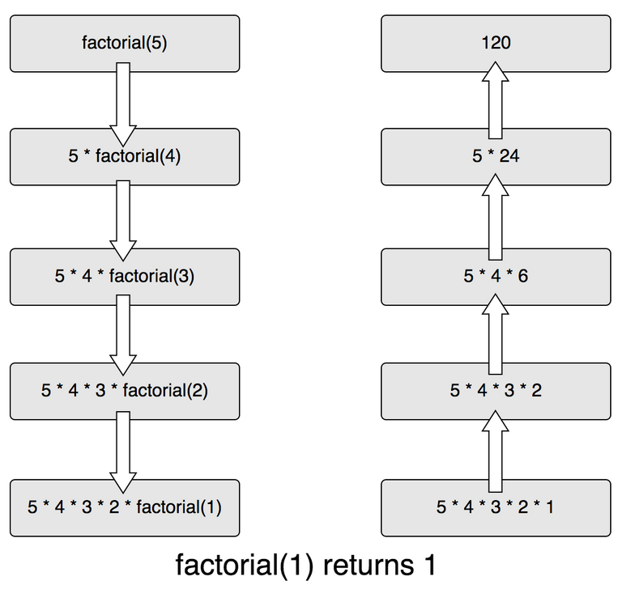
2.2 Practical Applications
2.2.1 Recursive Function Management
When a function is called → a new frame is pushed onto the Call Stack (parameters, variables, return address).
When the function ends → the frame is popped → execution returns to the previous position.
Recursion works by using multiple independent frames.
Too deep recursion → Stack Overflow.
25

Slide 26
2.2 Practical Applications
2.2.2 Expression Conversion and Evaluation
1. Concepts
Infix: Operator is placed between operands.
Example: A + B * C
Postfix: Operator comes after operands.
Example: A B C * +
Prefix: Operator comes before operands.
Example: + A * B C
26

Slide 27
2.2 Practical Applications
2.2.2 Expression Conversion and Evaluation
2. Problem
Infix expressions depend on operator precedence and parentheses.
A + B * C → B * C must be evaluated first.
(A + B) * C → A + B must be evaluated first.
Computers find infix expressions difficult to process → need to convert to Postfix/Prefix for simpler and consistent evaluation.
27

Slide 28
2.2 Practical Applications
2.2.2 Expression Conversion and Evaluation
Solution: Using the Shunting-yard Algorithm (Edsger Dijkstra)
Read the infix expression from left to right.
If an operand is encountered → append it to the result.
If an operator is encountered:
- Compare its precedence with operators in the stack.
- If higher precedence → push it onto the stack.
If an opening parenthesis is encountered → push onto the stack.
If a closing parenthesis is encountered → pop operators to the result until an opening parenthesis is found.
After reading the entire expression → pop all remaining operators in the stack to the result.
28

Slide 29
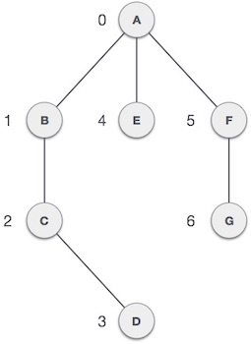
2.2 Practical Applications
2.2.3 DFS & Backtracking Algorithm
DFS (Depth-First Search):
Traverse deepest first, then backtrack.
Can be implemented using recursion or a stack.
Mainly used for graph or tree traversal/search.
29

Slide 30
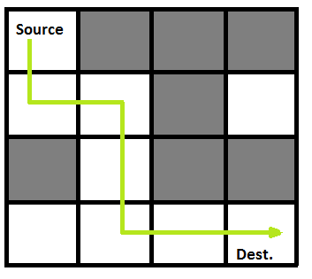
2.2 Practical Applications
2.2.3 DFS & Backtracking Algorithm
Backtracking:
Based on DFS but includes constraint checking.
When a wrong path is taken → backtrack and try another branch.
Commonly used for: Sudoku, mazes, combinations, permutations.
30

Slide 31
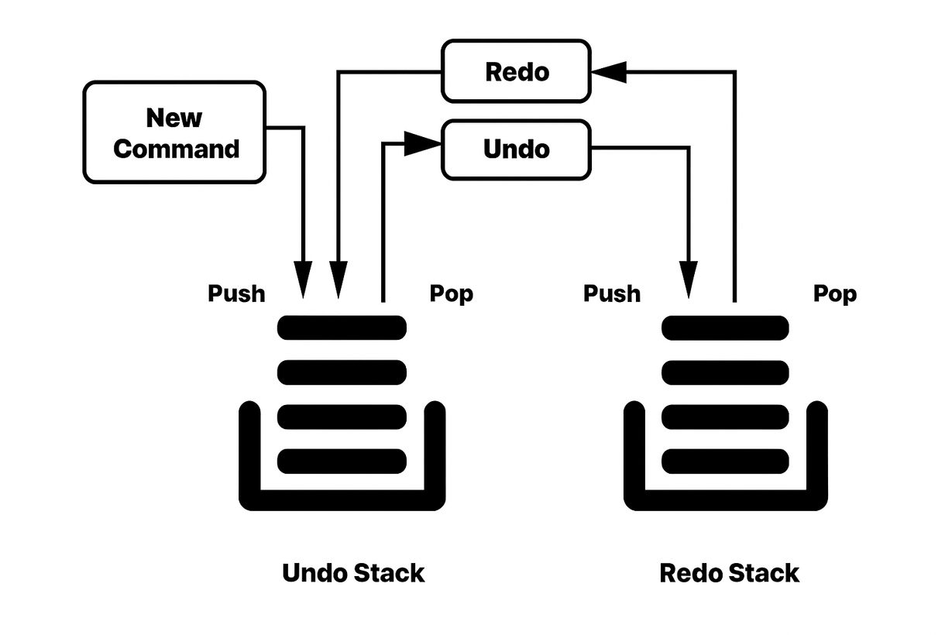
2.2 Practical Applications
2.2.4 Real-life Applications
Undo/Redo
In text editors, image editors, IDEs… systems often use two stacks:
Undo Stack: stores recent actions (each new action is pushed here).
Redo Stack: stores actions that have been undone.
31

Slide 32
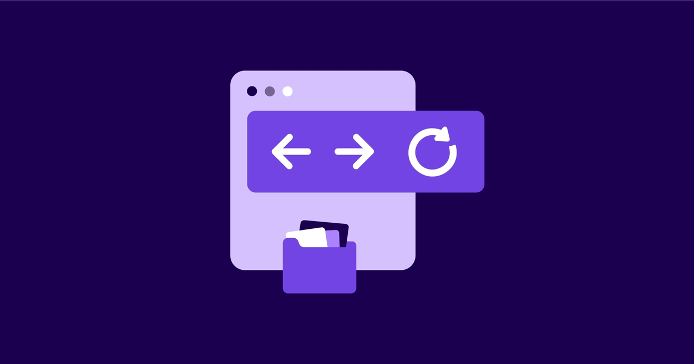
2.2 Practical Applications
2.2.4 Real-life Applications
Web Browsing History
Browsers use two stacks to manage Back and Forward buttons:
Back Stack: stores previously visited pages.
Forward Stack: stores pages navigated back from the Back Stack.
How it works:
When opening a new page → current URL is pushed onto the Back Stack.
When pressing Back → URL is popped from Back Stack and pushed to Forward Stack.
When pressing Forward → URL is popped from Forward Stack and reopened.
32

Slide 33
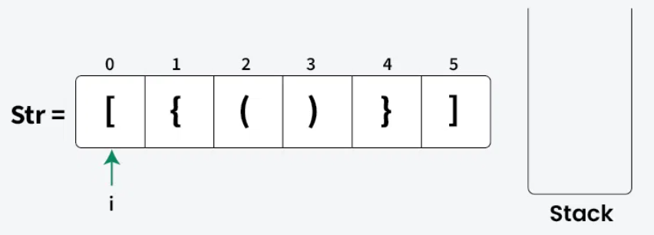
2.2 Practical Applications
2.2.4 Real-life Applications
Bracket Checking in Expressions
How it works:
When encountering an opening bracket (, {, [ → push into the Stack.
When encountering a closing bracket ), }, ] → pop from the Stack and check if it matches the most recent opening bracket.
If it matches → continue; if it does not match or the Stack is empty → the expression is invalid.
33

Slide 34
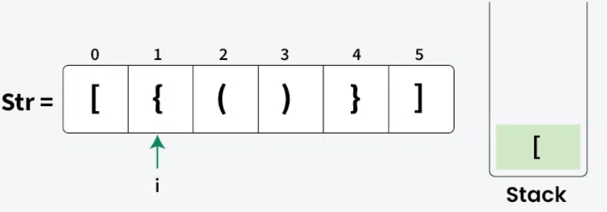
2.2 Practical Applications
2.2.4 Real-life Applications
Bracket Checking in Expressions
How it works:
When encountering an opening bracket (, {, [ → push into the Stack.
When encountering a closing bracket ), }, ] → pop from the Stack and check if it matches the most recent opening bracket.
If it matches → continue; if it does not match or the Stack is empty → the expression is invalid.
34

Slide 35
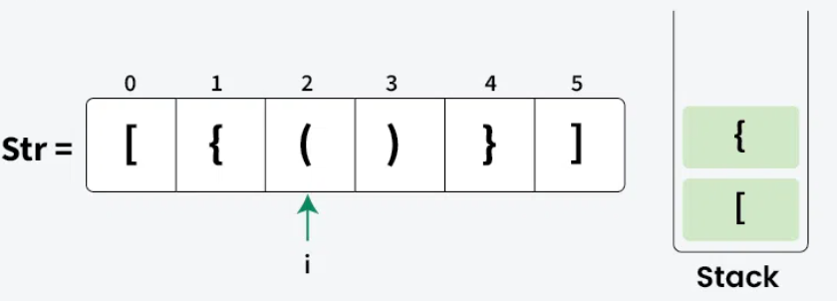
2.2 Practical Applications
2.2.4 Real-life Applications
Bracket Checking in Expressions
How it works:
When encountering an opening bracket (, {, [ → push into the Stack.
When encountering a closing bracket ), }, ] → pop from the Stack and check if it matches the most recent opening bracket.
If it matches → continue; if it does not match or the Stack is empty → the expression is invalid.
35

Slide 36
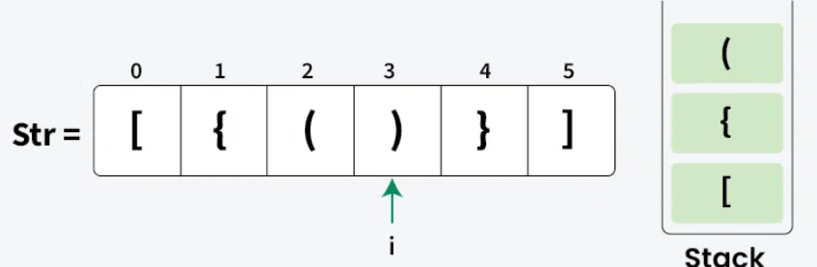
2.2 Practical Applications
2.2.4 Real-life Applications
Bracket Checking in Expressions
How it works:
When encountering an opening bracket (, {, [ → push into the Stack.
When encountering a closing bracket ), }, ] → pop from the Stack and check if it matches the most recent opening bracket.
If it matches → continue; if it does not match or the Stack is empty → the expression is invalid.
36

Slide 37
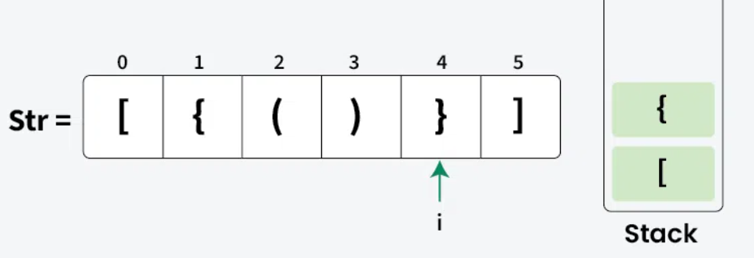
2.2 Practical Applications
2.2.4 Real-life Applications
Bracket Checking in Expressions
How it works:
When encountering an opening bracket (, {, [ → push into the Stack.
When encountering a closing bracket ), }, ] → pop from the Stack and check if it matches the most recent opening bracket.
If it matches → continue; if it does not match or the Stack is empty → the expression is invalid.
37

Slide 38
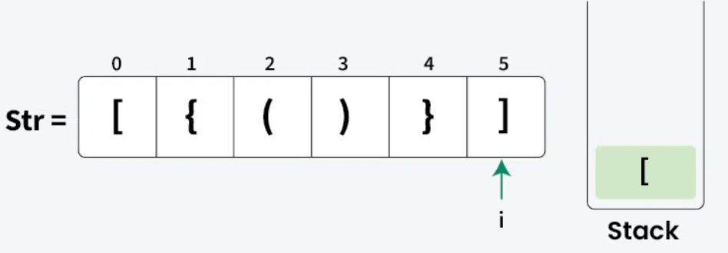
2.2 Practical Applications
2.2.4 Real-life Applications
Bracket Checking in Expressions
How it works:
When encountering an opening bracket (, {, [ → push into the Stack.
When encountering a closing bracket ), }, ] → pop from the Stack and check if it matches the most recent opening bracket.
If it matches → continue; if it does not match or the Stack is empty → the expression is invalid.
38

Slide 39
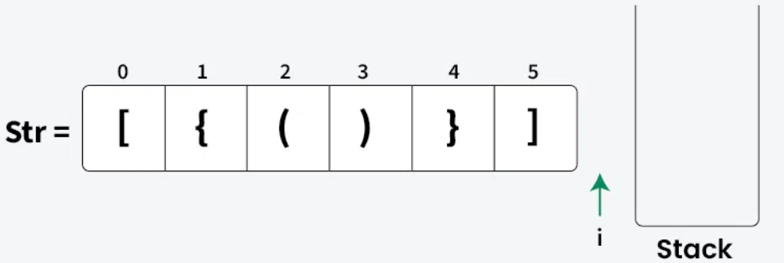
2.2 Practical Applications
2.2.4 Real-life Applications
Bracket Checking in Expressions
How it works:
When encountering an opening bracket (, {, [ → push into the Stack.
When encountering a closing bracket ), }, ] → pop from the Stack and check if it matches the most recent opening bracket.
If it matches → continue; if it does not match or the Stack is empty → the expression is invalid.
39

Slide 40
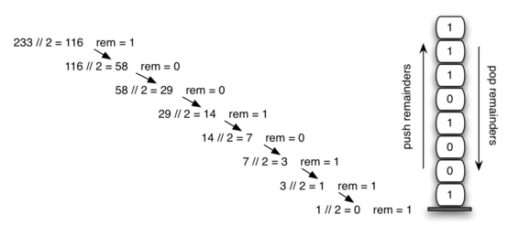
2.2 Practical Applications
2.2.4 Real-life Applications
Base conversion:
How it works:
Repeatedly divide the number by the new base, taking the remainder each time.
Each remainder is pushed onto the Stack.
After the division reaches 0, pop the elements from the Stack in reverse order to form the number in the new base.
40

Slide 41
2.2 Practical Applications
2.2.5 Advanced Applications
Applications in Research:
Natural Language Processing (NLP): The Shift-reduce parsing algorithm uses a stack to construct syntax trees.
Machine Learning: Reverse-mode differentiation and backpropagation rely on stacks to store computations and traverse backward to compute gradients.
Machine Vision: Algorithms such as flood-fill and region-growing utilize stacks in image processing tasks.
41

Slide 42
2.2 Practical Applications
#include <iostream>
#include <stack>
int main() {
stack<int> s; // Initialize an empty stack of integers
s.push(10); // Push element 10 onto the top of the stack
s.push(20); // Push element 20 onto the top of the stack
s.push(30); // Push element 30 onto the top of the stack
cout << s.top() << " popped\n"; // Print the top element (30)
s.pop(); // Pop the top element (30)
cout << "Top element is: " << s.top() << "\n"; // Peek the current top element (20) without removing it
cout << "Elements present in stack: ";
while (is.empty()) { // Traverse and print the remaining elements in the stack
cout << s.top() << " "; // Print the top element
s.pop(); // Pop the printed element
}
cout << "\n";
return 0;
}
2.2.6 Implementation Examples in Programming Languages
C++ with array-based implementation and the std::stack library.
42

Slide 43
2.2 Practical Applications
def create_stack():
return []
def is_empty(stack):
return len(stack) == 0
def push(stack, item):
stack.append(item)
print("pushed item:", item)
def pop(stack):
if is_empty(stack):
return "stack is empty"
return stack.pop()
# Test
stack = create_stack()
push(stack, 1)
push(stack, 2)
push(stack, 3)
print("popped item:", pop(stack))
print("stack after popping:", stack)
2.2.6 Implementation Examples in Programming Languages
Python with list
43

Slide 44
2.2 Practical Applications
from collections import deque
def create_stack():
return deque()
def is_empty(stack):
return len(stack) == 0
def push(stack, item):
stack.append(item) # append to end
print("pushed item:", item)
def pop(stack):
if is_empty(stack):
return "stack is empty"
return stack.pop() # pop from end
# Teststack = create_stack()
push(stack, 1)
push(stack, 2)
push(stack, 3)
print("popped item:", pop(stack))
print("stack after popping:", stack)
2.2.6 Implementation Examples in Programming Languages
Python with collections.deque
44

Slide 45
CONCLUSION
45

Slide 46
Achieved results
Understand the theory of stack and the LIFO principle.
Be proficient in operations such as: push, pop, peek/top, IsEmpty, and IsFull.
46

Slide 47
Future development directions
Applications in embedded systems
Effectively supports artificial intelligence applications, big data processing, and parallel programming.
47

Slide 48

Hướng phát triển mới
Ứng dụng trong hệ thống nhúng
Hỗ trợ hiệu quả cho các ứng dụng trí tuệ nhân tạo, xử lý dữ liệu lớn và lập trình song song.
48

