Slide 1
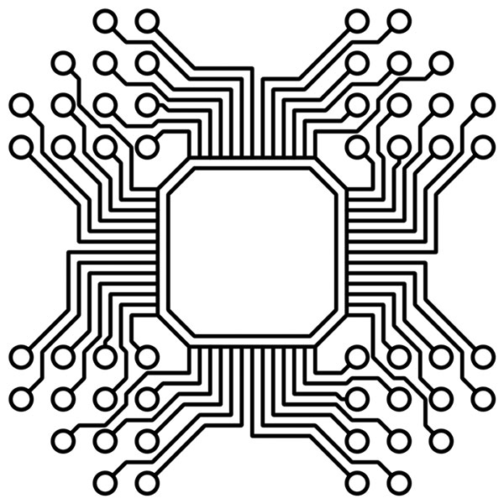
Low power Wide Area Network
Lecturer: Dr. Bui Ha Duc
Dept. of Mechatronics
Email: ducbh@hcmute.edu.vn

Slide 2
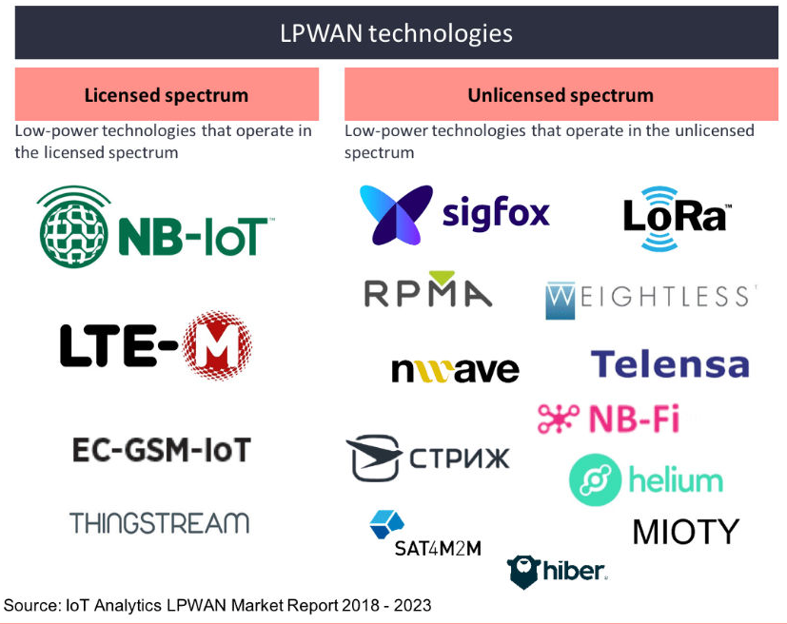
Low power WAN
Wireless technologies adapted for long-range and battery-powered endpoints
Range > 2km
Types
LoRaWAN
Sigfox
NB-IoT
LTE
…

Slide 3
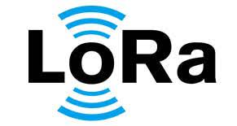


LoRaWAN
LoRa – Long Range
LoRA was developed by a French company named Cycleo in 2010
Semtech acquired Cycleo in May 2012
Lora used Chirp Spread Spectrum (CSS) modulation technology
Optimized for long-range, two-way communications and low power consumption
Nicolas Sornin

Slide 4
LoRa Specifications
LoRa Alliance
https://lora-alliance.org/
LoRa Specifications:
LoRa is deployed in a star-of-stars topology
Data rate: range from 0.3 kbps to 50 kbps
Packet size: is limited to 150 messages of 12 bytes per day
Security: two layers of cryptography
A unique 128-bit Network Session Key shared between the end-device and network server
A unique 128-bit Application Session Key (AppSKey) shared end-to-end at the application level
LoRaWAN has three different classes of end-point devices

Slide 5
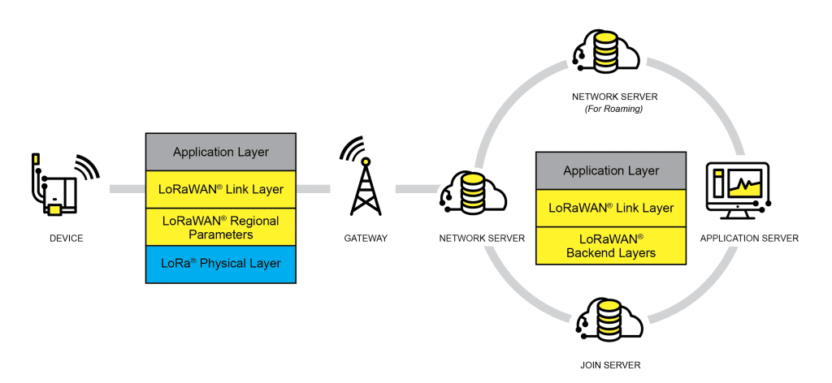
LoRa Architecture
Gateways
relay messages between end-devices and a central network server.
The gateways are connected to the network server via standard IP connections and act as a transparent bridge

Slide 6
LoRa Devices
LoRaWAN has three different classes of end-point devices
Class A – Lowest power, bi-directional end-devices
supported by all LoRaWAN end-devices
fully asynchronous
Can enter low-power sleep mode for as long as defined
Class B – Bi-directional end-devices with deterministic downlink latency
synchronized to the network using periodic beacons
open downlink ‘ping slots’ at scheduled times
Class C – Lowest latency, bi-directional end-devices
reduces latency on the downlink by keeping the receiver of the end-device open at all times
suitable for applications where continuous power is available
Notes:
https://www.thethingsnetwork.org/docs/lorawan/classes/

Slide 7
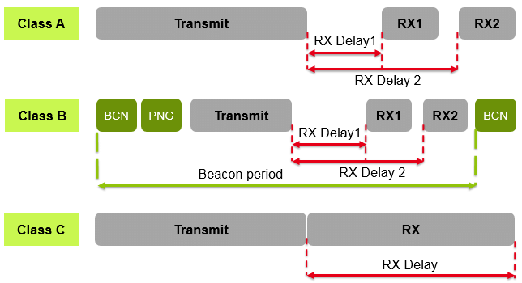
LoRa Devices

Slide 8
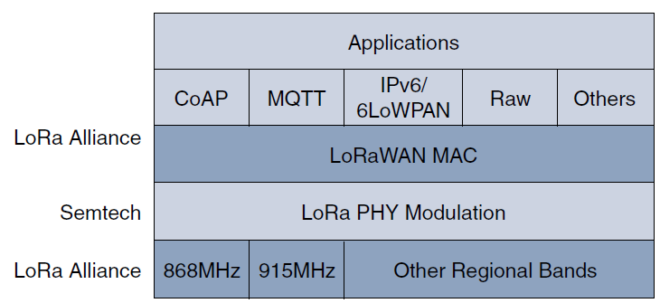
LoRaWAN Layers
430MHz in Asia
Notes:
Semtech is responsible for the PHY layer, while the LoRa Alliance handles the MAC layer and regional frequency bands

Slide 9
LoRaWAN Layers
LoRa Physical layer
Semtech LoRa modulation is based on chirp spread spectrum modulation (CSS)
CSS trades a lower data rate for receiver sensitivity to significantly increase the communication distance
CSS allows demodulation below the noise floor
LoRa devices can receive on multiple channels in parallel

Slide 10
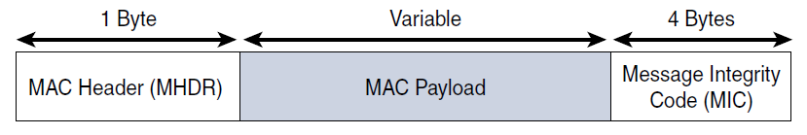
LoRaWAN Layers
LoRa MAC layer
LoRaWAN endpoints are uniquely addressable through a variety of methods:
global end device ID or DevEUI represented as an IEEE EUI-64 address.
32-bit device address DevAddr

