Slide 1

Three-loop planar master integrals for heavy-to-light form factors
arXiv:1810.04328
陈龙斌(Long-Bin Chen)
广州大学
2019.1.24

Slide 2

The need of higher order QCD corrections
QED $α\sim O\left(0.01\right)$
QCD $α_{s}\sim O(0.1)$ $u≫∧_{QCD}$
QED are more convergence
in perturbation expansion than QCD

Slide 3
Top quark
1. The heaviest particle in standard model
2. Suitable for QCD perturbative calculations
3. Huge samples of top quarks at the LHC
4. Study of CKM matrix element
5. Search for new physics beyond standard model
………………………….

Slide 4
Top Quark Decay at Next-to-Next-to Leading Order in QCD Jun Gao (Southern Methodist U.), Chong Sheng Li (Peking U. & Peking U., CAPT & Peking U.), Hua Xing Zhu (SLAC). Oct 2012. 5 pp. Published in Phys.Rev.Lett. 110 (2013) no.4, 042001 Charm-Quark Production in Deep-Inelastic Neutrino Scattering at Next-to-Next-to-Leading Order in QCD Edmond L. Berger, Jun Gao (Argonne), Chong Sheng Li (Peking U. & Peking U., CHEP & Peking U., SKLNPT), Ze Long Liu (Peking U. & Peking U., SKLNPT), Hua Xing Zhu (MIT, Cambridge, CTP). Jan 20, 2016. 6 pp. Published in Phys.Rev.Lett. 116 (2016) no.21, 212002

Slide 5
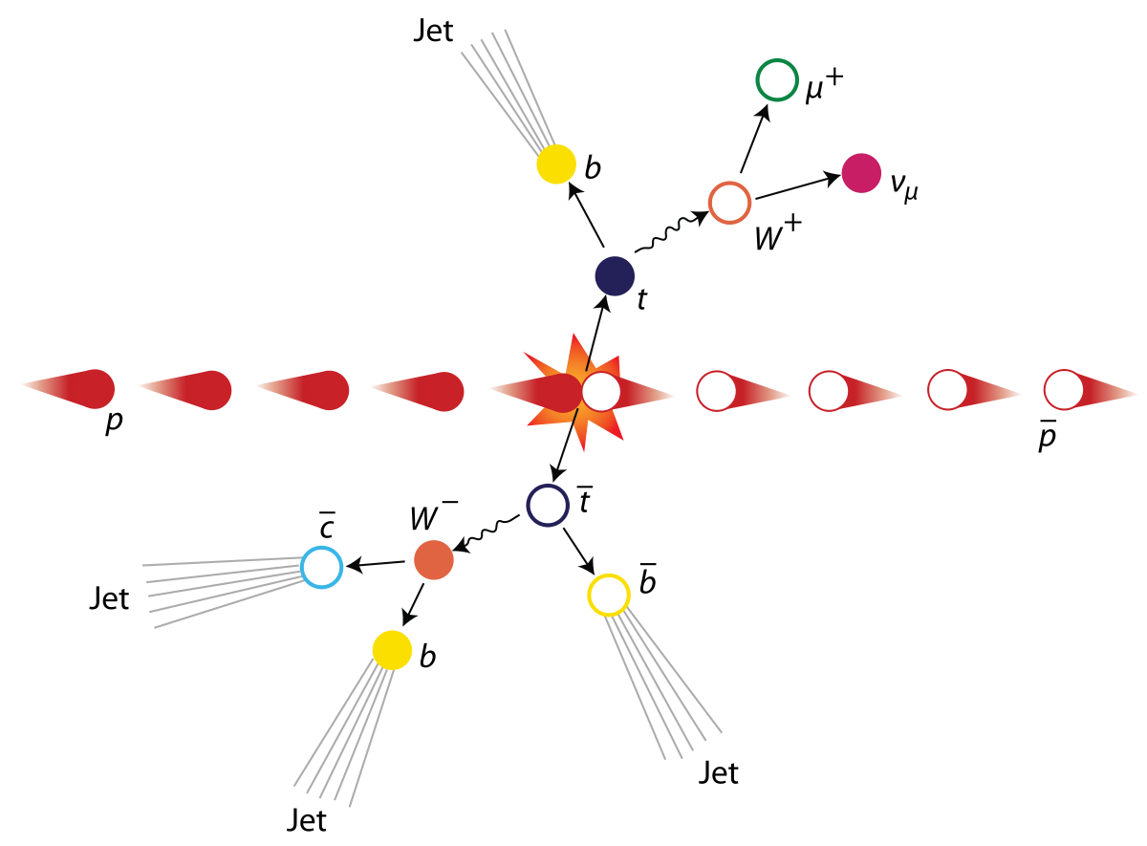

Slide 6
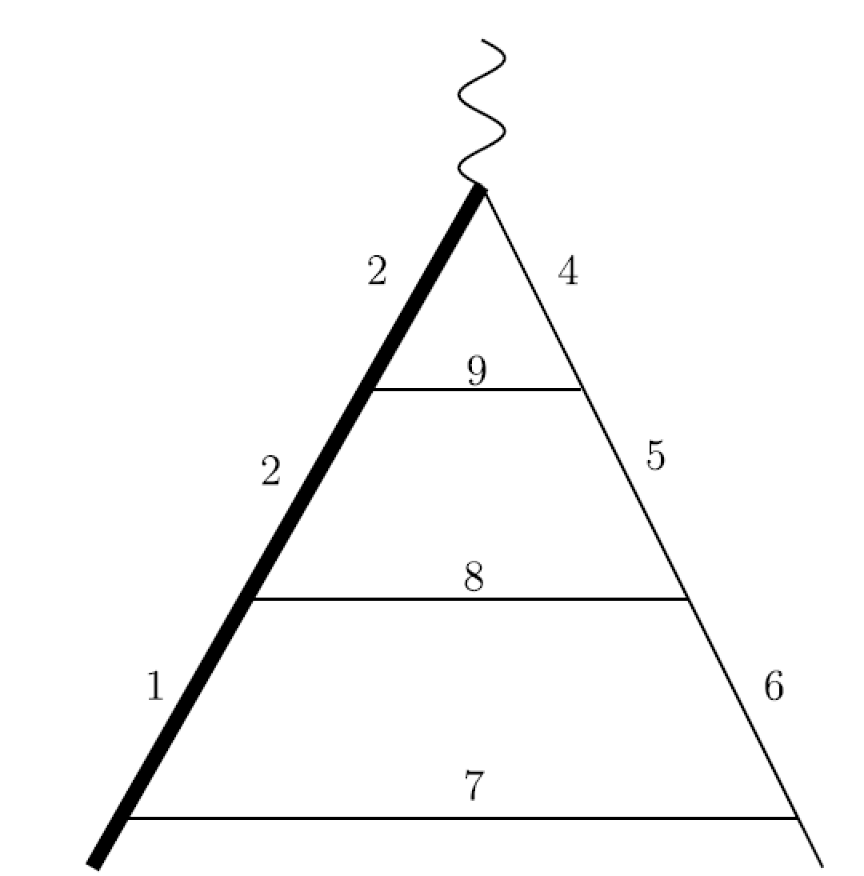
Heavy-to-light Form factors
W
t
b

Slide 7
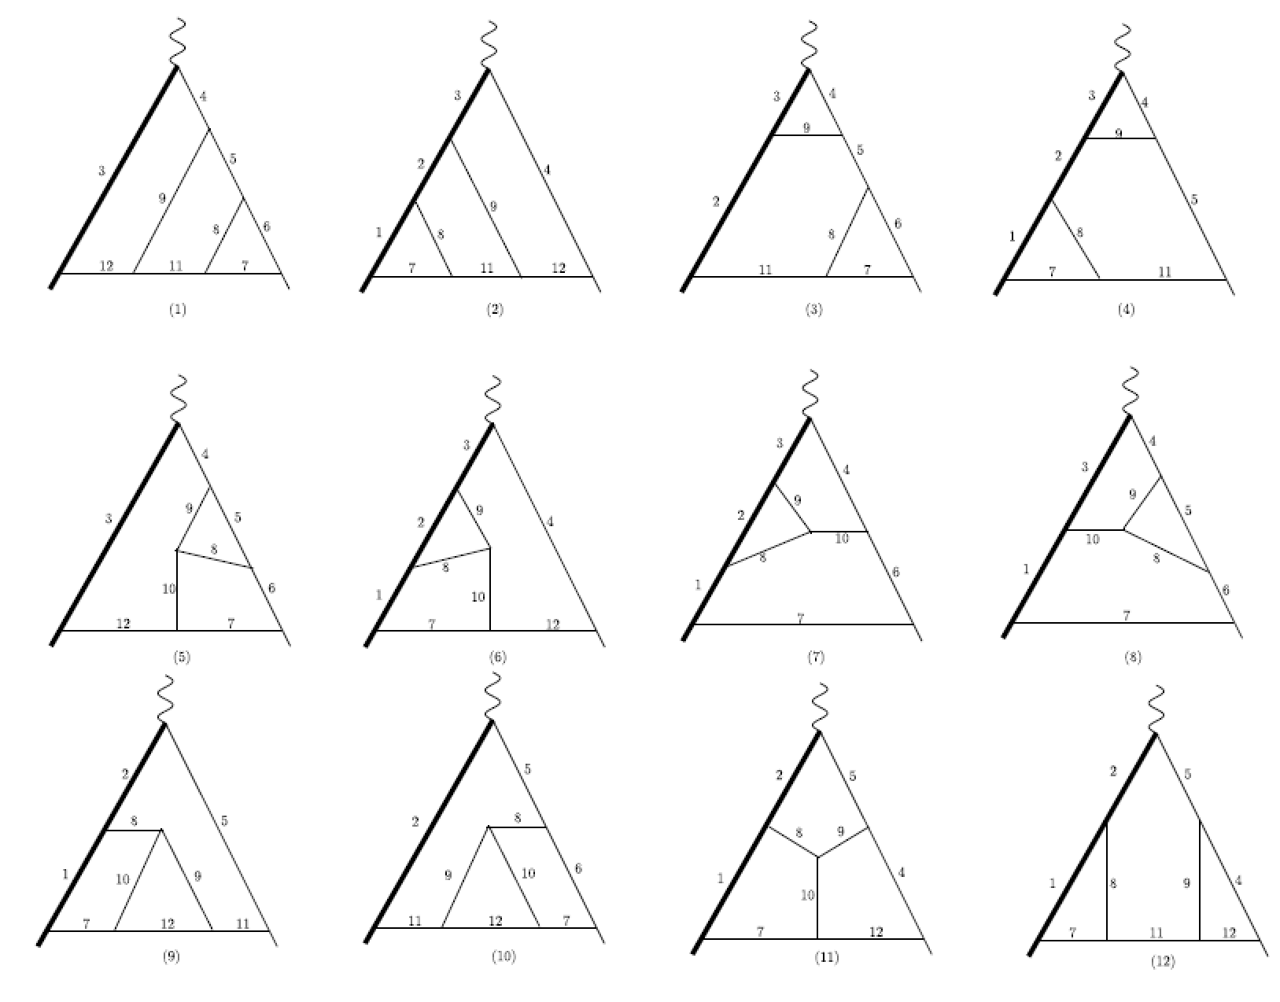
Color-planar diagrams（Leading Color Contribution）

Slide 8
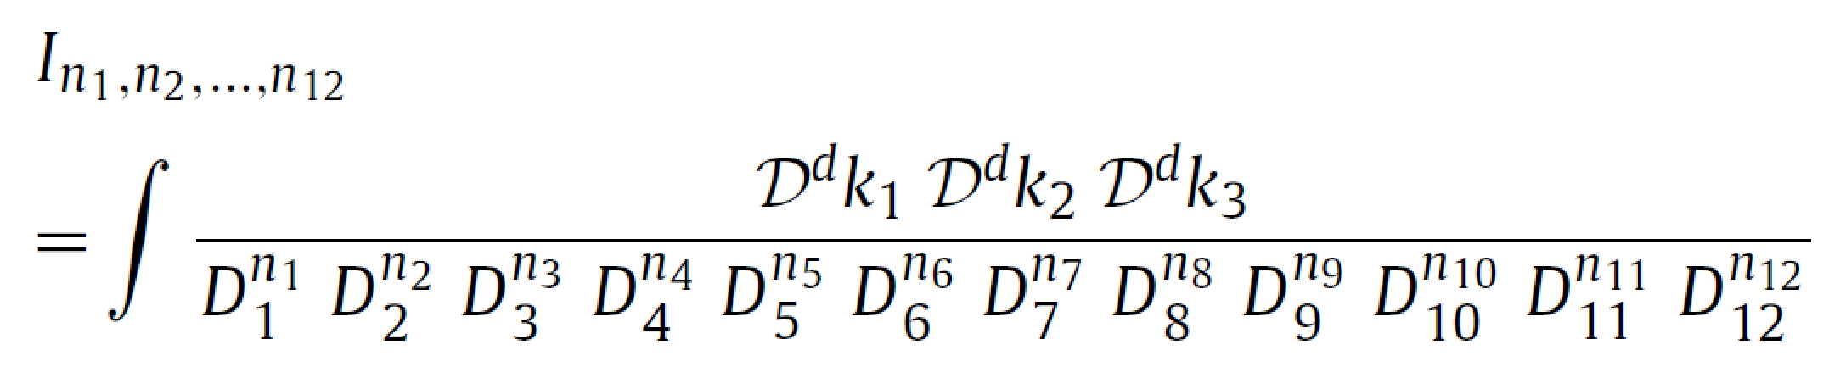
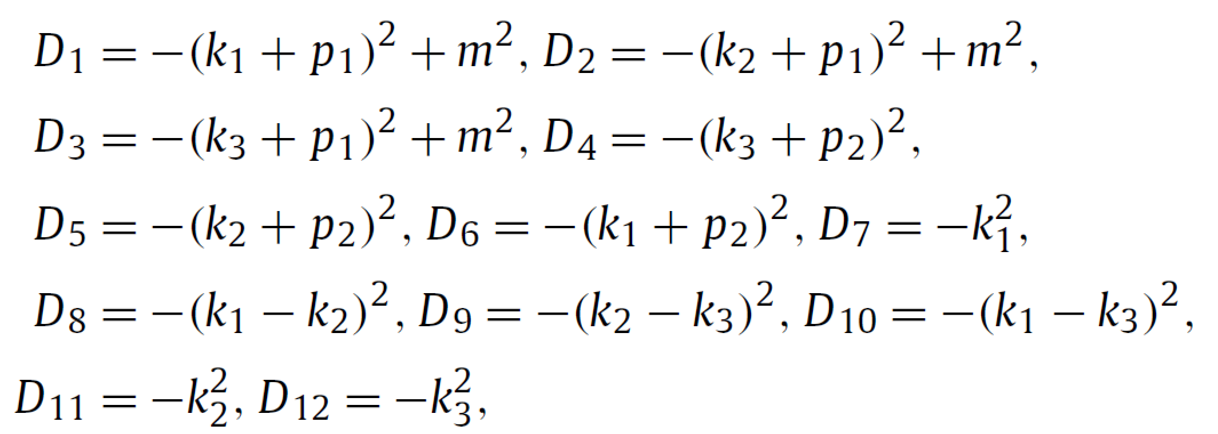

Integrals can be parameterized by
d=4-2$∈$

Slide 9
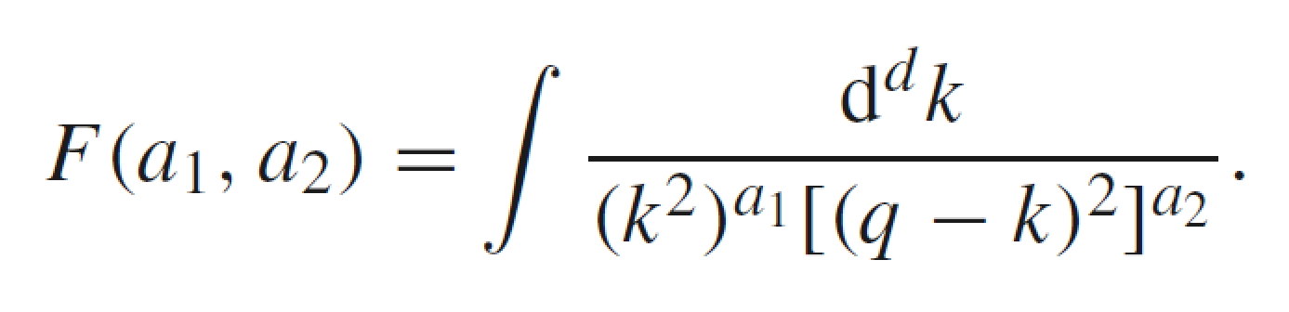
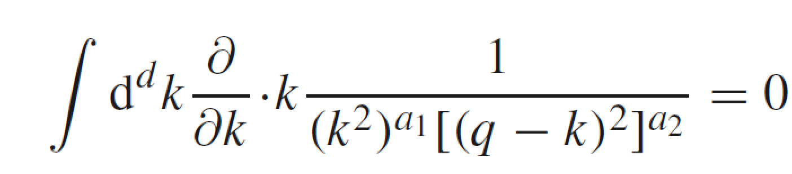
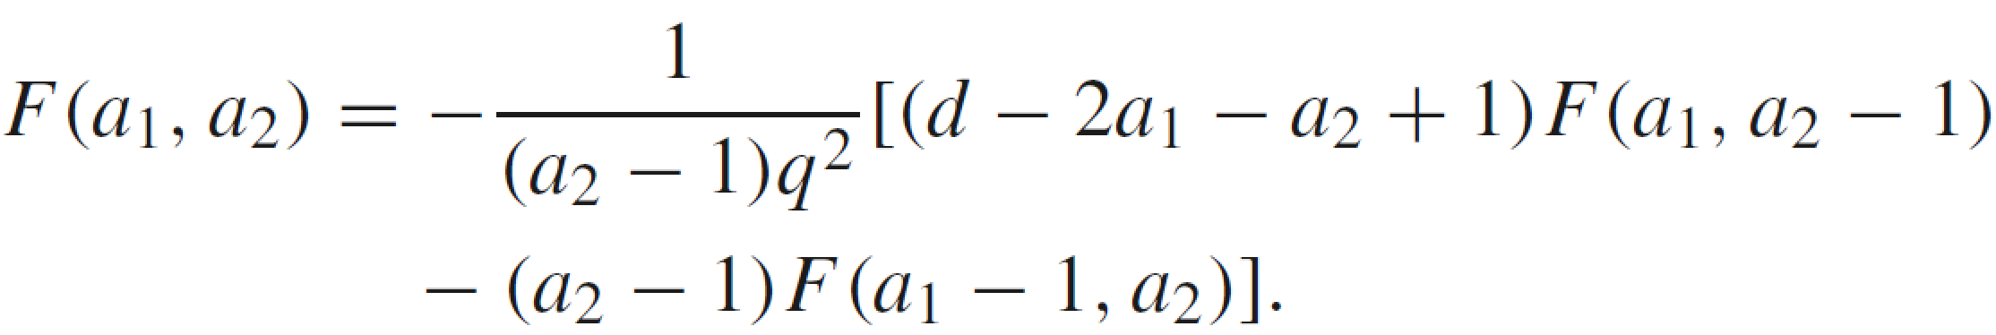
All integrals can be reduced to 71 Master Integrals (MI)
Integration-By-Parts (IBP) reduction
（ FIRE, Reduze, Kira…）
Example

Slide 10
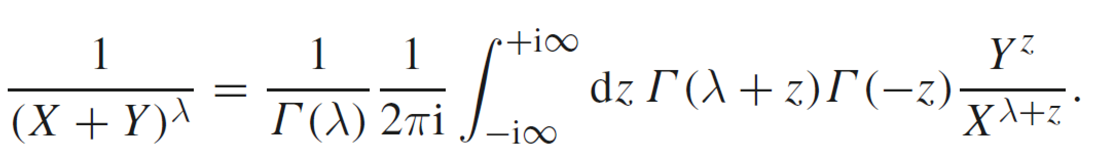
Calculations of Master Integrals
Evaluating by Feynman Parameters
Evaluating by Mellin-Barnes Integrals
Sector Decompositions (Numeric Calculations)
…………………

Slide 11
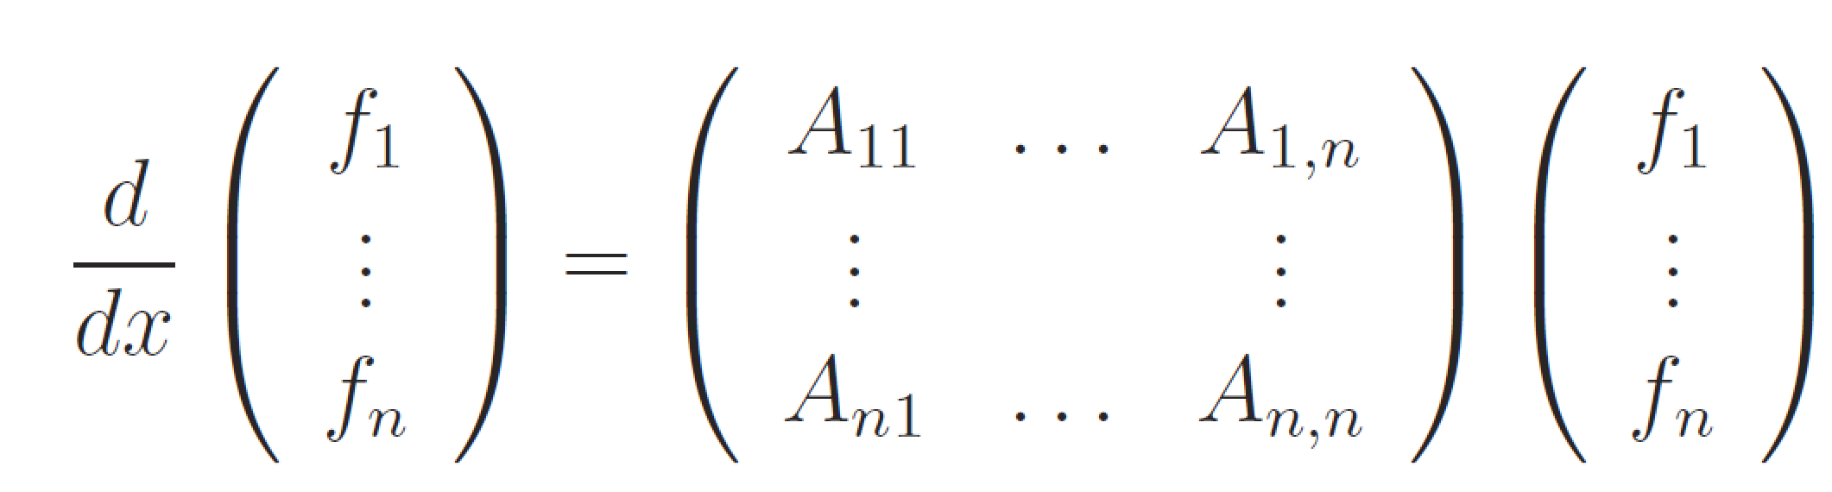
Differential Equations (DE)
x are Lorentz invariant kinematics

Slide 12
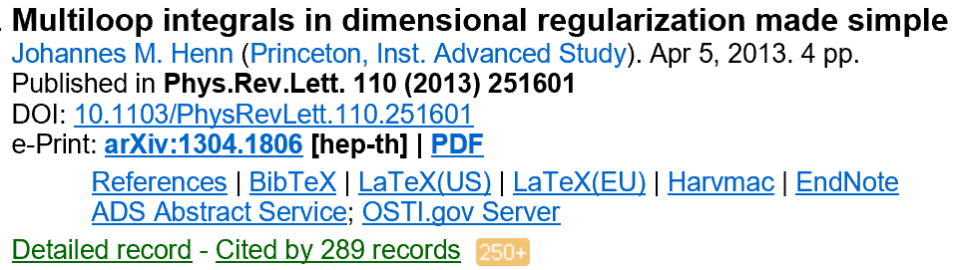
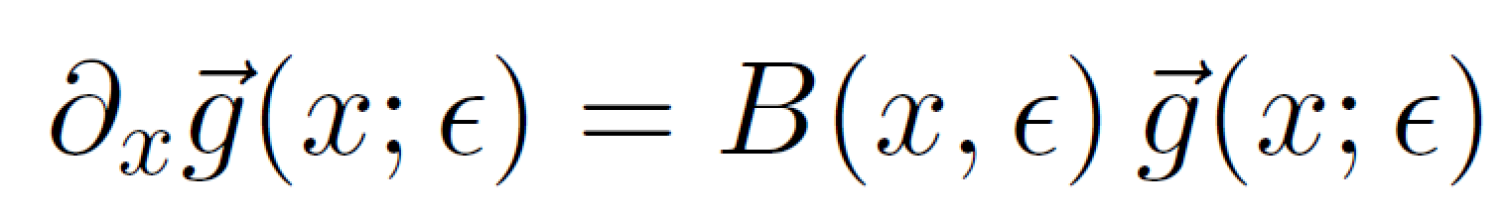
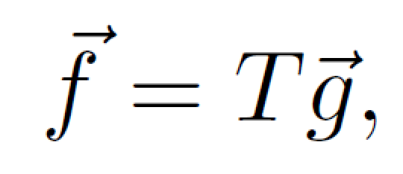
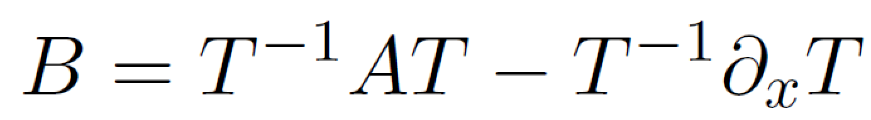
A suitable choice of basis (canonical basis)
arXiv:1304.1806

Slide 13
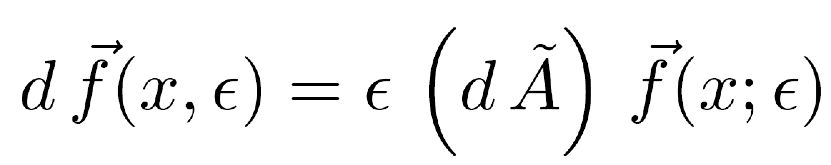

Slide 14
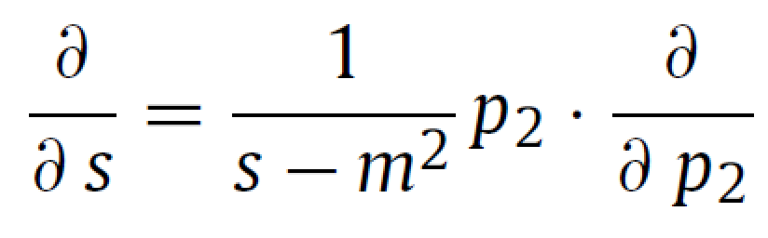
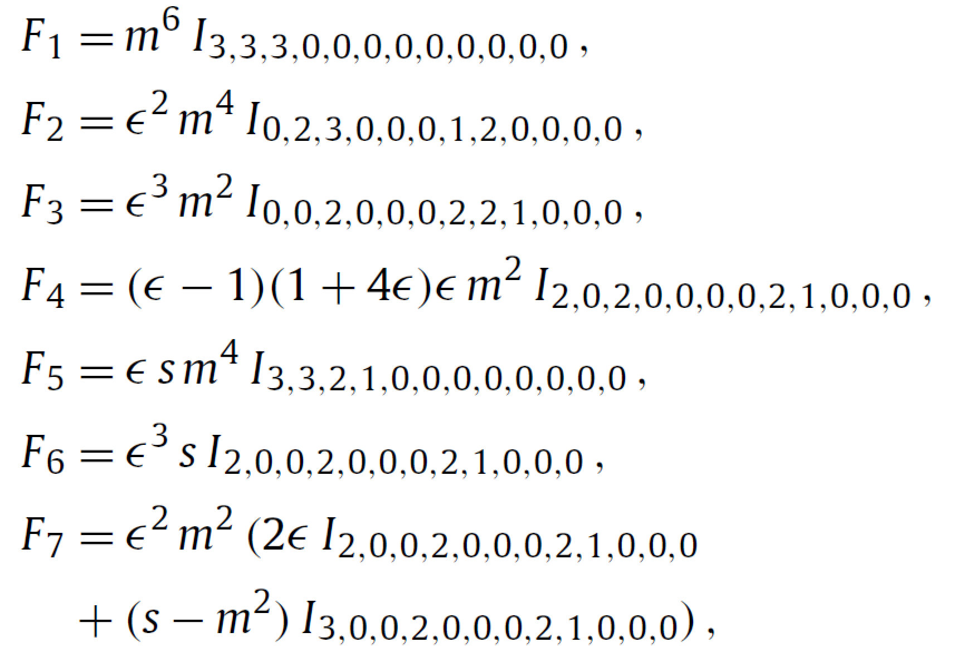
Canonical Basis:
………………………………………………………………

Slide 15
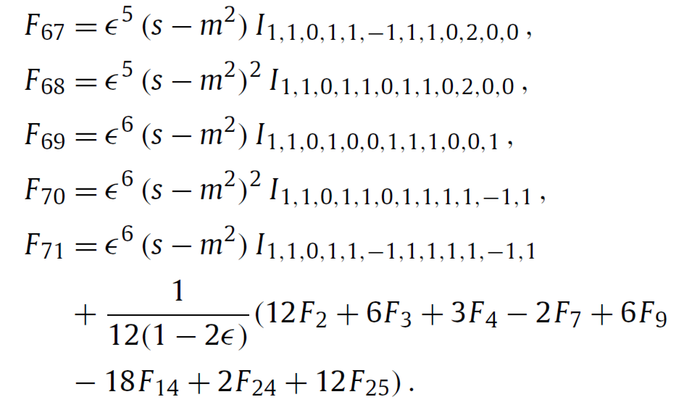

Slide 16
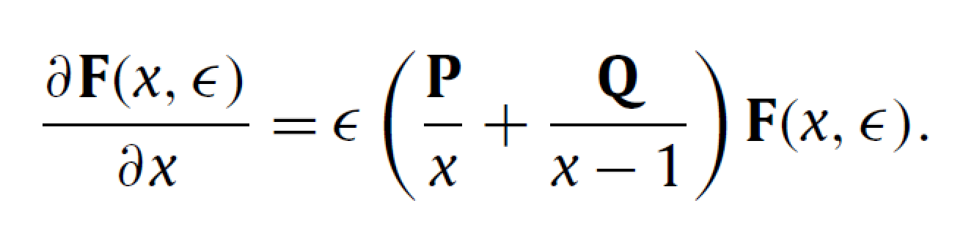
P and Q are 71*71 rational matrices

Slide 17
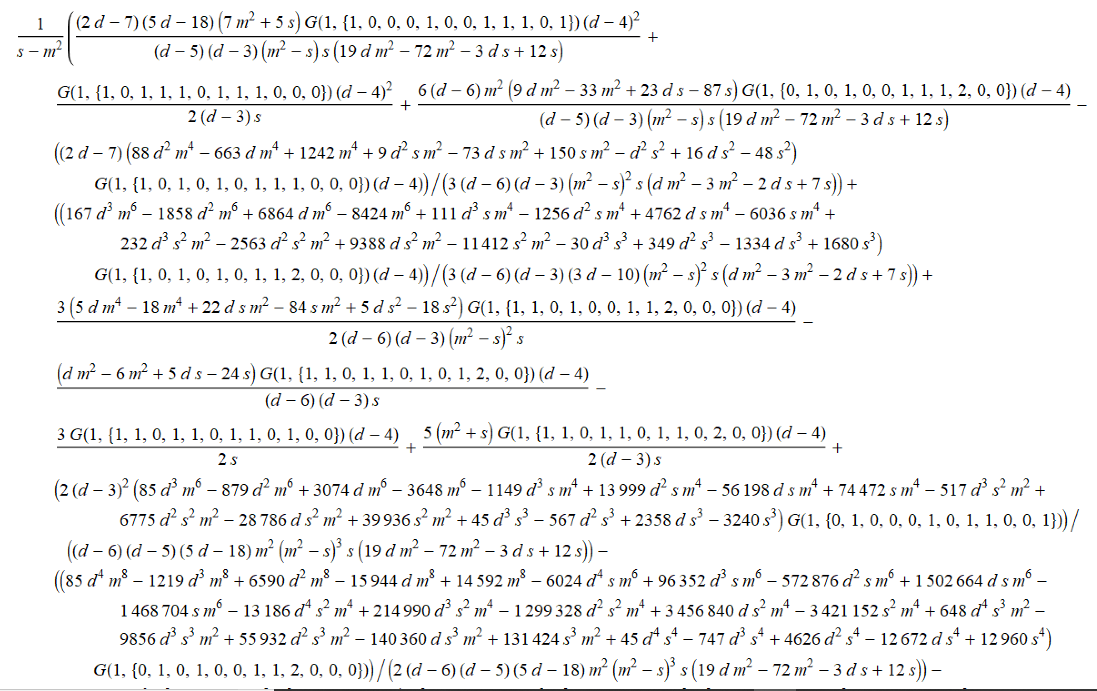
DE for non-canonical basis

Slide 18
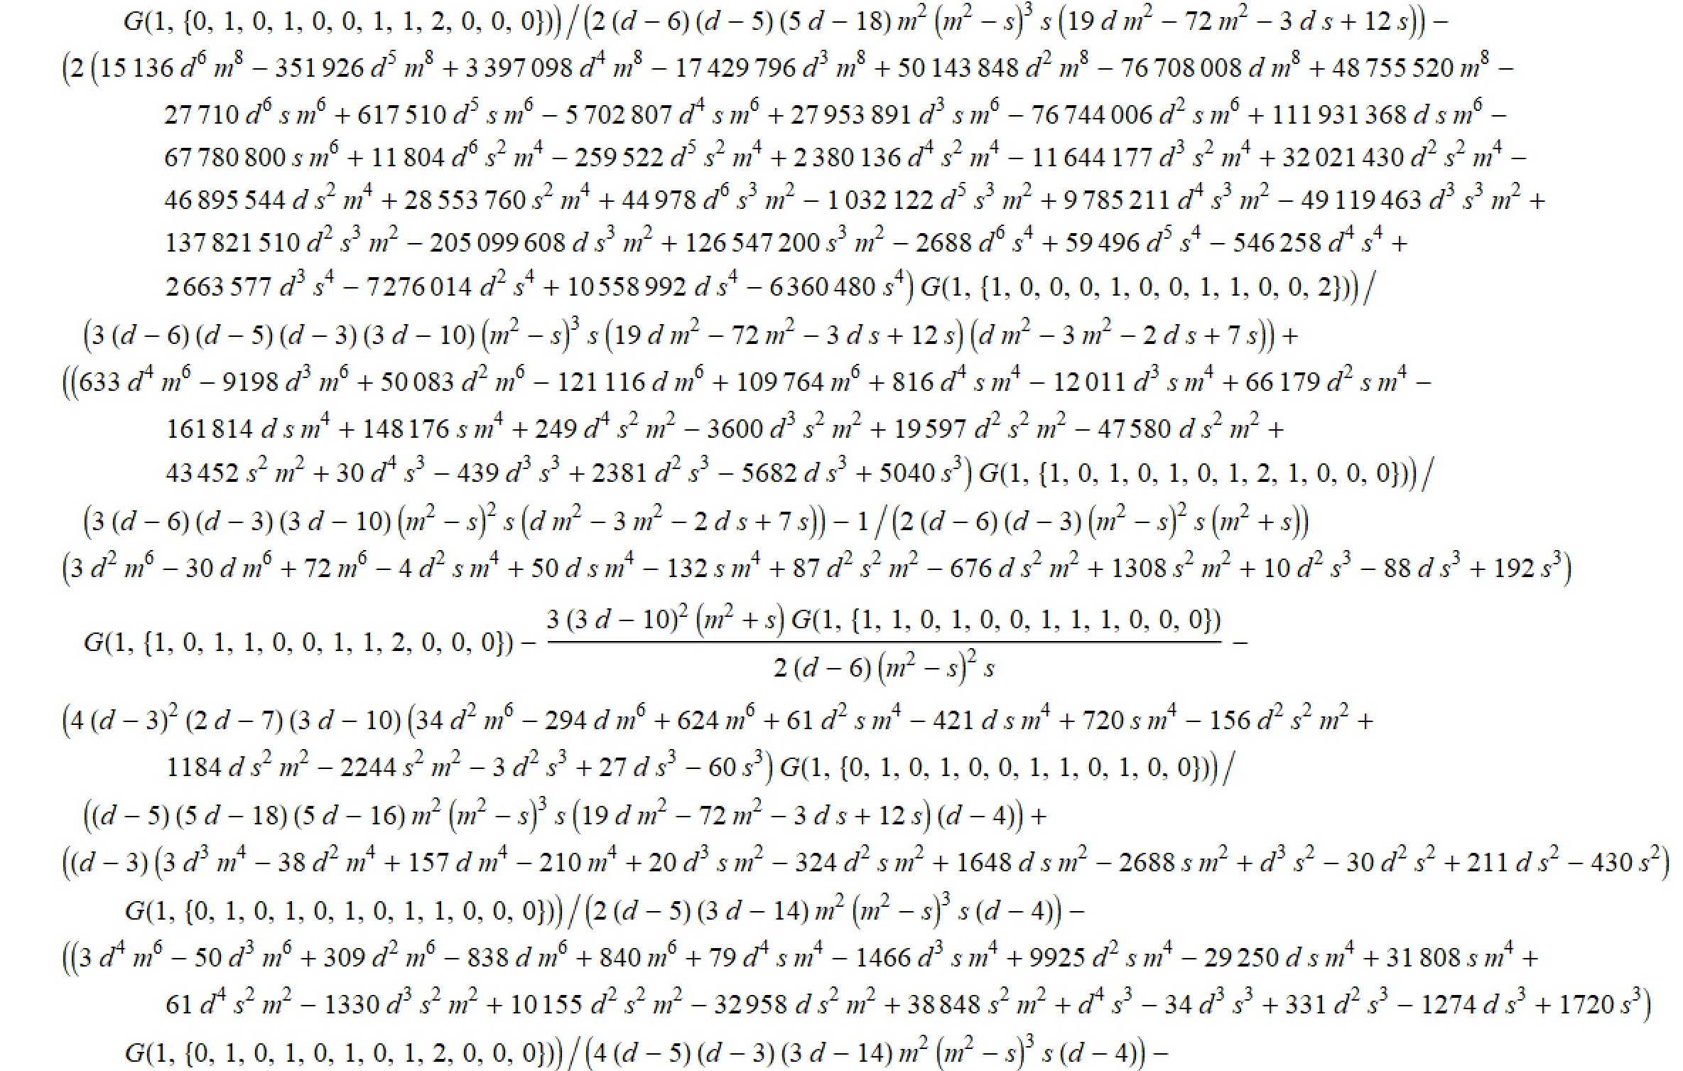
...........(about 30pages).

Slide 19
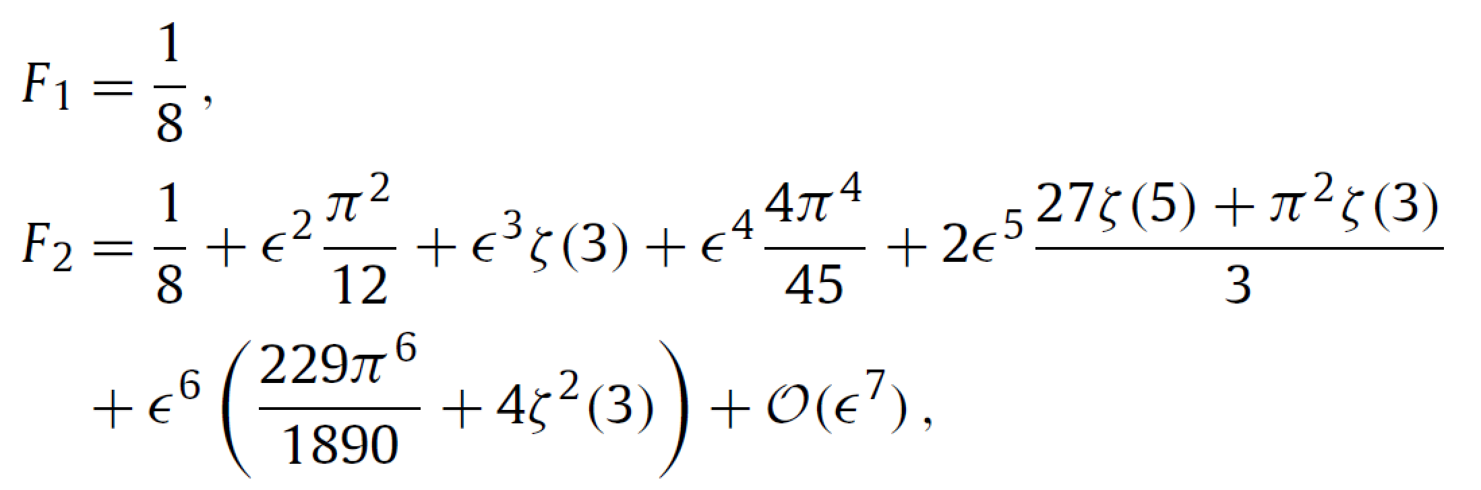

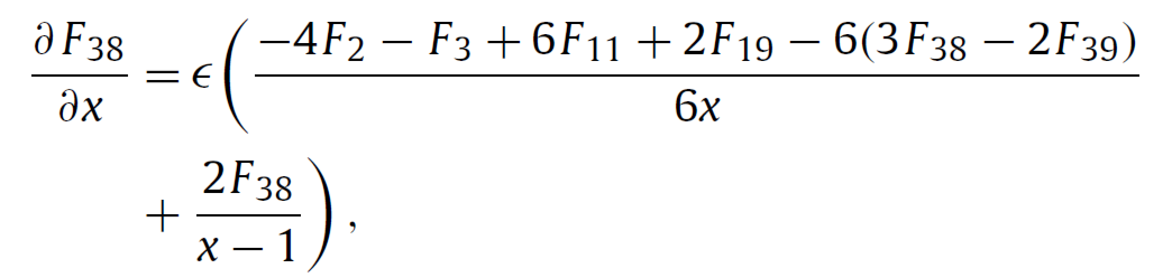
Boundary Conditions
Known
Regular at x=0

Slide 20
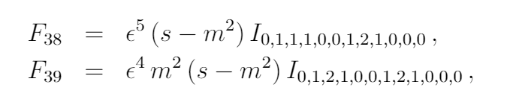
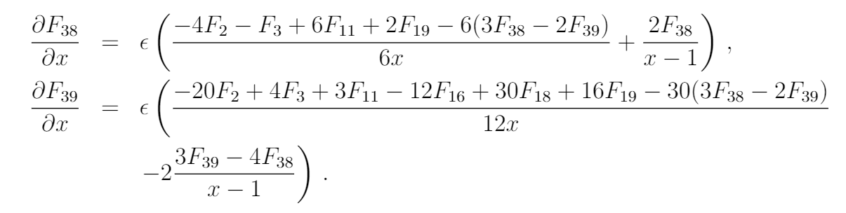
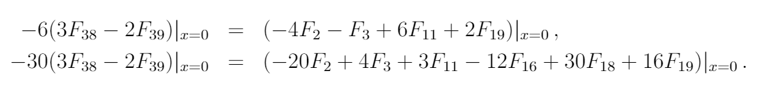

Slide 21
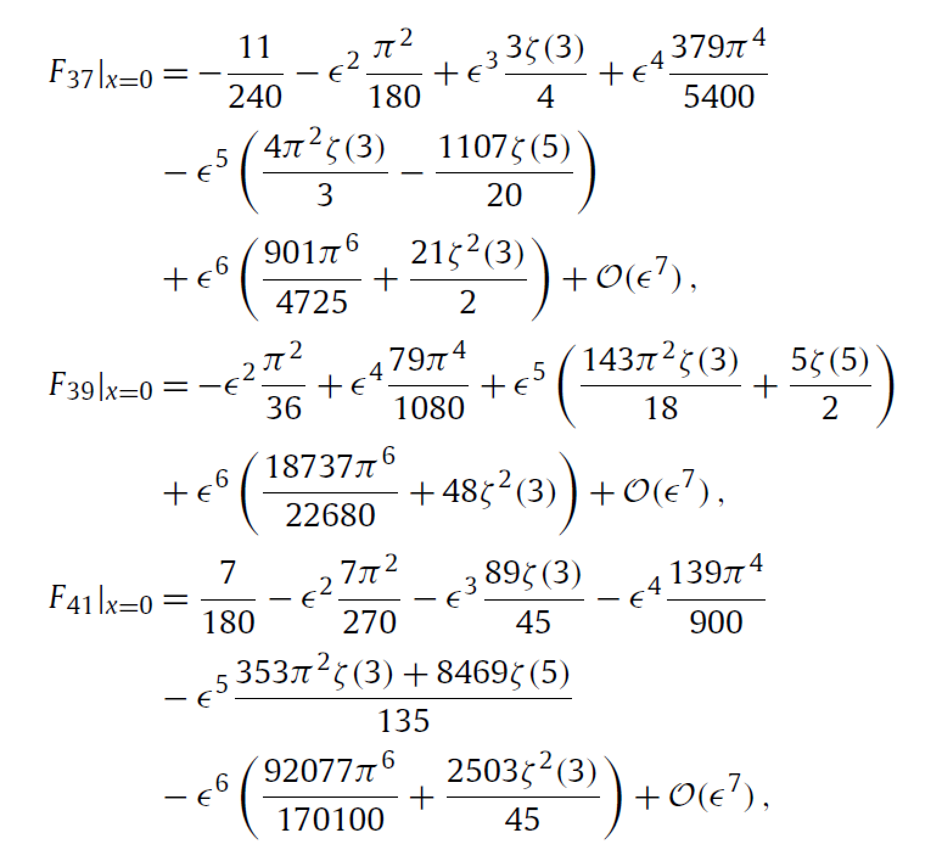

Slide 22
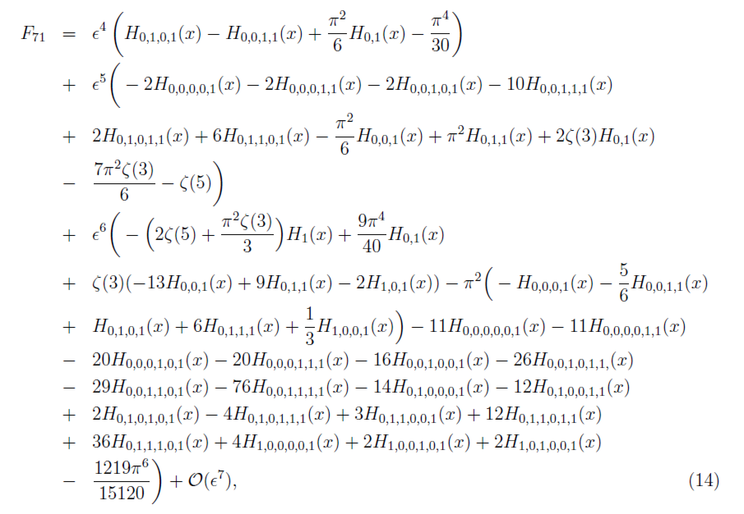
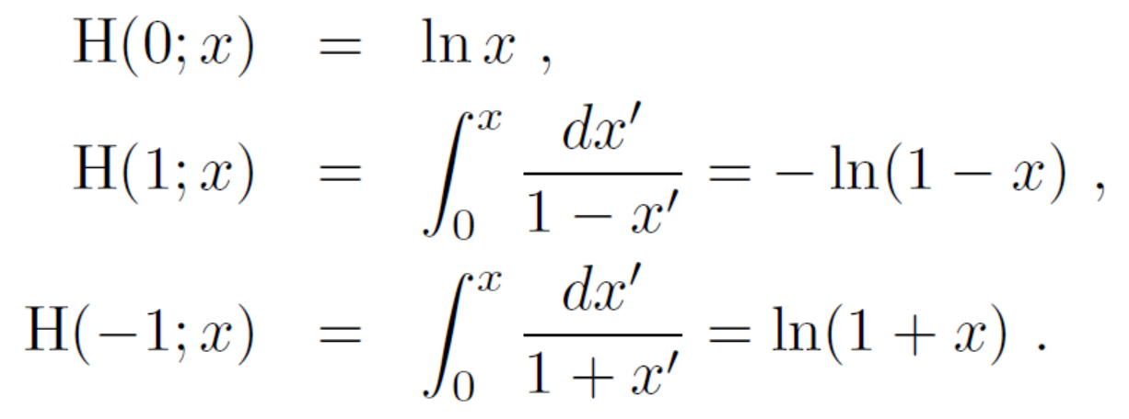
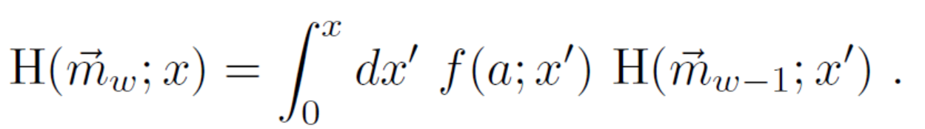
H are Harmonic Polylogarithms

Slide 23
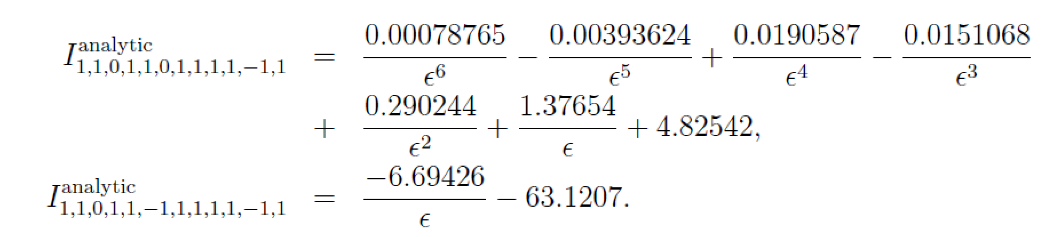
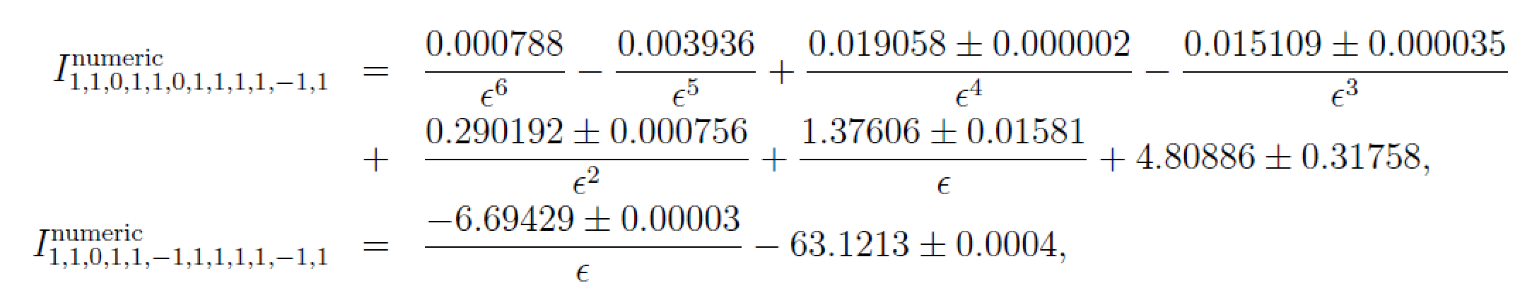
Check:（s=-1.3,m=1.0）
FIESTA packages

Slide 24
Thanks!

