Slide 1
M/String Theory and Collider physics
-- string phenomenology, higgs physics, superpartner spectrum, etc
Gordy Kane, Michigan Center for Theoretical Physics
CFHEP, Beijing, May 2014

Slide 2
Particle physics entering a very exciting time, particularly because data from CERN LHC, and from dark matter satellite and laboratory detection experiments, is beginning to emerge
There is another, less appreciated reason why we are entering an exciting time!
-- today for the first time there is a coherent, constrained, consistent theoretical framework to address essentially all the basic questions physicists want to ask about the particles that form our world, and the forces, how they fit into a deeper and broader framework, why they are what they are – “string theory”
Argue today can get guidance about goals from string phenomenology

Slide 3
String theory formulated in 10 or 11 space-time dimensions, in order to have a mathematically consistent theory (no anomalies)
To describe our world can separate 10D into 6 small D (typically they form a “Calabi-Yau manifold” with well studied mathematical properties) and 4 large D that can form the world we are familiar with – jargon “compactification”
For 11D (called M-theory) the small 7D manifold is a “G₂ manifold”
Difference between 10/11 D theories is technical, ignore it here
The CY (or G₂) manifold has properties that in part determine the physics that emerges from this compactified string theory, in particular the particles and forces

Slide 4
Compactified string theory is analogous to Lagrangian of a system
In all areas of physics one specifies the particular “theory” by giving the Lagrangian (Hamiltonian)
Physical systems are described not by the Lagrangian but by solutions to the equations
Normally find the ground state of a system, calculate energy levels and transitions
Analogous for string theory – our world corresponds to a stable or metastable ground state – called “vacuum”

Slide 5
The tests of the string theory are of the compactified theory, but they do depend on the full 10/11D theory in a number of ways – there are predicted relations between observables that depend on the full theory, 10 or 11D, the stringy characteristics of the CY or G2 (or even different) space – calculate them in each case

Slide 6
How should we try to relate string/M-theory and our real world?
Begin by making good assumptions about superpotential, Kahler potential, etc, assumptions not closely related to observables such as Higgs mass, supersymmetry breaking, etc. Some assumptions are already partially derived.
Then search for solutions of string/M theory framework that could be our world.

Slide 7
We started M/string compactification fall of 2005, interested in moduli stabilization, susy breaking, Higgs, since LHC coming (Acharya, Kane, Kumar, Bobkov, …)
Do the derivations here in M-theory case since those calculations effectively complete – results may hold in some or all other corners of string theory since they depend on only a few generic features of resulting soft-breaking Lagrangian
Note µ, tanβ not adjustable parameters, but not yet known accurately -- estimated

Slide 8
M-THEORY COMPACTIFICATIONS ON G₂ MANIFOLDS (11 D – 7 small D = our 4D)
Earlier work (stringy, mathematical) : Witten 1995
Papadopoulos, Townsend th/9506150, 7D manifold with G₂ holonomy preserves N=1 supersymmetry
Acharya, hep-th/9812205, non-abelian gauge fields localized on singular 3 cycles
Acharya, hep-th/0011289
Atiyah and Witten, hep-th/0107177
Atiyah, Maldacena, Vafa, hep-th/0011256
Acharya and Witten, hep-th/0109152, chiral fermions supported at points with conical singularities
Witten, hep-ph/0201018 – shows embedding MSSM probably ok
Beasley and Witten, hep-th/0203061, Kahler form
Friedmann and Witten, th/0211269
Lukas, Morris hep-th/0305078, gauge kinetic function
Acharya and Gukov, hep-th/0409101 – review – good summary of known results about singularities, holonomy and supersymmetry, etc – all G₂ moduli geometric – gravity mediated because two 3-cycles won’t interact directly in 7D manifold
Particles!

Slide 9
ASSUMPTIONS – note none closely related to results – string phenomenology
Compactify M-theory on G2 manifold (in fluxless sector)
No principle yet to set gauge group and matter at compactification scale – choose MSSM
Assume CC problem orthogonal, and that can tune CC to be small
Assume no mathematical obstacles to ok G2 manifold even though not yet known in detail – some predictions not sensitive to details of manifold
Keep approach fully generic, don’t fix any parameters or parameter space regions, don’t introduce any parameters
Assume can use generic Kahler potential (Beasley, Witten 2002).
Assume generic gauge kinetic function (Lukas, Morris 2003).

Slide 10
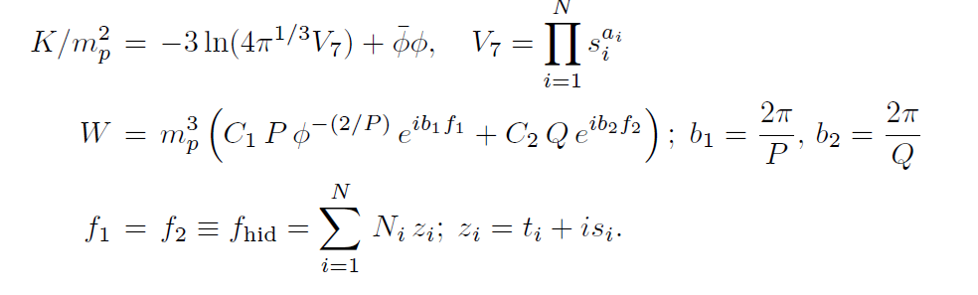


Slide 11
Need two details about compactified string theories:
GRAVITINO
-- in theories with supersymmetry the graviton has a superpartner, gravitino – when supersymmetry broken, gravitino mass (M_{3/2} ) splitting from the massless graviton is determined by the form of supersymmetry breaking
– gravitino mass sets the mass scale for the theory, for all superpartners, for some dark matter

Slide 12
Also:
MODULI
-- to describe sizes and shapes and metrics of small manifolds the theory provides a number of fields, called “moduli” fields
-- supersymmetry breaking generates a potential for all moduli
-- moduli fields have definite values in the ground state (vacuum) – jargon is “stabilized” – then measurable quantities such as masses, coupling strengths, etc, are determined in that ground state
-- moduli fields like all fields have quanta (also called moduli), with masses fixed by fluctuations around minimum of moduli potential

Slide 13
Supersymmetry breaking via “gaugino condensation” – as do RGE running down from high scale, force gets larger, like QCD force in SM – get “condensation”, like QCD hadrons – largest gauge groups condense first, generically at ∼ 10¹⁴ GeV – get non-zero F terms → supersymmetry breaking
Similar effect from chiral fermions

Slide 14
From Planck scale to 50 TeV “dimensional transmutation”
Scale of gaugino condensation ɅM_{pl} exp(-8² /3Qg² )exp(2Imf/3Q)
where Imf=N_{i} s_{i}
With Q-P=3, Imf=14Q/ → ɅM_{pl} e^{—28/3}  2x10¹⁴ GeV, so
Ʌ 10⁻⁴ M_{pl}  scale at which supersymmetry broken (F’s≠0)
Then WɅ³  10⁻¹² M_{pl}  2x10⁶ GeV = 2x10³ TeV. Also inverse volume factor 1/V₇ from e^{K/2} so
M_{3/2}  e^{K/2} W  50 TeV
[Note Imf/Q not explicitly dependent on Q – still dependent because of V₇ and P_{eff} , but weakly – so Ʌ rather well determined]
Q, P are ranks of condensing gauge group
Solves
hierarchy problem

Slide 15
THEN – with no parameters:
Moduli stabilized and supersymmetry simultaneously broken from gaugino and meson condensation, F-terms non-zero at ∼ 10¹⁴ GeV
Have 4D supergravity relativistic quantum field theory below compactification
Calculate full soft-breaking supersymmetric Lagrangian
Calculate stabilized moduli vevs, 1-2 orders of magnitude below M_{PL}
Can calculate moduli mass matrix – only need some properties
Have proved gravitino mass ≈ lightest eigenvalue of moduli mass matrix
Top-down “dimensional transmutation” calculation gives M_{3/2} ∼ 50 TeV (∼factor 2)
-- solves hierarchy problem
Moduli only interact gravitationally so can calculate lifetimes, decay early if heavy as expected from large gravitino mass, so no moduli problem, BBN ok
Supergravity → M_{scalars} = M_{3/2} so squarks too heavy for LHC
Include μ in theory (via Witten method) – discrete symmetry sets μ=0 – then moduli stabilization breaks symmetry so μ≠0 but suppressed by moduli vev
No strong and weak CP problems, EDMs, R-parity conservation, top yukawa, etc
→ Lots of results, testable predictions! So other results can be trusted

Slide 16
Think of effective theories for Higgs sector, LHC, superpartners, CPV both strong and weak, EDMs, rare b decays, R-parity violation, axions, cosmological history, dark matter, etc
In normal effective theory all operators have independent coefficients – in compactified M theory all coefficients are determined, all are related to one another, and calculable!

Slide 17
WHAT ABOUT HIGGS SECTOR?
Philosophy to compute Higgs mass, properties:
We have stabilized moduli and broken susy, and we computed the soft-breaking Lagrangian
Divide all compactified string/M theories into two classes
Some generically have TeV scale physics, Electroweak Symmetry Breaking, no contradictions with cosmology, etc – study all these – compute Higgs mass, etc
If our world is described by a compactified string/M theory it will look like these – turns out it’s easy to find them
The rest
Have computed the full soft-breaking Lagrangian by compactifying – then standard criteria allow seeing if EWSB conditions satisfied

Slide 18
Ask for all solutions with EWSB
Then calculate λ (of λh⁴ ) – large soft masses M_{hu} and M_{Hd} imply in “decoupling” sector of two doublet susy higgs sector
Use Witten argument for no µ in superpotential, and supergravity, and EWSB conditions →tanβ ≈ M_{3/2} /1.7µ (EW scale)
Stabilization breaks Witten symmetry so µ≠0 but µ ∼ moduli vev x M_{3/2} so µ∼few TeV, so tanβ  5
Calculate M_{h} for all solutions with EWSB – study them
Turns out all solutions satisfying above have M_{h}=126±2 !!
OR
Could think of this as derivation of Higgs mass
Could think of this as a correlation between vacua with our assumptions and Higgs mass

Slide 19
THEORY AT HIGH SCALE, TECHNICAL DETAILS OF COMPUTING M_{H}
Write theory at scale 10¹⁶ GeV, fix soft-breaking Lagrangian parameters by theory – no free parameters
Run down, maintain REWSB
Use “match-and-run” and also SOFTSUSY and Spheno, compare – match at (M_{stop1}M_{stop2})^{1/2} – two-loop RGEs – expect public software to work since scalars not too large
New 3 loop heavy scalar corrections to higgs mass included
Main sources of imprecision for given M_{3/2} are M_{top} (1 GeV uncertainly in M_{top} gives 0.8 GeV in M_{h} ) , α_{strong} , theoretical gluino mass (allow 600 GeV to 1.2 TeV), trilinear couplings (allow 0.8-1.5M₀)

Slide 20
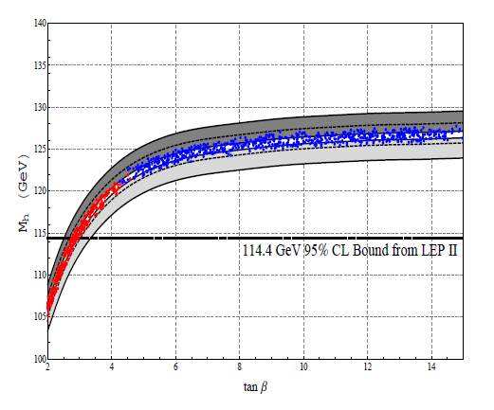
1112.1059, Kane, Kumar, Lu, Zheng, August 2011
M_{3/2}=100
M_{3/2}=50
Points are REWSB, no free parameters, gravatino= 50 TeV, µ=1 TeV,
M_{3/2}=25
This shows effect of doubling or halving gravitino mass, ΔM_{h} ≈ 1.5 GeV

Slide 21
EWSB, µ, tan, naturalness
Usual EWSB conditions [so higgs potential minimum away from origin]:
M_{Z}² = -2µ² + 2(M²_{Hd} –M²_{Hu} tan²)/tan² = -2µ² +2M² _{Hd} /tan² - 2M² _{Hu}
2Bµ = sin2 (M²_{Hu} + M²_{Hd} +2µ²)
M²_{Hu} runs to be small, M²_{Hd} and B don’t run much, µ suppressed, sin22/tan
If no µ from superpotential, and visible sector Kahler metric and Higgs bilinear coefficient independent of meson field, and if F_{mod} << F_{φ} then B (high scale)2M_{3/2} – recall µ≈0.1M_{3/2}
tan  M²_{Hd}/Bµ  M²_{3/2} /Bµ → tan  M_{3/2} /2µ [“high” scale]

Slide 22
Is h SM-like?
Theory -- all scalar terms in the soft-breaking Lagrangian predicted to be of order gravitino mass,  30 TeV so standard susy “decoupling” limit
Still supersymmetric Higgs sector of course, but H, A, H± also about equal to the gravitino mass  30 TeV, h light and SM-like
h is the lightest eigenvalue of the supersymmetric higgs mass matrix, in the decoupling limit –> BR are SM-like
Typically chargino and neutralino loops give few per cent deviations

Slide 23
Supersymmetry always stabilizes vacuum

Slide 24
LHC
Generic implications of moduli – gravitino – scalars connection for LHC
Gravitino mass  30 TeV
Supergravity equations → scalar superpartner masses  gravitino mass  30 TeV!
Effectively decoupling limit, one Higgs doublet, like SM, but not same as SM
Gaugino masses (gluino etc) generically suppressed ∼ TeV!
Do renormalization group running down to TeV scale, 3rd family runs fastest because running proportional to masses of quarks →because of virtual propagators stops, sbottoms lightest, dominate gluino decay → final states bbbb, bbtt, btbt, tttt plus two of N1 N2, C1 for gluino pairs

Slide 25
DeS VACUUM, GAUGINO MASSES SUPRESSED
-- With only compactifiation moduli one gets AdS extrema – minima, maxima, saddle points (no go theorems, Maldacena and Nunez…)
-- For M theory, positive F terms from chiral fermion condensates automatically present, cancel for CC and give deS minima – “uplift”
-- also, in M theory case the deS minima come from susy preserving extremum if ignore meson F terms, so the minima is near a susy preserving point in field space where gaugino masses would vanish
-- so SM gaugino masses are doubly suppressed – vanish at susy preserving point, and get no contribution from large F terms of mesons
M_{1/2}  K_{mn} F_{m} _{n} f_{SM}
-- can’t calculate suppression precisely, estimate  scalars/40
-- also anomaly contributions, threshold corrections

Slide 26
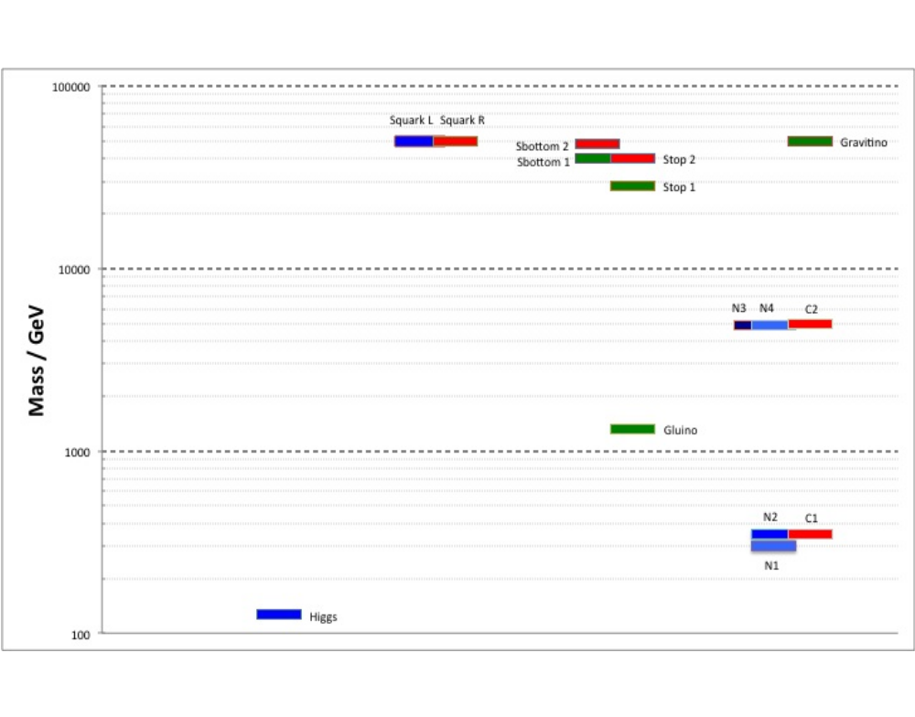
50 TeV
SPPC
1 TeV
LHC
Generic M theory spectrum

Slide 27
Lighter, enters propagator to 4th power
Gluino decays tbar (or bbar)
4 tops (or bbbb, or btbt) gluino stop top or b favored for gluino pair!
stop → enhanced 3rd family decays, about factor 2
N1 or N2 (→ C1+W* ) or C1 (over half of gluinos)
Gluino lifetime ∼ 10^{—19} sec, decays in beam pipe
Gluino decays flavor-violating
Papers LHC14,0901.3367; LHC7, 1106.1963
(or sbottom)

Slide 28
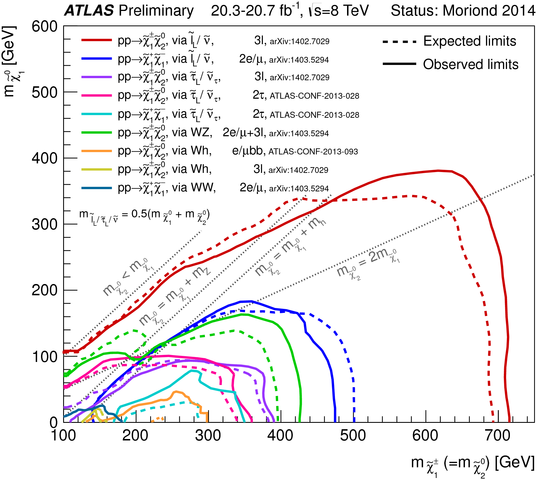
Scalar mediation

Slide 29
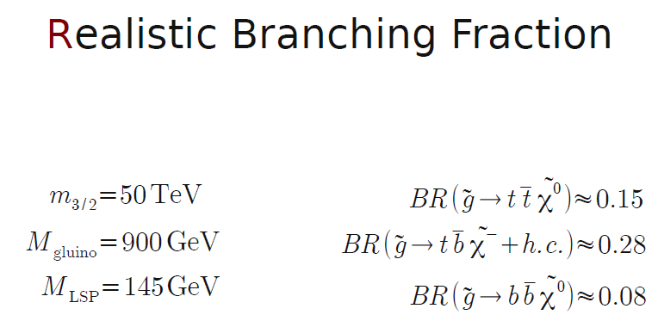
So BR (third family)  ½,
BR (1st + 2nd families  ½) per gluino

Slide 30
Suppose scalars indeed heavy, and gluino ∼ 1 TeV, and 3 light EWinos, and 3 heavier EWinos ∼ µ
What can be observed where? Example:
M_{3/2} = 30 TeV, 50 TeV pp collider, 3000 fb⁻¹
[Acharya, Krzysiek Bozek, Chakrit Pongitivanichkul, Kazuki Sakuraid, Sebastian Ellis, C-P Yuan]
stop1 ∼ 15 TeV, 1st and 2nd family squarks =30 TeV
µ=1TeV , gluino about 1.1 TeV, many gluinos at LHC
N_{i} = 194, 385, 1234, 1237 GeV C_{i} = 385, 1238 GeV
LHC: C1C1+N2C1 10⁵ , but C2N3+C2N4+C2C2 ∼ 0, stop ∼ 0
LHC magnets in 80 km tunnel → 60 TeV collider:
C1C1+N2C1 ∼ 10⁶ , N3,N4,C2  10⁴ , stop+gluino∼few C-P Yuan
Note BR(N2→ h N1) ≈ 1; BR(stop1 → top + gluino) ≈ 0.7C
Notes:
2C1

Slide 31
Naturalness? Fine-tuning? Little hierarchy? Of course compactified string theory is natural
M/String theory: ---------- M_{pl} ∼ 10¹⁸ GeV
susy (chiral fermion, gaugino condensation∼10¹⁴GeV)
---------- M_{3/2}  30-60 TeV
TeV ------------M_{gluino}
------------M_{chargino, neutralino}
Radiative EWSB
String theory gaugino suppression

Slide 33
String/M theory crucial for deriving Higgs results!
-- Must have theory with stabilized moduli and spontaneous supersymmetry breaking – compactified string theories
-- Must derive soft terms, otherwise could choose anything – e.g. large trilinears important, but people in past guessed they were small – string theory gave prediction of large trilinears
-- Must have µ embedded in string theory
-- Must exhibit string solutions with REWSB
-- Must have effectively no parameters
-- No R symmetry , since trilinears heavy and gauginos light

Slide 34
String theory too important to leave to string theorists
string/M-Theory maturing into useful predictive framework that relates many explanations and tests
Testing string/M-Theory means testing compactified theories and is underway – some tests already, lots of predictions to test
The opposite of “natural” is having a theory
Higgs mass and decays predicted
-- Higgs looks like what is expected from compactified M-theory with stabilized moduli – 126 GeV NOT unnatural or weird – not metastable vacuum
μ, tanβ included in theory, correlated with M_{h}
LHC – gluinos but not squarks
-- gluinos have enhanced 3rd family decays
-- gluino cross section tests spin ½, expected for superpartner
-- two light neutralinos and light chargino also probably observable
B_{s} → μμ and (g_{μ} -2) should deviate only a few % from SM values

Slide 35


Slide 36
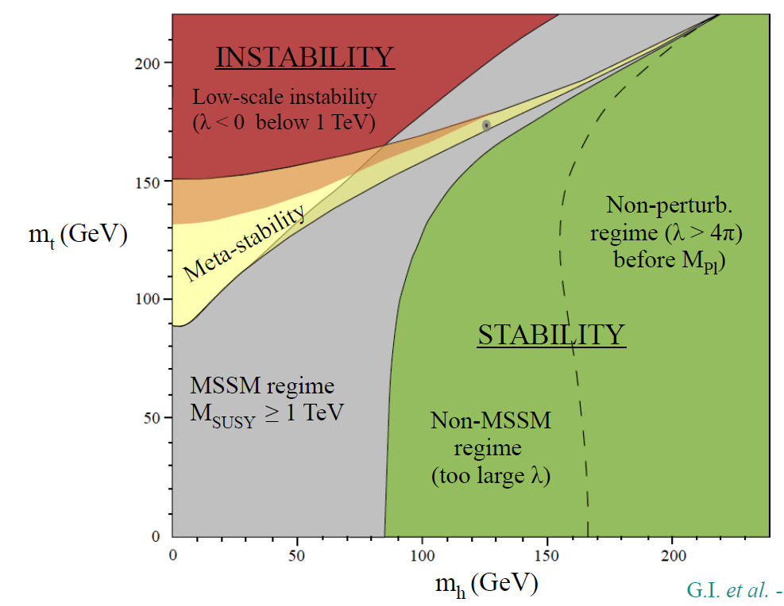
Supersymmetry automatically gives vacuum stability!
G. Isidori et al, susy 2013

Slide 37
Next briefly compare M-theory derivation with models assuming heavy scalars – first James Wells hep-th/0302127, Nelson et al
Very different
History very distorted, even recently

Slide 38
SPLIT SUSY (ETC) MODELS
Compactified
COMPACTIFIED(STRING)M THEORY
Derive solution to large hierarchy problem
Generic solutions with EWSB derived
main F term drops out of gaugino masses so dynamically suppressed
Trilinears > M_{3/2} necessarily
µ incorporated in theory (M-theory)
Little hierarchy significantly reduced
Scalars = M_{3/2} ∼ 50 TeV necessarily , scalars not very heavy
Gluino lifetime  10⁻¹⁹ sec, decay in beam pipe
M_{h} 126 GeV unavoidable, predicted
Assumes no solution (possible) for large hierarchy problem
EWSB assumed, not derived
Gauginos suppressed by assumed R-symmetry, suppression arbitrary
Trilinears small, suppressed compared to scalars
µ not in theory at all; guessed to be µ ∼M_{3/2}
No solution to little hierarchy
Scalars assumed very heavy, whatever you want, e.g. 10¹⁰ GeV
Long lived gluino, perhaps meters or more
Any M_{h} allowed

Slide 39
Approach to little hierarchy problem:

Slide 40
LITTLE HIERARCHY PROBLEM – NEW APPROACH
Running of M²_{Hu} in string/M theory [arXiv:1105.3765 Feldman, GK, Kuflik, Lu]
M²_{Hu} (t)  f_{M} (t) M²₀ – f_{A} (t) A²₀ A₀ > M₀= M_{3/2}  50 TeV
So stringy prediction is a decrease  50 in M²_{Hu} – if trilinears not large get order of magnitude less decrease in M²_{Hu}
Greatly reduces “little hierarchy problem” – covers gap from M_{3/2} to TeV
Compactified M theory → A₀ > M₀
f_{M} , f_{A} calculated from SM inputs, both about 0.12-0.13

Slide 41
