Slide 1
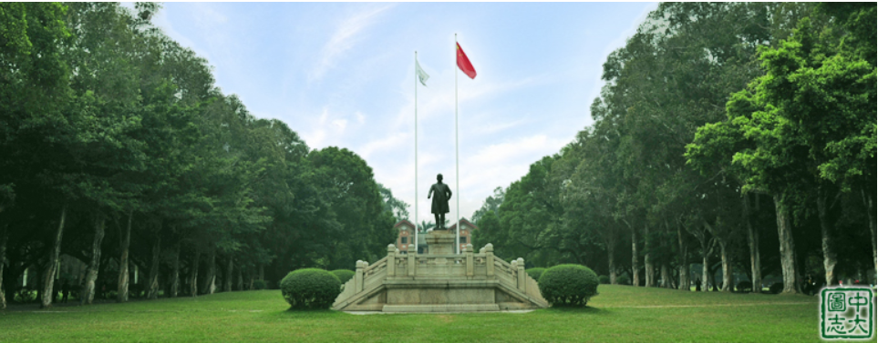
9th Workshop on TeV Physics
May 15-18,2014 SUN YAT-SEN UNIVERSITY
Notes:
Good morning, Ladys and Gentalmen,
Welcome to SunYatSen University to take part the TeV Physics workshop
Before we start this morning session, we first have a short opening.
Let us first invite professor Miao Li to give the Welcome address on behalf of the hosts. Locally, Miao Li now is the chairman of school of astronomy and space science.
Thanks for LiMiao, then I will say some words on behalf of the convenor of TeV working Group of China.

Slide 2
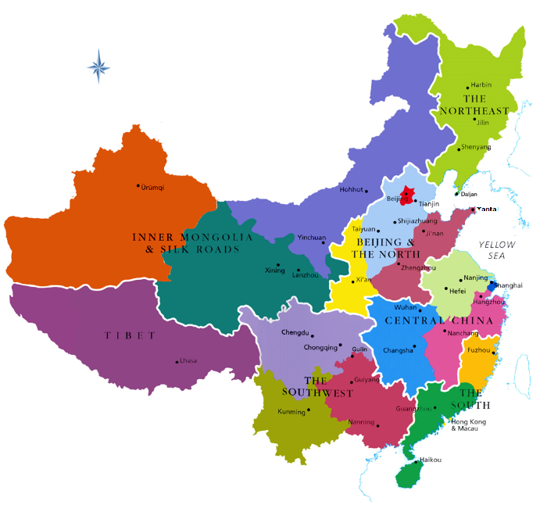

2005,1st; 2010,5th; 2012,7th THU
2009,4th Nankai
2007,2nd; 2013,8th LNNU
2008,3rd SDU
2011,6th USTC
2014,9th SYSU
Notes:
First this workshop is the annual meeting of TeV working group of China. And this workshop starts from 2005, this is already 9th workshops. Here I list all eight workshops before. We in Beijing in Tsinghua University have 1st 5th and 7th workshops; while in LiaoNing normal university at Dalian in Liaoning province, we have 2nd and 8th workshops; then in Shandong university in Yantai of Shandong province, we have 3rd workshop; in Nankai university in Tianjin, we have 4th workshop; in university of science of technology of china in Hefei of Anhui province, we have 6th workshop.
You see that this is the first time that this workshop is held in southern part of china. Guangzhou is the Capital city of GuanDong province, and since Guangdong is the home province of Professor Kuang, he is very much wanted to take part this workshop and made a lot preparations, unfortunately, his heath now not allow him to come, so he asked me represent him to read some opening words for this workshop.

Slide 3

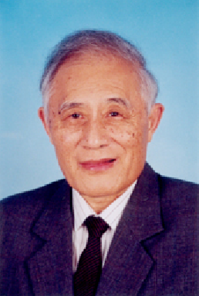





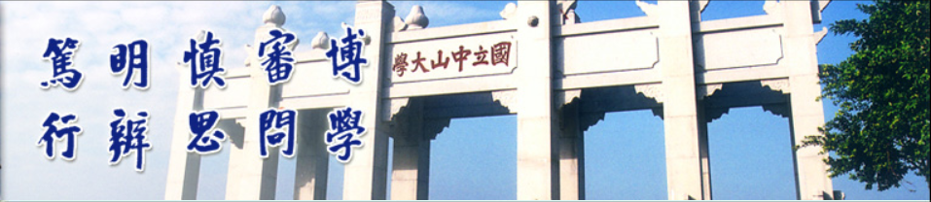
Openning Speech
Yu-Ping Kuang

Slide 4
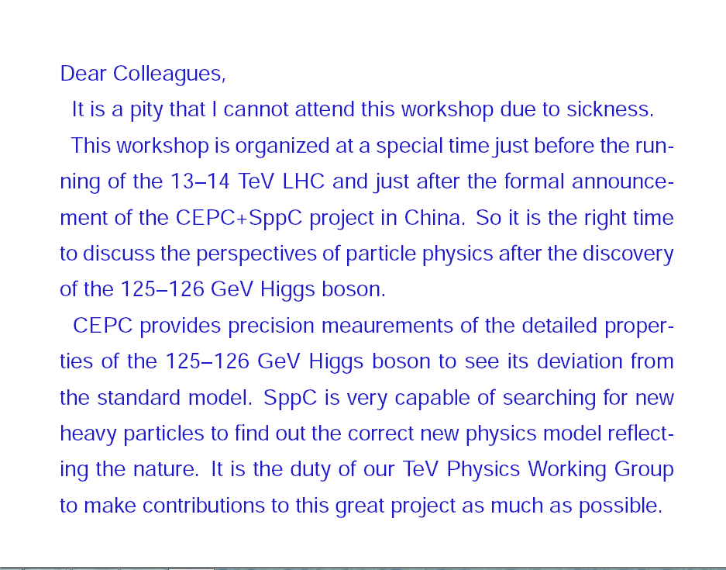
ISHP2013, Beijing, 16-8-2013 P Jenni, Freiburg and CERN
HE Frontier, European Strategy

Slide 5
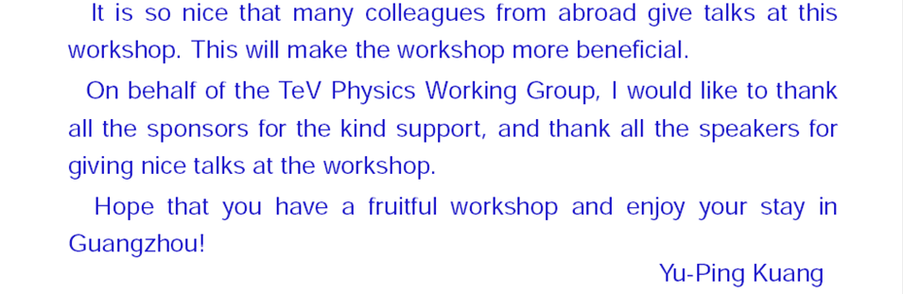
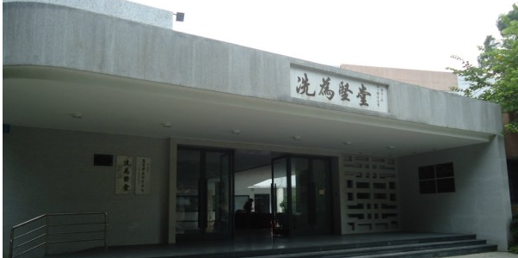

Notes:
OK, we finish this short opening.
Now we start the morning session. The original chairman professor Hongjian He is also ill and cannot come, so I represent him to chair the first session.

