Slide 1
Threshold resummation for top pair associated W boson production at Hardron Colliders
Hai Tai Li
Institute of Theoretical Physics , Peking University
In collaboration With C. S. Li, S. A. Li
2014 TeV workshop, Sun Yat-sen University, Guang Zhou
May 16 2014

Slide 2
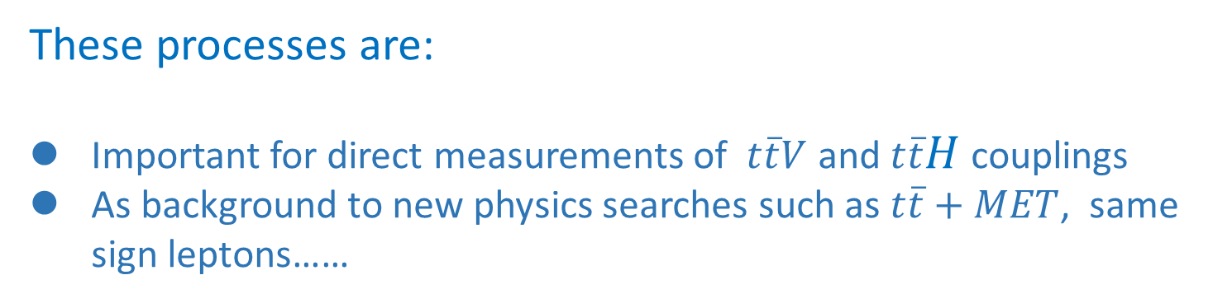

Associated top quark pair production
$t\overline{t}$ associated production production: $\begin{matrix}t\overline{t} Z & t\overline{t}W \\ t\overline{t}H & t\overline{t}γ\end{matrix}$
These processes are:
Important for direct measurements of $t\overline{t}V$ and $t\overline{t}H$ couplings
As background to new physics searches such as $t\overline{t}+MET$, same sign leptons……
In this talk, we concentrate on the production of $t\overline{t} W$ .

Slide 3
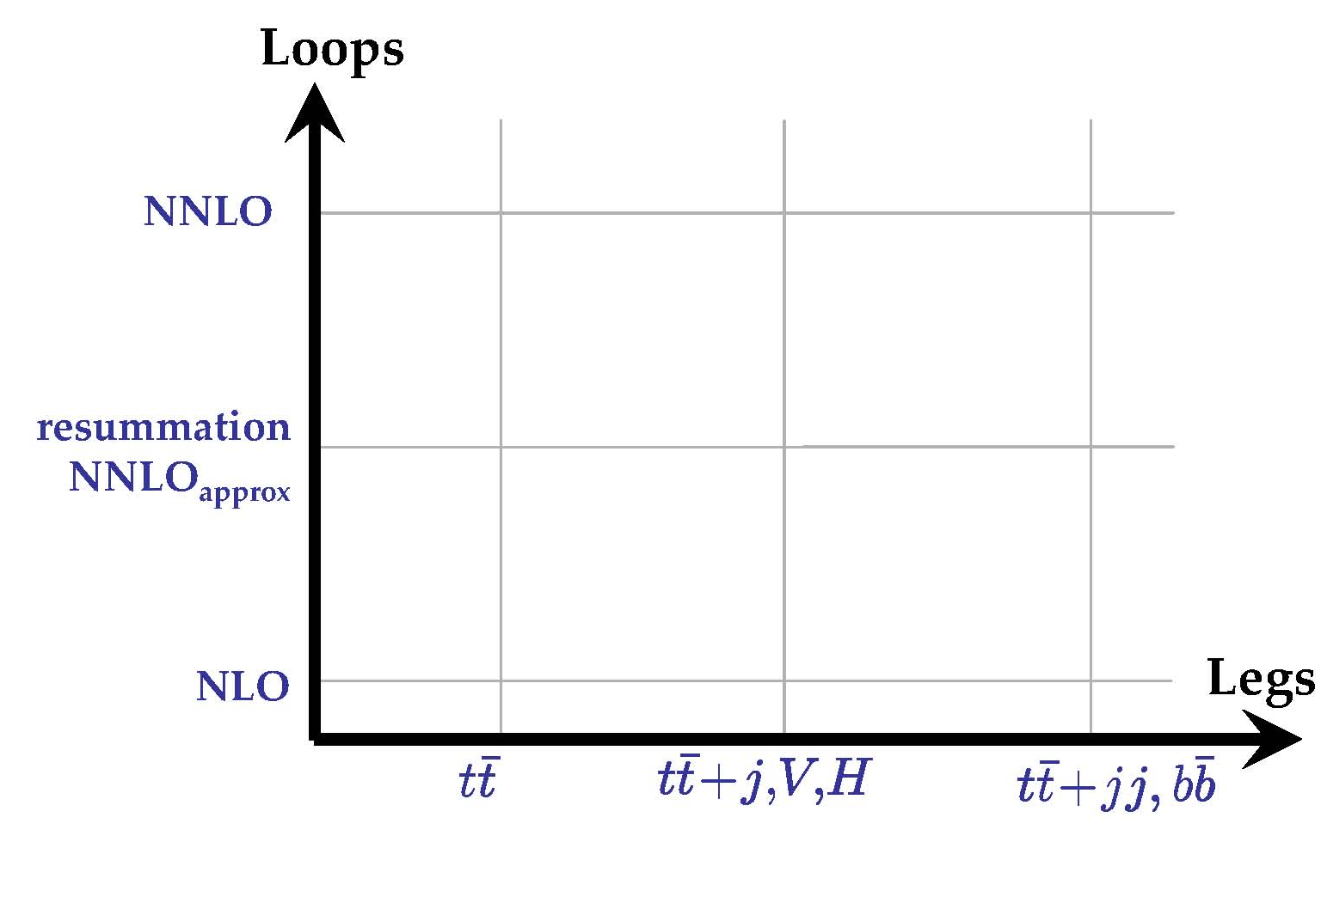
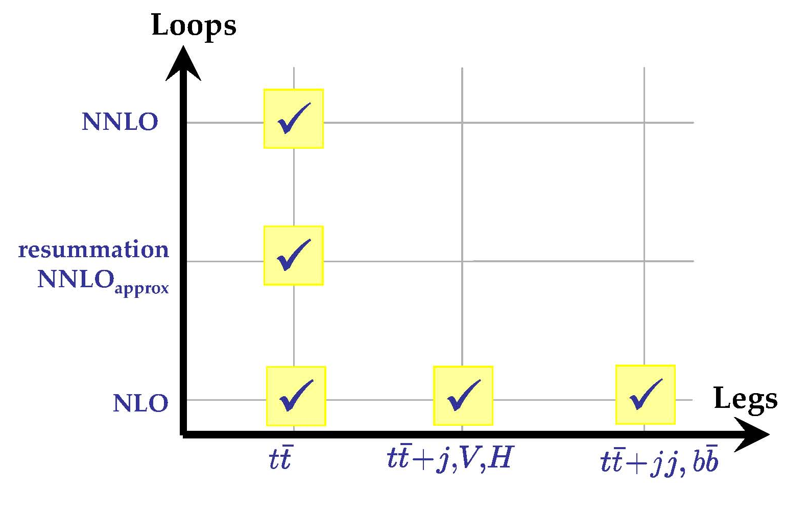
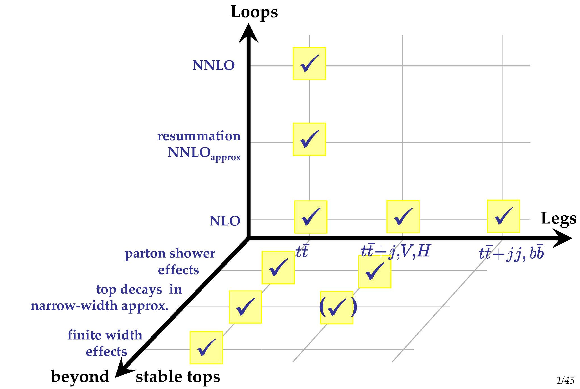

Associated top quark pair production

Slide 4
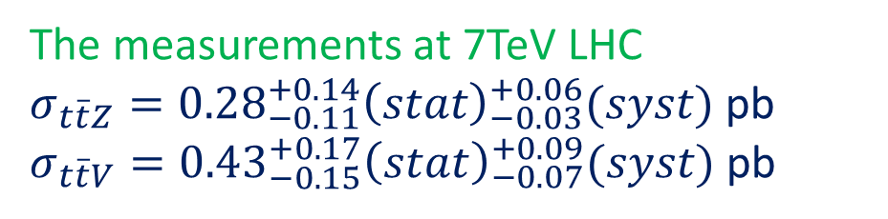
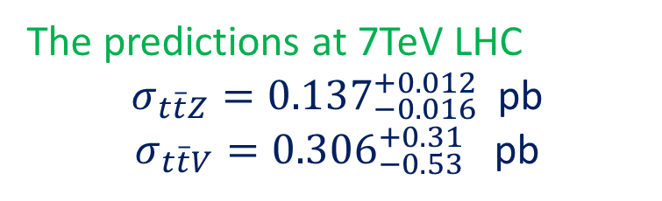

The measurement of $t\overline{t}V$ production
Performed by a trilepton analysis of ttZ events and a same-sign dilepton analysis of ttV events
The measurements at 7TeV LHC
$σ_{t\overline{t}Z}={0.28}_{−0.11}^{+0.14}{\left(stat\right)}_{−0.03}^{+0.06}(syst)$ pb
$σ_{t\overline{t}V}={0.43}_{−0.15}^{+0.17}{\left(stat\right)}_{−0.07}^{+0.09}(syst)$ pb
The predictions at 7TeV LHC
$σ_{t\overline{t}Z}={0.137}_{−0.016}^{+0.012}$ pb
$σ_{t\overline{t}V}={0.306}_{−0.53}^{+0.31}$ pb
CMS Collaboration 2013
Current events samples are small and the LHC will produce sufficiently large samples in the future.

Slide 5
Fixed order results
The total cross section, V.Hrischi, et al. 2011
Production and decay at NLO, J.M Campbel etal. 2012
The total cross section for $\overline{t}t W^{±}$ production

Slide 6

How to improve the predictions
Theroetical results
LO
NLO
NNLO
NNNLO
$$σ=σ_{0}[1 +{ α}_{s}L^{2} + α_{s}^{2}{ L}^{4} + α_{s}^{3} L^{6} + …$$
$+ α_{s}L +{ α}_{s}^{2} L^{3} + α_{s}^{3} L^{5} + …$
$+{ α}_{s} + α_{s}^{2}L^{2} + α_{s}^{3}L^{4} + …$
$+ α_{s}^{2}L + α_{s}^{3}L^{3} + …$
$+{ α}_{s}^{2} +{ α}_{s}^{3}L^{2} +…$
$+ α_{s}^{3}L +… ]$
LL
NLL
NNLL
NNNLL
…
The Logarithmical enhancement comes from:
logarithms of ultra-violet (UV) origin
logarithms of collinear origin
logarithms of soft origin

Slide 7

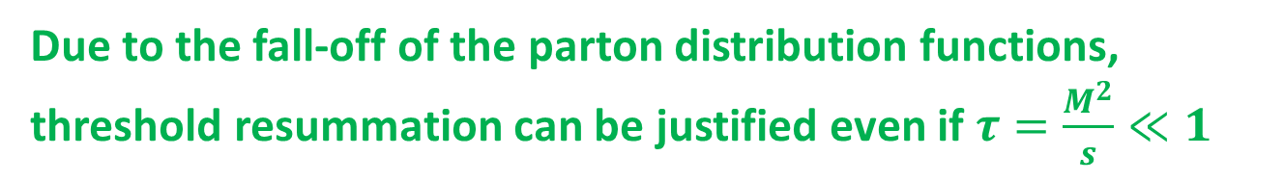
What are going to be resummed
Threshold definition: $\hat{s}=x_{1}x_{2}s≥M^{2}$ , $z=\frac{M^{2}}{\hat{s}}→1$
the invariant mass of top pair and W
In this case real gluon emission is soft.
Large logarithms: $α_{s}^{n} \frac{\ln^{2n−1}{(1−z})}{1−z}$
Due to the fall-off of the parton distribution functions, threshold resummation can be justified even if $τ=\frac{M^{2}}{s}≪1$

Slide 8



Factorization Formulla
$$μ_{h}$$
The partonic corss section is
$$μ$$
The RG equarions
$$μ_{s}$$

Slide 9
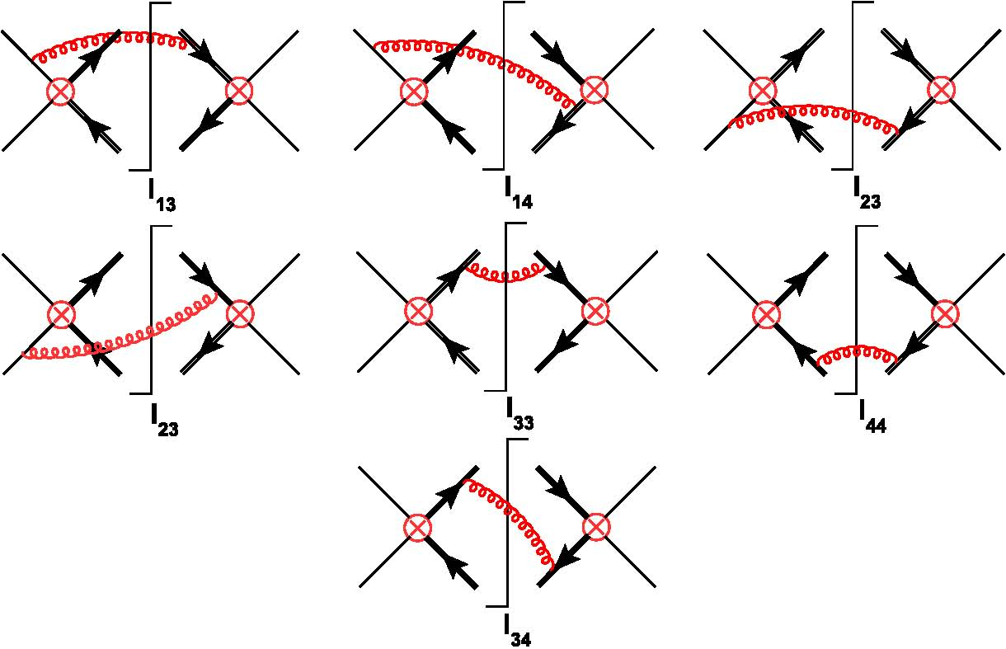
The Soft Fucntions

Slide 10

How to obtain the Hard Fucntions
The virtual corrections can be generated by MadLoop (V.Hrischi, et al. 2011 ), where ‘t hooft Velteman dimensional regularization scheme was adopted.
However, the results in conventional regularization scheme are needed
Kunszt et al, 1993
‘t hooft Velteman dimensional regularization
conventional regularization scheme
Comparing $d\hat{σ}$ in ‘t hooft Velteman scheme to that in the conventional scheme, only the ${\tilde{p}}^{′}$ functions are diﬀerent.

Slide 11
How to Check Hard Fucntions
The Divergence in the hard functions
The scale dependence terms in the Hard fucntion

Slide 12
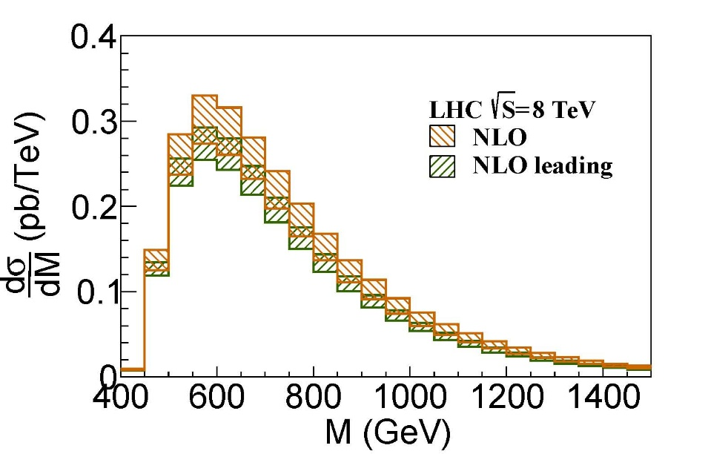
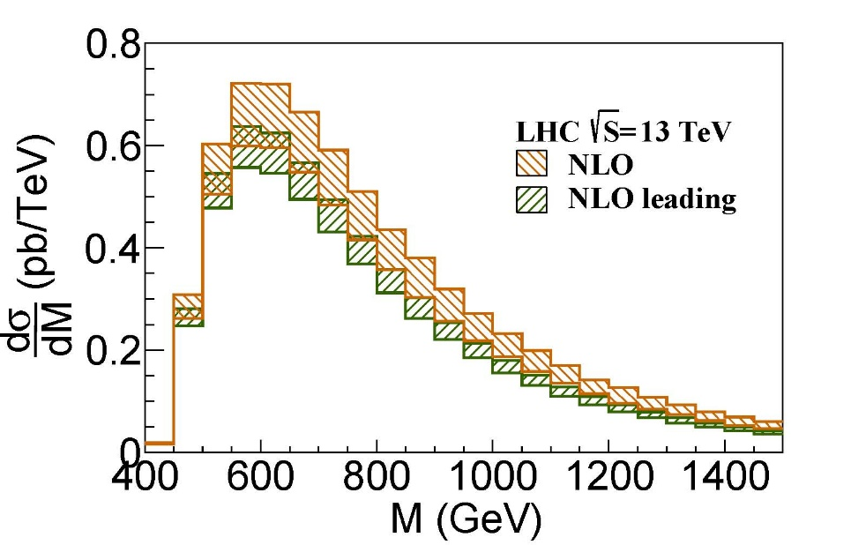

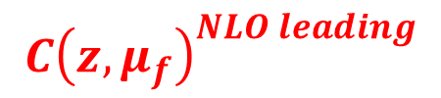
Expansion to fixed order
Resumed hard-scattering kernels is
Set $μ_{h}=μ_{s}=μ_{f}$
$$C{\left(z,μ_{f}\right)}^{NLO leading}$$

Slide 13
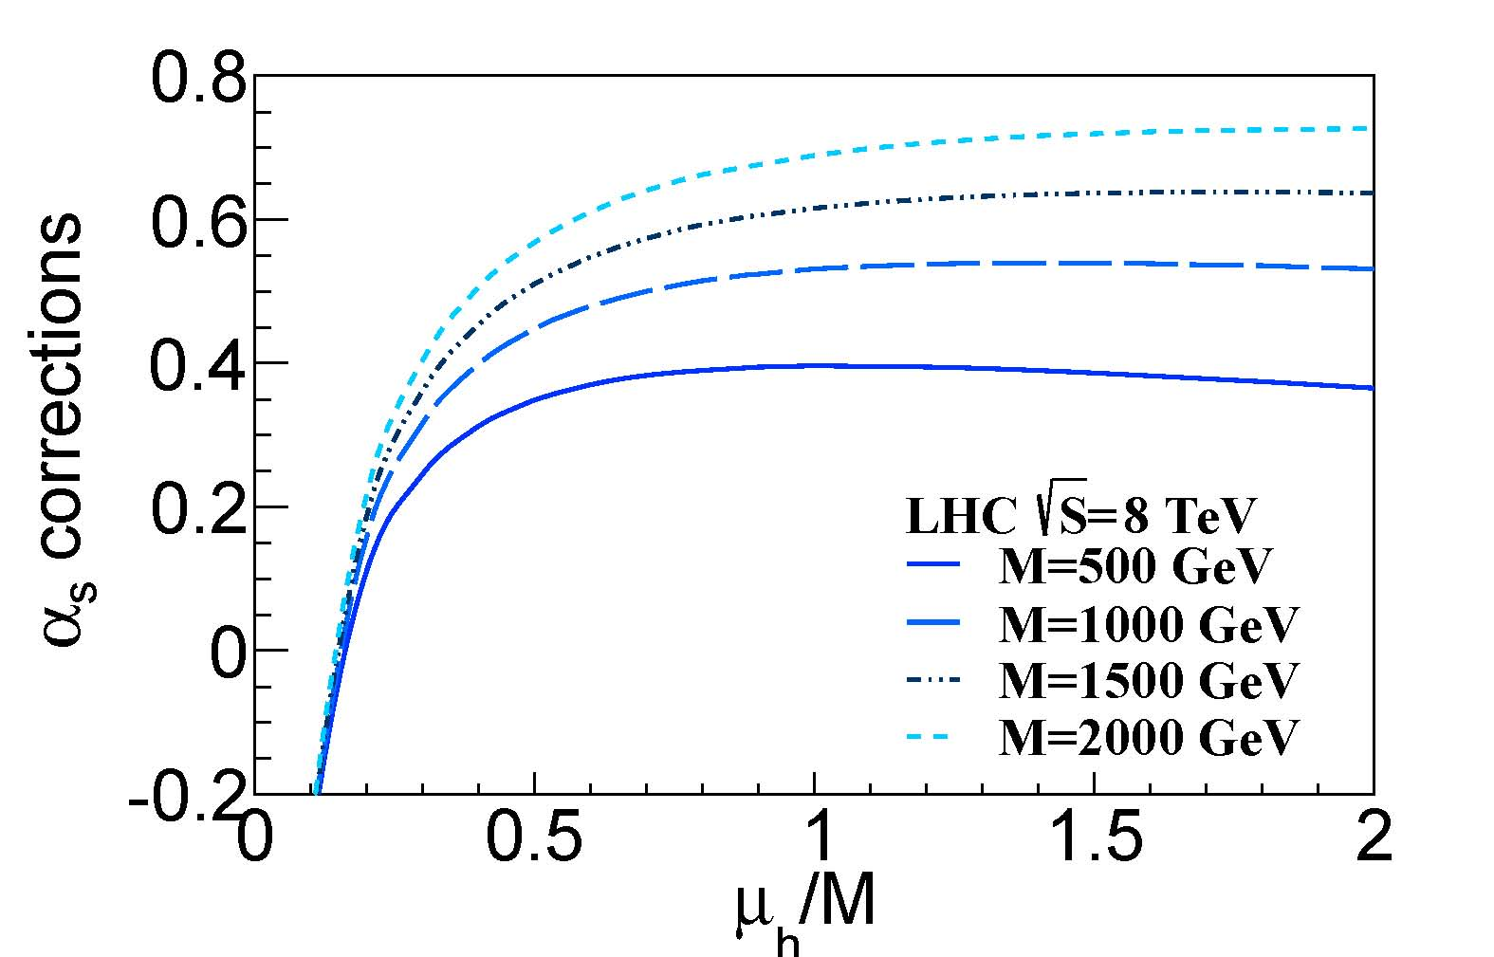
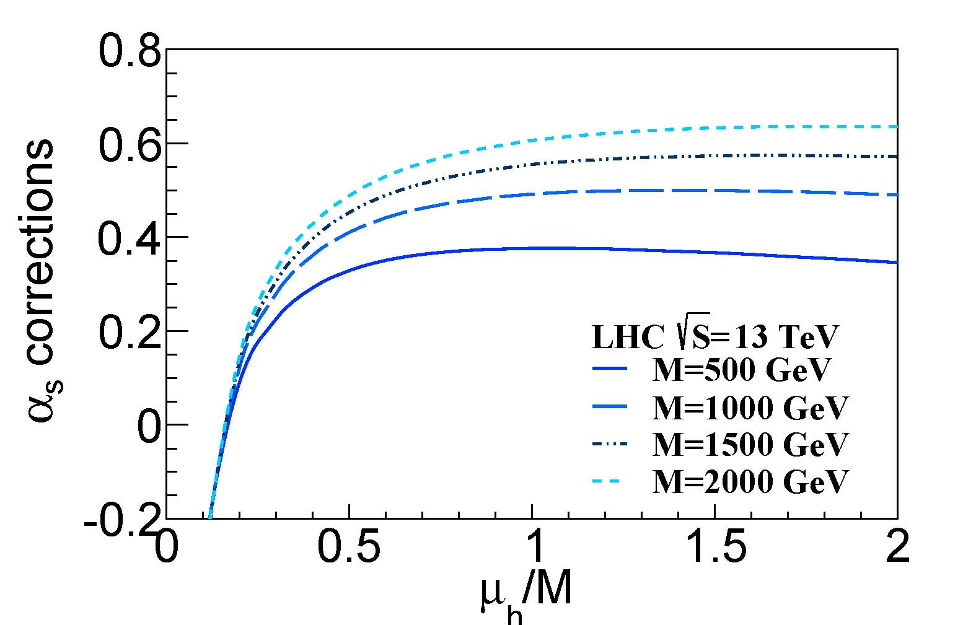

The Scale Settings
The results are more stable in the range $\frac{M}{2}<μ_{h}<2M$.
We set the default hard scale at $μ_{h}=M$.

Slide 14
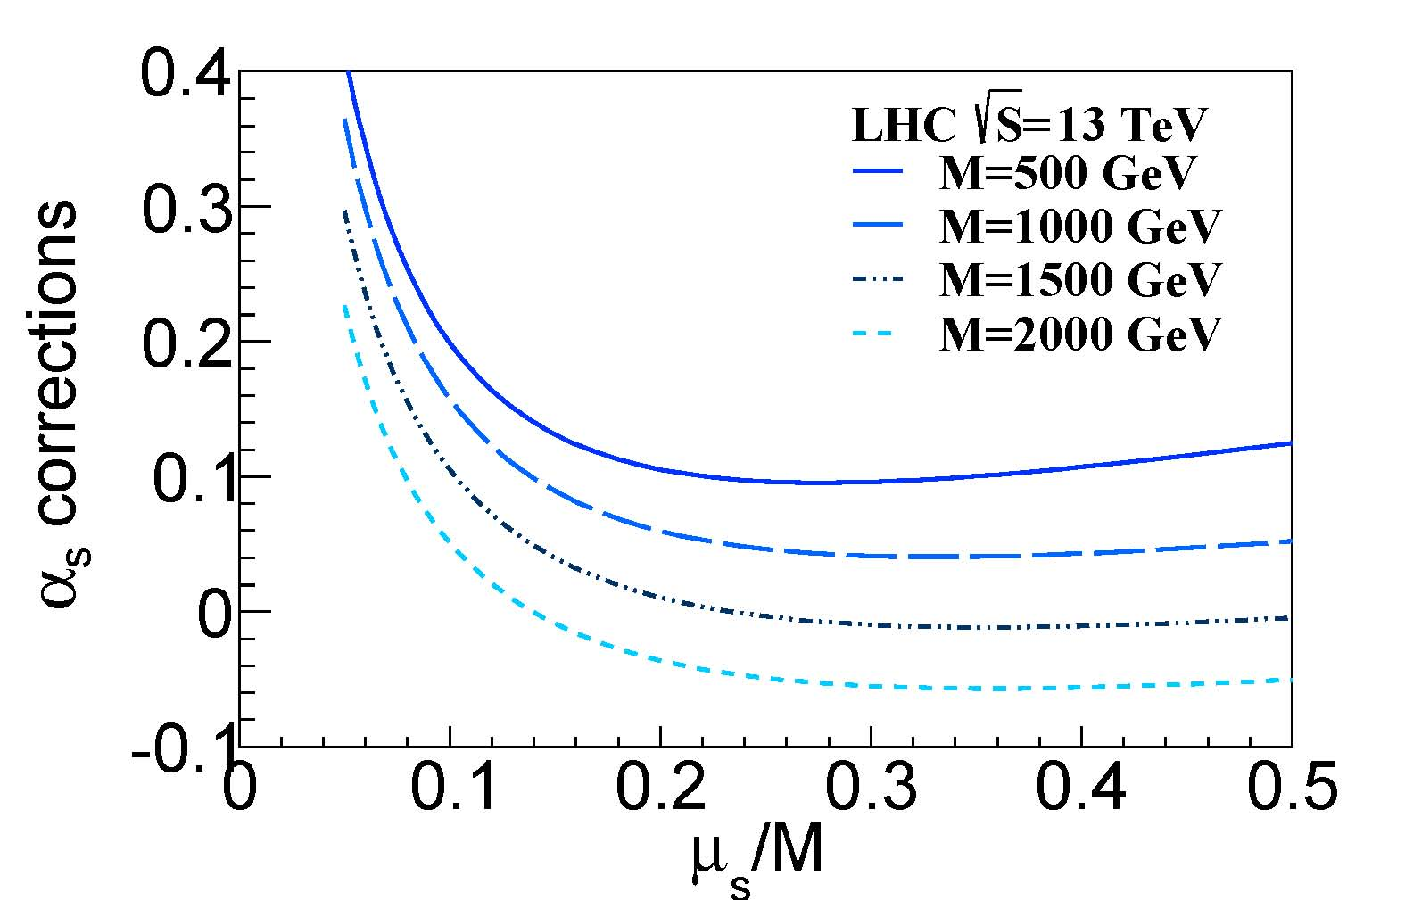
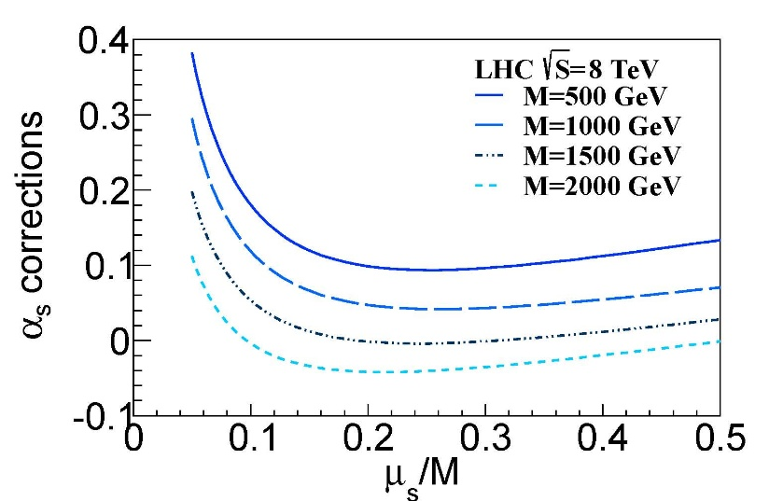
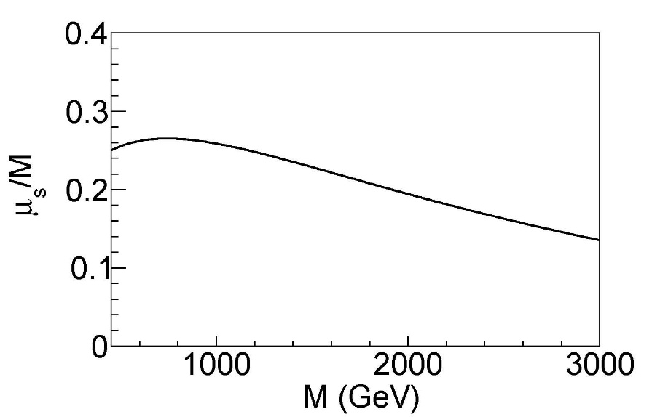
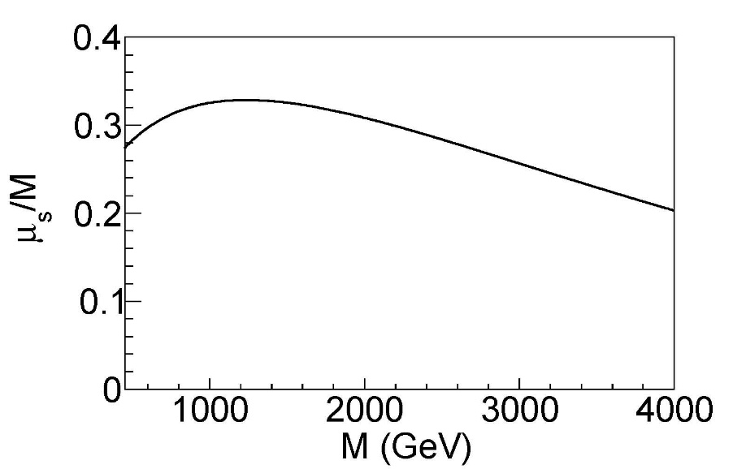
The Scale Settings
We set the scale at the exact position where one-loop correction is minimal

Slide 15
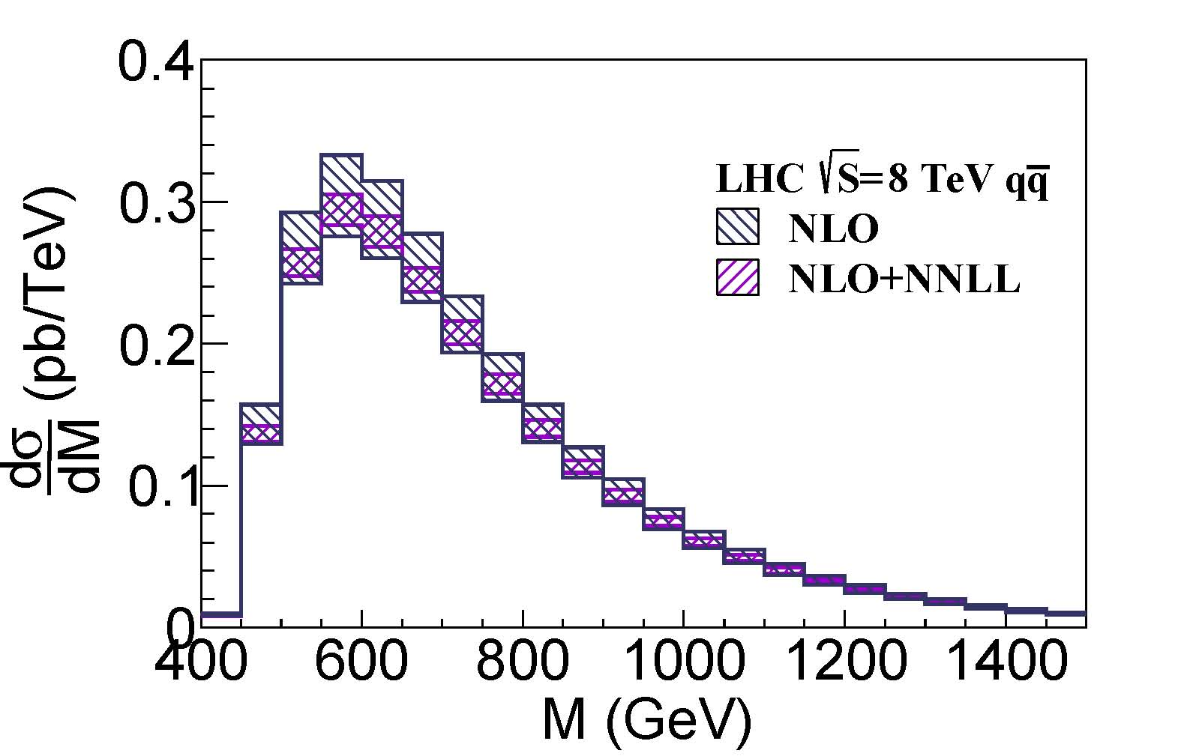
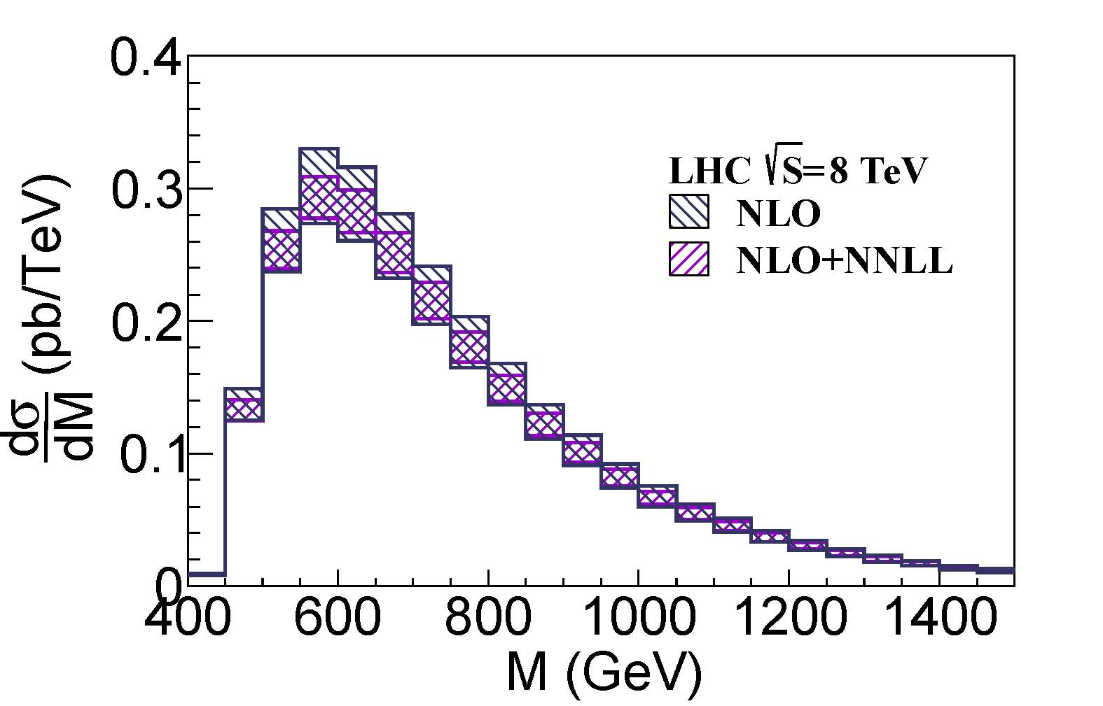
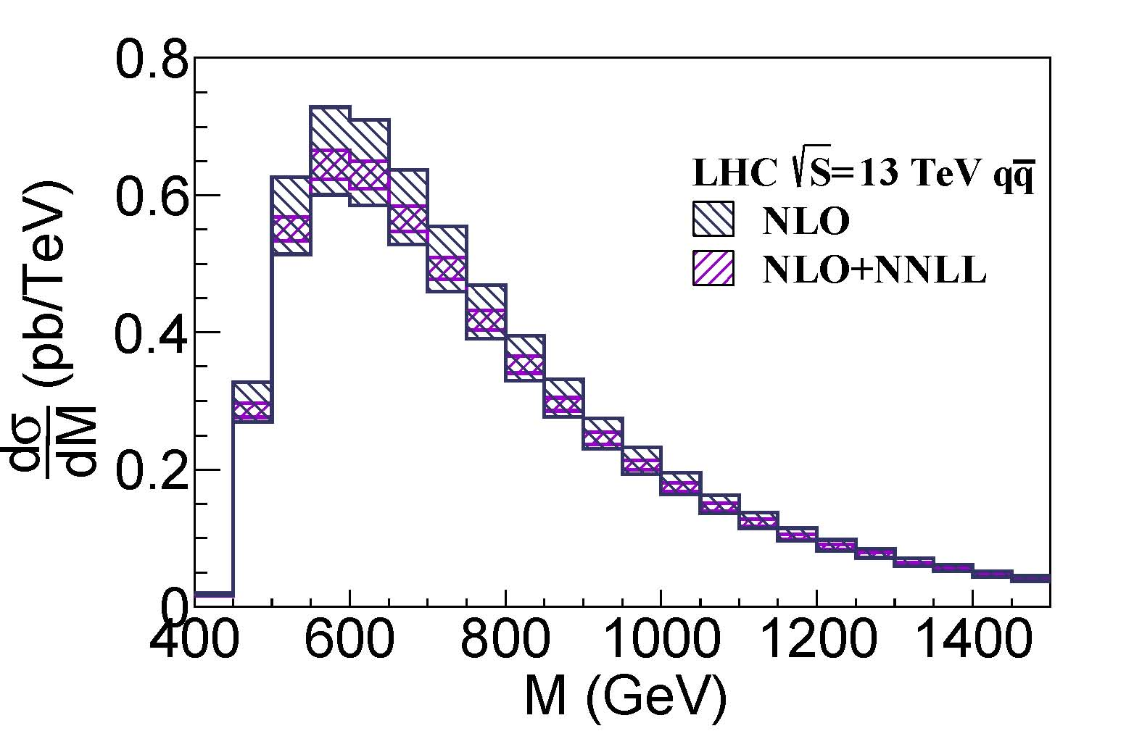
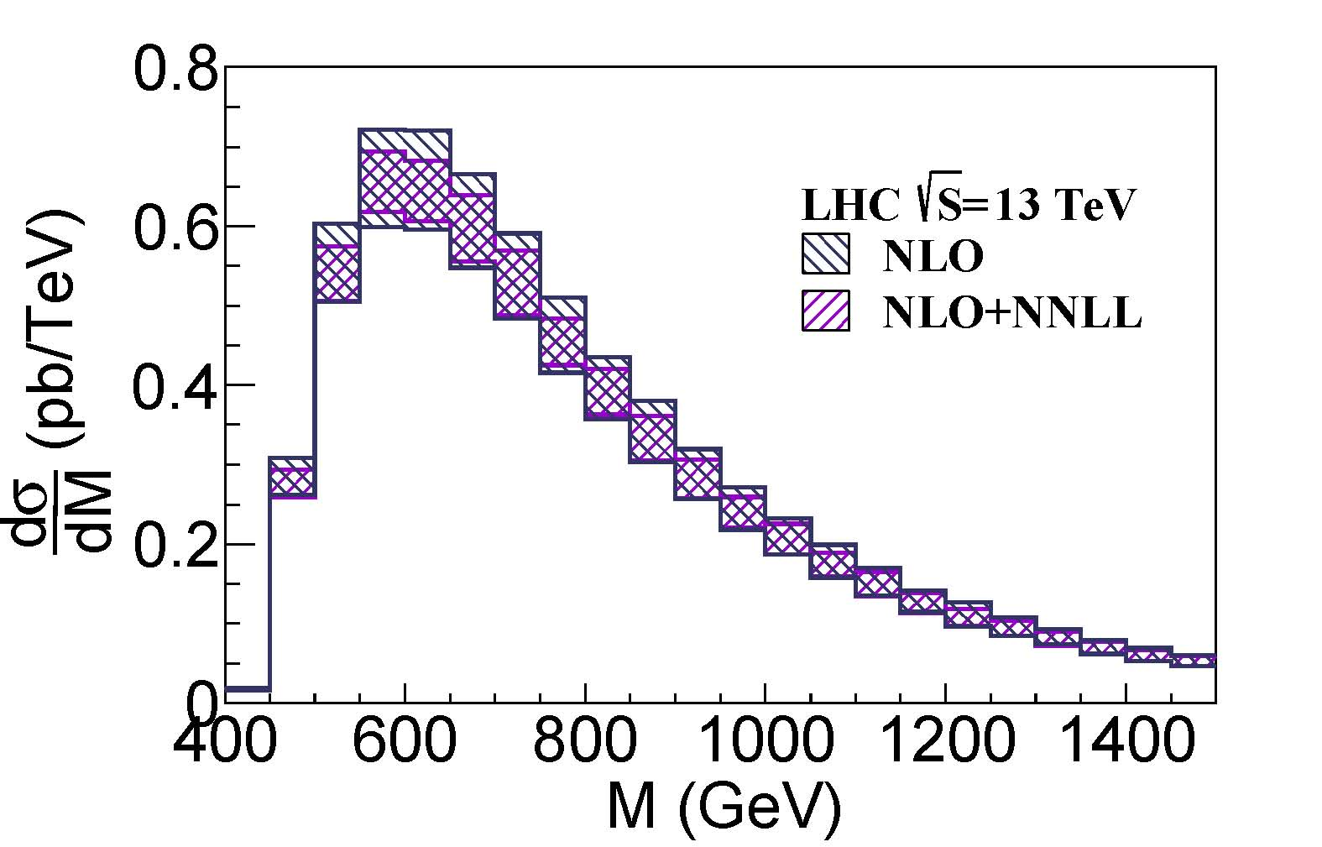
The resummation results
The NNLL distributions for the invariant mass of top pair and W boson

Slide 16

The resummation results
Total Cross section for $t\overline{t}W^{+}$ production
Total Cross section for $t\overline{t}W^{−}$ production

Slide 17
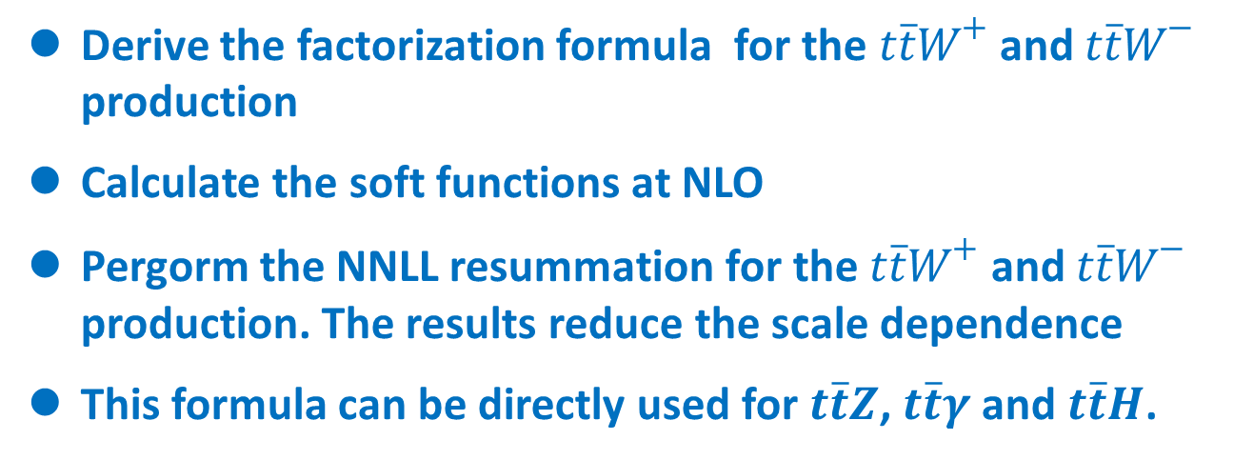
Summary and OutLook
Derive the factorization formula for the $t\overline{t}W^{+}$ and $t\overline{t}W^{−}$ production
Calculate the soft functions at NLO
Pergorm the NNLL resummation for the $t\overline{t}W^{+}$ and $t\overline{t}W^{−}$ production. The results reduce the scale dependence
This formula can be directly used for $t\overline{t}Z$, $t\overline{t}γ$ and $t\overline{t}H$.

Slide 18
Thanks for your attention !

Slide 19
Back up

Slide 20
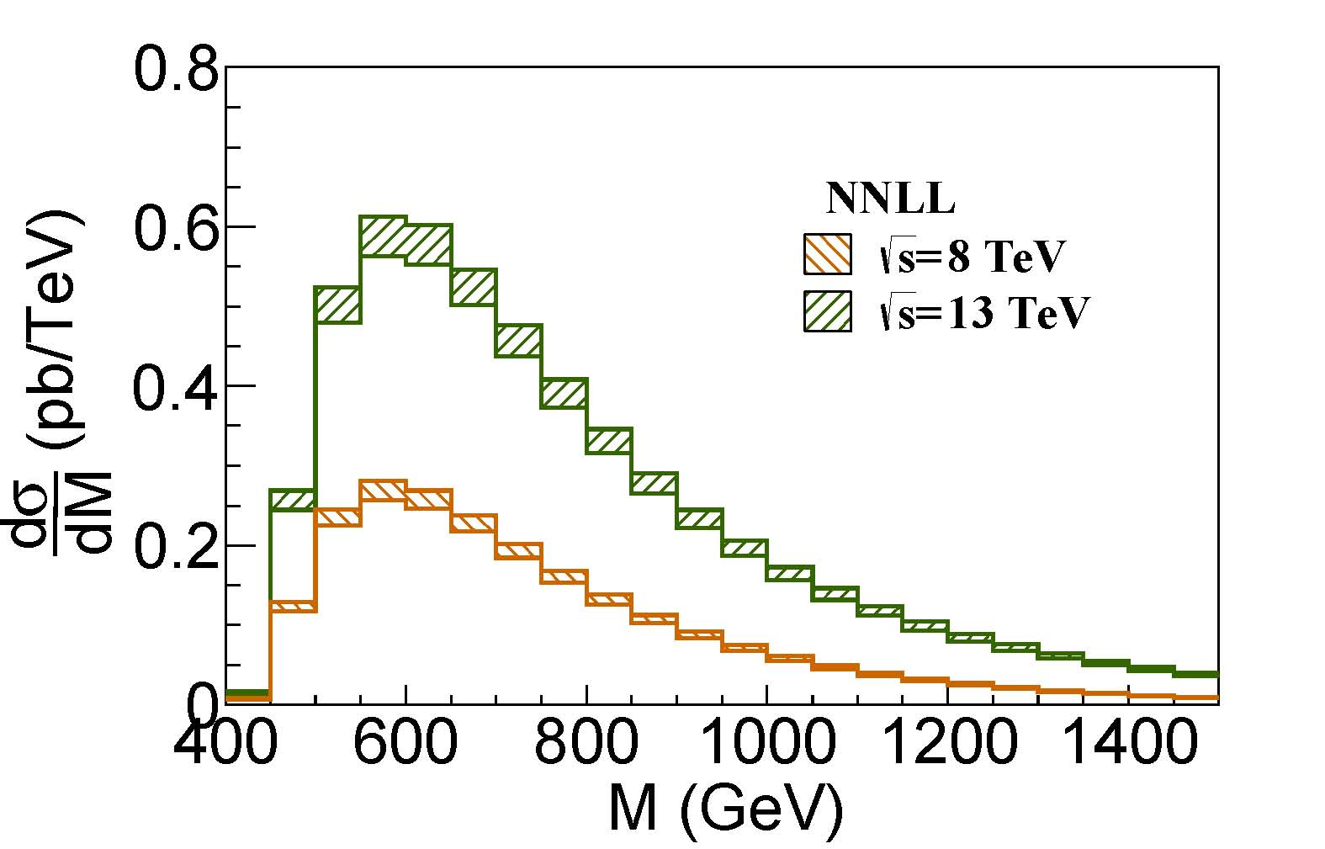

Slide 21

$$t\overline{t}W^{+}$$
Power corrections 8TeV LHC
muf | 1 | 2 | 0.5
qqb channel | 8.67 | 8.69 | 7.7
tota | 12.23 | 9.56 | 16.00
Power corrections 13TeV LHC
muf | 1 | 2 | 0.5
qqb channel | 21.66 | 22.85 | 17.4
tota | 45.28 | 34.38 | 60.89

