Slide 1

Threshold Resummation for Electroweak Gauge Boson Pair at the LHC
Yan Wang
Institute of Theoretical Physics, PKU
In collaboration with
Chong Sheng Li, Ze Long Liu, Ding Yu Shao
2014 Sun Yat-sen University
2014-05-16

Slide 2
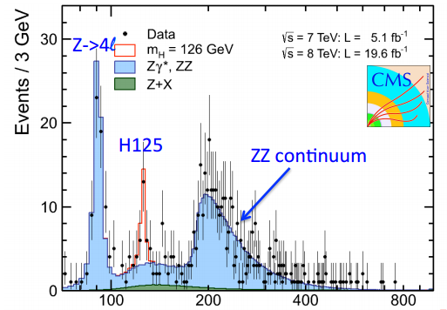
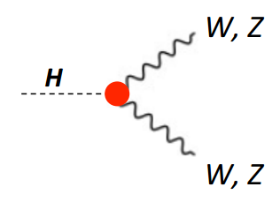
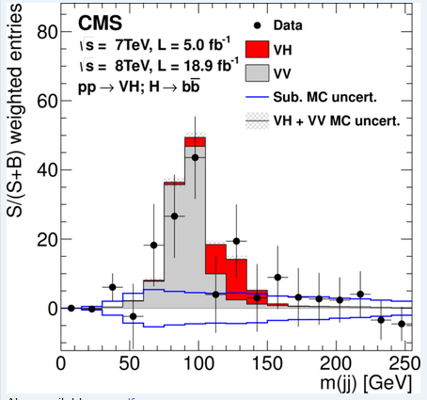
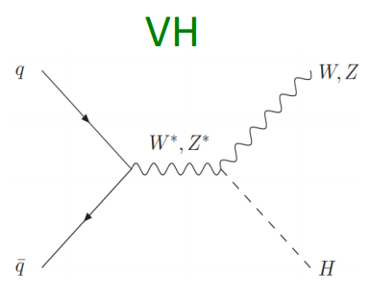
Background for the Higgs boson
arXiv:1310.3687 (hep-ex)

Slide 3
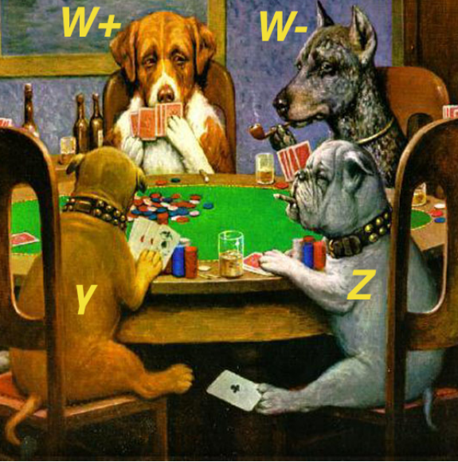
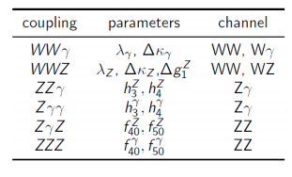
Anomalous Triple Gauge couplings
aTGC in effective Lagrangian

Slide 4
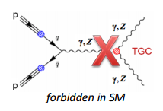
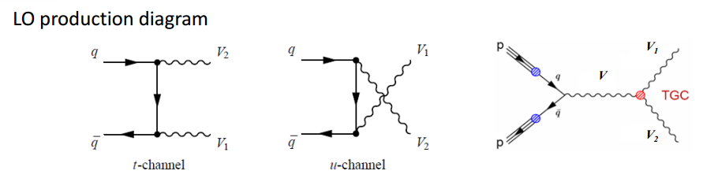
Anomalous Triple Gauge couplings
In SM no neutral TGC vertex.
Forbidden
Charged TGC vertex $λ_{γ}=λ_{Z}=0, g_{z}^{1}=κ_{γ}=κ_{Z}=1.$

Slide 5
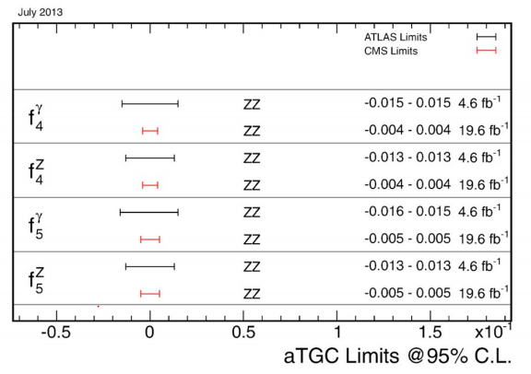
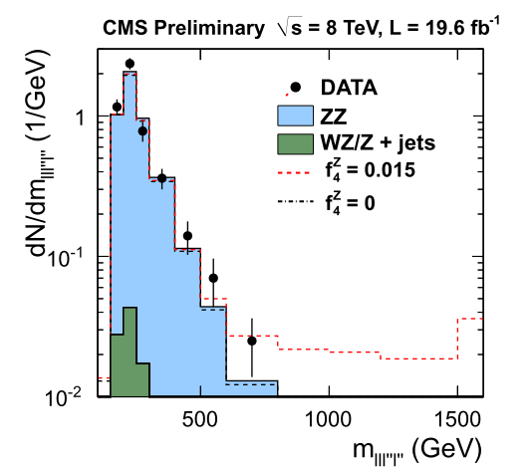


Anomalous Triple Gauge couplings
At interesting region
Loops contribute: ${10}^{−4}$
Some New physics : ${10}^{−3}$
aTGC effects:
increase cross sections at
high invariant mass ($M_{VV}$)
and its proxies: $p_{T}$

Slide 6
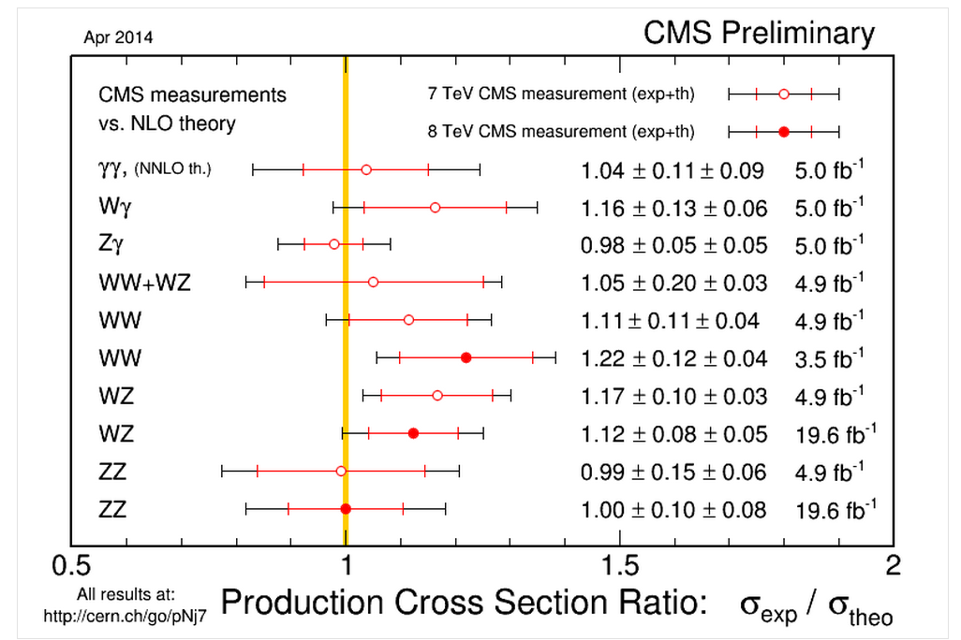
Diboson Experiments vs NLO predictions

Slide 7
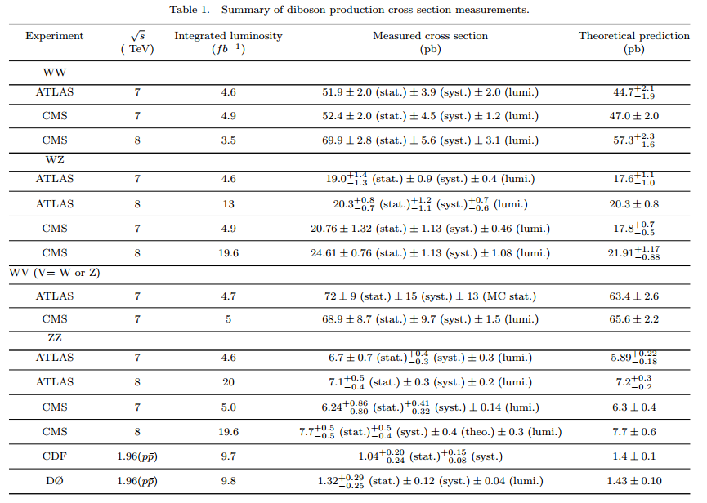
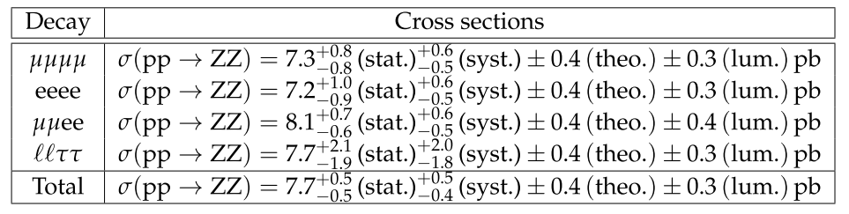

Slide 8
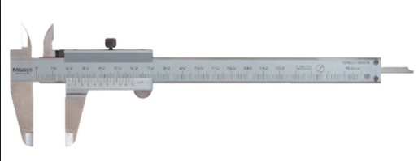
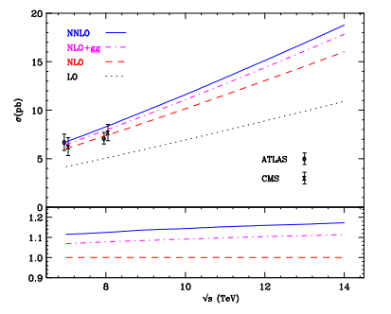
Master integral
T. Gehrmann, L. Tancredi And E. Weihs, JHEP 1308 (2013) 070
J. M. Henn, K. Melnikov And V. A. Smirnov, Arxiv:1402.7078
T. Gehrmann, A. Von Manteuﬀel, L. Tancredi And E. Weihs, Arxiv:1404.4853
F. Caola, J. M. Henn, K. Melnikov And V. A. Smirnov, Arxiv:1404.5590
ZZ NNLO
F. Cascioli, T. Gehrmann, M. Grazzini, Et.Al. Arxiv:1405.2219

Slide 9
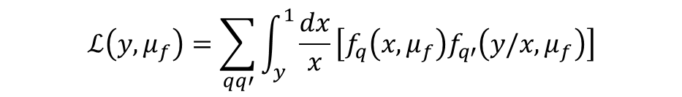
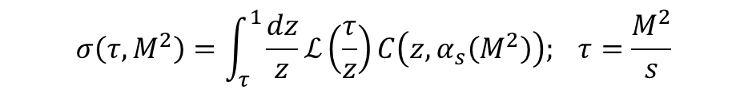
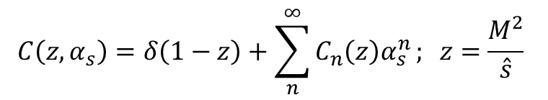
Why resummation
Generic observable in hadron collisions at energy $√s$:
$$σ\left(τ,M^{2}\right)=\int_{τ}^{1}{\frac{dz}{z}ℒ\left(\frac{τ}{z}\right)C\left(z,α_{s}\left(M^{2}\right)\right); τ=\frac{M^{2}}{s}}$$
Parton luminosity.
$$ℒ\left(y,μ_{f}\right)=\sum_{qq′}^{ }{\int_{y}^{1}{\frac{dx}{x}}\left[f_{q}\left(x,μ_{f}\right)f_{q′}\left(y/x,μ_{f}\right)\right]}$$
For the parton cross section $C(z,α_{s})$, it can be expanded as
$$C\left(z,α_{s}\right)=δ\left(1−z\right)+\sum_{n}^{∞}{C_{n}\left(z\right)α_{s}^{n}}; z=\frac{M^{2}}{\hat{s}}$$

Slide 10
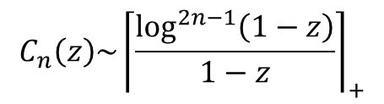
Why resummation
When s is close to $M^{2}$, $τ→1,$ since $z≥τ$ is also close to 1.
$$C_{n}\left(z\right)\sim {\left\lceil \frac{\log^{2n−1}\left(1−z\right)}{1−z}\right\rceil }_{+}$$
The perturbative expansion is unreliable in this region.
The effect of soft-gluon resummation can be relevant even relatively far from the hadronic threshold.
T. Becher, M. Neubert and G. Xu, JHEP 0807 (2008) 030
[arXiv:0710.0680 [hep-ph]]

Slide 11
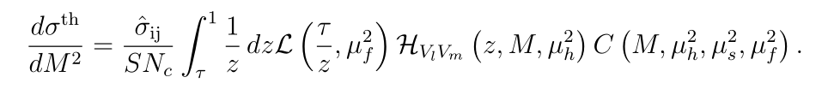
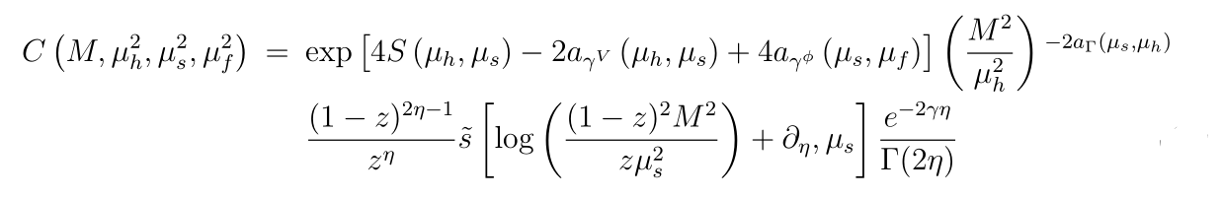



Factorization formulas
$$dσ\sim H(μ_{h})⋅S(μ_{s})⊗φ(μ_{f})$$
Expansion of the Hard function.
Define
$$η={2a}_{Γ} (μ_{s},μ_{f})$$

Slide 12
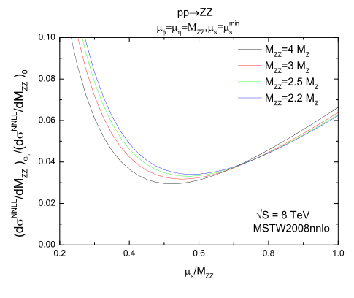
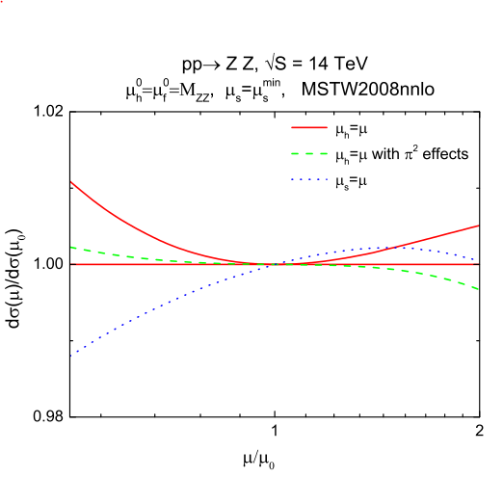
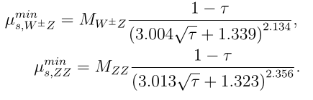
Determine soft scale
Soft & Hard scale dependence

Slide 13
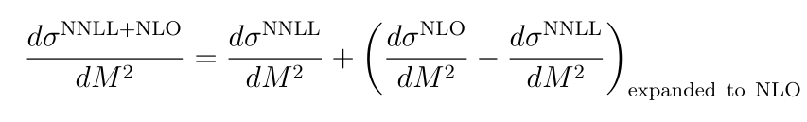
Factorization formulas
Including the nonsingular terms
Notes:
Then we should include the nonsingular terms up to NLO.
This is the final expression.

Slide 14
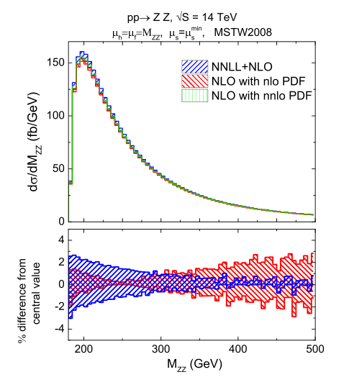
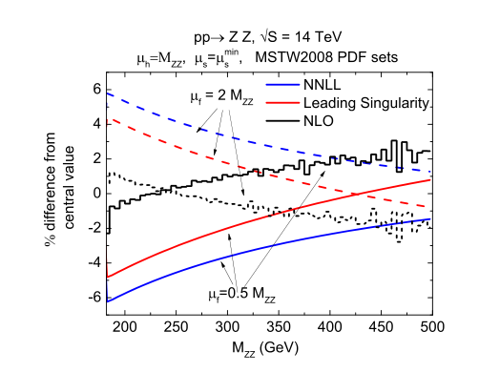
Factorization scale dependence

Slide 15
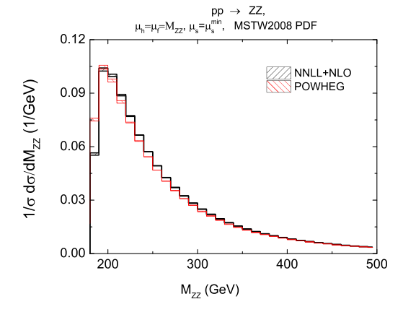
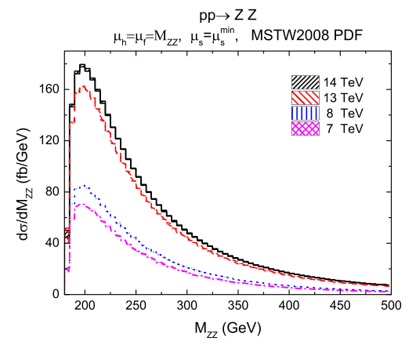
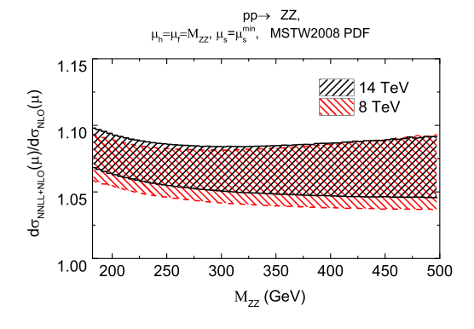

$including π^{2}$ effects
Compare with POWHEG
Distribution at the LHC
K-factor for resummation
Notes:
This is the PDF uncertainties.
We use MSTW2008 and CT10 and peak position.
peak position uncertainty is about 4%
and at large $q_{T}$ region is less than 2.5%
which is comparable to scale uncertainties.
The similar for ZZ and $W^{+}W^{−}$ productions.

Slide 16
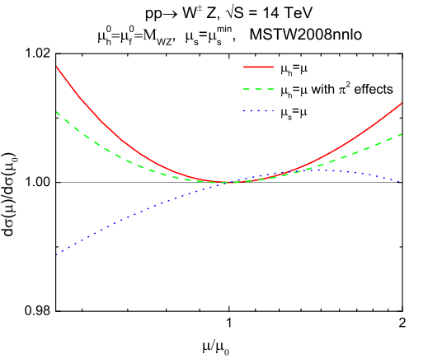
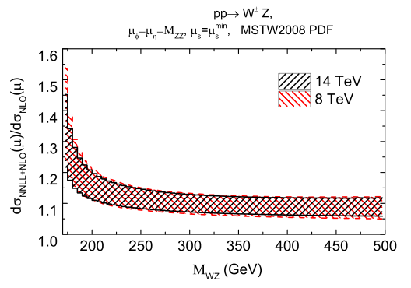
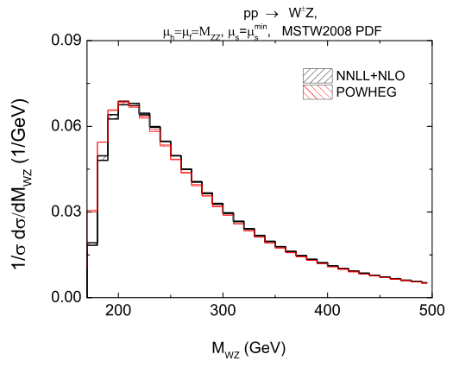
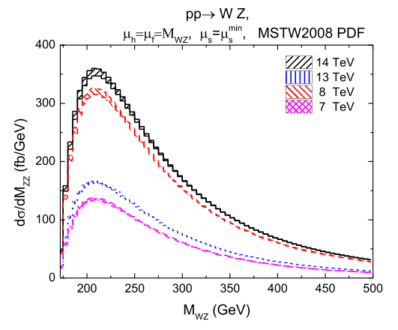

$$W^{±}Z$$

Slide 17
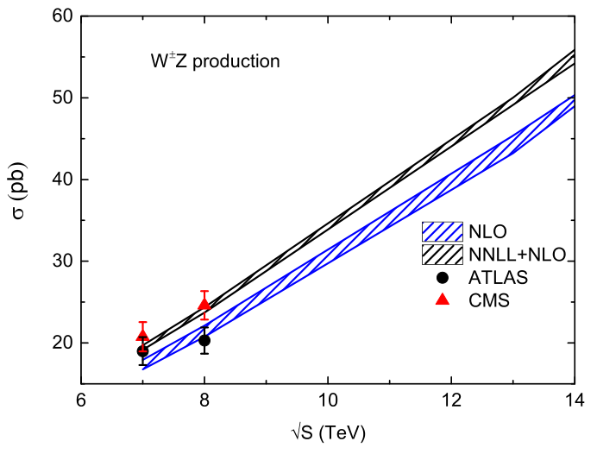
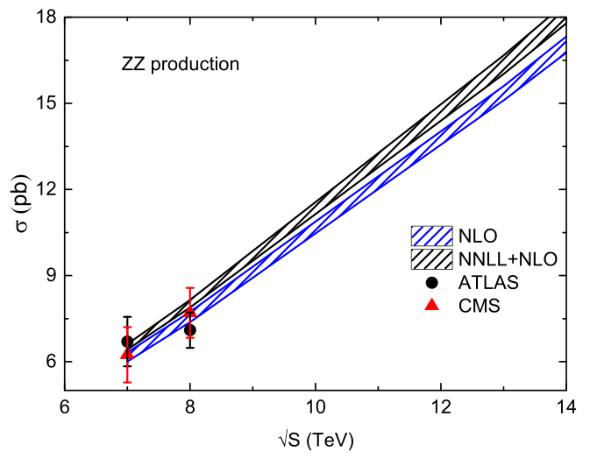
Compare with Experiments
Notes:
Here is the preliminary results of $q_{T}$ distribution for ZZ production, measured by CMS at $√S$ = 8 TeV.
We can see that our results agree with experiments data.

Slide 18
CONCLUSION
Presenting NLO + NNLL thershold resummation for gauge boson pair productions.
Improve NLO cross section about 8% for ZZ and 12% for WZ
Agree with POWHEG and experimental data very well.

Slide 19
THANK YOU

