Slide 1
Study of the AMS-02 results
毕效军 (Bi Xiao-Jun)
中国科学院高能物理研究所 (IHEP)

Slide 2
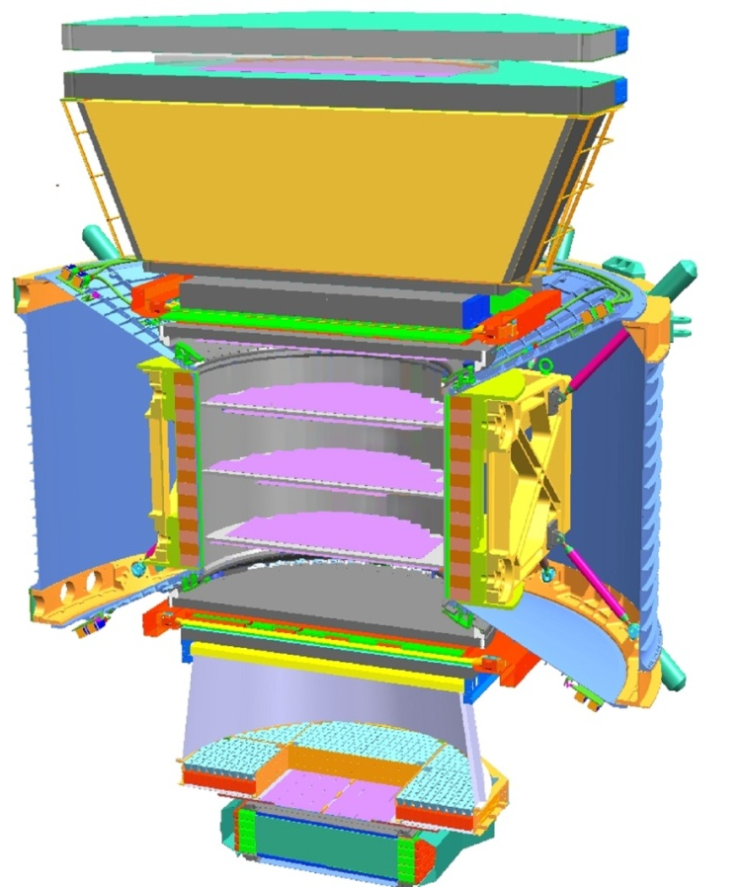
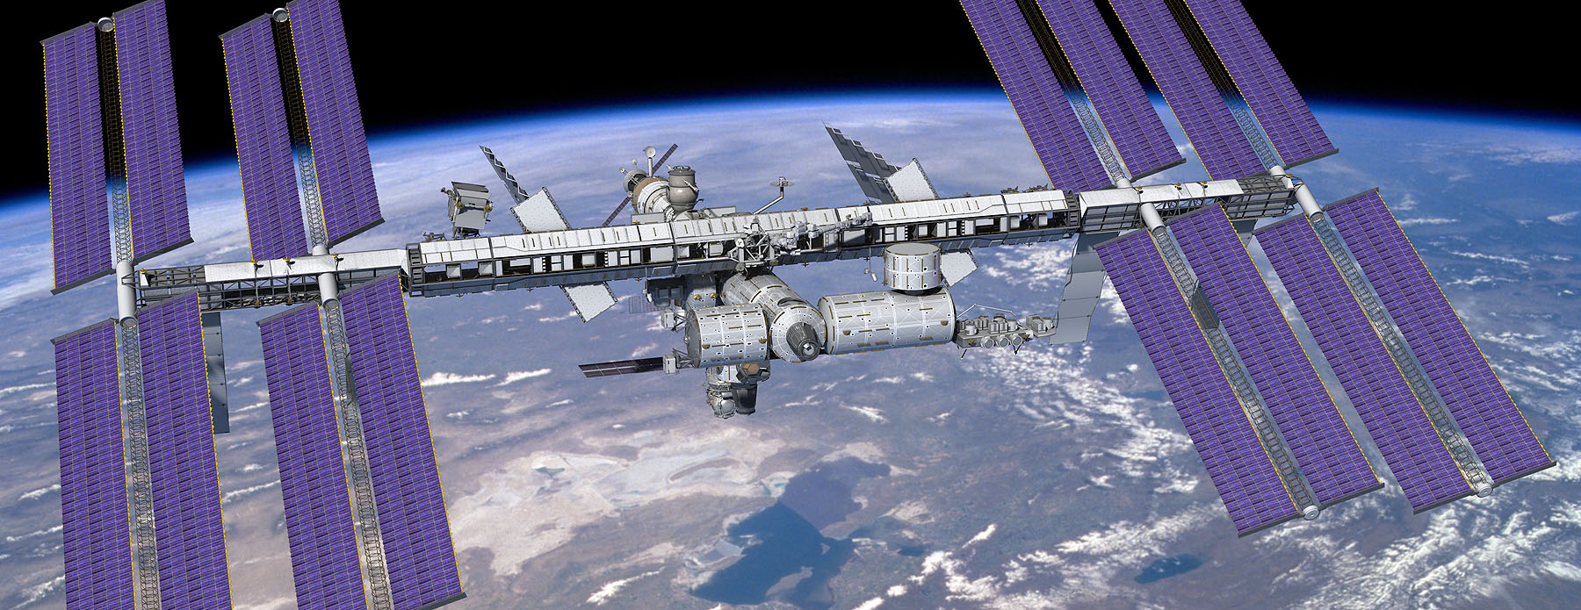
AMS02是国际空间站上唯一大型科学实验，将长期在轨运行
p
AMS
TRD
TOF
p
e⁺
e⁺
Tracker
TOF
RICH
ECAL
AMS物理目标：暗物质寻找
AMS物理目标：寻找反物质
AMS物理目标：带电宇宙线的精确测量
Notes:
2
2

Slide 3
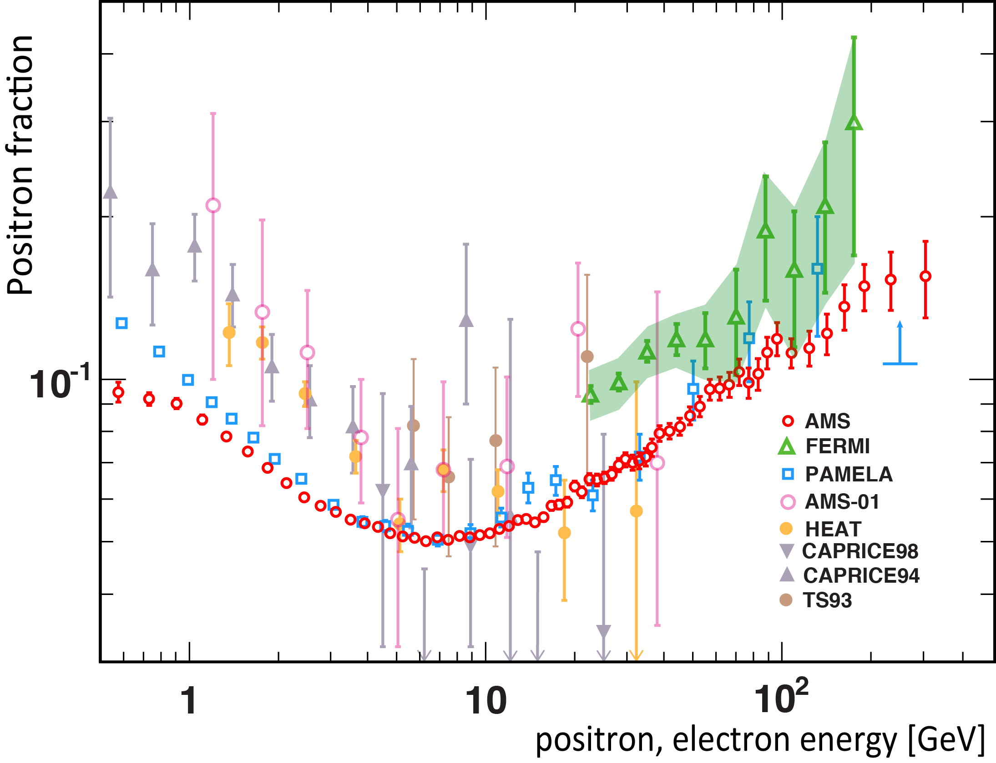

Slide 4
Fitting to the AMS-02 data
The positron fraction rises above ~10GeV, which can not be explained by cosmic ray physics. Extra sources of positron are needed, usually include astrophysical sources, such as nearby pulsars or dark matter
By a global fitting to the precise data of AMS-02 we study the properties of cosmic ray background and the extra sources (either pulsars or dark matter)

Slide 5
宇宙线的产生和传播
源 + 传播 = 观测
Notes:
观测=注入+传播

Slide 6
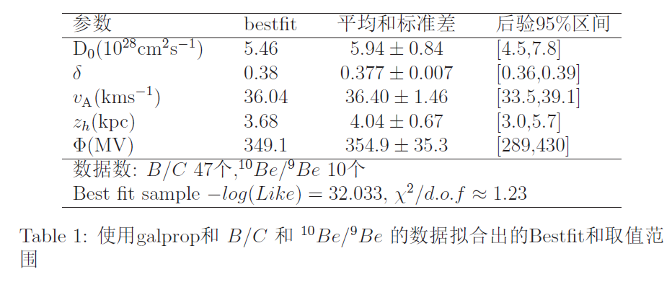
第一步，我们用宇宙线数据，用MCMC的方法拟合传播参数，在下面拟合AMS02、Fermi的电子谱的时候，固定这些传播的参数。
1，物理上传播是独立的，不应用电子的数据去拟合传播参数。
2，精度相差非常多，会使得传播参数完全不合理。
Lin, Cai, Yuan, Bi 2013

Slide 7
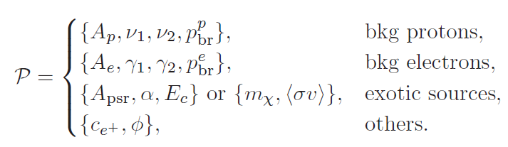
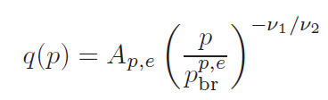

Bkg+pulsar (or DM)拟合数据
源 + 传播 = 观测
We adopt MCMC algorithm so that the fit converge quickly
For one set of parameters we calculate the propagation and compare the result with the AMS-02 data

Slide 8
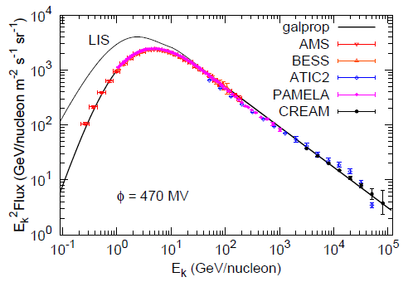
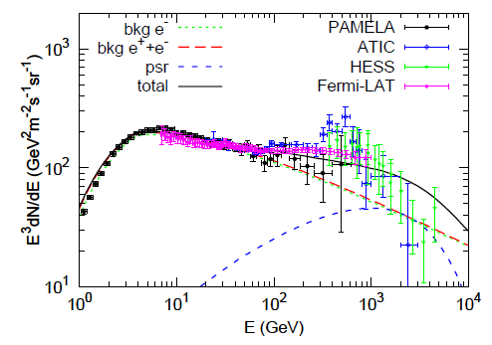
拟合的数据
AMS02 正电子比
PAMELA 电子谱，质子谱
Fermi/HESS的总电子谱

Slide 9
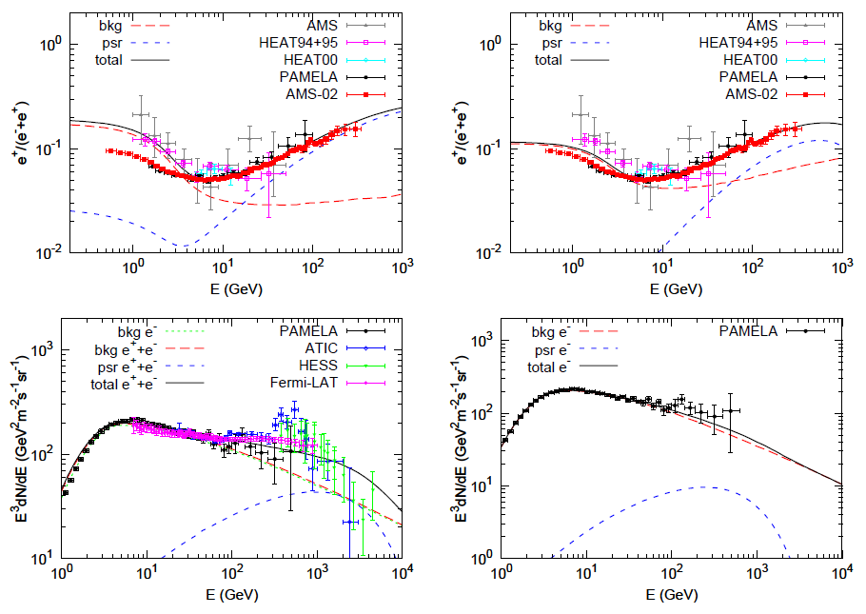
It seems pulsar can fit data roughly. However, the χ²/dof=1.8; 6σ deviates from expectaion. Fermi data is not consistent with the AMS02 data. We fit without including the Fermi data. χ²/dof=52/80; perfect fit to data!
Yuan, Bi, Chen, Guo, Lin, Zhang, 1304.1482

Slide 10


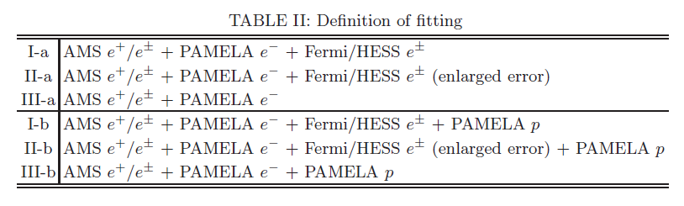
Fermi data has systematic errors?
Fermi has a 5%-10% uncertainty of absolute energy scale, this induce a 10~20% in flux
We give other two simulations: include the Fermi/HESS systematic errors; not include Fermi data at all.

Slide 11

宇宙线中的电子加正电子能谱
与以往实验的比较
AMS-02重要结果：
以前的实验结果是错误的
流量 x E³ (s sr m² GeV)⁻¹
能量(GeV)

Slide 12
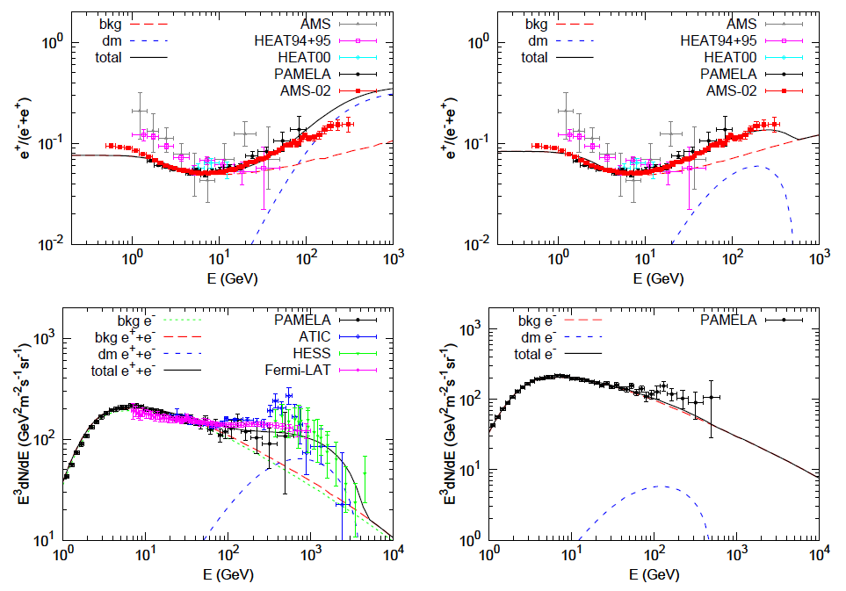
For DM the tension is stronger（AMS02-Fermi），χ²/dof=3.3 ；without Fermi, tau final state gives good fit

Slide 13
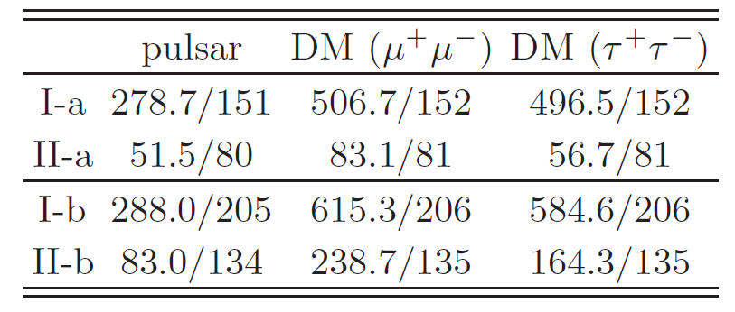
Fitting results of chi² per d.o.f

Slide 14
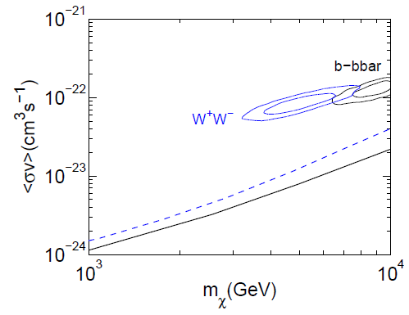

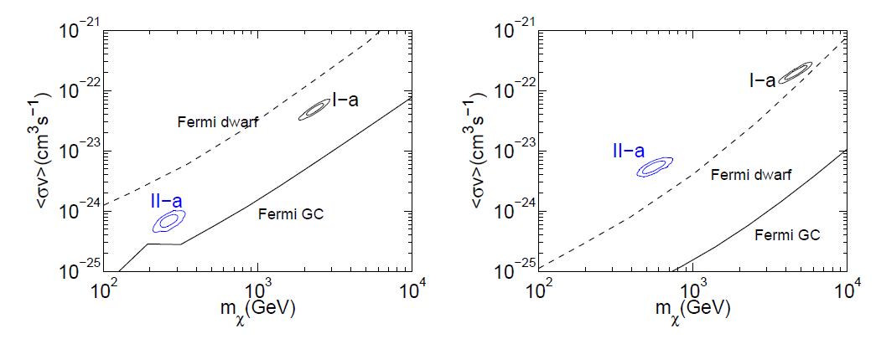
伽玛射线和反质子的限制
Yuan, Bi, Chen, Guo, Lin, Zhang, 1304.1482
See also, Jin, Wu, Zhou, 1304.1997
Cholis, Hooper, 1840

Slide 15
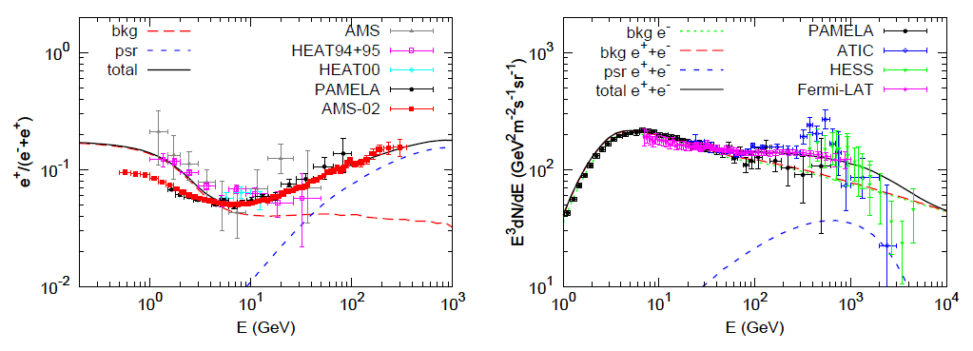
Electron spectrum with a break--- for pulsar
Yuan, Q., Bi, XJ, arXiv 1304.2687

Slide 16
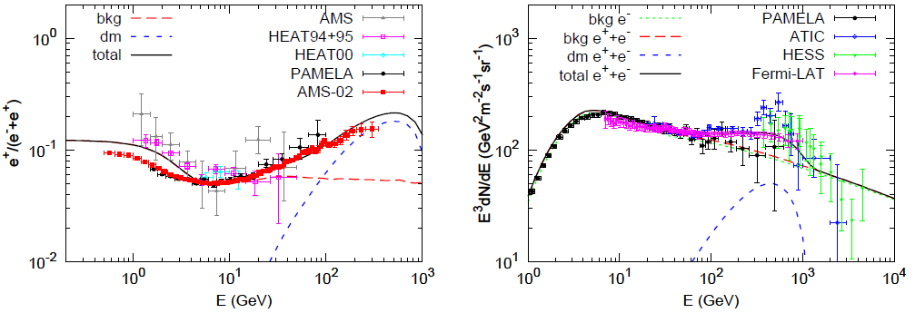
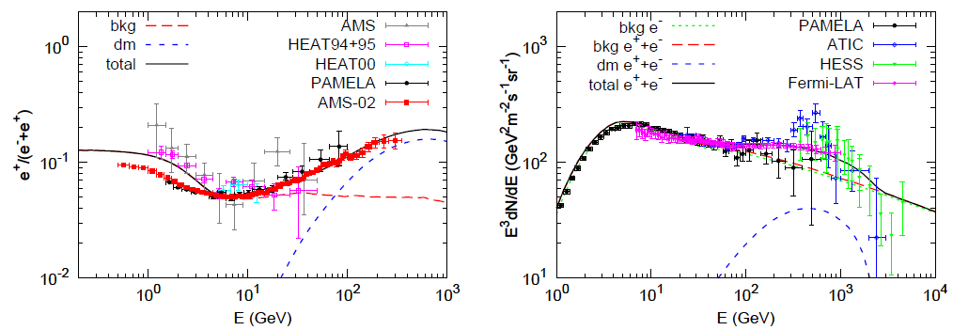
暗物质到mu和tau

Slide 17

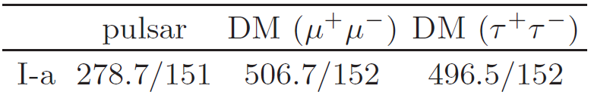
Chi2大大减小到~1，这时可以很好拟合数据

Slide 18
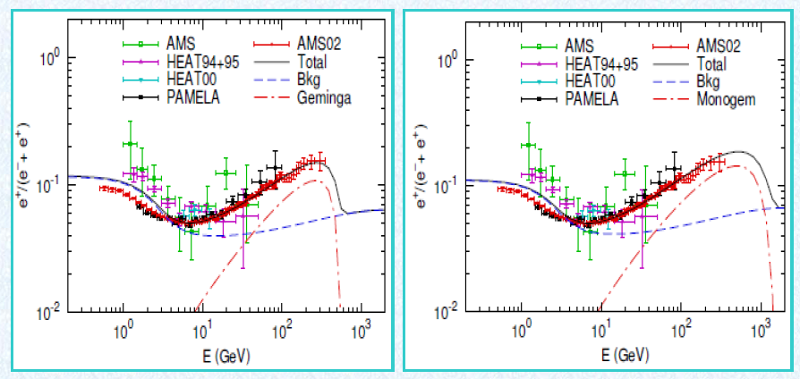
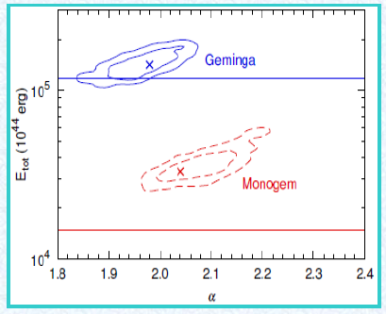
Interpret data with pulsars Yin et al. 1304. 4128
Index ~ 2, softer than before to fit PAMELA. Therefore larger total injection power.

Slide 19
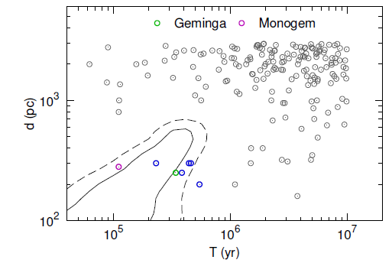
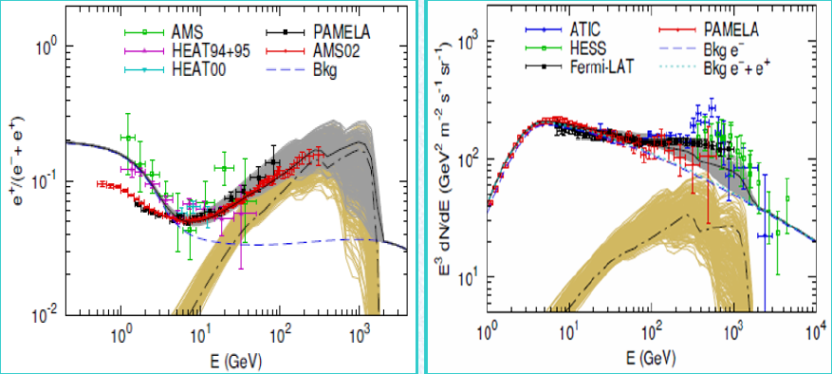
We consider contributions from nearby pulsars and add contributions from all pulsars.

Slide 20
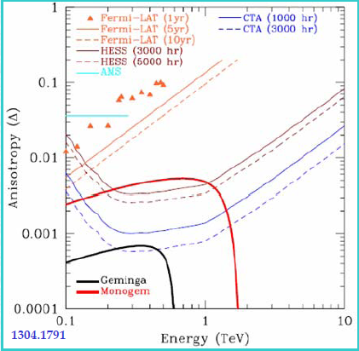
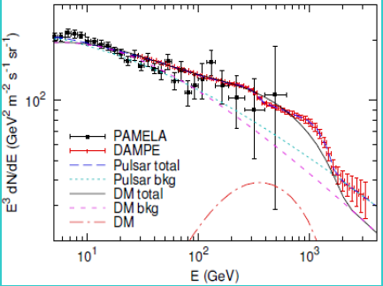
DM vs pulsar: flux anisotropy vs spectrum wiggles

Slide 21
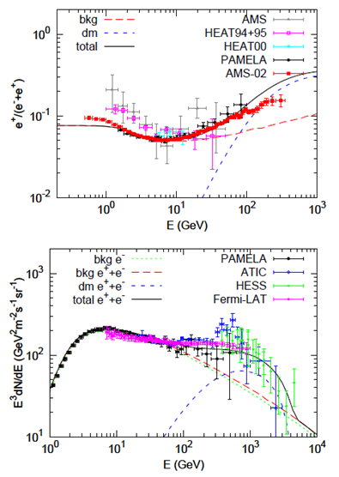
Systematic study of uncertainties of astrophysics
Propagation
Treatment of low energy data
Models of strong interaction
Galprop version

Slide 22
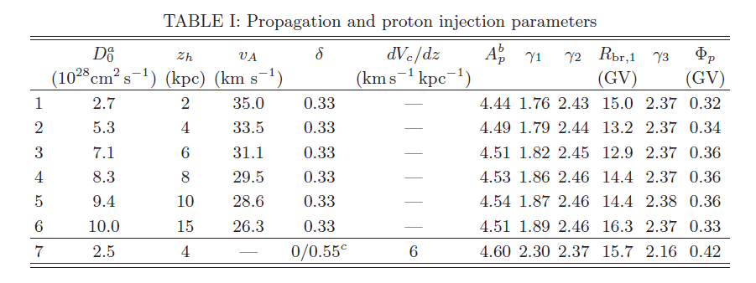
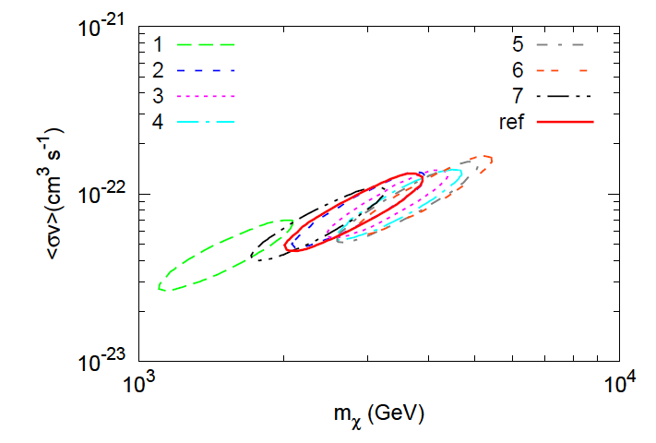
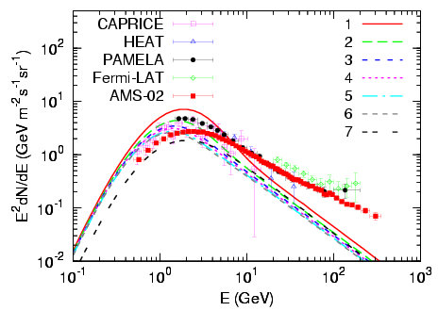
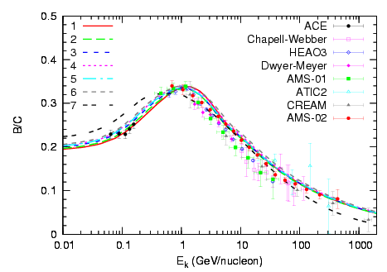
Propagation uncertainties

Slide 23
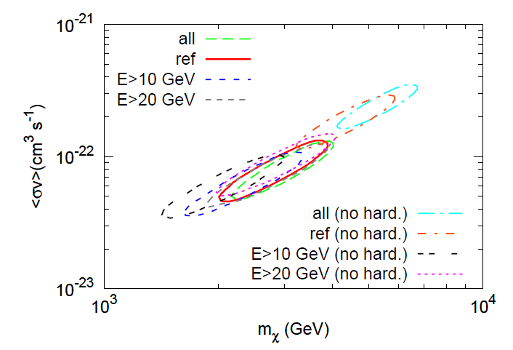
Low energy data

Slide 24
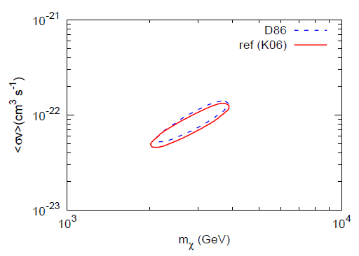
Strong interaction models

Slide 25
Strong interaction models

Slide 26
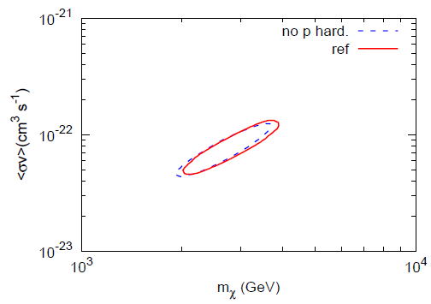
质子谱有（无）拐折

Slide 27
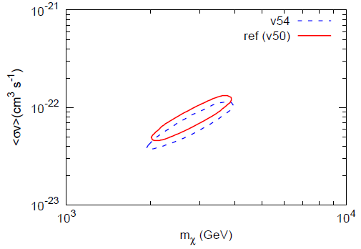
Different Galprop versions

Slide 28
Summary
With the AMS-02 precise data quantitative study is important!
Astrophysical uncertainties DO NOT change fitting results a lot, for example m_DM is within 2~3; future AMS02 data will considerably reduce the uncertainty.
Fermi electron spectrum shows inconsistence with AMS-02 positron ratio, by our fitting program.
DM interpretation of AMS-02 positron ratio meets challenges from Fermi gamma observations.
A break at the electron spectrum can reconcile the tension between AMS-02 and Fermi
Pulsars explain data well

