Slide 1
Short-range interactions between two God particles
贾宇 (Yu Jia)
中国科学院高能物理研究所
(Based on 1312.1944, to appear in Phys. Lett. B)
The 10th TeV Workshop, May 15-17, Guang Zhou

Slide 2

The Higgs-like boson was firmly discovered in July 4, 2012
ATLAS and CMS joint announcement

Slide 3

Physics Nobel Prize winners in 2013
The Royal Swedish Academy awarded the prize for “ the theoretical discovery of a mechanism that contributes to our understanding of the origin of mass of subatomic particles, and which recently was confirmed through the discovery of the predicted fundamental particle, by the ATLAS and CMS experiments at CERN’s Large Hadron Collider’’

Slide 4
Higgs mechanism (Wikipedia)
The Higgs mechanism is also called the Brout–Englert–Higgs mechanism or Englert–Brout–Higgs–Guralnik–Hagen–Kibble mechanism,^{[2]} Anderson–Higgs mechanism,^{[3]} Higgs–Kibble mechanism by Abdus Salam^{[4]} and ABEGHHK'tH mechanism [for Anderson, Brout, Englert, Guralnik, Hagen, Higgs, Kibble and 't Hooft] by Peter Higgs.^{[4]}

Slide 5
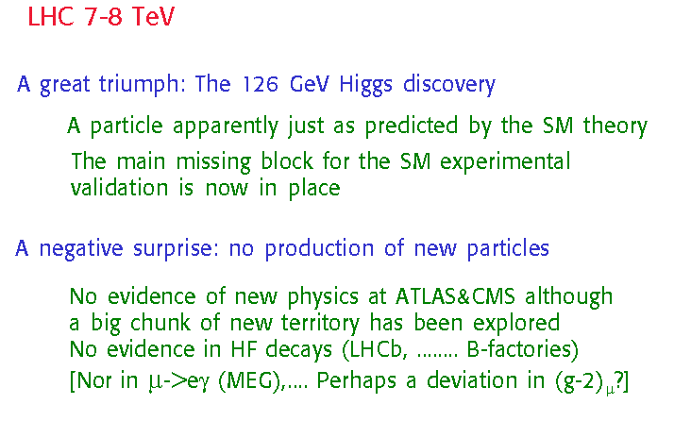
Guido Altarelli May 2013

Slide 6
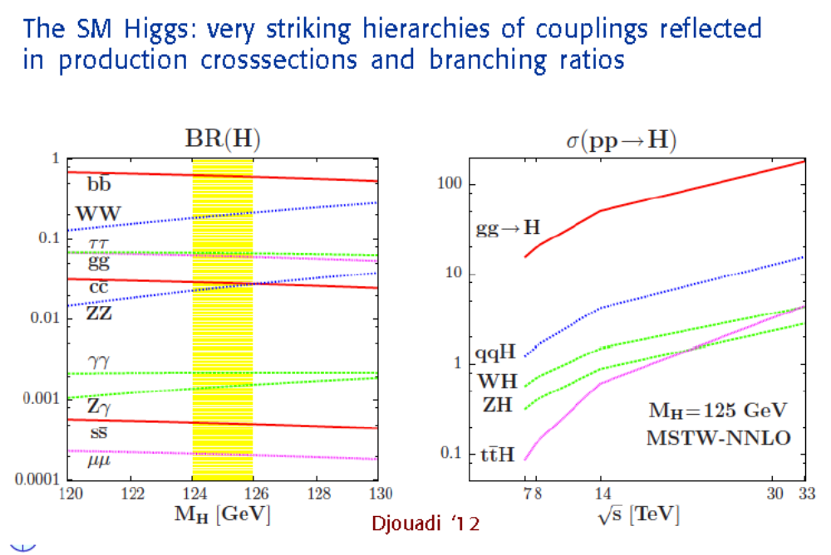

Slide 7
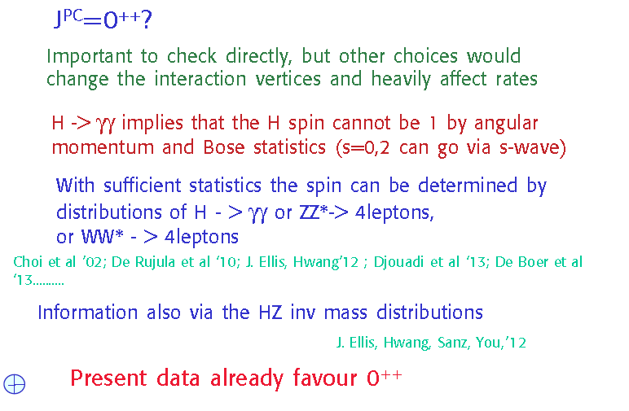
Quantum numbers of the new boson
Guido Altarelli May 2013

Slide 8
Particles/Interaction/Force/Profiles of the force
♣ Two massive objects, General Relativity/Newtonian law, attractive/long range
♣ electron-positron/QED/attractive/long range
♣ quark-antiquark/QCD/color-singlet channel, attractive/long-range, confinement
heavy quark-antiquark/may form onium bound states
♣ Higgs-Higgs/Electroweak interaction/?/short-range
Question: is there possible to arise the so-called “Higgsonium”?

Slide 9


A digression into nuclear physics
The familiar case: deuteron (氘核)
Nucleon-Nucleon elastic scattering at very low energy characterized by short-range compact interaction
Effective range expansion:
Experimentally one can extract that

Slide 10


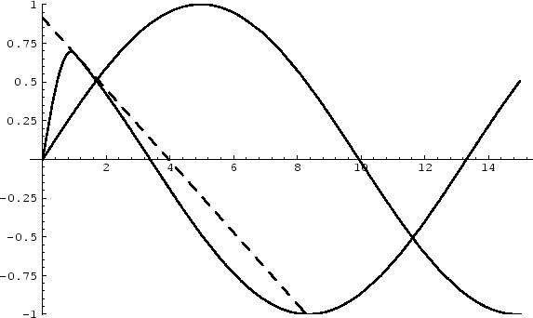
A quantum-mechanical example
Scattering length is unbound, unlike the effective range
Considering a square-well potential:

Slide 11
The strategy of this work
Study Higgs-Higgs elastic scattering near threshold
We match the Higgs sector of Standard Model onto a non-relativistic effective field theory that involves only the Higgs boson degree of freedom
With the aid of effective range expansion, we then extract the parameters that characterize the Higgs force, I.e., S-wave scattering length a₀ and effective range r₀

Slide 12
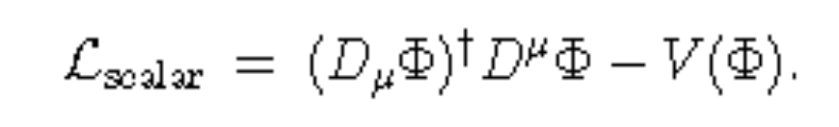

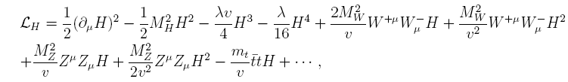
Full theory side– Standard Model
Scalar sector Lagrangian
Higgs potential:
After spontaneous symmetry breaking, Higgs sector reads

Slide 13
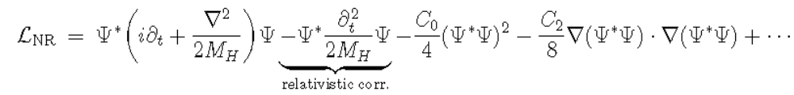

Nonrelativistic effective theory of Higgs boson
Integrating out all the heavy W/Z/top degree of freedom, and near the threshold, we have the NREFT:
Satisfying Galilean (Lorentz ) inv., parity invariance,…
Power counting:
This effective lagrangian is no longer hermitian, C₀ and C₂ are in general complex; this theory is no longer unitary, due to inelastic channel HH->WW/ZZ

Slide 14
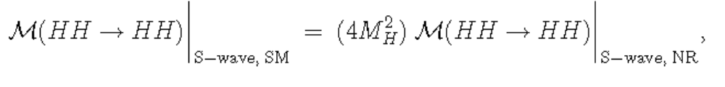
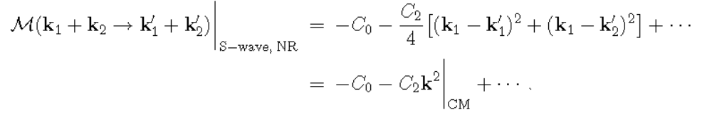
Matching equation
Equating the HH->HH elastic scattering in full theory and effective theory are exactly equal
In the tree-level, EFT side yields the S-wave amplitude

Slide 15

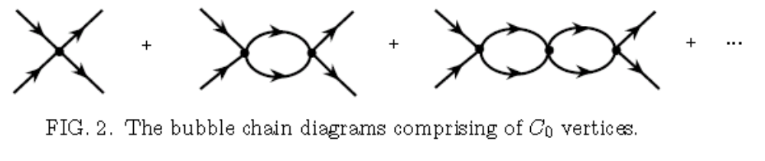
Connecting NR EFT and effective-range expansion
One-loop S-wave amplitude in NR EFT
One is able to resumming the bubble diagrams

Slide 16


Connecting NR EFT and effective-range expansion
The S-wave amplitude is characterized by the S-wave phase shift, or using effective range expansion
Or equivalently, from resummation of our NREFT diagrams
[Jia, hep-th/0401171]

Slide 17
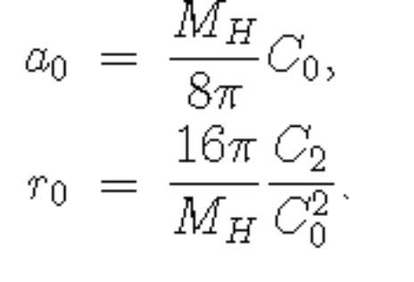
Connecting NR EFT and effective-range expansion
We can equate a₀ and r₀
Our task is then to compute C₀ and C₂ to NLO in Electroweak GSW model

Slide 18
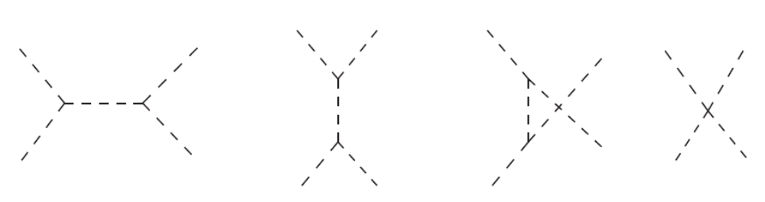
HH->HH elastic scattering at tree level in Standard Model
Only 4 tree-level diagrams (involving Higgs field only)
Define the following short-hands:

Slide 19
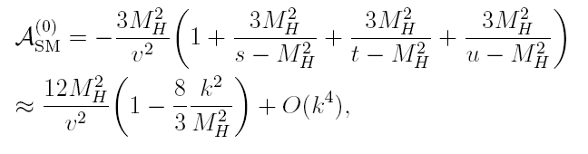
HH->HH elastic scattering at tree level in Standard Model
Needs to project out the S-wave contribution:
The D-wave contribution first starts at k^4

Slide 20
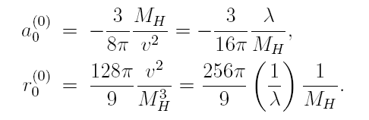
The S-wave scattering length and effective range at tree level
It is trivial to get
a₀ is slightly negative – the force is weakly attractive
r₀ much (~173 times) larger than the Compton wavelength of Higgs boson → This implies our EFT works very well

Slide 21
HH->HH elastic scattering at NLO in NREFT
Start from the exact nonperturbative NREFT amplitude
Truncate it to one-loop order

Slide 22
HH->HH elastic scattering at NLO in SM
♣ We work in R gauge, specifically, in Feynman-’t Hooft gauge (=1)
In the future attempting to try unitary gauge
♣ We choose to use the on-shell renormalization scheme (Sirlin, 1980; Hollik, 1990)
♣ New feature: W/Z/top quark now play a role – interesting to know their interplay

Slide 23
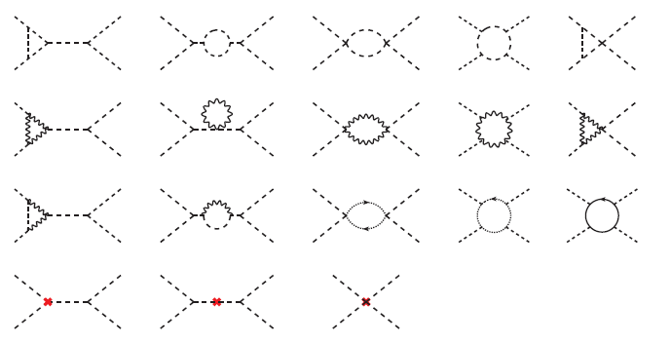
Some sample NLO diagrams for HH-> HH (603 diagrams)
Too many diagrams; calculation complicated

Slide 24
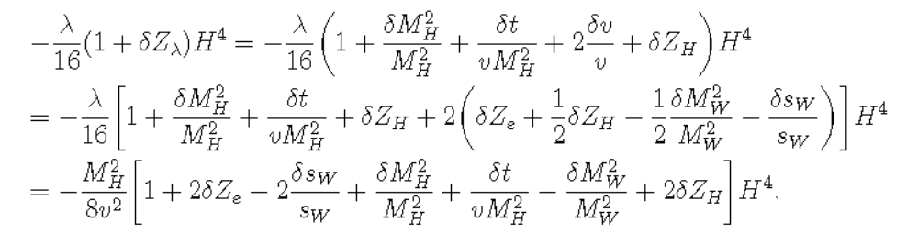
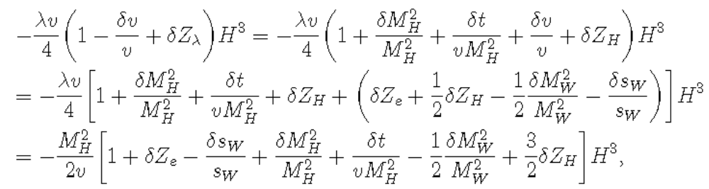
Counterterms in Feynman gauge
We need fix some parameters

Slide 25
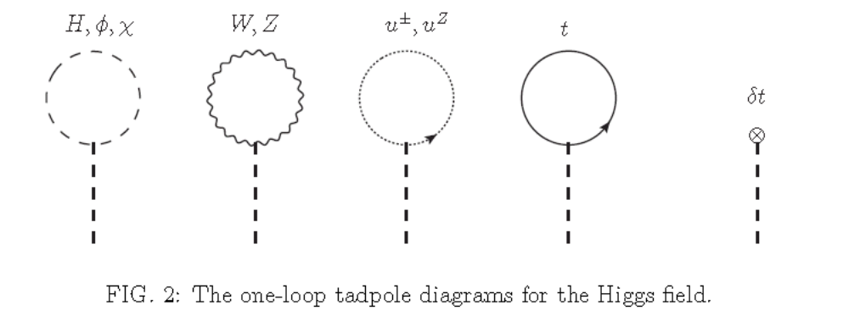
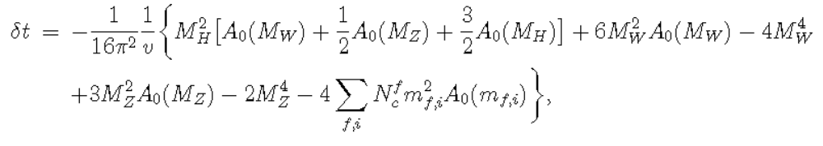
Counterterms in Feynman gauge
tadople

Slide 26
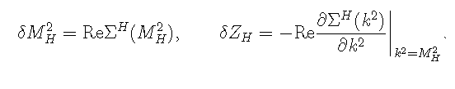
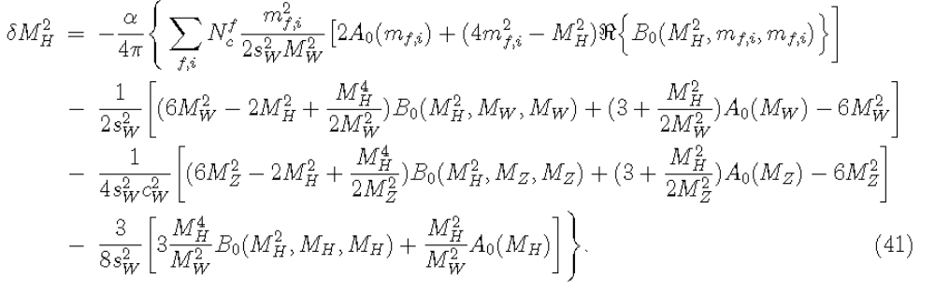
Counterterms in Feynman gauge
Higgs mass and wave-function renormalization

Slide 27
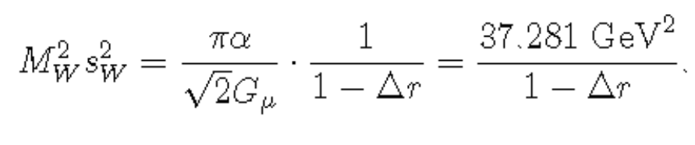
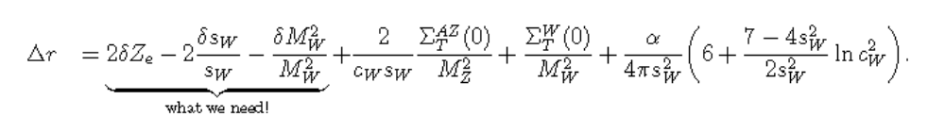
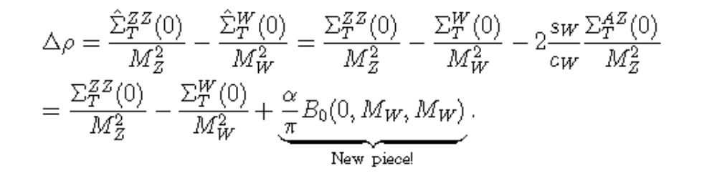
Counterterms in Feynman gauge
The counterterms related to W and Z

Slide 28
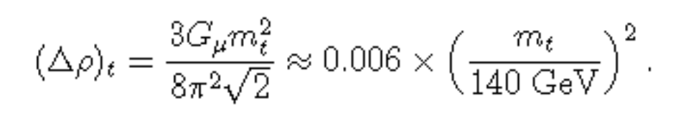
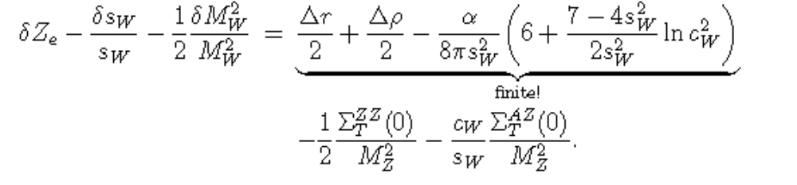
Counterterms in Feynman gauge
The counterterms related to W and Z

Slide 29
Numerical Results
Input parameters alpha= 1/137, mh = 126 GeV, GF = 0.0000116637 GeV⁻², mt =173.07 GeV, Mw = 80.38 GeV, mz = 91.1876 GeV.
The numerical values for a0 and r0 in tree level:
a₀⁽⁰⁾= -4.90x 10⁻⁵ fm very tiny
r₀⁽⁰⁾ =0.267 fm strikingly large!
The NLO correction: (only a few percent)
a₀⁽¹⁾ / a₀⁽⁰⁾ = -0.0355+ 0.0063 i,
r₀⁽¹⁾ / r₀⁽⁰⁾ = 0.0245 - 0.0145 i.

Slide 30
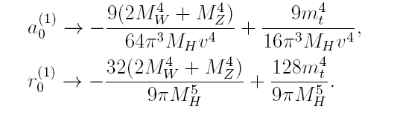
Hypothetic theoretical limit
In the limit of Mw(Mz), mt -> infinity, the NLO correction to the scattering length and effective range scale as
Note their effects are opposite! (non-decoupling)
Doubling top quark mass, the force even becomes weakly repulsive!

Slide 31
Conclusion
We study some fundamental properties of God particles--how they interact- a₀ and r₀
The short-range force between Higgs bosons are weakly attractive
NLO correction slightly decreases the attraction
♣ The attractive force seems not strong enough to bind two Higgs bosons to form Higgsonium

Slide 32
Conclusion
Unnaturally large force range, 0.3 fm, very weird. Similar as the typical length scale of strong interaction
Extremely difficult to measure at LHC via double Higgs boson production
Lattice simulation might be more feasible
The inter-Higgs force in some BSM scenario?

