Slide 1
Exploring the systematic uncertainties of SNe Ia
Shuang Wang
Northeastern University

Slide 2
Outline
1. Introduction
2. Previous Works
3. Current Works
4. Summary

Slide 3
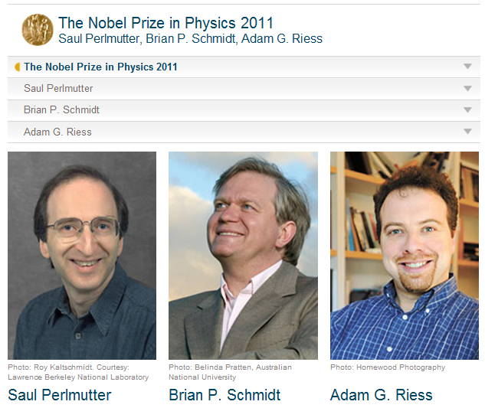
Introduction

Slide 4
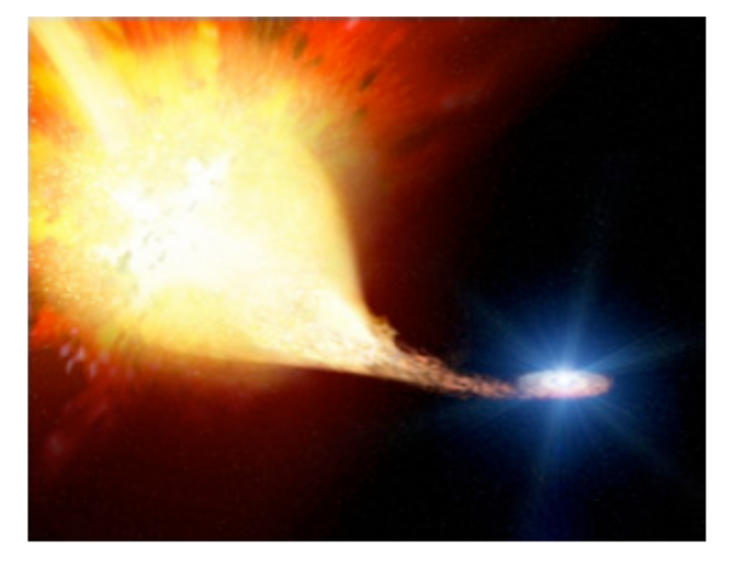
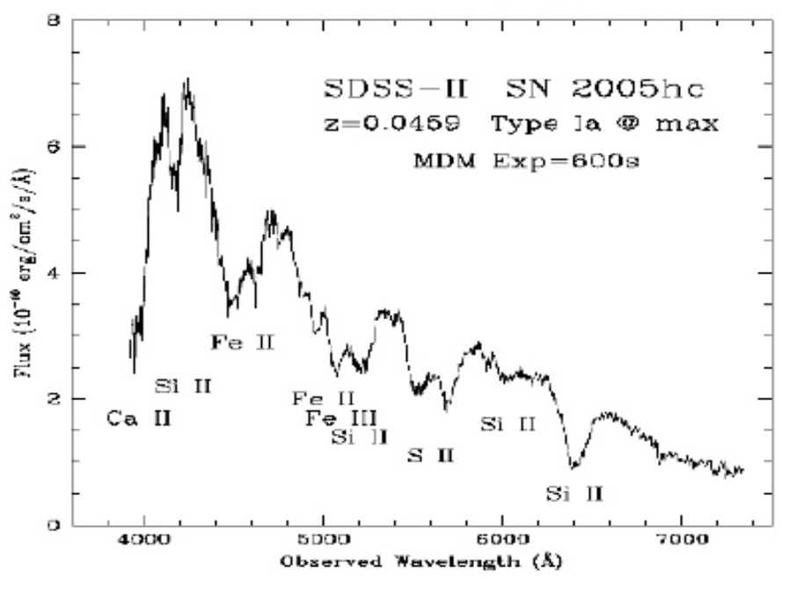
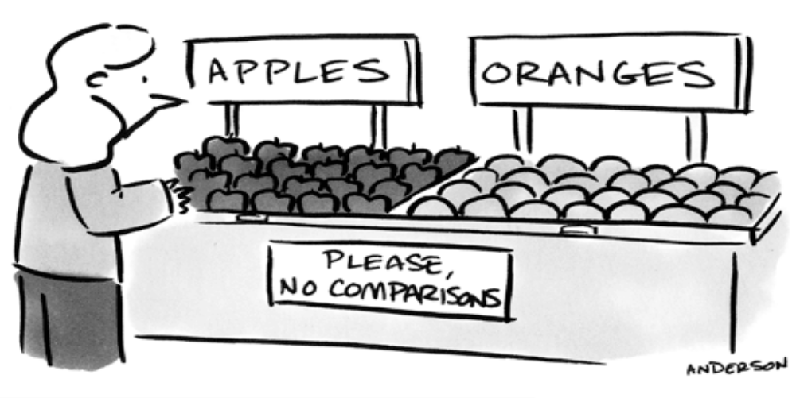

Slide 5
systematic uncertainties of SNe Ia
errors in photometry, calibration and identification of SNe Ia
host-galaxy extinction
gravitational lensing
intrinsic variation of physical properties of SNe Ia

Slide 6
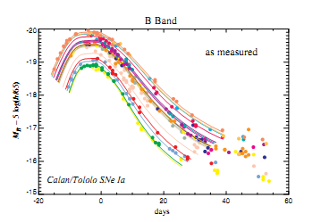
Supernova Training
(Using all SNe)
Lightcurve fitter model
Chi^2 Statistics
cosmology Information
(μ, α, β)
Light-curve Fitting
For one SN

Slide 7
Light-curve Fitting
1) rest-frame model mags + k-corrections:
Mlcs2k2 (Jha,Riess,Kirshner ApJ 659 122 2007)
2) rest-frame spectral model:
SALT2 (Guy et. al., A&A 466,11,2007)
stretch-luminosity parameter
color-luminosity parameter

Slide 8
A. Conley et. al.
Supernova Constraints and Systematic Uncertainties from the First 3 Years of the Supernova Legacy Survey
ApJS 192, 1 (2011)

Slide 9
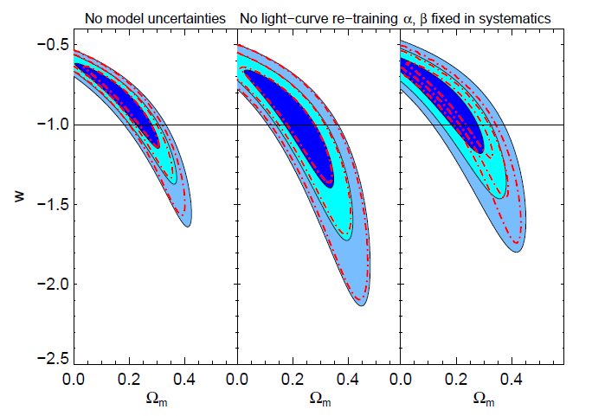

Slide 10
The possible evolution of α and β
For the Pan-STARRS1 data
Scolnic et. al., arXiv:1310.3824
For the Union2.1 data
Mohlabeng and Ralston, MNRAS 439, L16 (2014)

Slide 11
Shuang Wang, and Yun Wang
Previous Works
Exploring the Systematic Uncertainties of Type Ia Supernovae as Cosmological Probes
Phys. Rev. D 88, 043511 (2013)
For the SNLS3 data

Slide 12
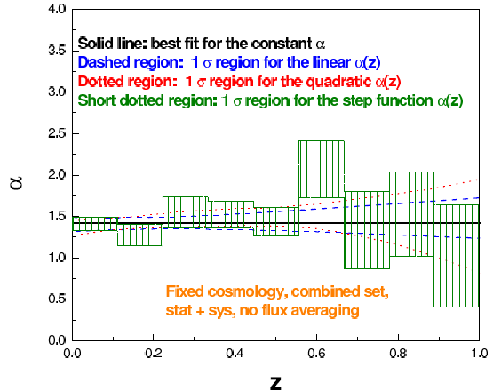

Slide 13
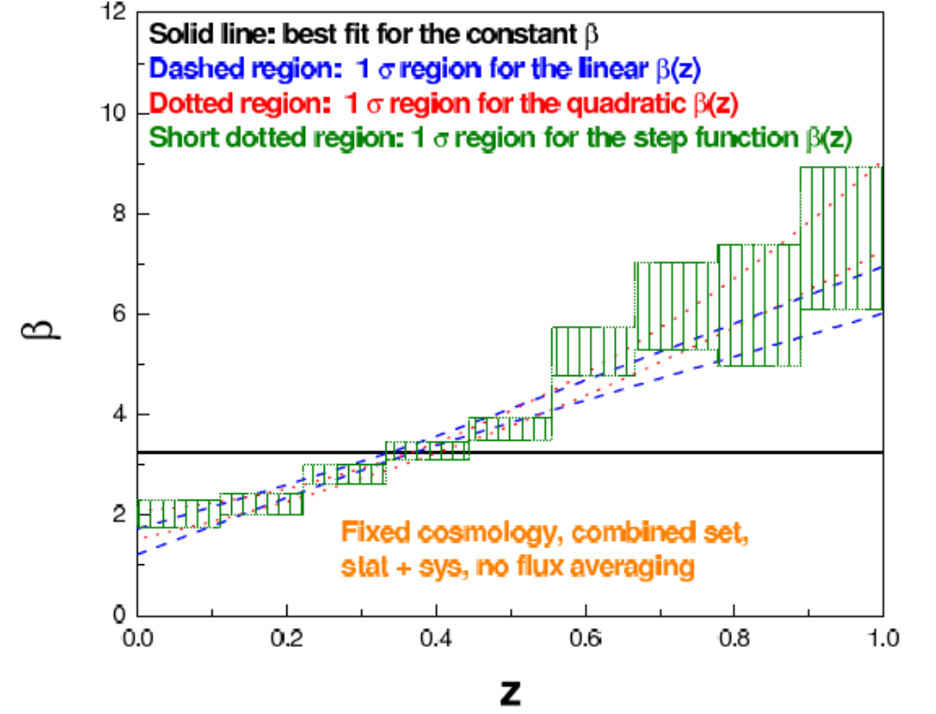

Slide 14
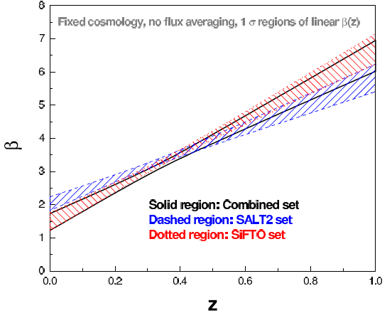

Slide 15
Current Works
Shuang Wang, Yun-He Li, and Xin Zhang
Exploring the evolution of color-luminosity parameter β and its effects on parameter estimation
Phys. Rev. D 89, 063524 (2014)
ΛCDM model, wCDM model, CPL model

Slide 16
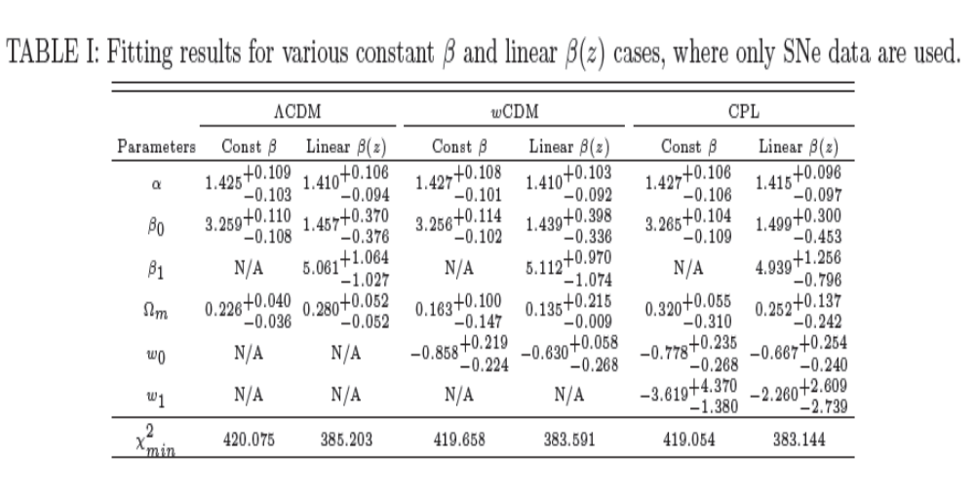
Fitting Results

Slide 17
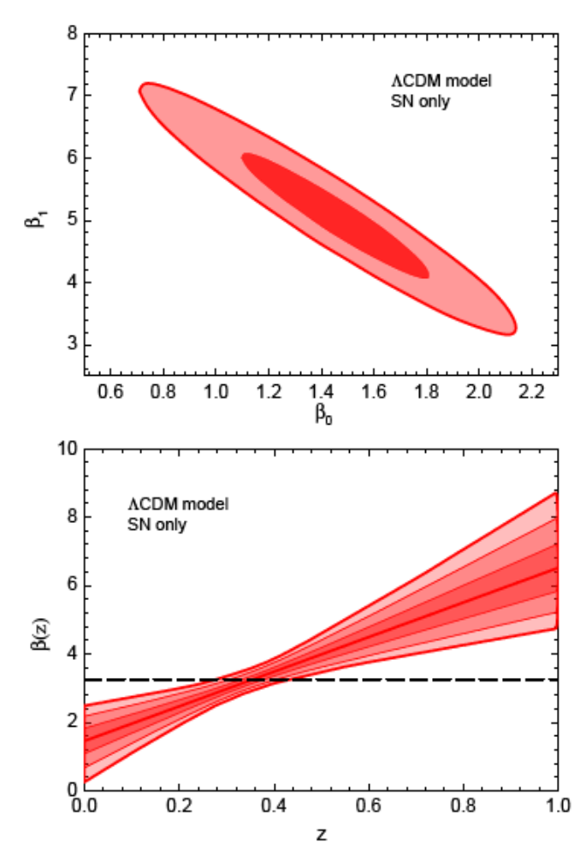
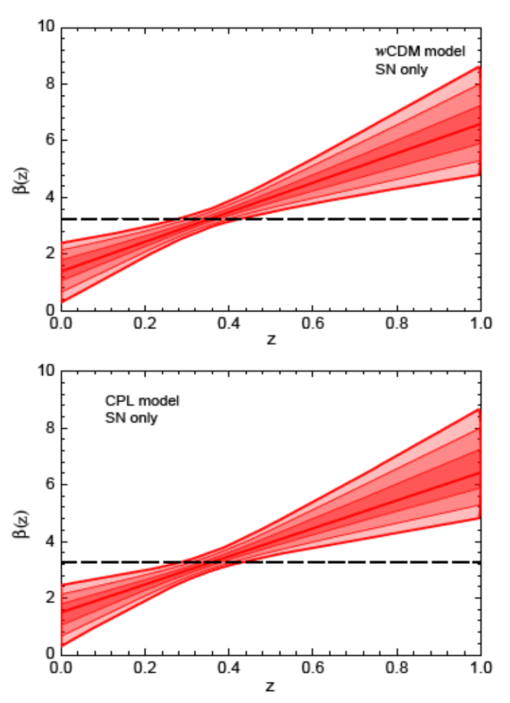

Slide 18
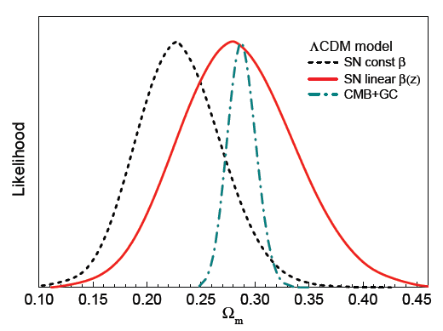

Slide 19
Shuang Wang, Jia-Jia Geng, Yi-Liang Hu, and Xin Zhang
Revisit of SNLS3 constraints on holographic dark energy: the effects of varying β and different light-curve fitters
arXiv:1312.0184

Slide 20
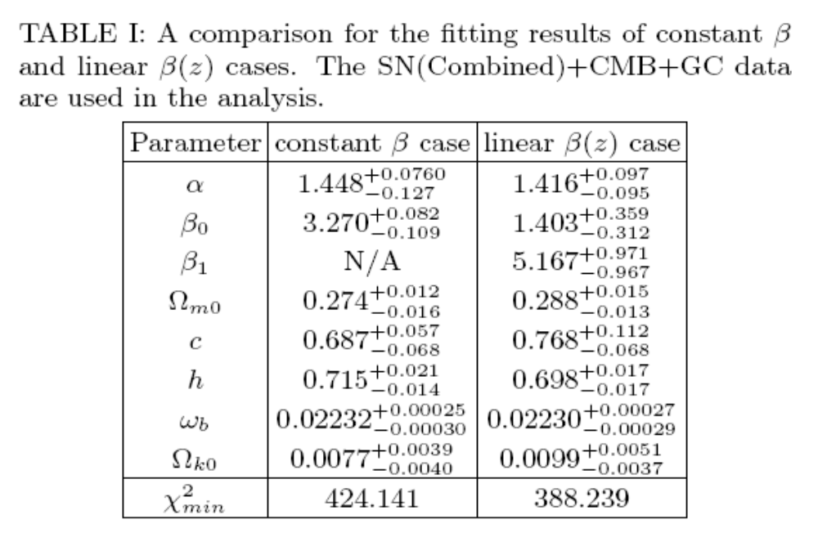

Slide 21
Summary
For all the models, adding a parameter of β can reduce the best-fit values of chi^2 by 36
β deviates from a constant at 6σ CL
A time-varying β has significant effect on parameter estimation
Considering the evolution of β is very helpful for reducing the tension between supernova and other observations
Open questions: other systematic uncertainties? How to deal with them?

Slide 22
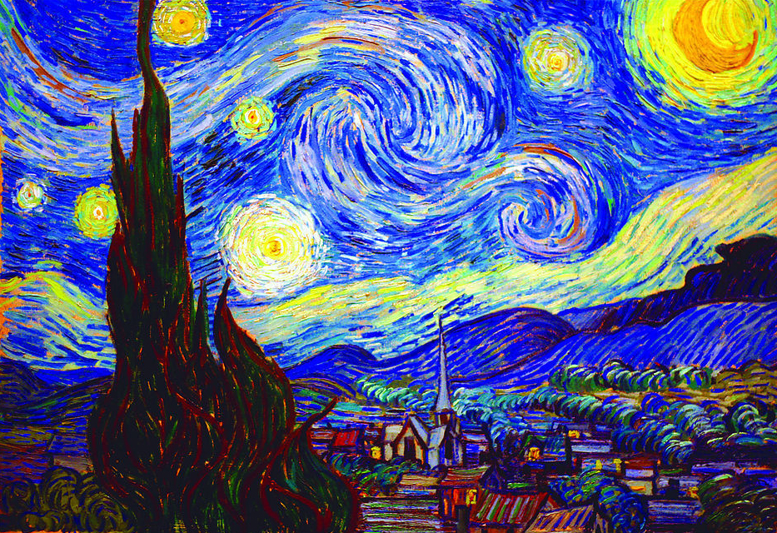
Thank You

