Slide 1
Hadronic b’ search at the LHC with top and W taggers
Shuo Yang (杨硕)/ Dalian University
in collaboration with Ji Jiang,Qi-Shu Yan,Xiaoran Zhao
arXiv1405.2514
2014.5.17 Conference of TeV Physics Working Group
@Sun Yat-Sen University

Slide 2
Outline
Vector-like b’ quark
Jet Substructure and top-tagger W-tagger
Hadronic b’ search with top and W taggers
Summary

Slide 3
I. Vector-like b’
Vector-like quarks
The chiral fourth generation has been almost ruled out by the Higgs data.
Vector-like quarks
left-handed and right-handed components transform the same
under SU(2)L*U(1)Y
the charged current of vector-like fermions are Vector Structure

Slide 4
Features of vector-like quark
Gauge invariant mass term without the Higgs
Doesn’t introduce anomaly
Work well with EWPT
Dangerous FCNCS → Bounds on mixing parameters

Slide 5
Vector-like quarks in New Phyiscs models
Warped or universal Extra dimensions
KK excitations of bulk fields
Little Higgs models
Partners of SM fermions for cancel the quadratic divergence of Higgs
Non-minimal SUSY extensions
VLQs increase corrections to Higgs mass without affecting EWPT
Composite Higgs models
VLQs appear as the excited resonances of the bounded states which from SM particles
… …

Slide 6
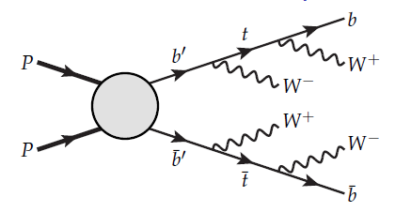
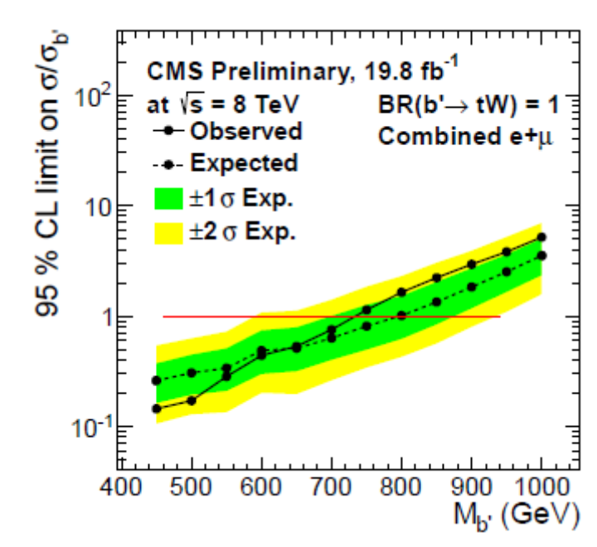
Search for vector-like b’
b’→tW b’→ bh b’→bZ b’→Wq
Golden channel : same sign lepton final state
The most stringent limit comes from CMS.
mb’ > 582 GeV ( Br(b’→bZ)=100%)
mb’ > 732 GeV
Br(b’→tW)=100% based on same sign lepton final states

Slide 7
Motivations for the search of fully hadronic mode
This mode has large branching ratio.
Difficult to analyze missing energy in multilepton channel
It is independent to confirm the theoretical prediction.
Current detectors has the capacity to detect some signal
in all-hadronic final states.
D0 collaboration hep-ex/0612040 CDF collaboration 0703.3790
CMS collaboration 1307.4617
ATLAS collaboration 1108.4755 CMS collaboration 1204.2488
The development of jet substructure technique can help.
There are recent studies on the phenomenology in fully hadronic mode.
SY and Qi-Shu Yan 1111.4530
M.R.Buckly, T. Plehn et al 1310.6034
M. Endo et al 1405.2677

Slide 8
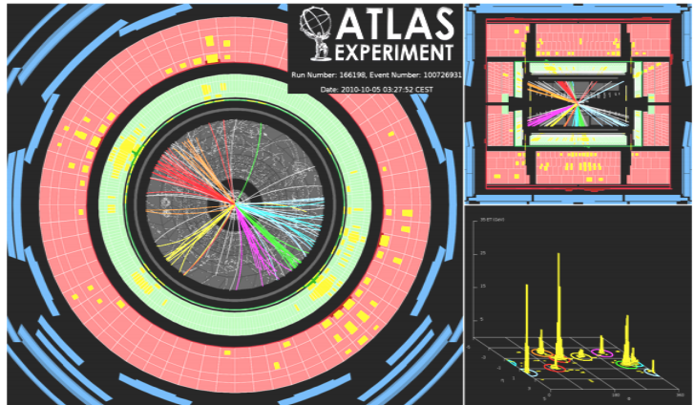
What is jet?
II. Jet Substructure and T-tagger and W-tagger
quark
quark
gluon
quark
quark
hadronisation
Why do we see jets? Parton fragmentation

Slide 9
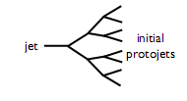
Jet Algorithms
Cone Algorithm
Recombination Algorithm
UAI,JetCLU,SISCone….
Jade,Kt, Cambrige-Aachen, Anti-Kt….
Based on fixed geometry
Idea: Put cone along dominatant direction of flow direction
Idea: Undo branching

Slide 10
Jet Substructure
Boosted Massive Particles
Lab frame
Rest frame
Hadronically decaying EW massive particles at high Pt = 2 jets
R=0.4
R=0.7

Slide 11
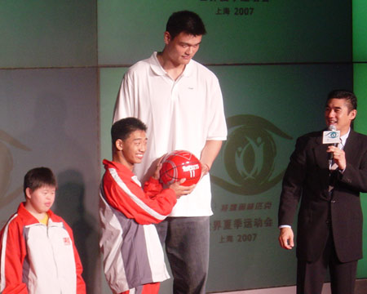
Jet cone size and fat jet
R=1.5
R=1.0
R=0.5
In order to separate signal, one have to anatomize the Jet
Substructure!

Slide 12
Brief history of Jet Substructure
Michael H. Seymour Searches for new particles using cone and cluster jet algorithms: A Comparative study, Jun 1993, Z. Phys. C62(1994) 127-138
Butterworth, Cox, Forshaw, Jan 2002 WW scattering at the CERN LHC, Phys. Rev. D65 (2002) 096014
Butterworth, Davison, Rubin, Salam, Feb 2008, Jet substructure as new Higgs search channel at the LHC, Phys.Rev.Lett.100(2008) 242001.
Kaplan, Rehermann, Schwartz and Tweedie, ``Top Tagging: A Method for Identifying Boosted Hadronically Decaying Top Quarks,'' Phys. Rev. Lett.101(2008) 142001
Grooming :Filtering ,Trimming, Pruning ,
Variable R, Nsubjettiness, Dipoloarity…….
Higgs –tagger, top-tagger, W-tagger …..
………………

Slide 13
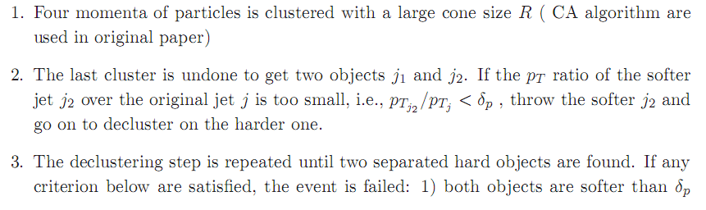
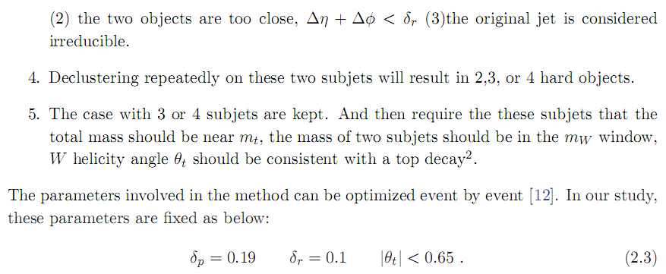
JH Top Tagger
John Hopkins Group PRL101 (2008)142001

Slide 14
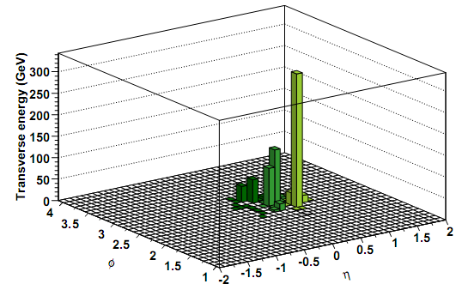
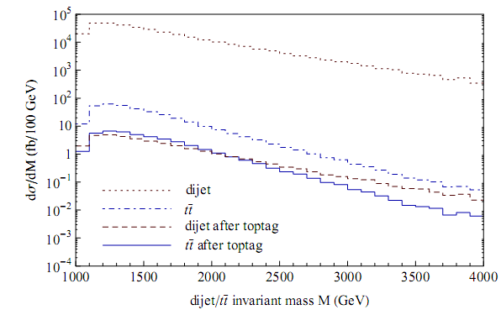
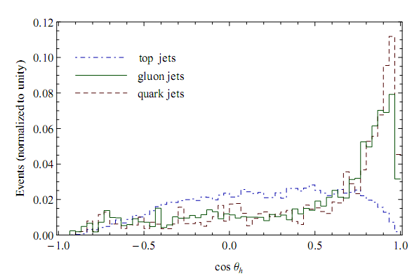
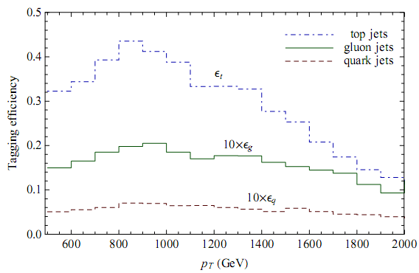

Slide 15
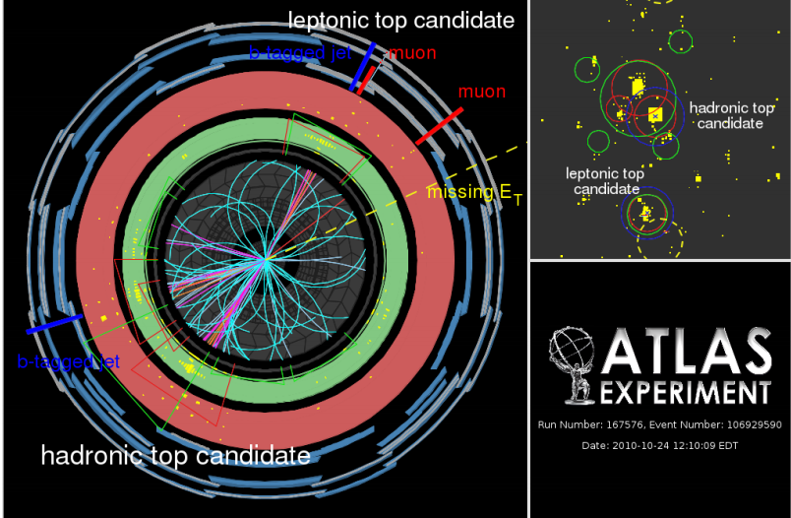
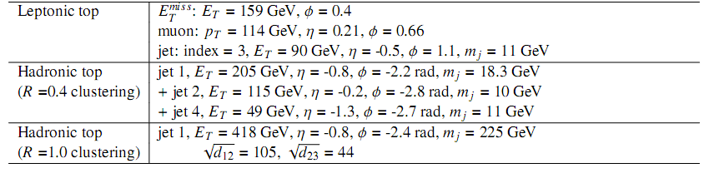
Exp for Jet Substructure

Slide 16


III. Hadronic b’ search with top-tagger and W-tagger
SY, Ji Jiang, Qi-Shu Yan, Xiaoran Zhao arXiv1405.2514
taggered top
taggered W

Slide 17
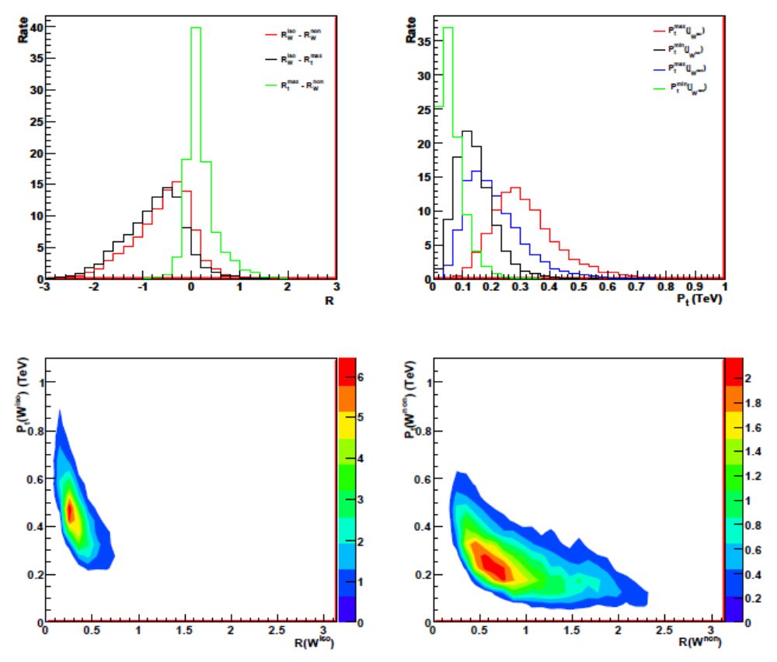
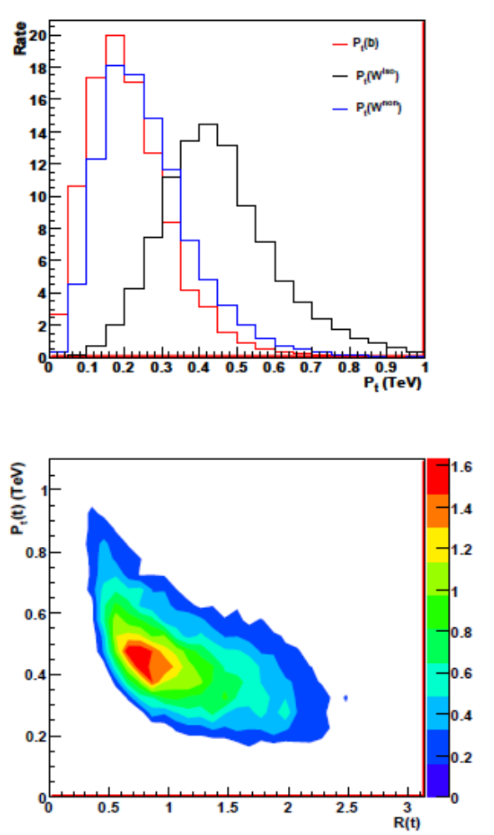
Features of the signal

Slide 18
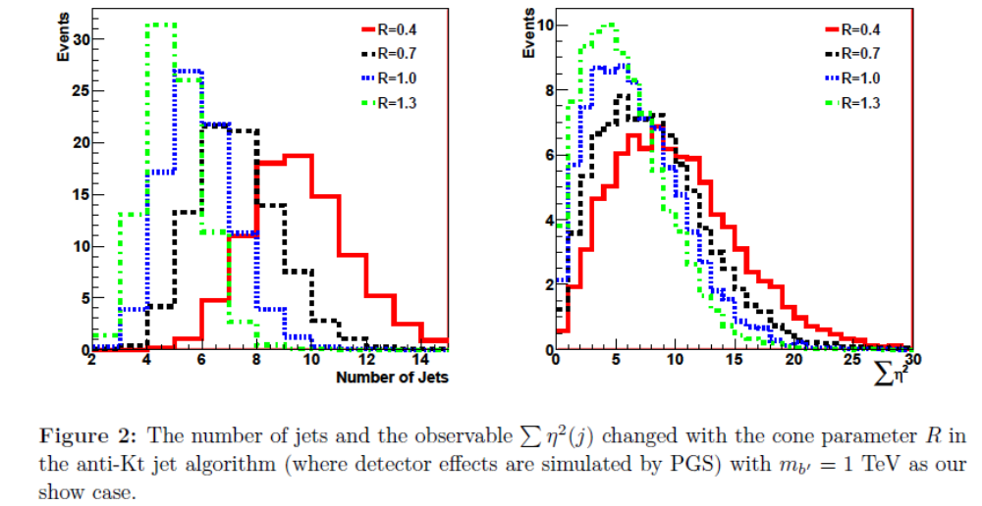

Slide 19
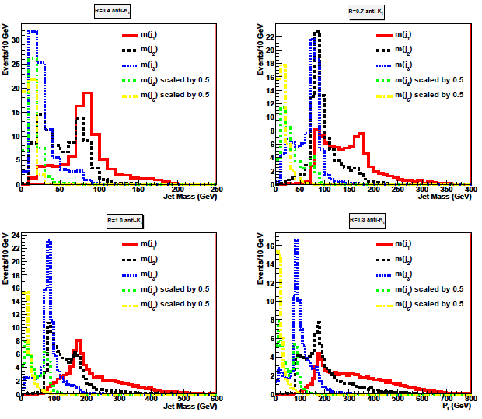

Slide 20
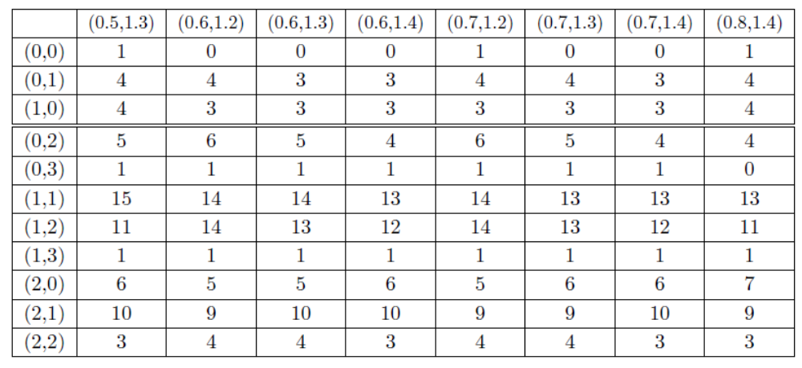
Tagged top and W
(HEPTopTagger and CMS Wtagger algorithms are used)

Slide 21
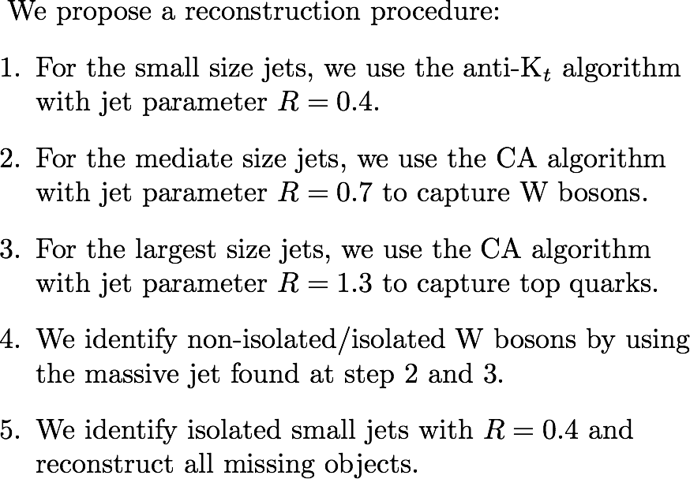



Part 3
14

Slide 22

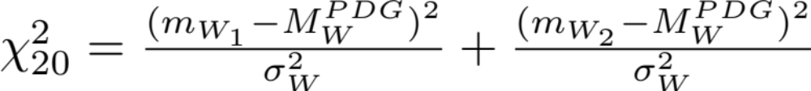
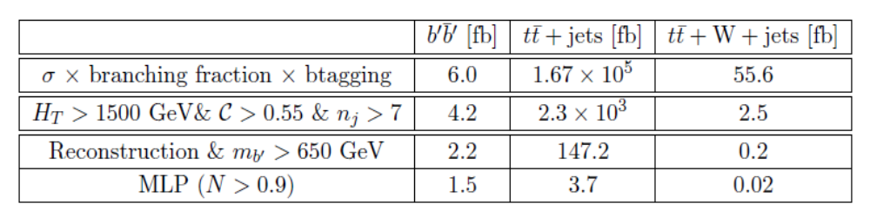

Part 3
Finding the missing objects:
9

Slide 23
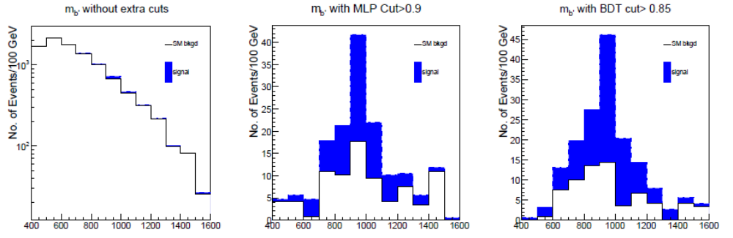
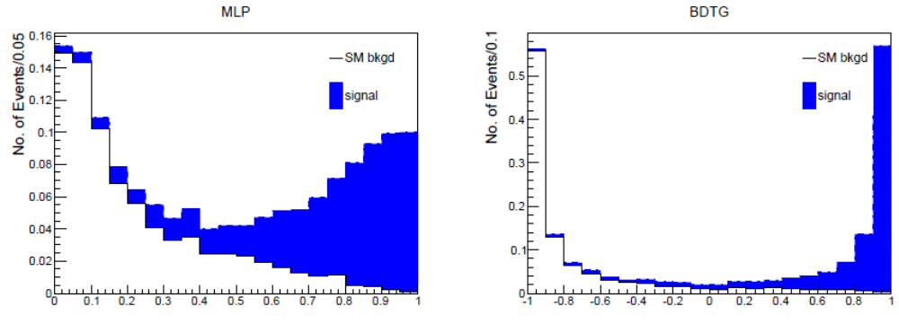
9

Slide 24
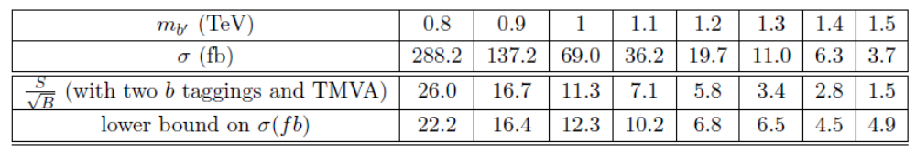
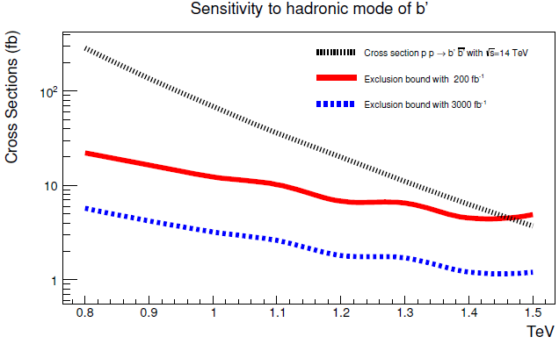
LHC sensitivity

Slide 25
IV Summary
Jet Substructure is helpful to identify highly boosted massive particles or to tell the jet origin.
By studying the processes pp →b’b’→twtw in fully hadronic mode, we find that the combinatorics can
be reduced and backgrounds can be suppressed
significantly with top taggers and W taggers.

Slide 26


Slide 27
Backup

Slide 28
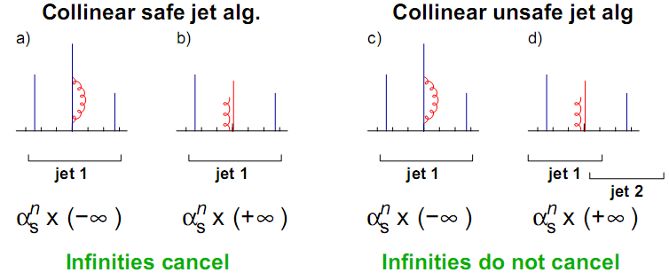
Illustration for collinear safety (left) and collinear unsafety in an IC-PR algorithm(right)

Slide 29
Refine the jet resolution
Filtering: break jet into subjets on angular scale Rfilt , take n filtered hardest subjets.
Trimming: break jet into subjets on angular scale Rtrim, take all subjets with Pt,sub>εPt,jet
Pruning: If the subjets about to be recombined have ΔR>Rprune and min(Pt1,Pt2)< ε(Pt1+Pt2), discard the softer one.

Slide 30
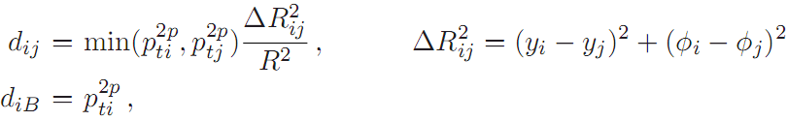
Calculate the distance dij between all pairs of pseudo-jets and the beam distance diB for each pseudo-jet.
Find the minimum in the list of dij and diB .
If the minimum is dij, recombine i and j into a new particle and then return to step 1.
If it is diB, define it as a final-state jet and remove it from the jet list. Return to step 1.
Iterate this process until the original list is empty, i.e., all peudo-jets have been clustered to jets.
The dij and diB in most popular sequential recombine algorithms for
use at the LHC can be parameterized as:
P is a parameter, 1 for kt, -1 for anti-kt, 0 for CA

Slide 31
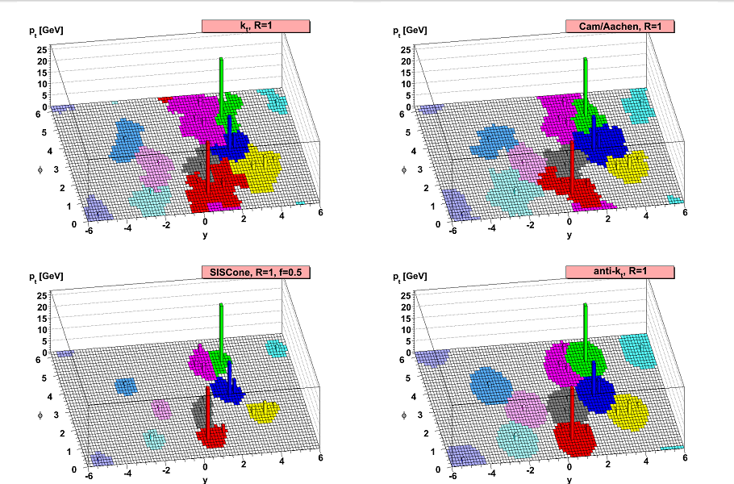
Borrowed from Salam’s talk

Slide 32
