Slide 1

Near Mass Degeneracy in the Scalar Meson Sector :
A Challenge to the Quark Model ?
Hai-Yang Cheng (鄭海揚)
Academia Sinica
in collaboration with Fu-Sheng Yu (Lanzhou Univ)
9th Workshop of TeV Physics Working Group in 2014
SYSU, May 17, 2014

Slide 2
1⁻ ½⁺
φ
Ξ
Κ∗
Σ
Λ
ω
ρ
N
f₀ = ss
κ = qs
σ=1/√2(uu+dd)
a₀⁺ = ud
0⁺
f₀
a₀
f₀
κ
κ
σ
a₀
σ
2-quark model
expt.

Slide 3
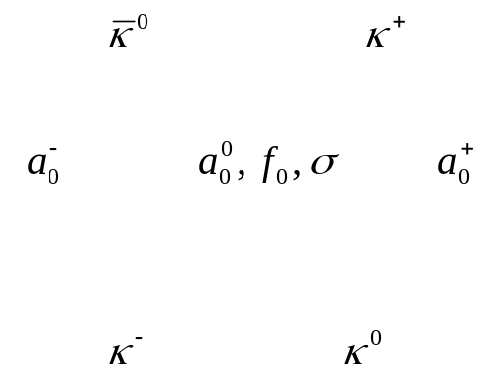
Scalar Mesons are p-wave mesons in 2-quark model
-
Consider J^{P}=0⁺ scalar mesons ⇒ L=1 if they are made of qq
Two nonets (nonet=octet+singlet) have been observed:
light nonet (< 1 GeV)
I=0: σ(500), f₀(980), I=1/2: κ(800), I=1: a₀(980),
heavy nonet (> 1 GeV)
I=0: f₀(1370), f₀(1500), f₀(1710), I=1/2: K*₀(1430), I=1: a₀(1450)
 | f₀(500) | K₀*(800) | f₀(980) | a₀(980)
mass (MeV) | 400-550 | 682±29 | 990±20 | 980±20
width (MeV) | 400-700 | 547±24 | 40-100 | 50-100
Why are f₀(980) & a₀(980) degenerate in mass ?
Why are σ (or f₀(500)) & κ (or K₀*(800)) much broader than f₀ & a₀ ?

Slide 4
Near mass degeneracy of scalar mesons
seems to be a universal phenomenon !
m(f₀(980)) = 990 ± 20 MeV, m(a₀(980)) = 980 ± 20 MeV
Near degeneracy between a₀(1450) & K₀*(1430)
m(a₀(1450)) = 1474 ± 19 MeV, m(K₀*(1430)) = 1425± 50 MeV
Near degeneracy between D_{s0}*(2317) & D₀*(2400)
m(D_{s0}*) = 2317.8 ± 0.6 MeV, m(D₀*) = 2318 ± 29 MeV
B_{s0}* & B₀* have not been observed yet, but the closeness of their
masses is strongly expected
A great challenge to the QM !!!

Slide 5
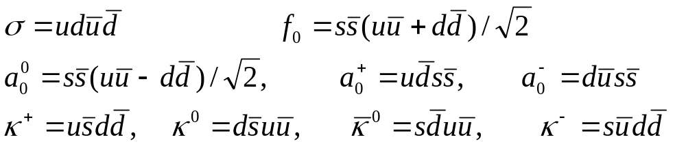
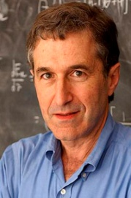

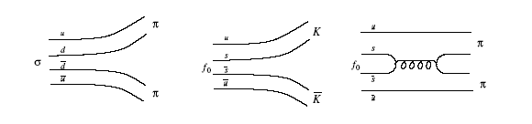
Tetraquark (4-quark)picture
Major difficulties with a₀ and f₀ can be circumvented in the four-quark model (Jaffe 1977)
Mass degeneracy between f₀ and a₀ is natural
σ→ ππ, κ→ Kπ & f₀, a₀ → KK are OZI allowed (fall apart) ,
while f₀→ ππ & a₀→ πη_{q} are OZI suppressed so that
Γ(4-quark)>>Γ(2-quark)
f₀(980) and a₀(980) are very close to KK threshold
) f₀(980) width is dominated by ππ, a₀ governed by πη state.
This explains why m_{σ} » Γ_{σ} » Γ_{κ} À Γ_{f} » Γ_{a}

Slide 6
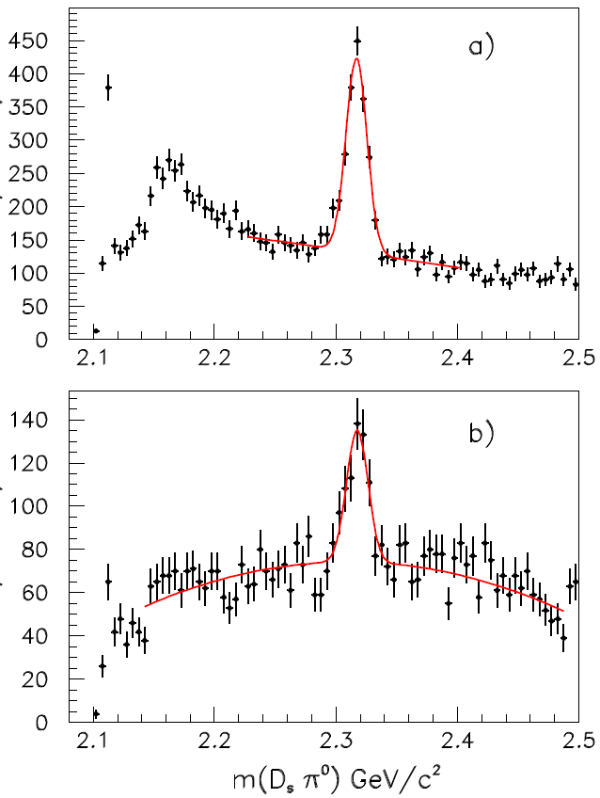
A new chapter in 2003 -- scalar charmed meson D_{s0}*(2317)
In 2003 BaBar observed a narrow scalar charmed meson D_{s0}*(2317) with mass of 2317 MeV and width less than 7 MeV, confirmed by Belle and CLEO
much smaller than the predictions of ∼ (2480-2510) MeV from potential models for D_{s0}*(2317) in a (cs) bound state
⇒ D_{s0}* state expected to be very broad in QM is actually very narrow as it is below DK threshold; the only allowed strong decay is isospin-violating D_{s}π⁰
A very striking observation !
D_{s0}*
D₀*
∼ 160 MeV
∼ 70 MeV
expt
Wei-Shu Hou and I (’03) proposed an S-wave four-quark (csnn) picture for D_{s0}*(2317) , hoping that it is lighter than 2-quark D_{s0}*(cs)

Slide 7
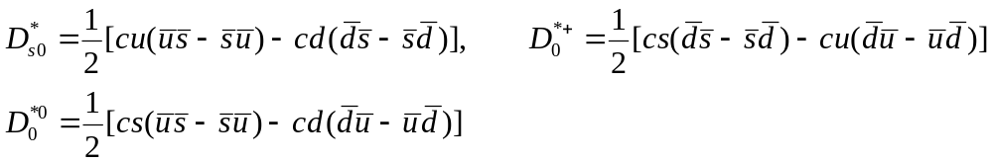
Some ideas
▬
Tetraquarks in 3_{A} multiplet have the same masses [Dmitrasinovic (’05)]
▬
▬
▬
▬
▬
▬
▬
cqqq ⇒ 3⊗3⊗3 = 3_{A}⊕ 3_{S}⊕ 6⊕15
Mass can be lowered by ’t Hooft’s instanton-induced quark interactions
▬
difficulty: (cq) 3 multiplet and sextet 6 tetraquark states have not been seen
Non-observation of a heavier & broad D_{s0}* is against the tetraquark picture
Instanton effects [Jin et al (’10)]
The same mechanism for mass degeneracy between K₀*(1430) & a₀(1450)

Slide 8
Mixing between cs & DK threshold ⇒ low mass of D_{s0}*(2317)
cq & Dπ state ⇒ low mass of D₀*(2400)
[van Beveren, Rupp (’03)]
This conjecture is realized by
• QCD sum rules [Dai, Zhu et al (’06, ’08)]
• Lattice [Mohler et al, PRL (’13)]
cs & DK interpolating fields ⇒ D_{s0}*(2317) below DK threshold
cq & Dπ interpolating fields ⇒ D₀*(2400) above Dπ threshold
Early lattice results without meson-meson interpolating fields yield D_{s0}* substantially above DK threshold
D_{s0}* mass becomes smaller in later unquenched simulations, but still larger than the data

Slide 9
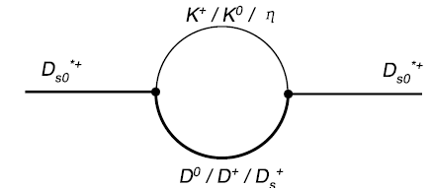
Poles of scattering amplitude on Riemann sheet in unitarized ChPT
pole below threshold in real axis ⇒ bound state
pole on 2nd Riemann sheet ⇒ resonance above threshold
A DK bound state is found with M=2312±41 MeV, which is precisely D_{s0}*(2317),
and a BK bound state (B_{s0}*) found with M=5725±39 MeV
However, it doesn’t work for D₀*, two I=1/2, S=0 resonances found: one board
with M=2097 MeV and one narrow state with M=2448 MeV
[Guo et al (’06); Cleven et al (’09); Torres-Rincon et al (’14)]
Mass shifts due to self-energy chiral loops [Guo, Krewald, Meissner (’08)]
Self energies can pull down scalar meson masses significantly

Slide 10
Heavy quark effective theory (HQET) &
Heavy meson chiral perturbation theory (HMChPT)
•
on-shell quark: p=m_{Q}v
off-shell quark: p=m_{Q}v+k k: residual momentum
m_{Q}
HQET: effective theory of QCD with m_{Q}→∞ and fixed v_{μ}; it possesses
heavy quark spin-flavor symmetry
Consider the strong decay D*→ Dπ. We shall use HMChPT to describe its dynamics; heavy quark symmetry (HQS) & chiral symmetry are synthesized
T.M. Yan et al (’92)
Wise (’92)
Burdman, Donoghue (’92)

Slide 11
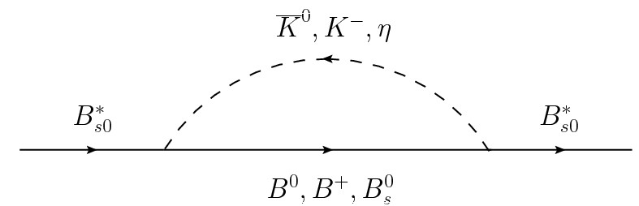
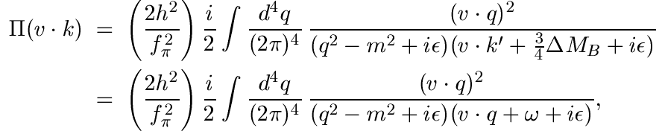

Mass shift in HMChPT
propagator of B_{s0}*
Δ_{S}: mass splitting between parity-even & parity-odd doublets
ΔM_{S}: mass splitting between spin partners of scalar doublet
loop integral: Cho (’93); (CLY)² (’94); Falk, Grinstein (’94)
Boyd, Grinstein (’95); Bernard, Kaiser, Meissner (’95)
Stewart (’98); Scherer (’03)
Loop divergence is absorbed by counterterms
There is a log term ln(Λ²/m²) with an arbitrary renormalization scale
Λ, which is often chosen to be Λ_{χ}, the chiral symmetry breaking scale

Slide 12
Mass shift: δM=M_{phys} – M_{bare}
Bare masses taken from potential model calculations:
Godfrey, Kokoski (’91); Di Pierro, Eichten (’01)
 | Bare mass | δM | M | Γ | Bare mass | δM | M | Γ
B_{s0}* | 5804 | -100 | 5704 |  | 5830 | -152 | 5678
B₀* | 5706 | -101 | 5605 | 73 | 5760 | -23 | 5737 | 477
D_{s0}* | 2487 | -249 | 2238 |  | 2480 | -235 | 2245
D₀* | 2377 | -34 | 2343 | 103 | 2400 | -80 | 2320 | 75
Self-energy correction will push down the masses of B_{s0}* and D_{s0}* more than that of B₀* & D₀*
However, mass shift is overshooting for D_{s0}*, the predicted mass of order 2240 MeV is too small compared to experiment. Near degeneracy cannot be explained by HMChPT
In sharp disagreement with Guo, Kewald, Meissner

Slide 13

Mass shift in a model
Since HMChPT fails to explain m(D_{s0}*) and near degeneracy in D sector, we will work in the conventional model without heavy quark & chiral expansion
 | Bare mass | δM | M | Γ | Bare mass | δM | M | Γ
B_{s0}* | 5804 | -85 | 5719 |  | 5830 | -105 | 5725
B₀* | 5706 | 4 | 5710 | 68 | 5760 | -37 | 5723 | 71
D_{s0}* | 2487 | -130 | 2357 |  | 2480 | -124 | 2356
D₀* | 2377 | -72 | 2305 | 124 | 2400 | -83 | 2317 | 131
It works much better than HMChPT
Near mass degeneracy in B sector is implied
Results sensitive to the renormalization scale Λ. Measured masses of D_{s0}* & D₀* can be well reproduced by setting Λ=1.85 GeV for D₀* and 1.93 GeV for D_{s0}*

Slide 14
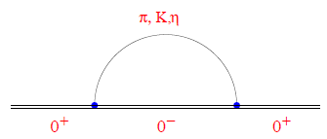
Low masses of D_{s0}* & D₀* and near mass degeneracy can be qualitatively understood as a result of self-energy effects due to strong coupled channels. However, we should not take them as quantitative predictions due to many uncertainties:
unknown input bare masses
contributions from other channels
dependence of renormalization scale Λ
1⁻
1⁺
Near degeneracy in B sector is implied by chiral loop calculations. Now we wish to make quantitative predictions on scalar B meson masses.

Slide 15
Masses of B₀* & B_{s0}*
B₀*, B_{s0}*, B’₁, B’_{s1} have not been seen yet. Near degeneracy is expected to work even better in B sector.
 | B₀* | B_{s0}*
Cleven et al (’14) |  | 5625±45
Lutz et al (’04) | 5526 | 5643
Torres-Rincon (’14) | 5530 | 5748
Guo et al (’06) | 5536±29 | 5725±39
Matsuki et al (’07) | 5592 | 5617
Orsland et al (’99) | 5592 | 5667
Vijande et al (’08) | 5615 | 5679
Cleven et al (’11) |  | 5696±40
Bardeen et al (’03) | 5627±35 | 5718±35
T. Lee et al (’07) | 5637 | 5634
Badalian et al (’08) | 5675±20 | 5710±15
 | B₀* | B_{s0}*
Lahde et al (’00) | 5678 | 5781
Z.G. Wang (’08) |  | 5700±110
Eichten et al (’06) | 5706 | 5804
Colangelo et al (’12) | 5708±23 | 5707±1
UKQCD (’08) |  | 5760±9
Dmitrasinovic (’12) | 5728±25 | 5716±25
Lakhina et al (’07) | 5730 | 5776
Ebert et al (’10) | 5749 | 5833
Sun et al (’14) | 5756 | 5830
Godfrey et al (’91) | 5760 | 5830

Slide 16
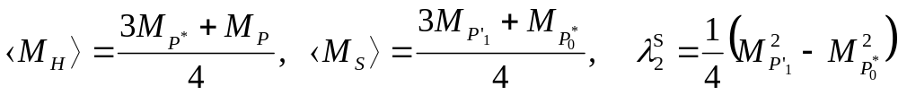
HQS for the masses of B_{s0}* & B₀*
Consider the two parameters Δ_{S} =<M_{S}> - <M_{H}> & λ₂^{S} in HMChPT
In heavy quark limit, both parameters are independent of heavy quark flavor
With input from the charm spectroscopy we obtain
M(B₀*)=5708±23, M(B_{s0}*)=5707±1, M(B’₁)=5753±31, M(B’_{s1})=5766±1
Colangelo et al (’12)
Near degeneracy in D sector will imply the same in scalar B sector via HQS

Slide 17


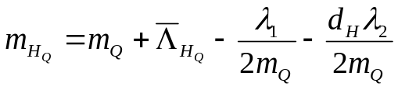
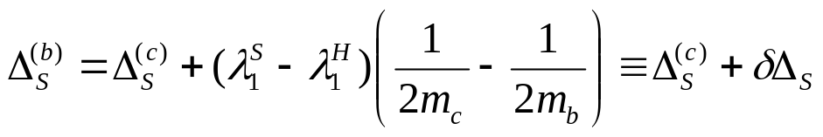
1/m_{Q} and QCD corrections
QCD corrections
0.89 ± 0.01 = 0.82 [1- O(α_{s})] + O(1/m_{Q}) ⇒ dominated by QCD correction
1/m_{Q} corrections
In heavy quark effective theory
M(B₀*)=5715±22 MeV + δΔ_{S} M(B_{s0}*)=5715±1 MeV + δΔ_{S}
M(B_{s0}*)=5715±22 MeV + δΔ_{S} M(B₀*)=5715±1 MeV + δΔ_{S}
δΔ_{S} is estimated to be of order -35 MeV or less
Near degeneracy is not spoiled by 1/m_{Q} & QCD corrections

Slide 18
B_{s0}* is below BK threshold, B’_{s1} below B*K threshold. The strong decays B_{s0}*→ B_{s}π⁰, B’_{s1}→ B_{s}*π⁰ violate isospin symmetry. Hence, they are very narrow. It will be even more difficult to identify B*₀
Recall D_{s0}*(2317)→ D_{s}π⁰
D_{s}⁺→ K⁺K⁻π⁺
D_{s}⁺→ K⁺K⁻π⁺π⁰

Slide 19
Proposals for near degeneracy of K₀*(1430) & a₀(1450)
Mixing of qq heavy scalar nonet with light tetraquark nonet
a₀(1450)
K₀*(1430)
[Black, Fairborz, Schecter (’00)]
K’₀*
a’₀
qq scalars are pushed up, while qqqq scalars are pushed down
a₀
K₀*
a₀(980)
K₀*(800)
Heavy scalar mesons form another tetraquark nonet
[Maiani et al (’07)]
f₀(1500)
a₀(1450)
K₀*(1430)
Difficulty: A qq nonet should exist around 1.2 GeV, but it has not been seen
f₀(1370)
Instanton effects
[Jin et al (’09)]

Slide 20
Bare mass | Λ | Δ M | M(K₀*)
1500 | 1150 | -36 | 1464
1550 | 1500 | -62 | 1489
Self-energy effect on a₀(1450) has not been studied: a₀(1450)→ ωρ, a₀(980)f₀(500)
f₀(1710)
primarily a glueball
f₀(1500)
a₀(1450)
degenerate in SU(3) limit
K₀*(1430)
f₀(1370)=1/3(uu+dd+ss) receives q-q annihilation contributions; f₀(1500)=1/6(uu+dd-2ss) doesn’t have q-q annihilation
f₀(1370)
When glueball-quarkonium mixing is turned on, f₀(1370) will have a slight mixing with glueball.

Slide 21
Conclusions
m(f₀(980)) = 990 ± 20 MeV, m(a₀(980)) = 980 ± 20 MeV
⇒ tetraquark picture for light scalar mesons
Near degeneracy between a₀(1450) & K₀*(1430)
m(a₀(1450)) = 1474 ± 19 MeV, m(K₀*(1430)) = 1425± 50 MeV
⇒ still no satisfactory explanation
Near degeneracy between D_{s0}*(2317) & D₀*(2400)
m(D_{s0}*) = 2317.8 ± 0.6 MeV, m(D₀*) = 2318 ± 29 MeV
⇒ Qualitatively, near degeneracy can be explained in terms of self-energy effects due to strong coupled channels
B_{s0}* & B₀* have not been observed yet, but the closeness of their
masses is strongly expected
⇒ Scalar B masses can be quantitatively deduced from HQS with input from charm spectroscopy. We predict M(B₀*) ∼ M(B_{s0}*) ∼ 5715 MeV + δΔ_{S}

