Slide 1
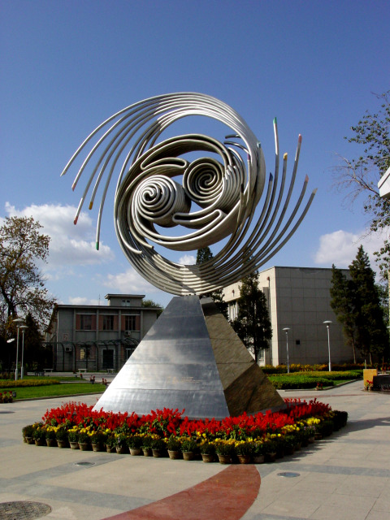








International Summer School on TeV Experimental Physics (iSTEP 2014)
Hosted by Institute of High Energy Physics (IHEP), Beijing
August 20-29, 2014
iSTEP is aimed to guide the first
steps of the beginners at particle
physics, such as senior undergraduate
and young graduate students.
As an experimental summer school,
hands-on tutorials will be provided
and honor prizes will be announced
at the end of school.
Theoretical Topics:
Electroweak Theory QCD Theory Collider Physics Phenomenology Higgs Physics Phenomenology
Super Symmetry – SUSY Theory
Non-SUSY Beyond Standard Model Monte Carlo Simulation and
Event Generator
Future of TeV Physics
The inaugural summer school
on TeV experimental physics will
provide lectures on both theoretical
and experimental particle physics
to develop our understanding of
physics at the TeV scale.
Experimental Topics: Accelerator Physics Detector and Event Reconstruction
Calorimeter Tracking and Vertexing Detector Muon Detector Trigger and Data Acquisition System Statistics Methods in Particle Physics Higgs Physics Experiments
Standard Model Precision
Measurements at Collider Experiments Hadron Physics Experiments SUSY Searches at Collider Experiments Non-SUSY New Physics Searches
at Collider Experiments
.
Apply before 15th June 2014 at:
http://indico.ihep.ac.cn/conferenceDisplay.py?confId=4127
Contact: liangliphy@sjtu.edu.cn, zhanghq@ihep.ac.cn
International Advisory Committee:
Yong Ban (PKU), Guoming Chen (IHEP), Hesheng Chen (IHEP, Chair)
Shenjian Chen (NJU), Yuanning Gao (THU), Tao Han (U. Pittsburgh/THU)
Xiangdong Ji(SJTU/U. Maryland), Shan Jin (IHEP), Xinchou Lou (IHEP)
Caidian Lu(IHEP), Yajun Mao (PKU), Shufang Su (U. Arizona)
Qing Wang(Tsinghua) , Liantao Wang (U. Chicago),
YiFang Wang (IHEP), Xueyao Zhang (SDU), Zhengguo Zhao (USTC)
Organizer Committee:
Mingshui Chen (IHEP), Xin Chen (Tsinghua) , Yaquan Fang (IHEP)
Liang Li (SJTU, Contact person), Qiang Li (PKU), Jianbei Liu (USTC)
Lianliang Ma (SDU), Manqi Ruan (IHEP), Dayong Wang (PKU)
Haijun Yang (SJTU), Huaqiao Zhang (IHEP, Contact person)
Hongbo Zhu (IHEP), Xuai Zhuang (IHEP)

Slide 2
Why Summer School?
Big physics ideas need big machines
Big machines need big number of people
US HEP community size ~ 10000
Europe HEP community size ~ 10000
Japan HEP community size ~ 2000
China HEP community size ~ 300
CEPC + SPPC: the need to increase current community size by a factor of 20-30!
Do it step by step: iSTEP [从娃娃抓起]
International Summer School on TeV Experimental Physics
Start from the beginner’s level, even senior undergraduates are welcome

Slide 3
How to do it?
Each year attract 60-100 new students
Each new student refers 1-2 friends
We might reach ~50% of the original goal after 20 years
Right on time for SPPC!
Obviously the key is to keep the students occupied and interested
Easier said than done
Keep in mind that the students do not know much about particle physics
Believe in the beauty of (particle) physics and curiosity of human nature
Please, for all lecturers, use less formulas, use more diagrams
According to Hawking, each new formula kills 50% potential students
OK, I lied, but you get the idea…

Slide 4
Who is doing it?
International Advisory Committee (alphabetical order):
Yong Ban班勇 (PKU), Guoming Chen陈国明 (IHEP), Hesheng Chen陈和生 (IHEP, Chair)
Shenjian Chen陈申见 (NJU), Yuanning Gao高原宁(THU), Tao Han韩涛 (U. Pittsburgh/THU)
Xiangdong Ji季向东 (SJTU/U. Maryland), Shan Jin金山(IHEP), Xinchou Lou娄辛丑(IHEP)
Caidian Lu吕才典(IHEP), Yajun Mao冒亚军(PKU), Shufang Su苏淑芳(U. Arizona)
Liantao Wang王连涛(U. Chicago), Qing Wang王青(Tsinghua)
YiFang Wang王贻芳(IHEP), Xueyao Zhang张学尧(SDU), Zhengguo Zhao赵政国(USTC)
Most of them do not even know that they are in the committee (sh!)
Organizer Committee (alphabetical order): :
Mingshui Chen陈明水(IHEP), Xin Chen陈新(Tsinghua) , Yaquan Fang方亚泉(IHEP)
Liang Li李亮(SJTU, Contact person), Qiang Li李强(PKU), Jianbei Liu刘建北(USTC)
Lianliang Ma马连良(SDU), Manqi Ruan阮曼奇(IHEP), Dayong Wang王大勇(PKU)
Haijun Yang杨海军(SJTU), Huaqiao Zhang张华桥(IHEP, Contact person)
Hongbo Zhu朱宏博(IHEP), Xuai Zhuang庄胥爱(IHEP)
Please join us!
Be an advisor or organizer, a lecturer, or simply a helper
We need all the help we can get

Slide 5
Who is teaching it?
Confirmed lecturers (random order, partial list):
陈和生:开幕致辞/中国高能物理现状和展望
曹庆宏: Electroweak Theory, Collider Physics Phenomenology
高杰: Accelerator Physics
司宗国: QCD Theory
曼奇: Detector and Reconstruction Overview
胡涛: Calorimeter
晏启树: MC Generator
杨金明: SUSY
杨李林: Higgs Physics Phenomenology
姜春华: Muon Detector
刘振安: Trigger/DAQ
李海波: Hadron Physics Experiments
庄胥爱: SUSY Searches at Collider Experiments
Bruce Mellado: Higgs Physics Experiments, Non-SUSY New Physics Searches at Collider Experiments
Keisuke Fujii: Tracking &Vertexing Detector
Glen Cowan: Statistics Methods in Particle Physics
Thanks a bunch!
Full agenda finalizing as we speak
Funding limits the number of foreign lecturers and students
Students can be admitted directly by organizers or advisors, or apply by themselves (need a reference letter)
Application deadline: June 15, 2014 (for those who self-apply)
Registration deadline: June 30, 2014 (for everyone)
http://indico.ihep.ac.cn/conferenceDisplay.py?confId=4127
Please nominate good speakers (e.g. Future of TeV Physics?)

Slide 6
Most important of all
We need more money, hehe
60 students X 10 days at IHEP
Average cost: 2000 RMB/person
More cost: foreign lecturers travelling, cookies, lecture room, excursion, 10 fellowships etc.
Registration fee: 1000 RMB
Total cost: ~ 260K RMB
Require: 200K RMB
Funding support:
NSFC (pending): 50K RMB
CHEP, PKU (confirmed): 50K RMB
CHEP, Tsinghua (confirmed): 20-30K RMB
Others?
Please help!
Thanks to all the organizers and advisors, especially lecturers, let’s do it and keep the momentum going for 20 years!

