Slide 1
21cm Hydrogen spectrum anomaly and dark matter
Qiaoli Yang
Jian University
Phys.Rev.Lett. 121 (2018) 111301
Nick Houston, Chuang Li, Tianjun Li, Qiaoli Yang, Xin Zhang.
Phys.Rev.Lett. 108 (2012) 061304
O. Erken, P. Sikivie, H. Tam, Q. Yang.
Phys.Rev.Lett. 103 (2009) 111301
P. Sikivie, Q. Yang.

Slide 2
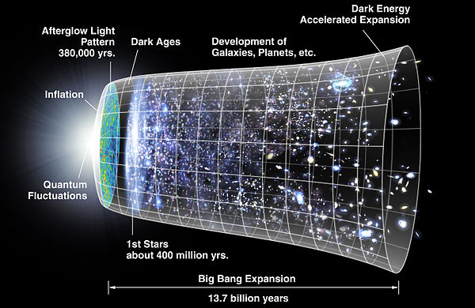
Dark Ages
picture by NASA

Slide 3
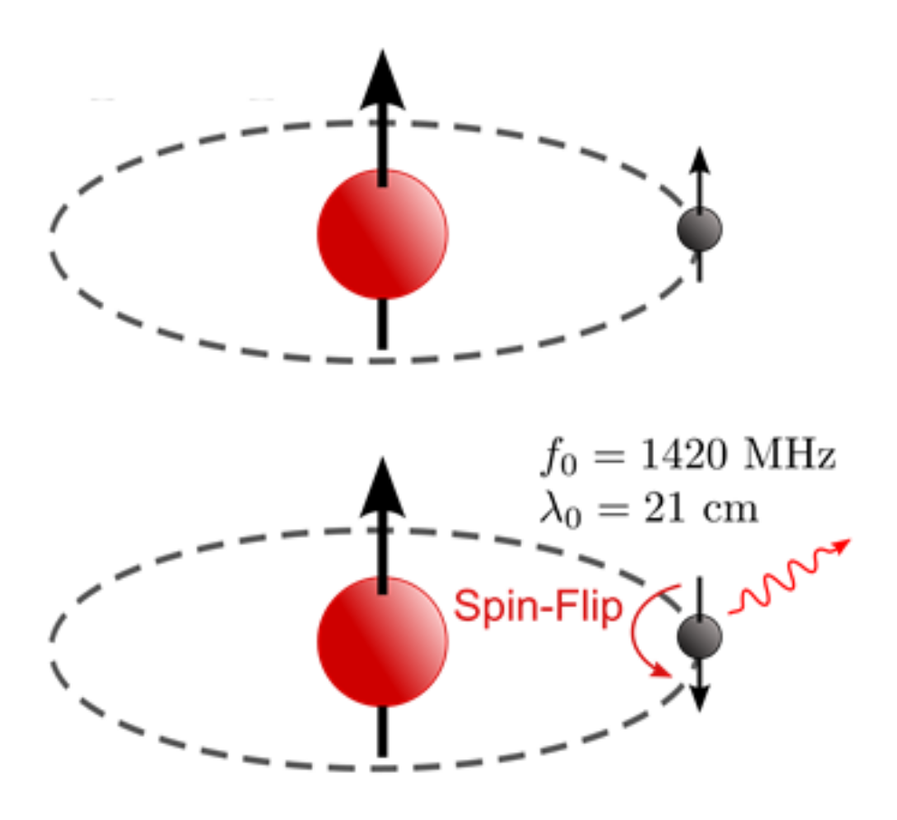
21 cm transition

Slide 4
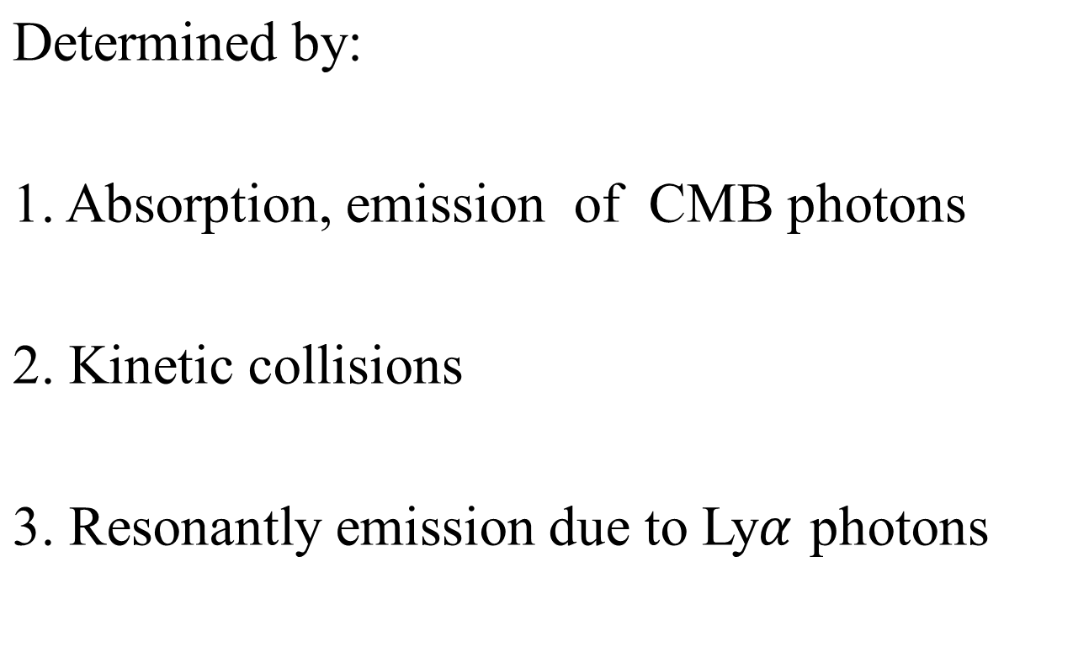
Spin temperature

Slide 5
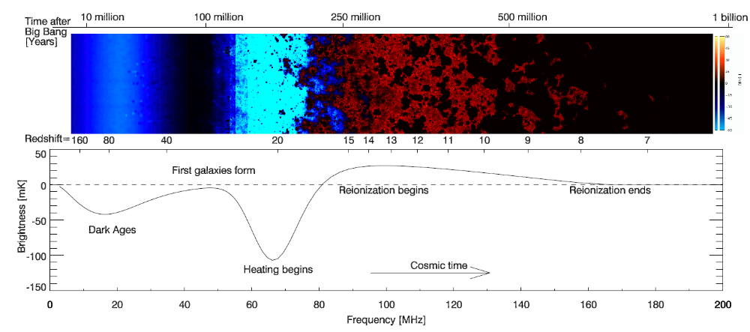
Dark Ages
Rep. Prog. Phys. 75, 086901 (2012), J. Pritchard, A. Loeb.

Slide 6
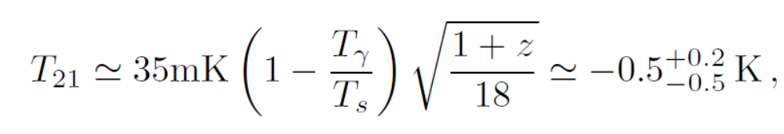

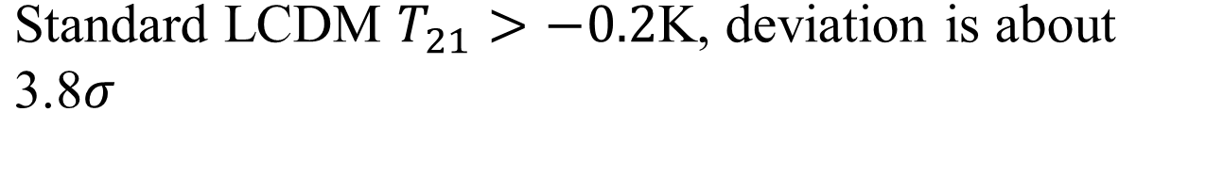
The EDGES anomaly

Slide 7
Cold Dark Matter (CDM)
CDM is widely believed to be an important part of the universe based on a large number of observations:
Dynamics of galaxy clusters.
Rotation curves of galaxies.
Abundance of light elements.
Gravitational lensing.
Anisotropies of the CMBR.

Slide 8

CDM
Accounts 23% of total energy density of universe while baryonic matter accounts 4%.
Properties:
a. Pressureless
  Primordial velocity is very small , at most
  ~ today .
  b.Collisionless
Cold dark matter is weakly interacting (so dark), except for gravity.

Slide 9
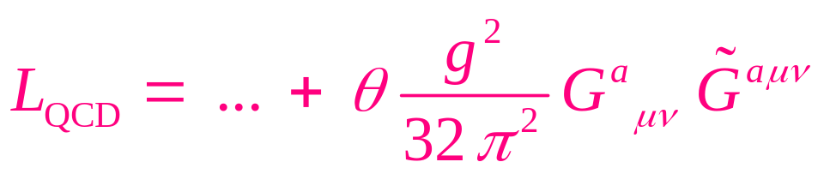

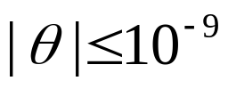
Axion Properties
Introduced to solve the strong CP problem of the standard model.
In QCD, a formally total divergence term cannot be neglected due to the instanton solutions.
This term violates CP invariance if
The measurement of electric dipole moment of neutron gives a upper limit:

Slide 10
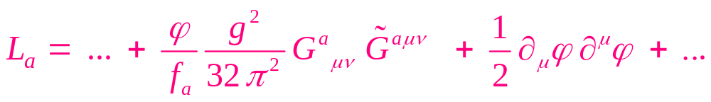
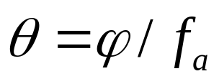
To solve the strong CP problem, one introduces a new U(1) symmetry that is spontaneously broken
where relaxes to zero.
A pseudo-Nambu-Goldstone boson is produced

Slide 11
After QCD phase transition, the “PQ” Nambu-Goldstone boson acquires mass due to instanton effects, hence becoming a quasi-Nambu-Goldstone boson, the “axion”.
Axion models: PQWW, KSVZ, DFSZ.
Axion like particles (ALPs) can also arise from string compactifications.

Slide 12
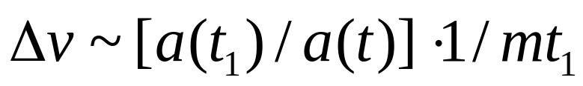
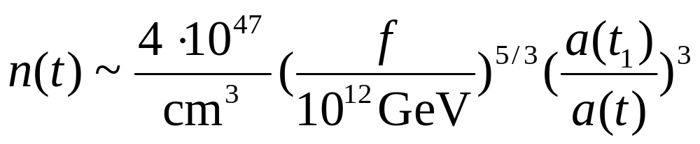
Cold axion properties
Small velocity dispersion:
.
High physical space density:

Slide 13
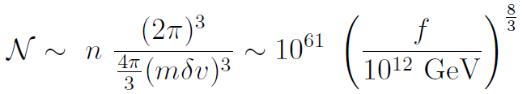
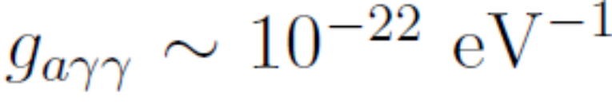
Cold axion properties
High phase space density due to 1&2:
Particles number is effectively conserved:

Slide 14
Cold axions form BEC if they thermalize
BEC results from the impossibility to allocate additional charges to the excited states for given temperature.
Axion particle number is effectively conserved and is the relevant charge.
Cold axions’ effective temperature is below the critical temperature which is very high due to axions high number density.

Slide 15
axion BEC in three arenas:
1. in the linear regime within the horizon.
2. in the non-linear regime within the horizon.
3. upon entering the horizon.

Slide 16
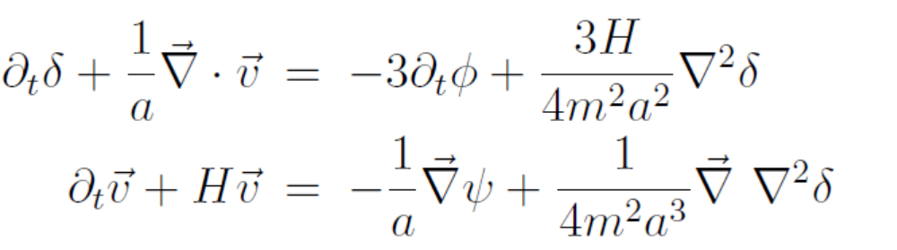

Axion BEC in the linear regime within horizon.
From first order of density perturbation theory within the horizon, we get:
where

Slide 17
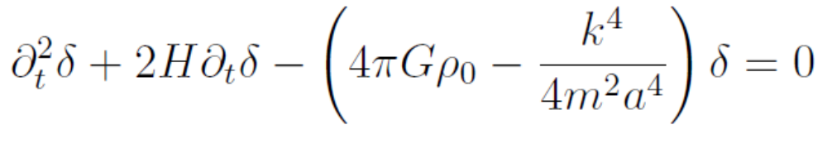
This implies a nonzero Jeans length compared with the collisionless DM.
From equation above, one gets:

Slide 18
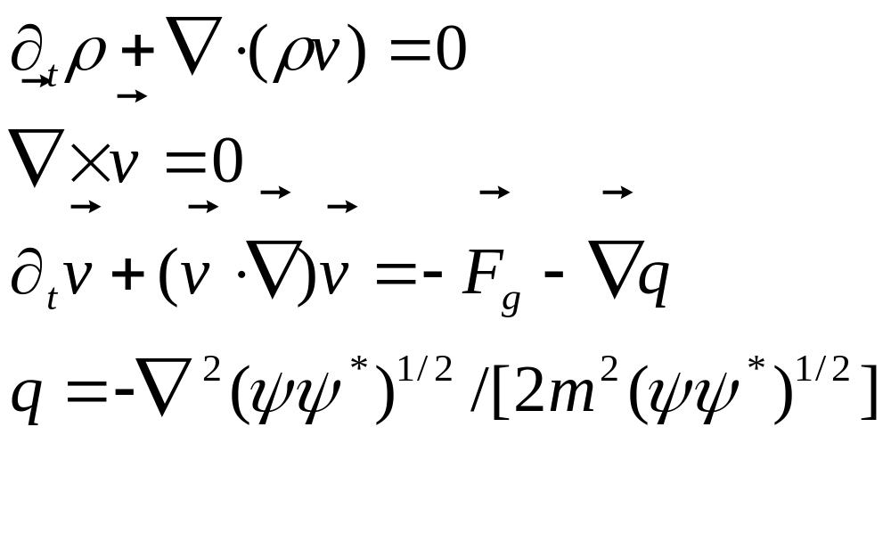
The equation of motion in non-linear regime within horizon:

Slide 19
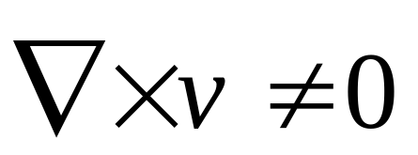
In the galactic halos BEC has the property
by appearance of vortices.
BEC is consistent with small scale structures.

Slide 20


Most many particle systems are in the particle kinetic regime where:
The cold axions are in the opposite regime:
Let us call it “condensed regime”.

Slide 21
The question is: starting with an arbitrary initial state, how quickly will the average axion state occupation numbers approach a thermal distribution?

Slide 22
We derive evolution equations for the out of
equilibrium system, as an expansion in powers of the coupling strength.
The first order terms average to zero in the kinetic regime. The second order terms yield the ordinary Boltzmann equation.

Slide 23
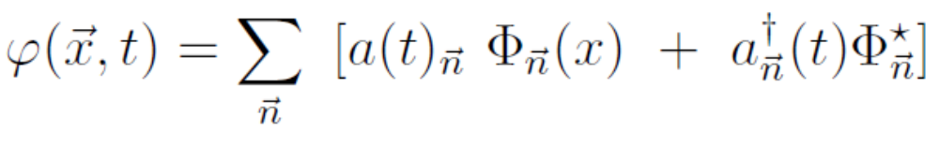

The axions can be written:
The Hamiltonian is

Slide 24
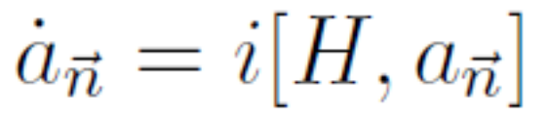


Solve the Heisenberg equation
perturbatively,
where: .
One gets:

Slide 25
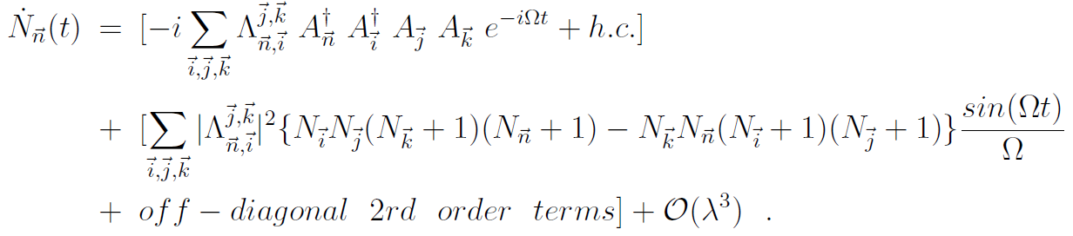

Slide 26

The second order terms yield the Boltzmann equation. The first order terms, along with the off diagonal second terms average to zero in the “kinetic regime”.
In the condensed regime, the first order terms no longer average to zero and dominate. Considering the high occupation numbers of axion states, we can replace the operator A, A⁺ with complex numbers whose magnitude is of order .

Slide 27
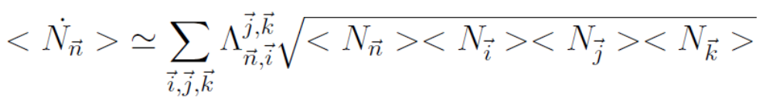

We get a c-number equation:
which lead to the thermalization rate :
for the gravitational interaction.

Slide 28
