Slide 1
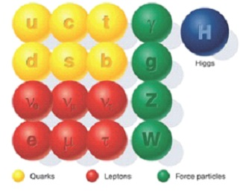
Lecture 6 Some Discussions of SM

Slide 2

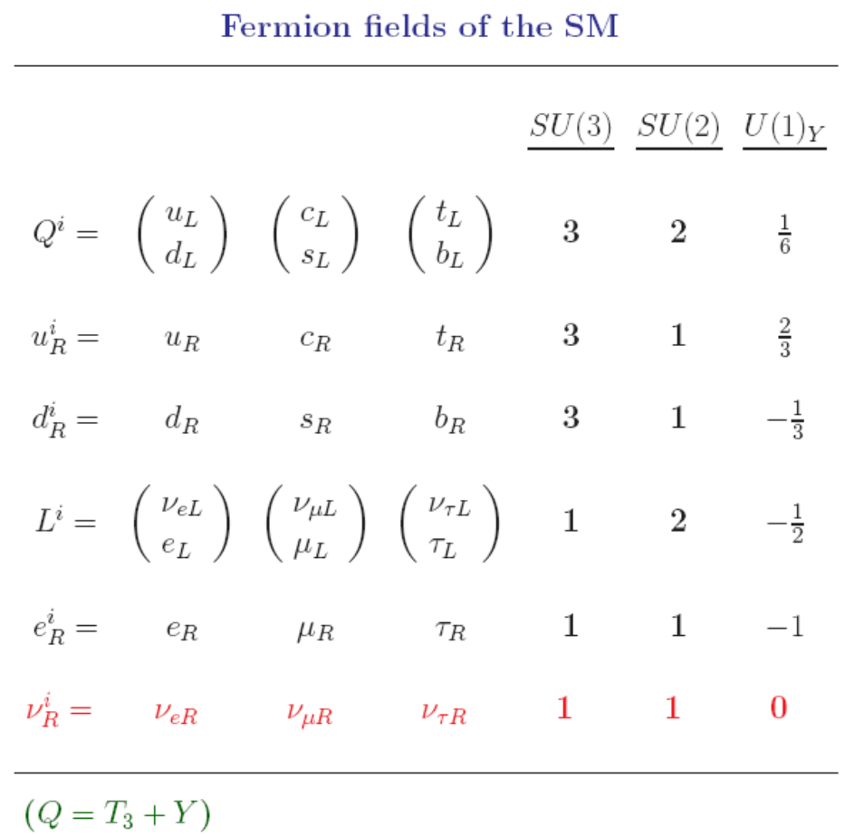
(1) Chiral fermions

Slide 3
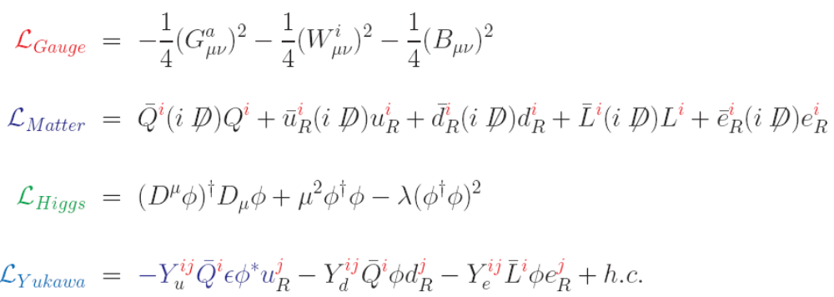

Slide 4

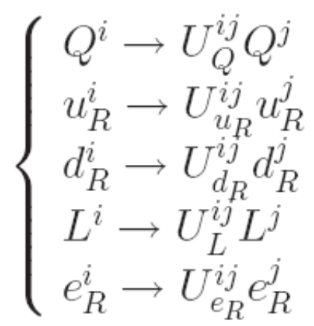



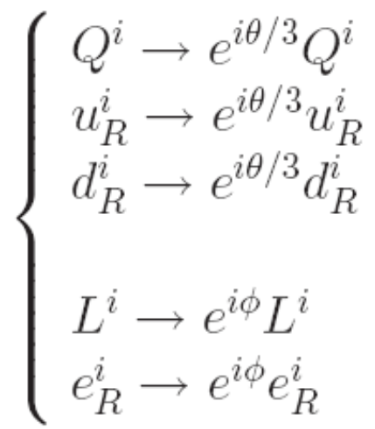






(2) Global flavor symmetry

Slide 5
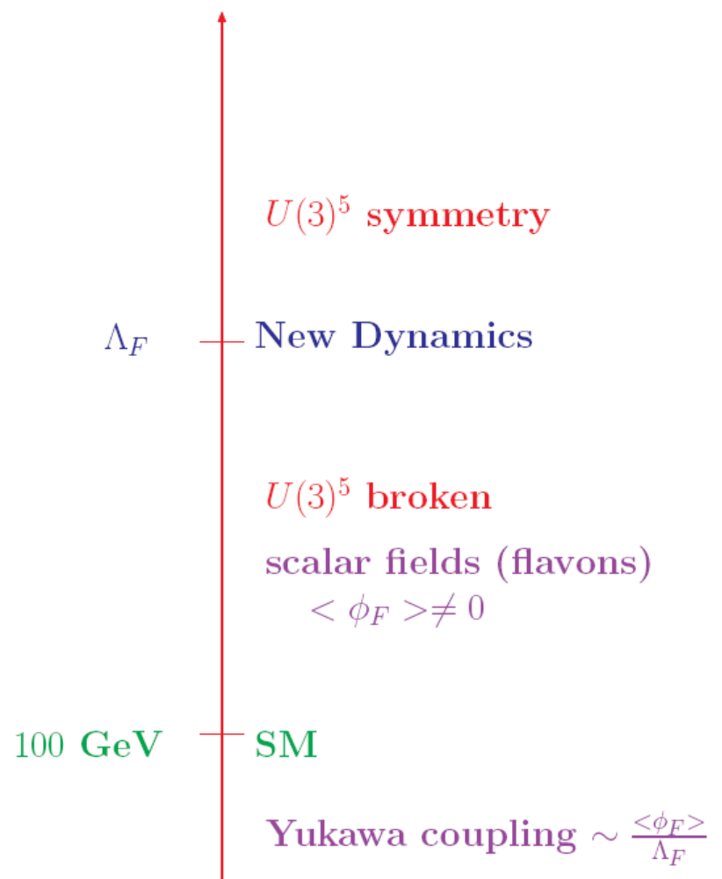
Flavor dynamics ?

Slide 6
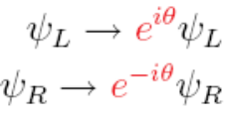
approximate symmetry
broken by instanton effects (very very small)
SU_{L}(3)×SU_{R}(3)
SU_{V}(3)
(if m_{u}=m_{d}=m_{s}=0)
(if m_{u}=m_{d}=m_{s}≠0)
SU_{L}(2)×SU_{R}(2)
SU_{V}(2)
QCD
(if m_{u}=m_{d}=0)
(if m_{u}=m_{d}≠0)
U_{A}(1)
broken by anomaly
(classical level)
(quantum level)
C, P
broken by θ-term

Slide 7


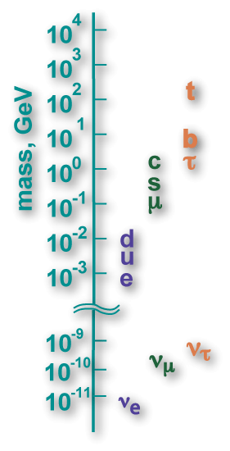


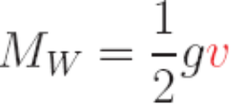
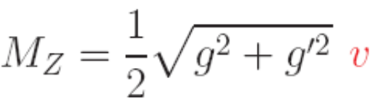

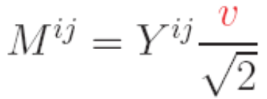



7/18

Slide 8
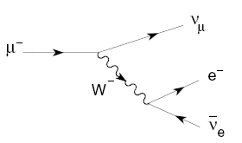


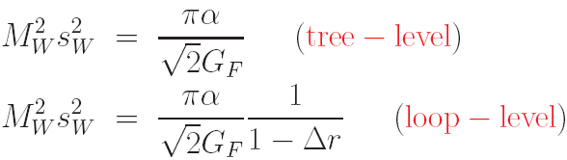
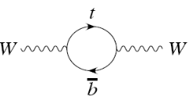
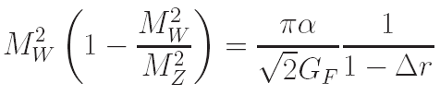
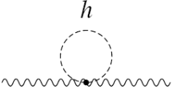
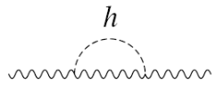


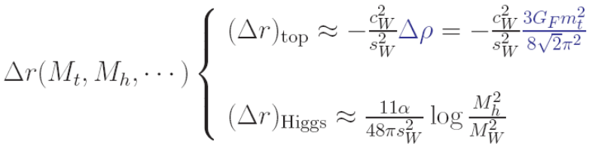
(4)

Slide 9
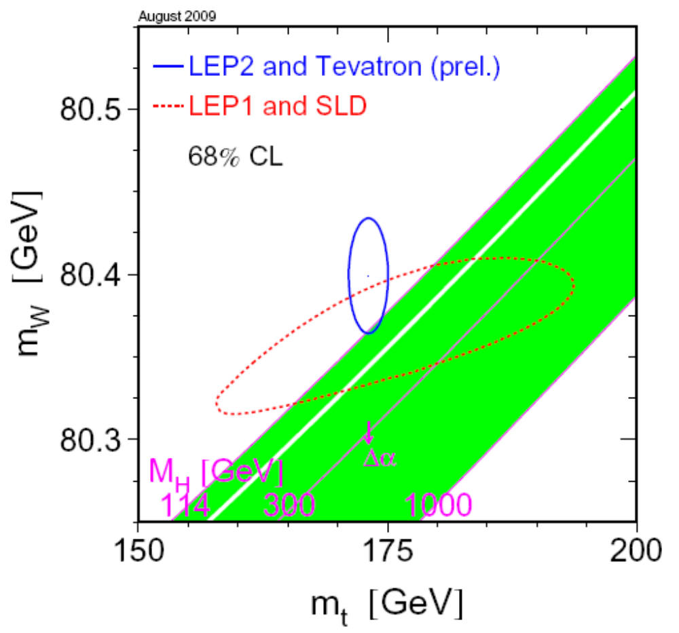
9/18

Slide 10
A comparison of direct and indirect determinations of the masses of the Higgs Boson
J. H. Field （2017）
A model-independent analysis finds an indirect value of Higgs mass of ≃ 70 GeV, below the directly measured value of 125.7± 0.4 GeV
A goodness-of-fit test to the Standard Model using all Z-pole observables and W-mass has a chi-square probability of ≃ 2%

Slide 11
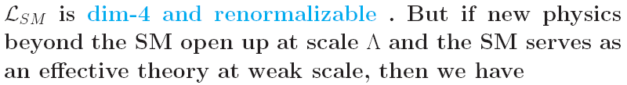

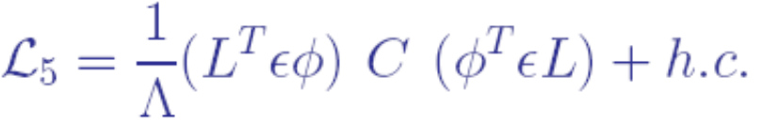
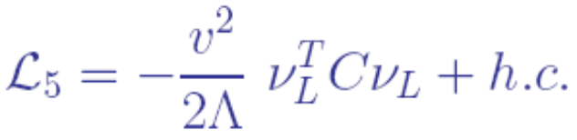
(5)
11/18

Slide 12

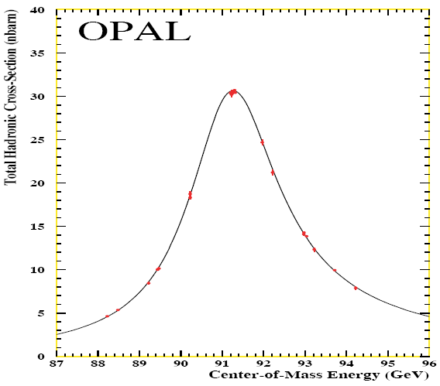
(6)

Slide 13

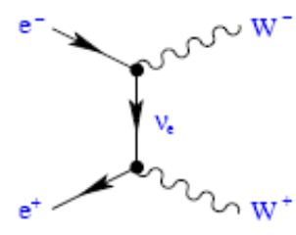
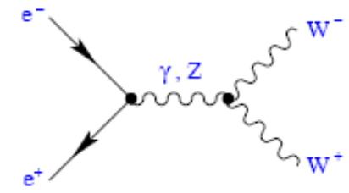
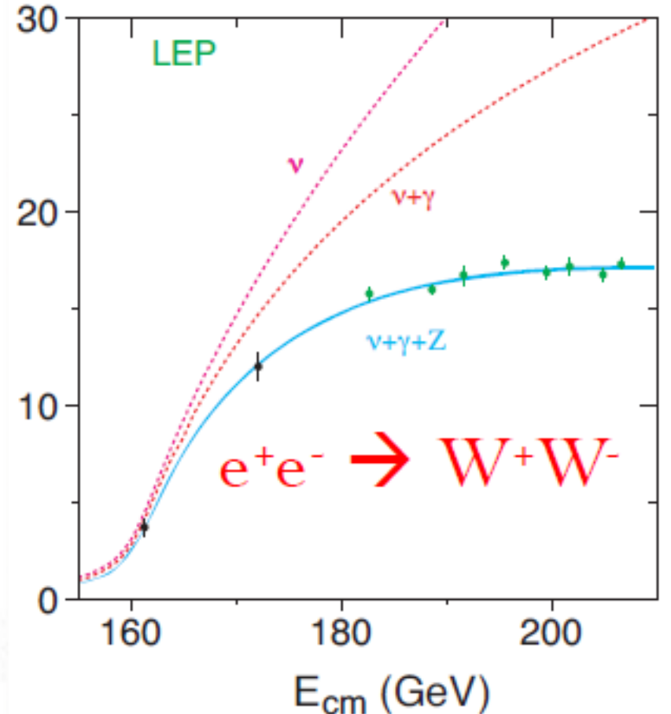

Slide 14
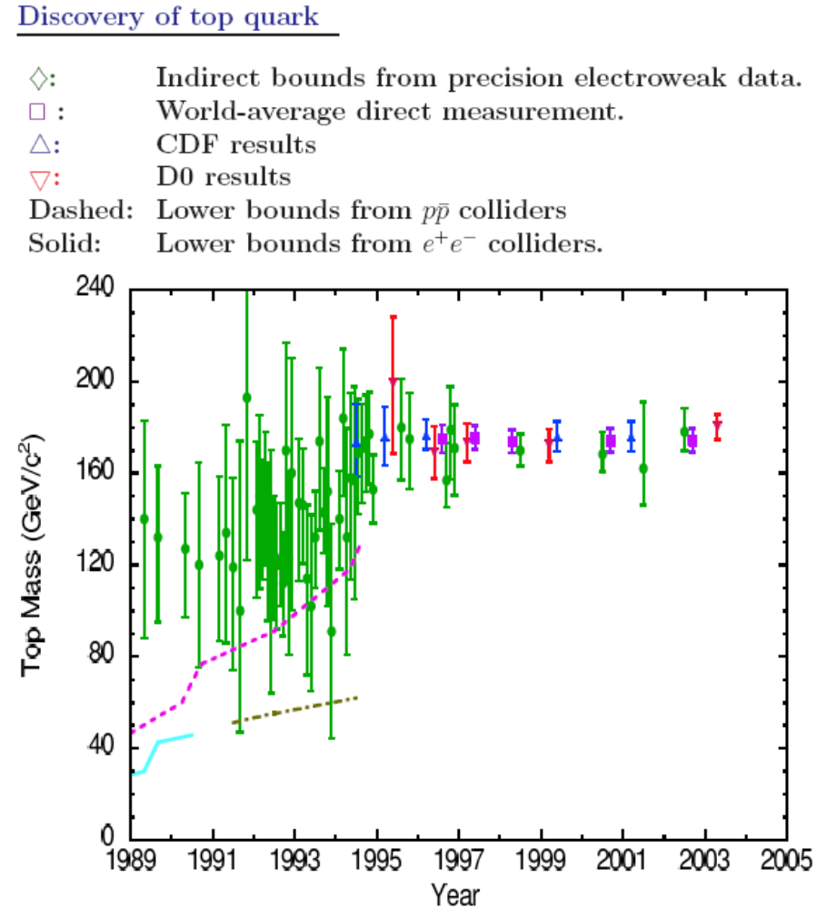
14/18

Slide 15



(7) Problems or Crisis ?
(from particle expt )
A_{FB} at LEP:
Cosmic dark matter
(a real crisis ? )

Slide 16

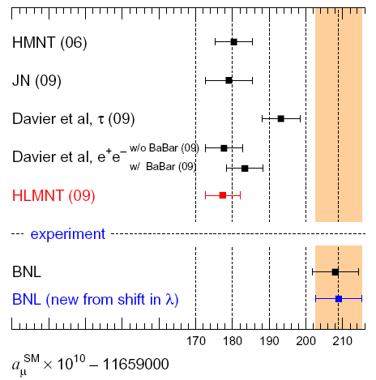
16/18

Slide 17
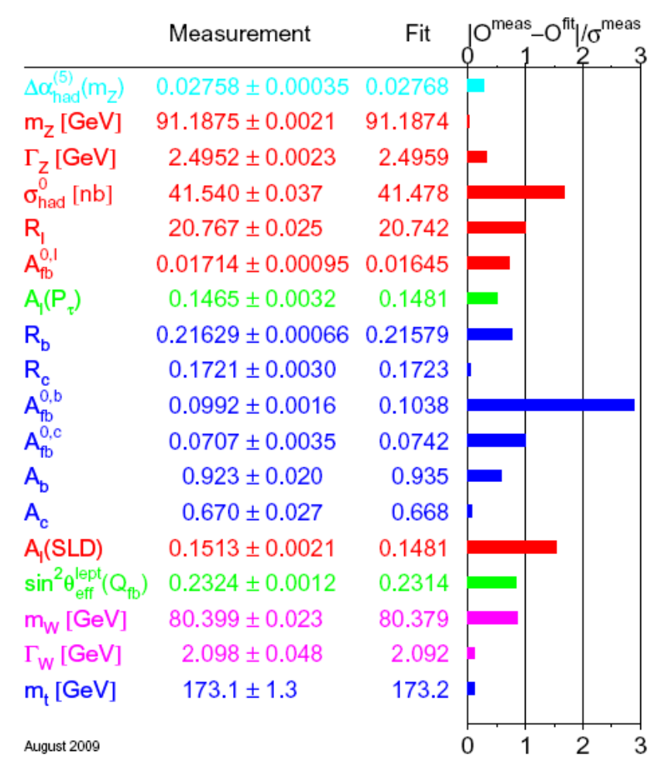
A_{FB} at LEP:

Slide 18

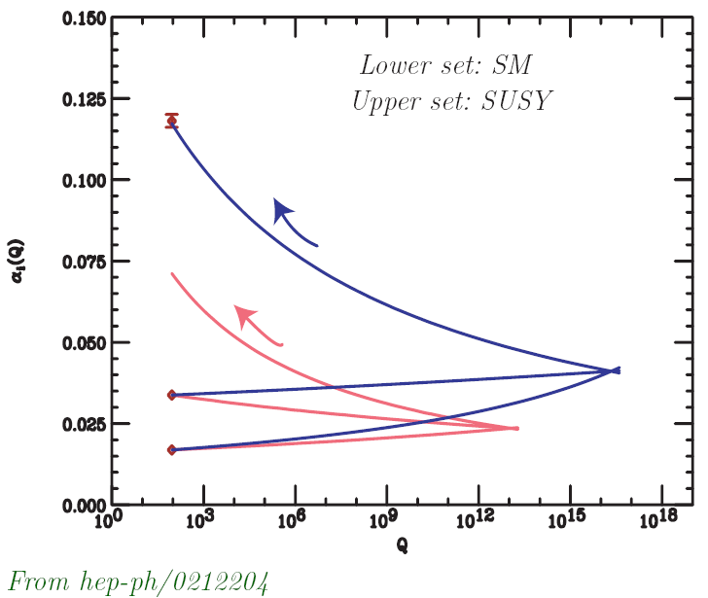
18/18

Slide 19

下课了

