Slide 1

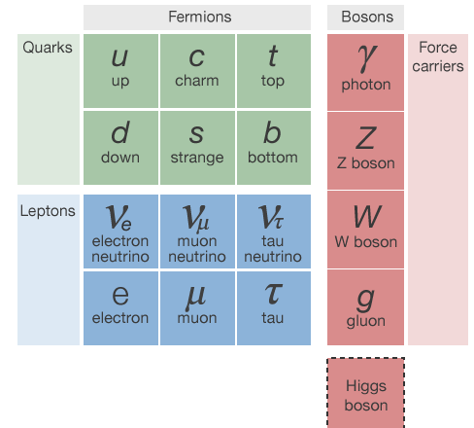

Slide 2



















Slide 3
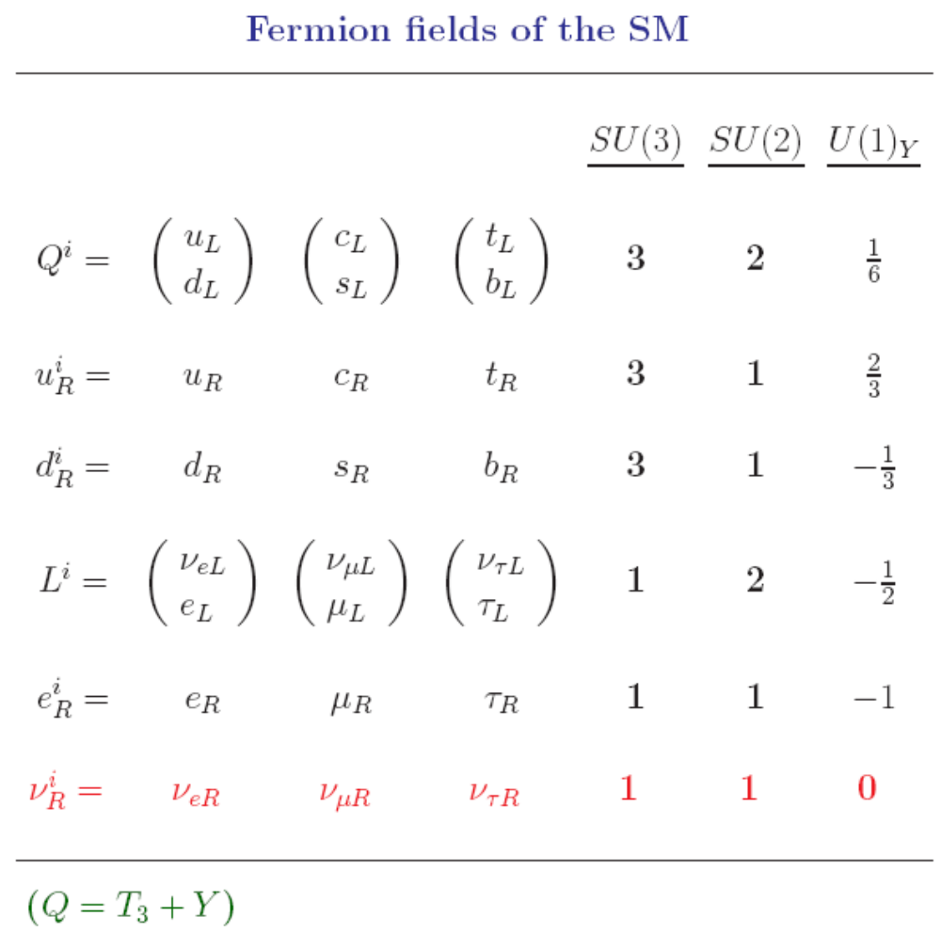
3/18

Slide 4
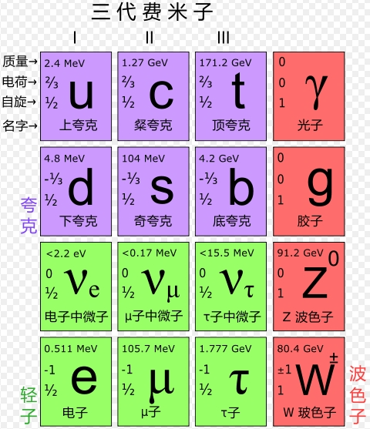
4/18

Slide 5



5/18

Slide 6
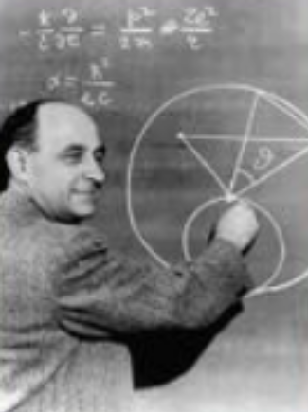
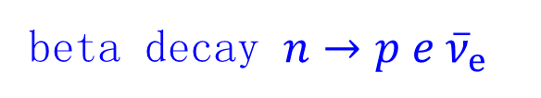
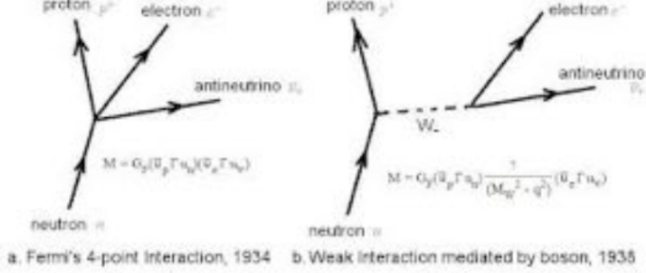
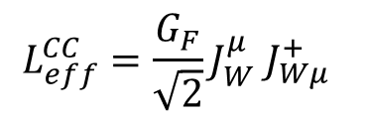
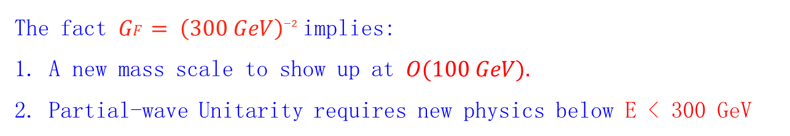
The Weak Nuclear Force
Tao Han
iSTEP 2017

Slide 7
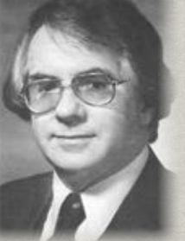
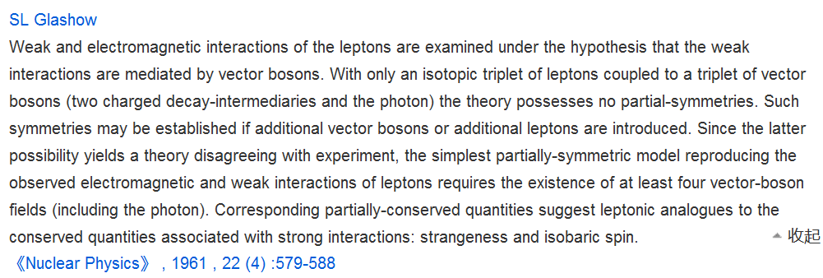
The Idea of EW Unification
Partial-symmetries of weak interactions

Slide 8

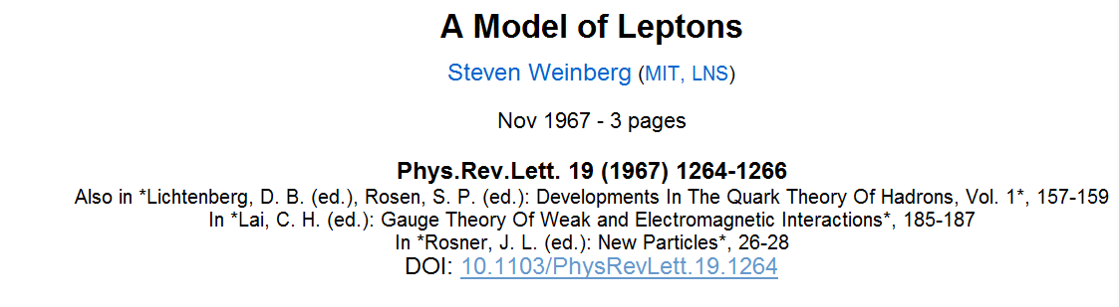
The birth of the Standard Model
In 1967, Weinberg produced a gauge theory that correctly predicted electromagnetic and weak nuclear forces. This was later to become known as the electroweak theory. In his paper, 'A model of leptons', he showed that although electromagnetism is much stronger than the weak force of everyday energies, the only way to devise a theory of the weak force is to include the electromagnetic force. Weinberg showed how what was seemingly impossible could be achieved and the forces could be unified through the interchange of particles in spite of the difference in their strengths. Abdus Salam had independently reached the same conclusions and what became known as the Weinberg-Salam model was a major advance on earlier models that had originally been applied to leptons... (Chris Cooper, Physics).

Slide 9


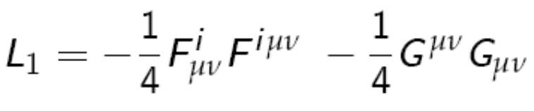


6/18

Slide 10
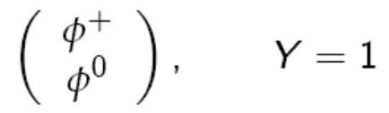



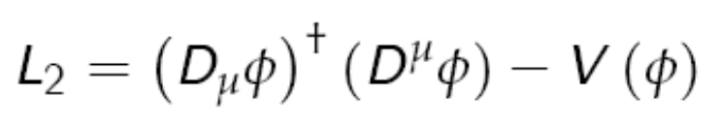
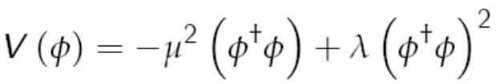

7/18

Slide 11
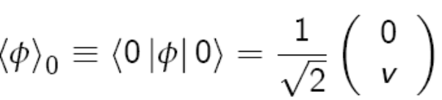
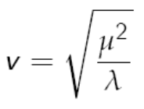


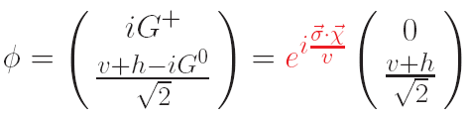

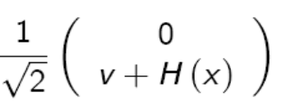

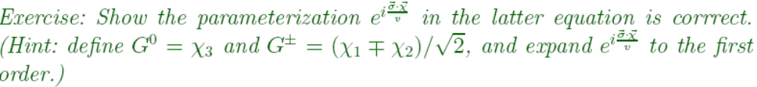
8/18

Slide 12



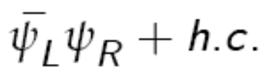
9/18
is not SU(2) invariant

Slide 13
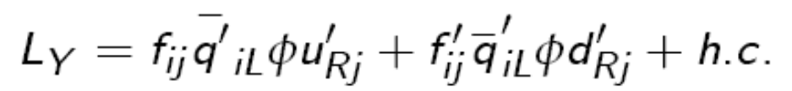
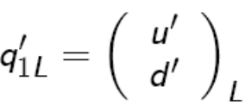

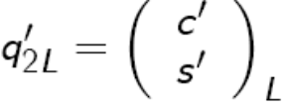
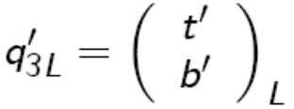
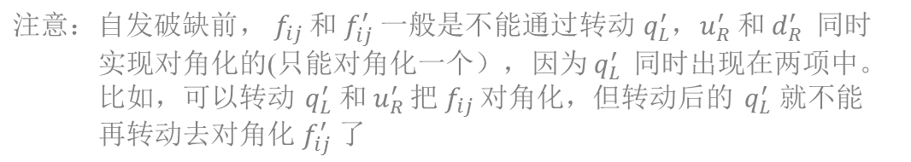
10/18
arbitrary matrix
not hermitian

Slide 14
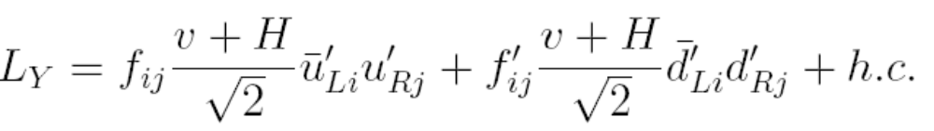

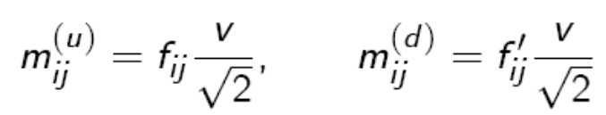





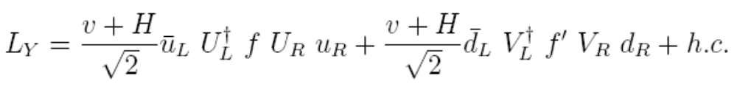
11/18
Unitary rotations:
diagonalized by bi-unitary transformation
Quark mass matrix & Yukawa couplings
黑格斯没有树图的
FCNC Yukawa 耦合
simultaneously diagonalized

Slide 15
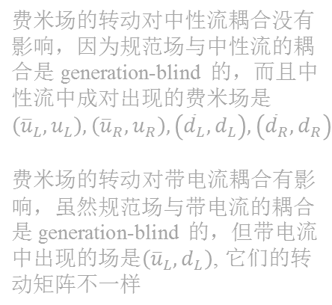
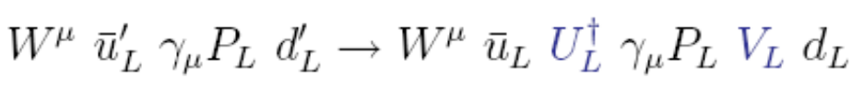
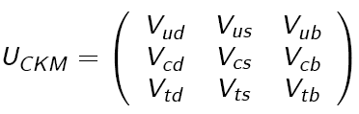


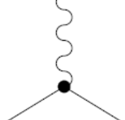
Fermions’ unitary rotations
have only one impact in gauge couplings:
Charged current coupling:
also unitary
For example: top decays
t → W d ~ |V_{td}|²
t
d, s, b
distinguishable
e.g., b-tagging
t → W s ~ |V_{ts}|²
t → W b ~ |V_{tb}|²

Slide 16
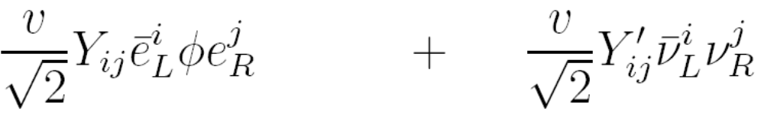

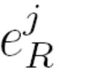










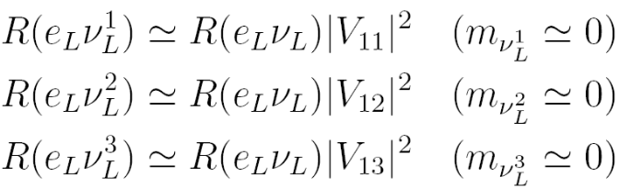



Now, look at lepton flavor rotation – any impact in gauge couplings ?
13/18
:
Mass:
undistinguishable
missing energy
detectable
production cross section or decay rate
转动对耦合和
可观测量没影响
转动对可观测量没影响

Slide 17
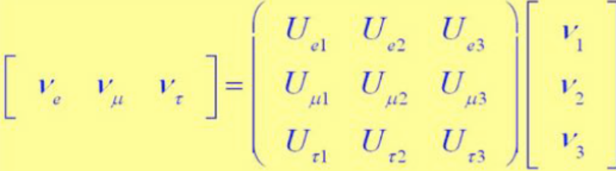









lepton flavor rotation （类似CKM的矩阵）
引起的物理现象只是：neutrino oscillation
14/18
为了简单，可以选取一个basis:
自发破缺前把带电轻子的Yukawa耦合对角化
这样只有中微子的质量是非对角的、需要对角化
左手中微子的转动矩阵（类似CKM矩阵）导致‘中微子震荡’
source
propagation
detection

Slide 18

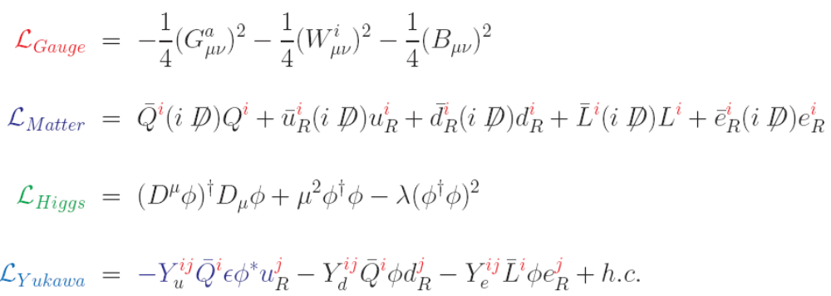

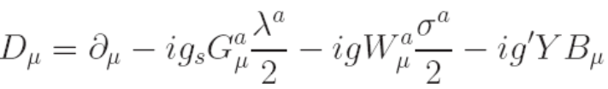












15/18

Slide 19
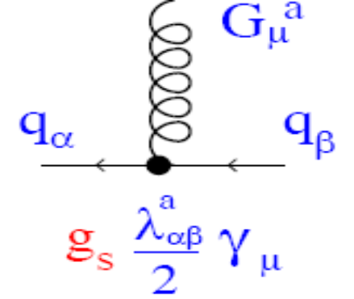
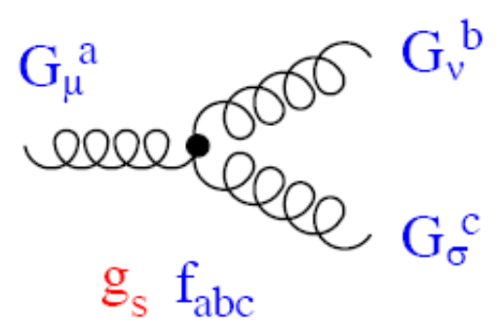
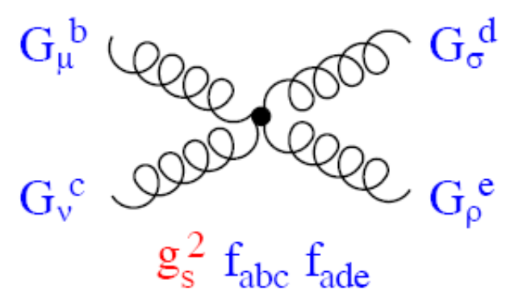
16/18
QCD interactions:

Slide 20
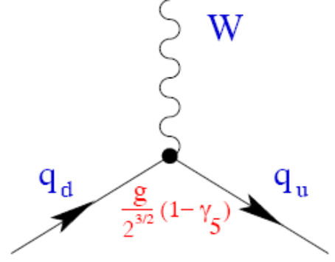
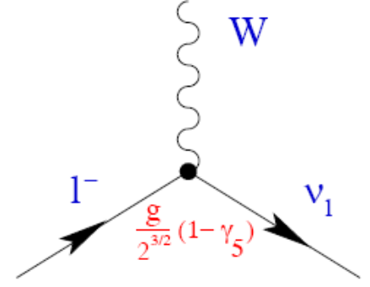
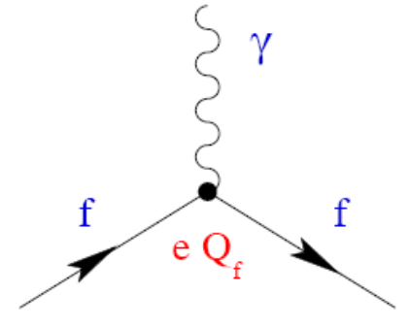
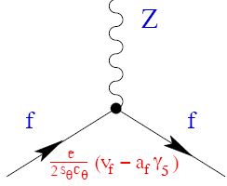
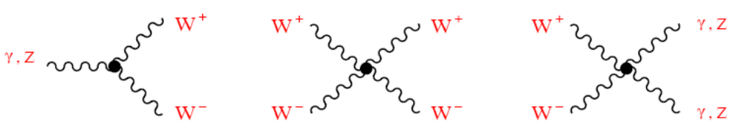
EW gauge interactions:
17/18

Slide 21
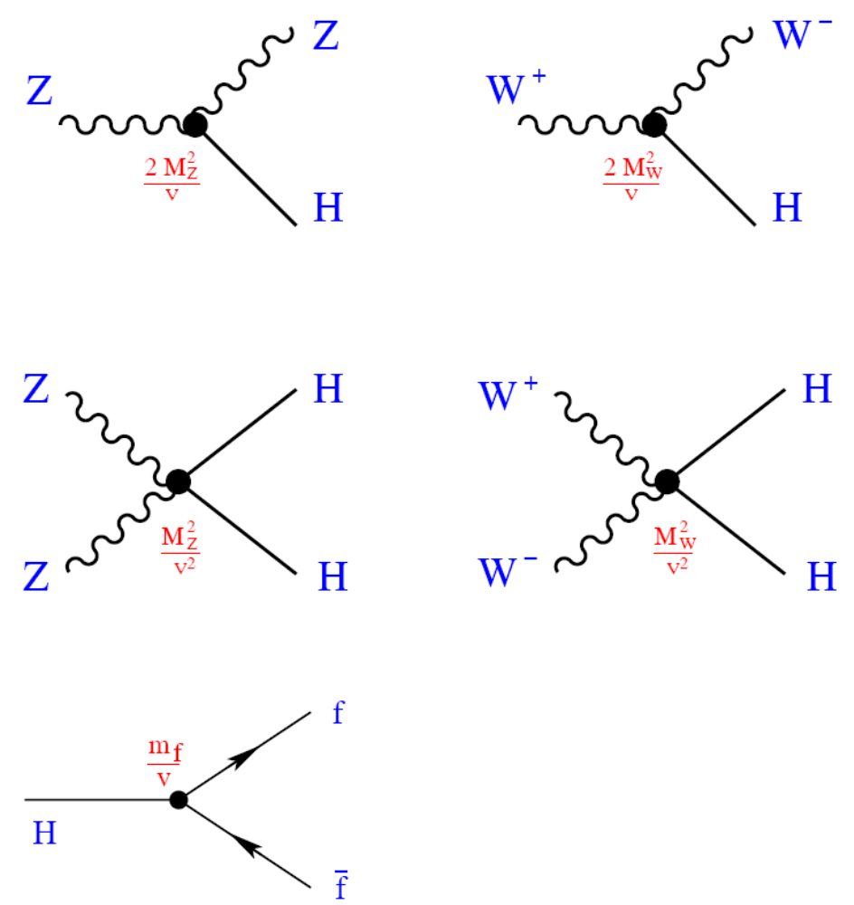
Higgs gauge+Yukawa interactions:
18/18

Slide 22
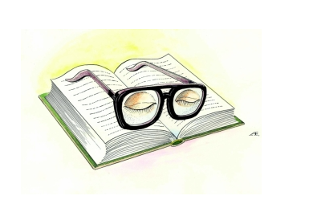
休息一会儿

