Slide 1

Driving your car is stressful -
parking shouldn’t have to be.

Slide 2
PROBLEM
Finding a parking space in a big city can be a frustrating experience
Wastes time (in NY, 29 percent of commuters spend 20 minutes on average looking for a parking spot)
Wastes fuel (In one month, people drive about an extra million miles looking for parking spots, close to 47,000 gallons)
Source: IBM Survey 2011. http://www.govtech.com/transportation/Smart-Parking-Tech-US-Cities.html

Slide 3
SOLUTION
A smart automated system, which is able to reduce waste of time, gas usage, and increase the safety of drivers.
Find Your Car, will be able to do just that

Slide 4
BUSINESS POINTS
Parking structure owners will benefit from having more occupancy. So, they benefit from buying this solution
Using this smart system, a lot of data will be generated and will go through IBM BLUEMIX servers. This will be very helpful in terms of Big Data Business solutions

Slide 5
USER BENEFITS
SAFETY
Increases safety by reducing parking conflicts and bottleneck traffic
Can save a driver over twenty minutes per day
ATMOSPHERE
Can reduce 730 Tons of carbon dioxide and 47,000 gallons of gas a year
MORE BUSINESS
Clients are more likely to visit restaurants and stores with easier parking

Slide 6
BUSINESS MODELS
USER SIDE
Pay a monthly fee to reserve a number of parking spaces (tiered levels)
Bronze Level: $20 - Reserve 1-10 times
Silver Level: $30 - Reserve 30-50 times
Gold Level: $70 - Unlimited
PARKING OWNER SIDE
Pay for a 1-3 year support and maintenance program
Standard Support: M-F 8:00 - 6:00 PM on-site availability
Extended Support: 24 hrs 7 days/week on-site availability

Slide 7
ORIGINALITY
It is the only parking platform to integrate with AT&T M2X, IBM’s Bluemix, and Konekt PRO.
It solves many environmental, and economical issues
It generates a lot of use full data for feature problem solving purposes using Big Data

Slide 8
APPLICATION UI

Slide 9
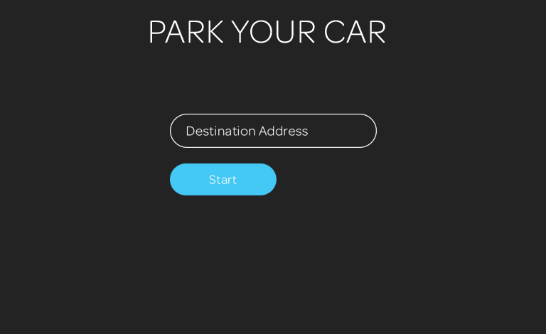

Slide 10
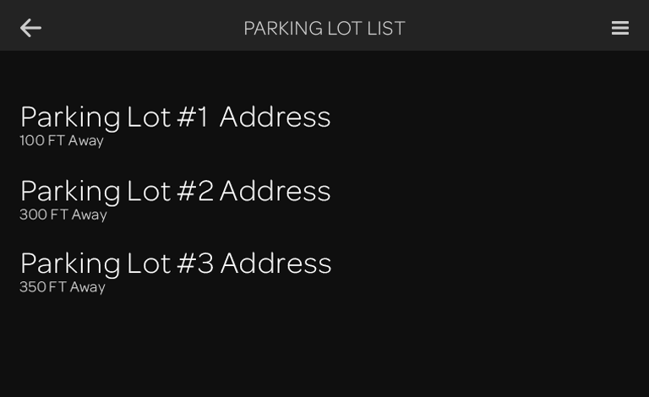

Slide 11
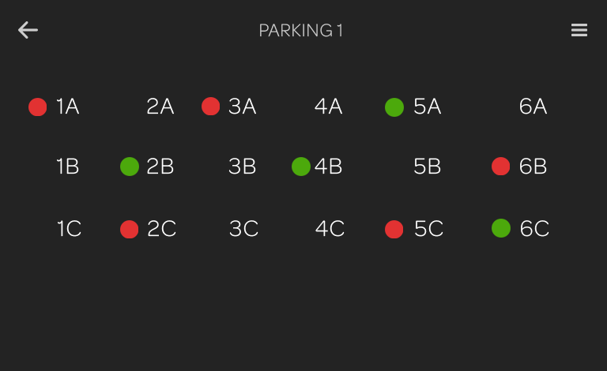

Slide 12
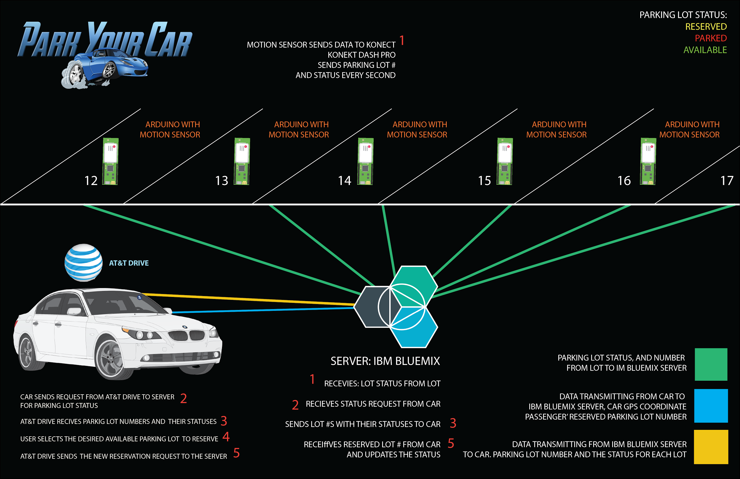

Slide 13
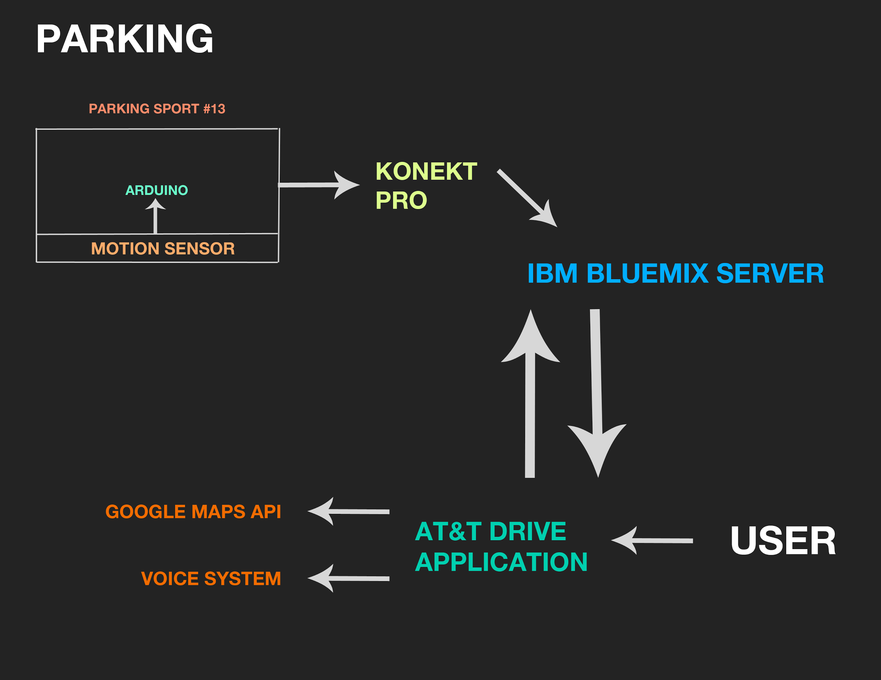
SYSTEMS MODEL

Slide 14
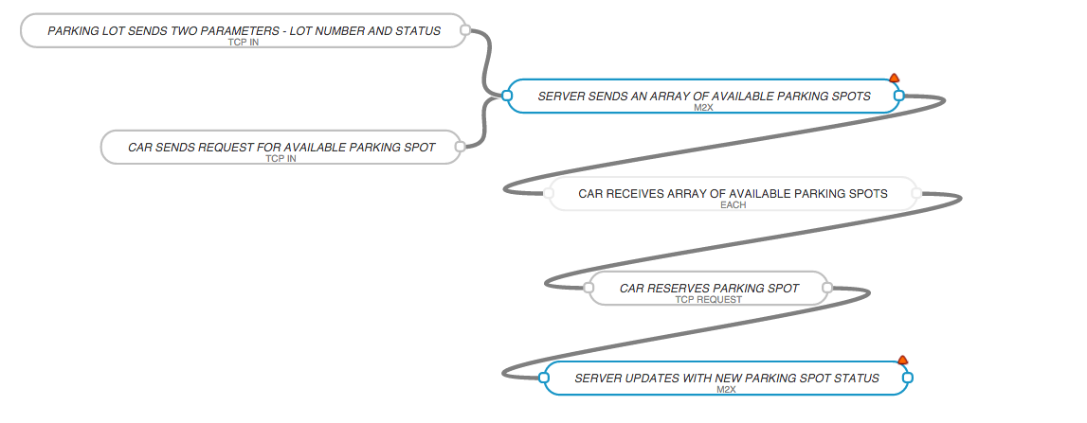
AT&T Flow Design

