Slide 1
Module - 2:
Modern Physics & Quantum Mechanics

Slide 2
Syllabus
Introduction to blackbody radiation spectrum- Wien's law, Rayleigh Jean’s law, Stefan -Boltzmann law and Planck's law (qualitative), Deduction of Wien's law and Rayleigh Jeans law from Planck's law.
Wave-Particle dualism, de-Broglie hypothesis, de-Broglie wavelength. Heisenberg's uncertainty principle and its physical significance, Application of uncertainty principle-Non-existence of electron in the nucleus (relativistic case),
Wave function- Properties, Physical significance, Probability density, Normalization, Eigen values and Eigen functions. Time independent Schrödinger wave equation. Particle in a box- Energy Eigen values and probability densities, Numerical problems.

Slide 3
Introduction to Quantum mechanics
https://www.youtube.com/watch?v=SDxzZHSBhw0
Science dealing with the behaviour of matter and light on the atomic and subatomic scale.
The properties of molecules and atoms and their constituents—electrons, protons, neutrons, and other more esoteric particles such as quarks and gluons.

Slide 4
Quantum mechanics arose gradually, from theories to explain observations which could not be explained with classical physics
Black-body radiation problem,
Photoelectric effect.
Compton effect.
Early quantum theory was developed in the mid-1920s by Erwin Schrödinger, Werner Heisenberg, Max Born and others.
The modern theory is formulated in various specially developed mathematical formalisms.
In one of them, a mathematical function, the wave function, provides information about the probability amplitude of energy, momentum, and other physical properties of a particle.

Slide 5
BLACK Body Radiation
https://www.youtube.com/watch?v=ugsvADj1wts&ab_channel=PhysicsMadeEasy
Blackbody radiation is a cornerstone in the study of quantum mechanics. This experiment is what led to the discovery of a field that would revolutionize physics and chemistry. Quantum mechanics gives a more complete understanding of the fundamental mechanisms at the sub-atomic level.
A body which absorbs all the radiations incident on it is called a perfect black body.
When radiations are allowed to fall on such a body, they are neither reflected nor transmitted. Such a body after absorbing the incident radiations gets heated and starts emitting radiations of all wavelengths.
These radiations are known as black body radiations.
In practice perfect black body does not exist. It is an ideal body. A surface coated with lamp black may be considered as perfectly black for all practical purposes.

Slide 6
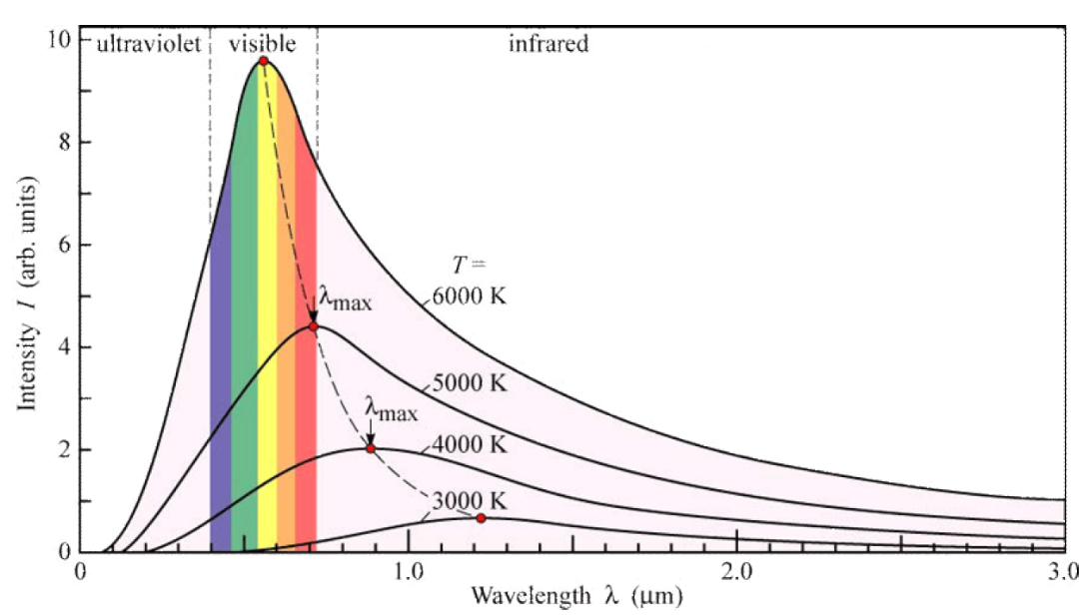
Distribution of energy in the black body radiation spectrum
The distribution of energy among the different wavelength of thermal radiation of a black body is shown in the figure. The curves in the figure represent the variation of intensity of the radiation (or energy) with wavelength for different temperatures.
Characteristics of blackbody radiation
At a given temperature the black body emits continuous range of wavelengths i.e., at a given temperature, the intensity of radiation increases with the wavelength and reaches the maximum value at a particular wavelength. Then it decreases with the increase in wavelength.
Energy at a definite wavelength increases with increase in temperature of the black body.
At a given temperature, the energy is not uniformly distributed in the radiation spectrum of the black body.
The wavelength at which maximum emission of energy takes place decreases (i.e., shifts towards the shorter wavelength) with increase in temperature. This is known as Wien’s displacement law.
The area under each curve represents the total energy emitted at a given temperature and it is found to be directly proportional to the fourth power of the absolute temperature i.e. It represents Stefan’s fourth power law

Slide 7


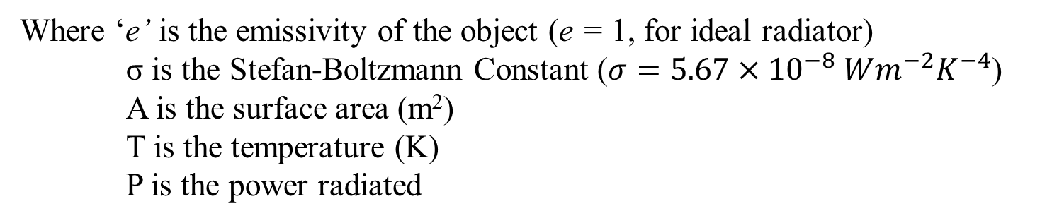

Stefan-Boltzmann law
The total radiant heat power emitted from a surface is proportional to the fourth power of its absolute temperature
$$\frac{P}{A}∝T^{4}$$
$$∴ \frac{P}{A}=σT^{4}$$
For hot objects other than ideal radiators, the law is expressed in the form:
$$P=eσ{AT}^{4}$$
Where ‘e’ is the emissivity of the object (e = 1, for ideal radiator)
σ is the Stefan-Boltzmann Constant ($σ=5.67×{10}^{−8} Wm^{−2}K^{−4}$)
A is the surface area (m²)
T is the temperature (K)
P is the power radiated

Slide 8
Classical Theories
Any model/theory for blackbody radiation should explain the experimental energy spectrum curve for a blackbody
First theory on blackbody radiation was provided by Wilhelm Wien in 1896
Lord Rayleigh and Sir James Jeans in 1900 introduced the Rayleigh - Jeans model of Blackbody radiation

Slide 9
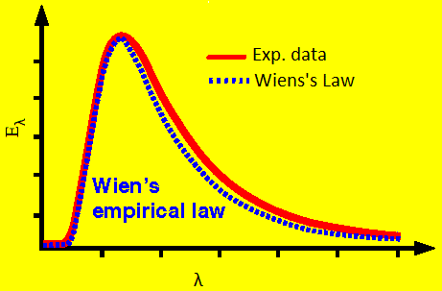

Wien’s law
Wien deduce the relation between the wavelength of emission and the temperature of the source. As per Wien’s law, the expression for energy density is,
$$U_{λ} dλ=C_{1 }λ^{−5} e^{−\left(\frac{C_{2}}{λT}\right)} dλ$$
Where C₁ and C₂ constants.
This is called Wien’s law of energy distribution in the blackbody radiation spectrum.
Drawbacks and Significance of Wien’s Law: The theory proposed by Wien, fitted well with the curve at shorter wavelengths, but it failed on the longer wavelength side.

Slide 10
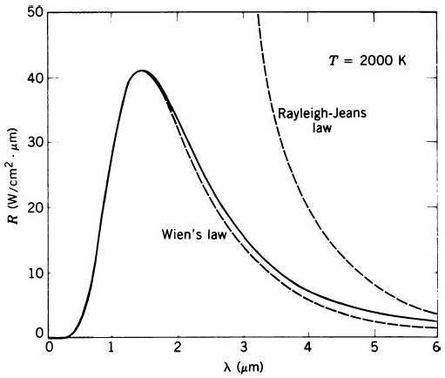
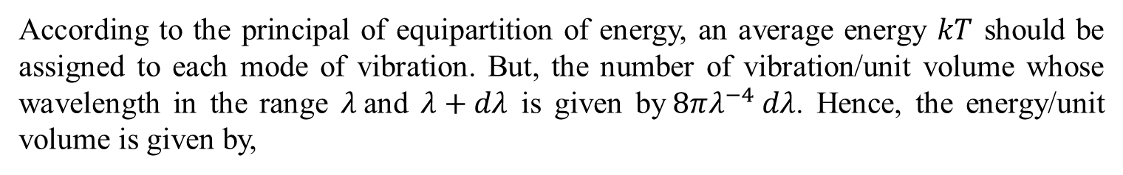
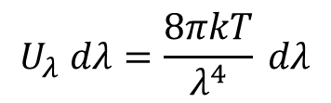
According to the principal of equipartition of energy, an average energy $kT$ should be assigned to each mode of vibration. But, the number of vibration/unit volume whose wavelength in the range $λ$and $λ+dλ$ is given by$8πλ^{−4} dλ$. Hence, the energy/unit volume is given by,
$$U_{λ} dλ=\frac{8πkT}{λ^{4}} dλ$$
This equation is known as Rayleigh$−$Jean’s equation.

Slide 11
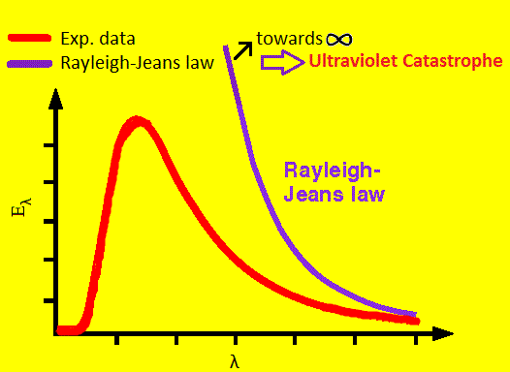

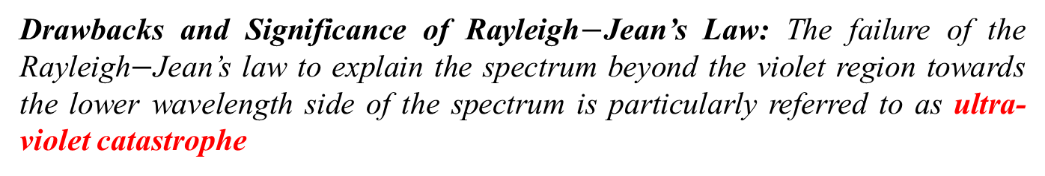
Rayleigh$−$Jean's law
Rayleigh and Jeans considered the black body radiator full of electromagnetic waves of all wavelengths between 0 and ∝. The Rayleigh – Jeans law is given by,
where K is the Boltzmann constant.
As per the above equation, the energy radiated by the black body is expected to decrease with increase in wavelength.
Thus Rayleigh – Jeans law correctly predicts the fall of intensity towards the longer wavelength side.
Drawbacks and Significance of Rayleigh$−$Jean’s Law: The failure of the Rayleigh$−$Jean’s law to explain the spectrum beyond the violet region towards the lower wavelength side of the spectrum is particularly referred to as ultra-violet catastrophe

Slide 12
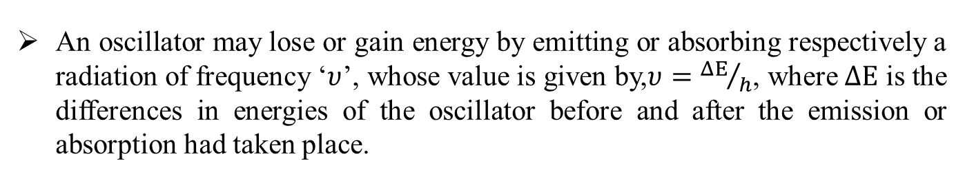
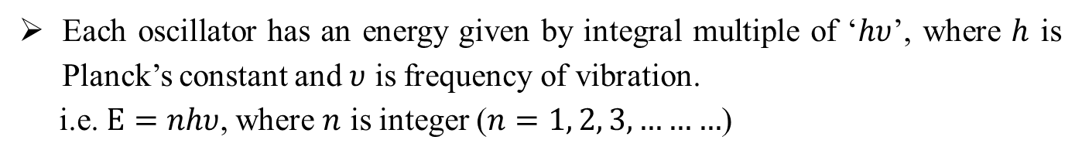
Planck’s Law for the energy density in the spectrum of blackbody
Planck’s made following assumptions in order to understand the blackbody radiation spectrum.
A blackbody consists of a very large number of electrical oscillators, with each oscillator vibrating with a frequency of its own. Planck brought two special conditions in his theory. They are,
Each oscillator has an energy given by integral multiple of ‘$hυ$’, where $h$ is Planck’s constant and $υ$ is frequency of vibration.
i.e.$Ε=nhυ$, where $n$ is integer ($n=1, 2, 3, ………$)
An oscillator may lose or gain energy by emitting or absorbing respectively a radiation of frequency ‘$υ$’, whose value is given by,$υ={ΔΕ}/h$, where $ΔΕ$ is the differences in energies of the oscillator before and after the emission or absorption had taken place.

Slide 13
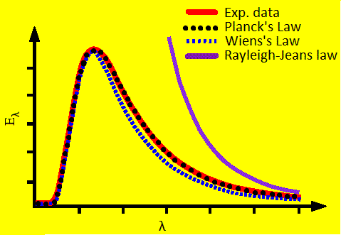
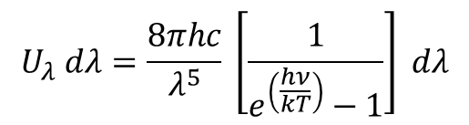
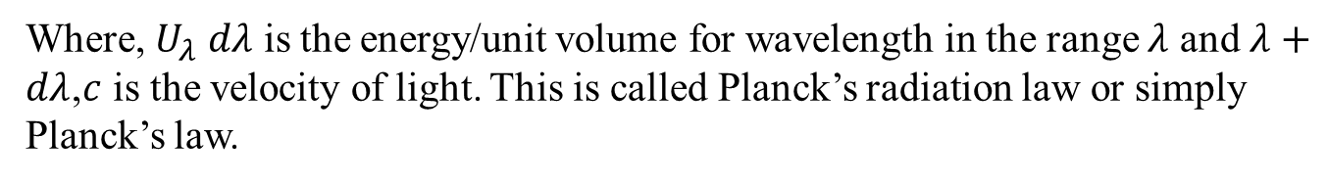
Based on the above ideas, he derived an equation which successfully explained the entire spectrum of the blackbody radiation. It is given by,
$$U_{λ} dλ=\frac{8πhc}{λ^{5}} \left[\frac{1}{e^{\left(\frac{hν}{kT}\right)}−1}\right] dλ$$
Where, $U_{λ} dλ$ is the energy/unit volume for wavelength in the range $λ$ and$λ+dλ$,$c$ is the velocity of light. This is called Planck’s radiation law or simply Planck’s law.

Slide 14
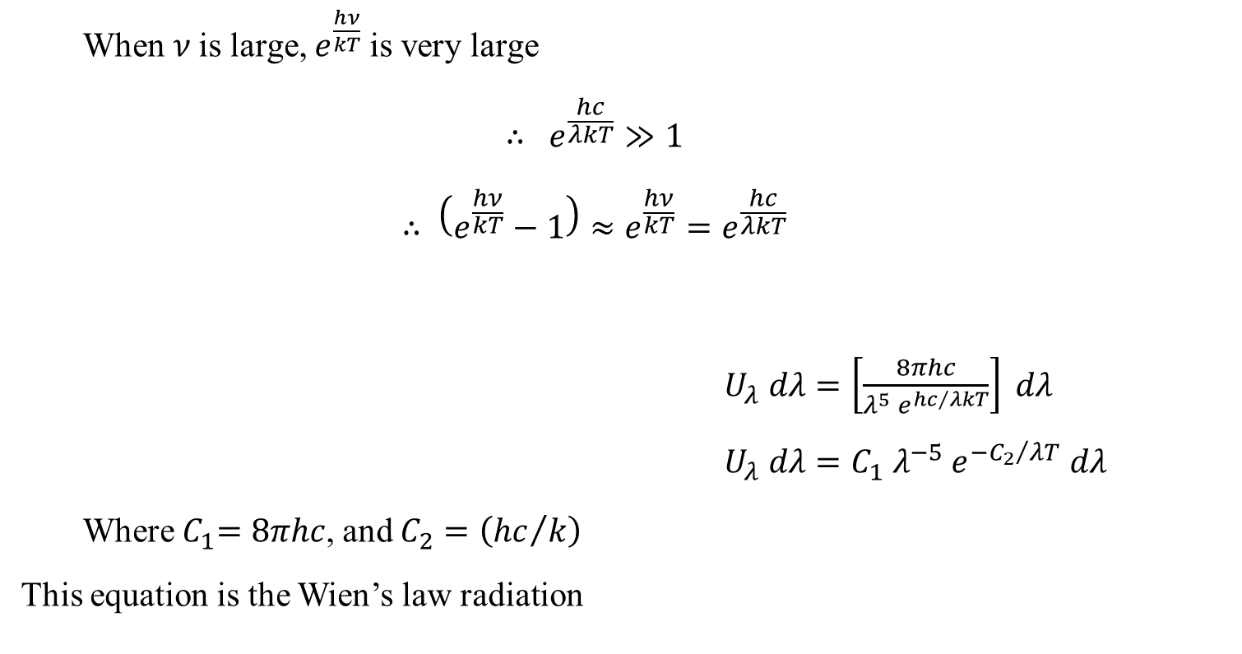
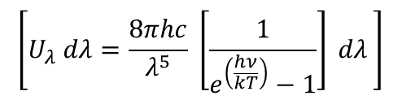
Reduction of Planck’s law to Wien’s law and Rayleigh-Jean’s law
For shorter wavelength (Reduction of Planck’s law to Wien’s law),
$ν=\frac{c}{λ}$ is large
When $ν$is large, $e^{\frac{hν}{kT}}$is very large
$$∴ e^{\frac{hc}{λkT}}≫1$$
$$∴ \left(e^{\frac{hν}{kT}}−1\right)≈e^{\frac{hν}{kT}}=e^{\frac{hc}{λkT}}$$
$U_{λ} dλ=\left[\frac{8πhc}{λ^{5} e^{{hc}/{λkT}}}\right] dλ$
$U_{λ} dλ=C_{1} λ^{−5} e^{{−C_{2}}/{λT}} dλ$
Where${ C}_{1}=8πhc$, and $C_{2}=\left({hc}/k\right)$
This equation is the Wien’s law radiation
$$\left[U_{λ} dλ=\frac{8πhc}{λ^{5}} \left[\frac{1}{e^{\left(\frac{hν}{kT}\right)}−1}\right] dλ \right]$$

Slide 15

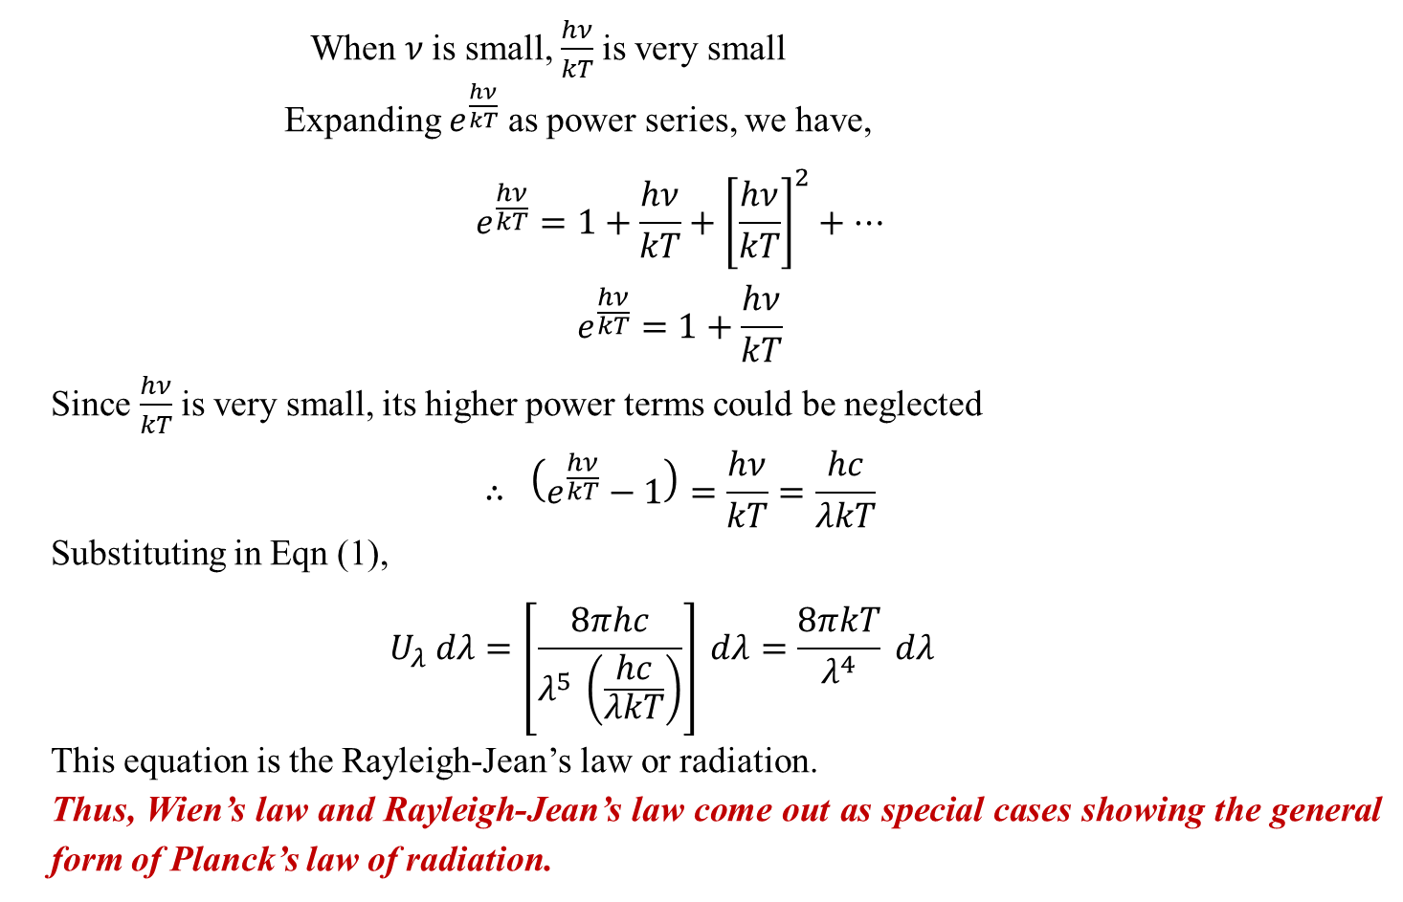

For longer wavelength (Reduction of Planck’s law to Rayleigh-Jean’s law), $ν=\frac{c}{λ}$ is small
When $ν$is small, $\frac{hν}{kT}$is very small
Expanding $e^{\frac{hν}{kT}}$ as power series, we have,
$$e^{\frac{hν}{kT}}=1+\frac{hν}{kT}+{\left[\frac{hν}{kT}\right]}^{2}+…$$
$$e^{\frac{hν}{kT}}=1+\frac{hν}{kT}$$
Since $\frac{hν}{kT}$is very small, its higher power terms could be neglected
$$∴ \left(e^{\frac{hν}{kT}}−1\right)=\frac{hν}{kT}=\frac{hc}{λkT}$$
Substituting in Eqn (1),
$$U_{λ} dλ=\left[\frac{8πhc}{λ^{5} \left(\frac{hc}{λkT}\right)}\right] dλ=\frac{8πkT}{λ^{4}} dλ$$
This equation is the Rayleigh-Jean’s law or radiation.
Thus, Wien’s law and Rayleigh-Jean’s law come out as special cases showing the general form of Planck’s law of radiation.

Slide 16

Compton Effect
•
Recoil electron
φ
Incident photon
θ
Scattered photon
$∆$λ = (h/mc) (1-cosθ)

Slide 17
Wave Nature of Particles
Light exhibits wave-particle duality
Is this dual nature an inherent property only of light?
Does matter (material objects) exhibit dual nature?
Can a particle, say an electron behave as a wave?

Slide 18
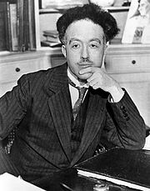

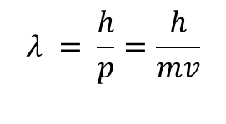
de Broglie Hypothesis
=
Answer was provided by Louis de Broglie in 1924
‘Since nature loves symmetry, if the radiation behaves as particle under certain circumstances and as waves under certain other circumstances, then one can even expect that, entities which ordinarily behave as particles to exhibit properties attributable to only waves under appropriate circumstances’
de Broglie – all moving objects have wave as well as particle characteristics
The wavelength λ associated with a particle of mass ‘m’ moving with a velocity v is called de Broglie wavelength and is given by
$$λ = \frac{h}{p}=\frac{h}{mv}$$

Slide 19
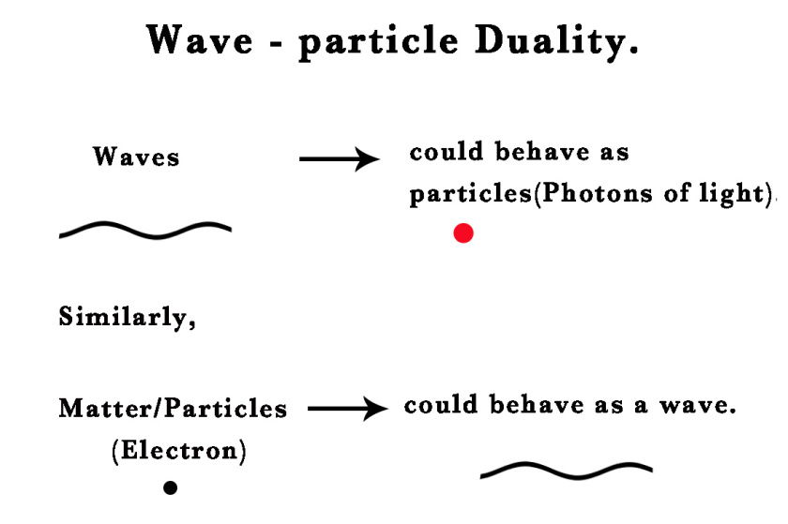

Slide 20


de Broglie wavelength of an accelerated electrons
Consider an electron of rest mass m and charge e, accelerated by a potential difference of V volt from rest to a velocity v. Then work done on the electron is W = eV
This work done is converted into kinetic energy of the electron.
If p is the momentum of the electron then, p = mv
Squaring on both sides we get, p² = m²v²

Slide 21




Equation (1) becomes
Therefore the de Broglie wavelength of accelerated electron is given by
The above equation can be written as,

Slide 22
h = 6.63 × 10⁻³⁴ Js,
m = 9.1 × 10⁻³¹ kg,
e = 1.6 × 10⁻¹⁹ C

Slide 23


Relation between Kinetic Energy and de-Broglie Wavelength
We know that, the kinetic energy is
p² = 2mE
Then the de Broglie wavelength is

Slide 24
Problems
1. Calculate the de Broglie wavelengths of the following:
A 50-g tennis ball moving at 260 km/h.
A 1500-kg car travelling at 430 km/h.
An electron with K.E. 1 eV.
Solution
1.8 × 10⁻³⁴ m (wavelength too small to be detected)
3698 × 10⁻³⁴ m (wavelength too small to be detected)
1.23 × 10⁻⁹ m = 1.23 nm (observable wavelength)
From the above problem - only for particles of atomic or nuclear size will the wave behavior be observable.

Slide 25



Problem #2: A particle of mass 0.5 MeV/c² has kinetic energy 100 eV. Find its de Broglie wavelength, where c is the velocity of light. (Jan 2020)
Solution:
Given
m = 0.5 MeV/c²
E = 100 eV.
λ = ?

Slide 26


3. Calculate the de Broglie wavelength of an electron accelerated under a potential difference of 100 V.
Solution
Given
V = 100 V
To find
λ = ?

Slide 27


4. Evaluate de Broglie wavelength of Helium nucleus that is accelerated through 500 V. Given, mass of proton = mass of neutron = 1.67 x 10⁻²⁷ kg.
Solution
Given
Mass of proton = mass of neutron m = 1.67 x 10⁻²⁷ kg
V = 500 V
To find
λ = ?
Helium nucleus has 2 protons and 2 neutrons
Therefore, the mass of nucleus = 4m
= 4 x 1.67 x 10⁻²⁷ kg
Charge of nucleus, q = 2 protons
= 2 x 1.6 x 10⁻¹⁹ C = 3.2 x 10⁻¹⁹ C

Slide 28
5. Calculate the momentum of an electron and the de Broglie wavelength associated with it if its kinetic energy is 1.5 keV.
Ans: p = 2.09 x 10⁻²³ kgm/s & λ = 3.17 x 10⁻¹¹ m.

Slide 29


6. Compute the de Broglie wavelength for a neutron moving with one tenth part of the velocity of light, given, mass of neutron = 1.674 x 10⁻²⁷ kg.
Solution
Given
m = 1.674 x 10⁻²⁷ kg
Velocity of light = 3 x 10⁸ m/s.
Velocity of neutron,
To find
λ = ?

Slide 30
7. Find the momentum and energy of neutron whose de Broglie wavelength is 0.1 nm

Slide 31
8. Estimate the potential difference through which an electron is accelerated so that its de Broglie wavelength becomes 2 nm.

Slide 32
9. Compare the momentum, total energy and kinetic energy of photon and electron having same de Broglie wavelength 0.4 nm.

Slide 33
Heisenberg’s uncertainty principle and applications (non confinement of electron in the nucleus)

Slide 34

Heisenberg’s uncertainty principle
Statement: “It is impossible to determine simultaneously both the position and momentum of a particle with accuracy.”
The product of the uncertainties in the simultaneous determination of the position and momentum of a particle is equal to or greater than h/4π.
If Δp and Δx are the uncertainties in the momentum and position of a particle, then we can write the mathematical form of Heisenberg’s uncertainty principle as

Slide 35
Heisenberg Uncertainty Relations
If we try to measure the position of a particle accurately, then there is an uncertainty in the measurement of its momentum and vice versa
Uncertainties from some experiments can be greater than given by these relations, but never smaller
Uncertainty is valid even if we use sophisticated instruments and techniques
Uncertainty relation is an inherent property of nature/matter

Slide 36


Applications of HUP
Non confinement of electron in the nucleus
let us assume that electrons exist in the nucleus. As the radius of the nucleus in approximately 10⁻¹⁴ m. If electron is to exist inside the nucleus, then uncertainty in the position of the electron is given by
∆x= 10⁻¹⁴ m
According to uncertainty principle

Slide 37


If this is p the uncertainty in the momentum of electron ,then the momentum of electron should be at least of this order,
that is p=1.05x10⁻²⁰ kg m/sec.
An electron having this much high momentum must have a velocity comparable to the velocity of light. Thus, its energy should be calculated by the following relativistic formula

Slide 38
Therefore, if the electron exists in the nucleus, it should have an energy of the order of 20 MeV.
It is observed that beta-particles (electrons) ejected from the nucleus during beta –decay have energies of approximately 3 Me V, Experimental results show that no electron or particle in the atom possess energy greater than 4 MeV.
which is quite different from the calculated value of 20 MeV.
Therefore, it is confirmed that electrons do not exist inside the nucleus.

Slide 39

P1. An electron has a speed of 800 m/s. The inherent uncertainty in its measurement is 0.003%. Calculate the corresponding uncertainty that arises in the measurement of its position.
Given
v = 800 m/s
Inherent uncertainty involved in measurement of v = 0.003%
Find
Δx = ?
Solution
Inherent uncertainty in speed,

Slide 40


Inherent uncertainty in momentum,
Therefore, the uncertainty in position is

Slide 41
P2.The position and momentum of an electron with energy 0.5 keV are determined. What is the minimum percentage uncertainty in its momentum, if the uncertainty in the measurement of its position is 0.5 Å

Slide 42
P3. An electron has a speed of 4.8 x 10⁵ m/s accurate to 0.012 %. With what accurate can be located the position of electron.

Slide 43
Wave Function
Wave associated with the particle is represented by a function called the wave function
Ψ(x, t) – central object in Q.M
In Q.M. the state of a particle/system is specified by the wave function

Slide 44
In Classical Mechanics
Particle satisfies Newton’s equation of motion:
Wave satisfies the wave equation

Slide 45
d²y/dx² =(1/V²) d²y/dt²

Slide 46
In Quantum Mechanics
Wave function Ψ(x, t) satisfies the Schrodinger equation
Ψ(x, t) contain all possible measurable information that can be obtained from the system

Slide 47
Physical Significance of Wave Function
Wave function
Itself has no physical interpretation.
Gives only the amplitude of the de Broglie (matter) wave
Does not correspond to any physical quantity
Mostly Ψ(x, t) (obtained by solving S.E.) will be a complex valued function
Physical observables should be real → Ψ(x, t) cannot represent a measurable quantity

Slide 48
One way to extract a real number from a complex function is by taking square of the modulus
If Ψ is complex, then the square of the modulus (square of its absolute magnitude) defined by
|Ψ|²= Ψ* Ψ is real.
Physical significance/interpretation of the wave function is given using its modulus squared, |Ψ|²

Slide 49
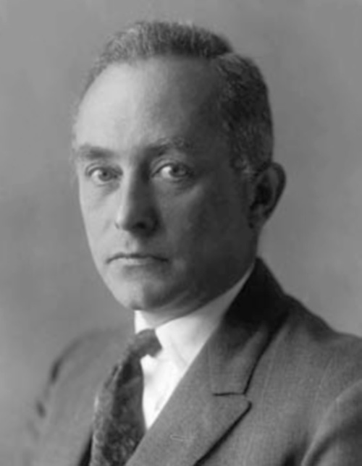
Probabilistic Interpretation of Wave Function
Probabilistic interpretation of the wave function was given by Max Born.
|Ψ(x, t)|² → Probability density for finding the particle at x,t
Probability P(x, t) of finding the particle within a region dx, between x and x + dx, at a time t is
P(x, t) = |Ψ(x, t)|² dx

Slide 50
Total probability to find the particle anywhere in space at a time t is
If the particle is confined in a region 0 to L, the probability to find the particle anywhere in this region is

Slide 51
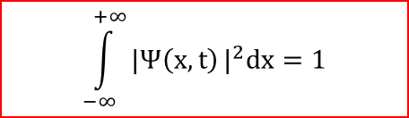
Normalization
$$\int_{−∞}^{+∞}{|Ψ\left(x,t\right)}|^{2}dx=1$$
Eqn is called the normalization condition
Must be satisfied by all wave functions
Ψ(x, t) that satisfies the above equation are said to be normalized
Non normalizable wave functions are physically unacceptable

Slide 52
Properties of Wave Function
Important properties of Ψ(x,t) that follow from the probabilistic interpretation are:
Ψ must be single valued everywhere
Ψ must be finite everywhere
Ψ and dΨ/dx must be continuous everywhere
As x → ±∞, Ψ → 0 ( wave function must vanish at boundaries)

Slide 53
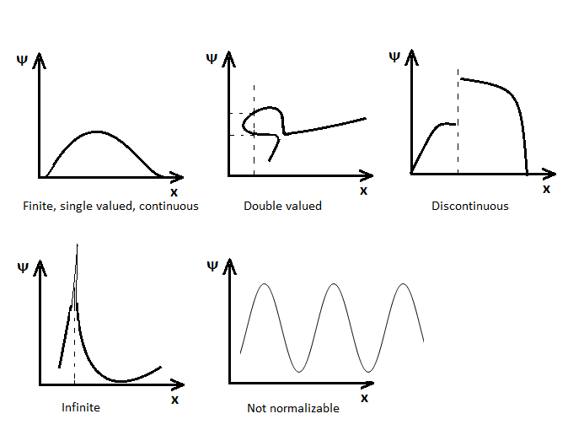
Properties of Wave Function
ψ₁
ψ₂

Slide 54



Problems
1. If the wave function of a particle in an infinite potential box of width ‘L’ is
where x is the position and n is the quantum number, find B.
Solution:
Normalization condition is

Slide 55





Slide 56



Normalized Wave function is

Slide 57

Time independent Schrodinger Wave Equation
Consider a particle of mass “m” moving with velocity “v” in space.
The wave function describing the de Broglie wave considered travelling in positive x-direction can be written as
----------------- (1)
Differentiate twice w r to x, we get
----------------- (2)

Slide 58



Similarly, differentiate equation (1) twice w r to t , we get
----------------- (3)
We know that, the classical wave equation,
Where, y is the displacement and v is the velocity of the wave.
We can write the wave equation for de Broglie wave for the motion of a free particle as,
----------------- (4)

Slide 59




Substitute equations (2) & (3) in (4), we get
Substituting,
&
----------------- (5)

Slide 60




But, we know that,
----------------- (6)
Substitute (5) in (6), we get

Slide 61




Let V be the potential energy, then the total energy of the particle is
E = K.E + P.E
This is the time independent Schrodinger wave equation in one dimension.

Slide 62
Eigen functions and Eigen values
Acceptable wave functions corresponds to meaningful physical system obtained by solving TISE are called Eigen functions.
The wave function for a given physical system contains the measurable information about the system.
Once the Eigen functions are known, they could be used in Schrodinger’s equation to evaluate energy values. These values are called Eigen values.
To obtain specific values for physical parameters, for example energy, you operate on the wave function with the quantum mechanical operator associated with that parameter.
“Eigenvalue" comes from the German "Eigenwert" which means proper or characteristic value. "Eigenfunction" is from "Eigenfunktion" meaning "proper or characteristic function"

Slide 63


Corresponding to each Eigen value is an "Eigen function".
Operator
Operator
25 x 5

Slide 64
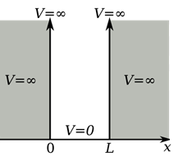

Application of Schrodinger Wave Equation
Particle in one dimensional infinite potential well (particle in a box)
Consider a free particle of mass ‘m’ confined to a box of width ‘L’ with infinitely high walls.
The Schrodinger equation for a particle in one dimension is

Slide 65



Region outside the box, the equation becomes
(Since V = ∞, outside)
The acceptable solution to the above equation is ψ = 0.
Region inside the box, the equation becomes
(Since V = 0, inside)
------------------------- (1)

Slide 66


Let
------------------- (2)
Equation (1) becomes,
------------------- (3)
The solution of Equation (3) is given by
------------------- (4)
Where A and B are the constants depending on the boundary condition

Slide 67

To determine A & B
Let us apply the boundary conditions (wave function must vanish at the boundaries, ψ = 0 at x = 0 & x = L)
1. At x = 0 ⇒ ψ = 0
Equation (4) becomes; 0 = A + 0 ⇒ A =0
2. At x = L ⇒ ψ = 0
Equation (4) becomes;
⇒
⇒
⇒
⇒
------------------- (5)
where n=1, 2, 3, ......

Slide 68

Now equation (4) becomes
Is the non-normalized wave function & B is a constant.
To evaluate B, we should normalize the wave function (equation (6))
Normalization condition
⇒

Slide 69
⇒
⇒
⇒
⇒
⇒

Slide 70



Normalized Wave function is (equation (6) becomes)
Eigen Values
From equation (2) & (5), we have
&
⇒
This equation gives the allowed values of energy for different value of n.
Where, n = 1, 2, 3, .....

Slide 71






n value | State | Wave function | Energy Eigen value
n = 1 | Ground State |  | Zero point energy (E₀)
n = 2 | First Excited State
n = 3 | Second Excited State

Slide 73
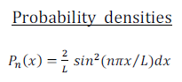
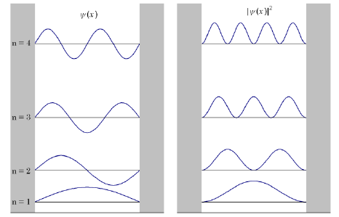

Graphical Representation

Slide 74
Problems
1. An electron is bound in an one dimensional potential well of width 1 Å, but of infinite wall height. Find its energy values in the ground state, and also in the first two excited states.
Given
L = 1 Å
Solution
We know that,
To find
E₁ =?, E₂ =?, E₃ =?
Where n = 1, 2 & 3 corresponds to ground, first and second excited states.

Slide 75


For ground state (n=1)
For the first excited state (n=2)
For the second excited state (n=3)

Slide 76
Recap
de Broglie wavelength
&
Heisenberg’s uncertainty principle
Probability of finding particle
Normalization condition
Time independent Schrodinger wave equation in one dimension.

Slide 77
n value | State | Wave function | Energy Eigen value
n = 1 | Ground State |  | Zero point energy (E₀)
n = 2 | First Excited State
n = 3 | Second Excited State

Slide 78






Problems
1. A quantum particle confined to one dimensional box of width ‘L’ is in its first excited state. What is the probability of finding particle over an interval of (L/2) marked symmetrically at the centre of the box.
Solution we know that
Where
&

Slide 79






Slide 80


2. The ground state energy of an electron in an infinite well is 5.6 meV. If the width of the well is doubled, calculate the ground state energy.
Given
E₁ = 5.6 meV
Find
E’ = ?
When L’ = 2L
Solution
We know that, For ground state (n=1)
When the width of the well is doubled, i.e. L’ = 2L, then new energy is

Slide 81
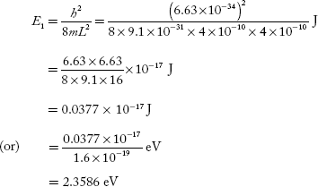
3. An electron is bound in one-dimensional box of size 4 × 10^{–10} m. What will be its minimum energy?
Solution
Given
L = 4 × 10^{–10}
Find
E₁ = ?

