Slide 1
Question1
Testing code:
Copy of Earth_Engine_TensorFlow_logistic_regression.ipynb
https://github.com/hongirsa/ALR/blob/main/development/Copy%20of%20Earth_Engine_TensorFlow_logistic_regression.ipynb

Slide 2
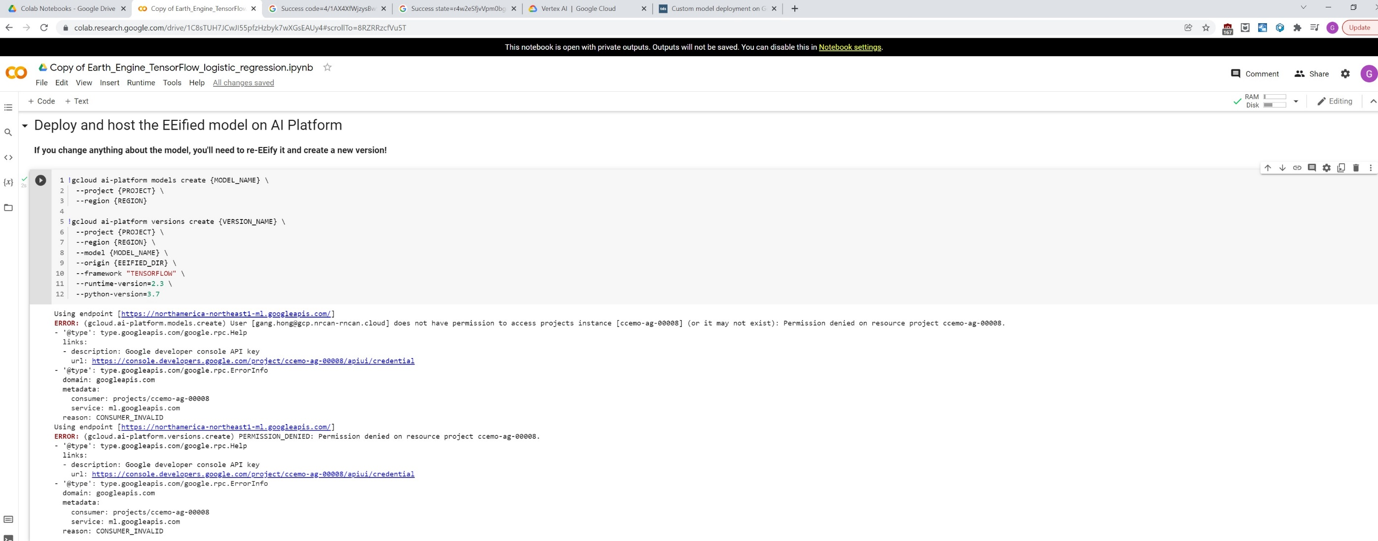

Slide 3
Question 2
Testing code: Copy of Earth_Engine_TensorFlow_AI_Platform.ipynb
https://github.com/hongirsa/ALR/blob/main/development/Copy%20of%20Earth_Engine_TensorFlow_AI_Platform.ipynb

Slide 4
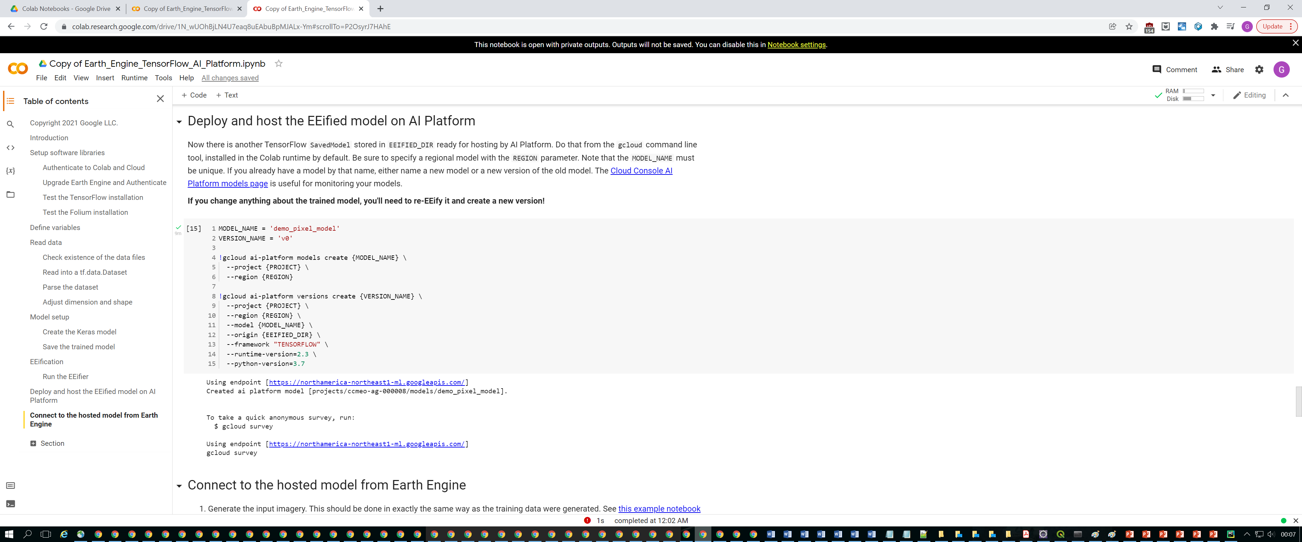
This slides shows model deployed successuflly

Slide 5
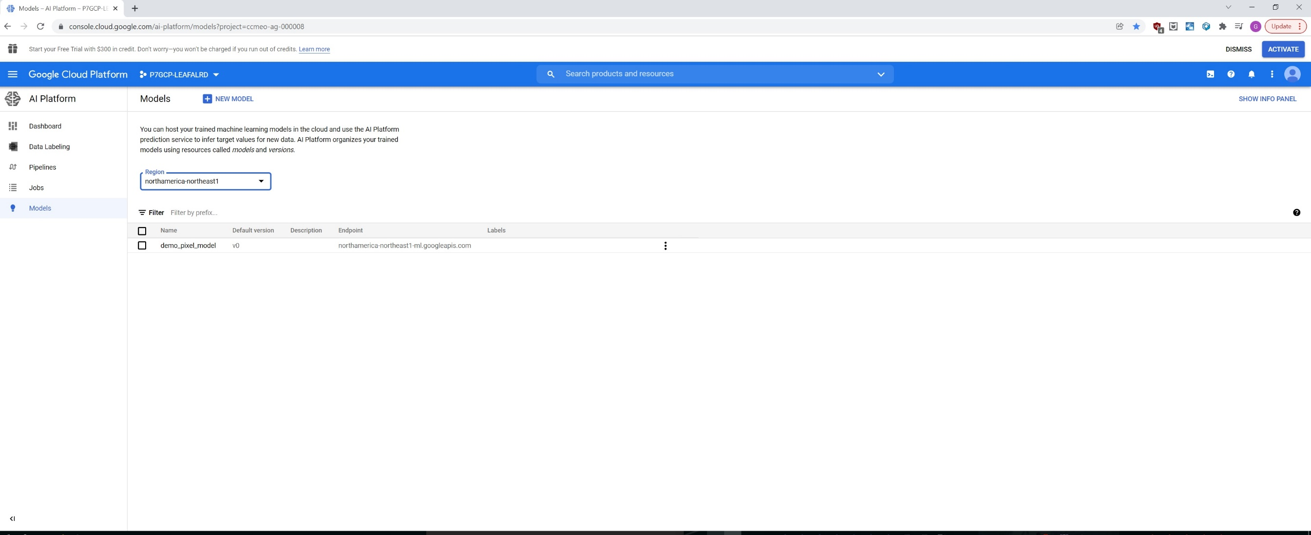
This slide shows model does exist

Slide 6
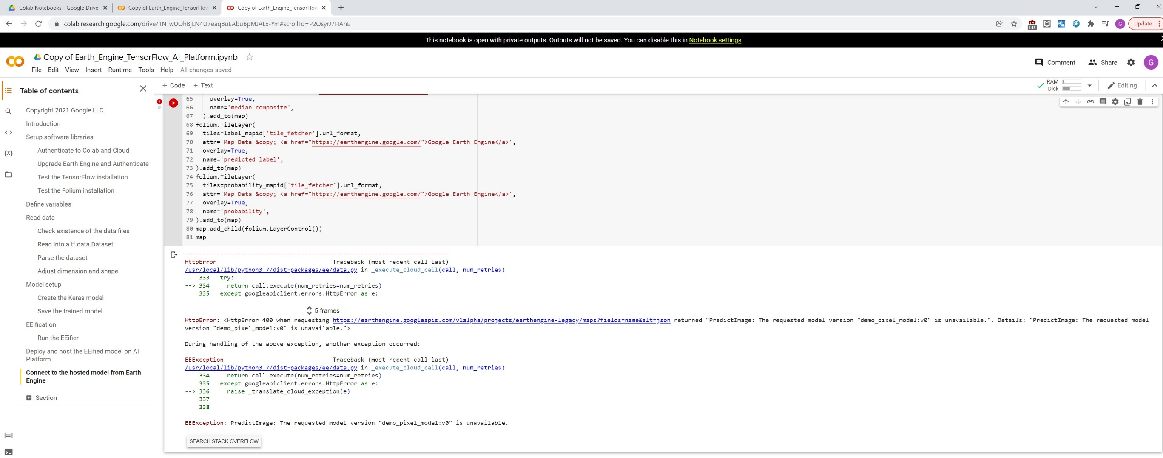
But the error shows the model does not exist

