Slide 1
Question1
Testing code:
Copy of Earth_Engine_TensorFlow_logistic_regression.ipynb
https://github.com/hongirsa/ALR/blob/main/development/Copy%20of%20Earth_Engine_TensorFlow_logistic_regression.ipynb

Slide 2
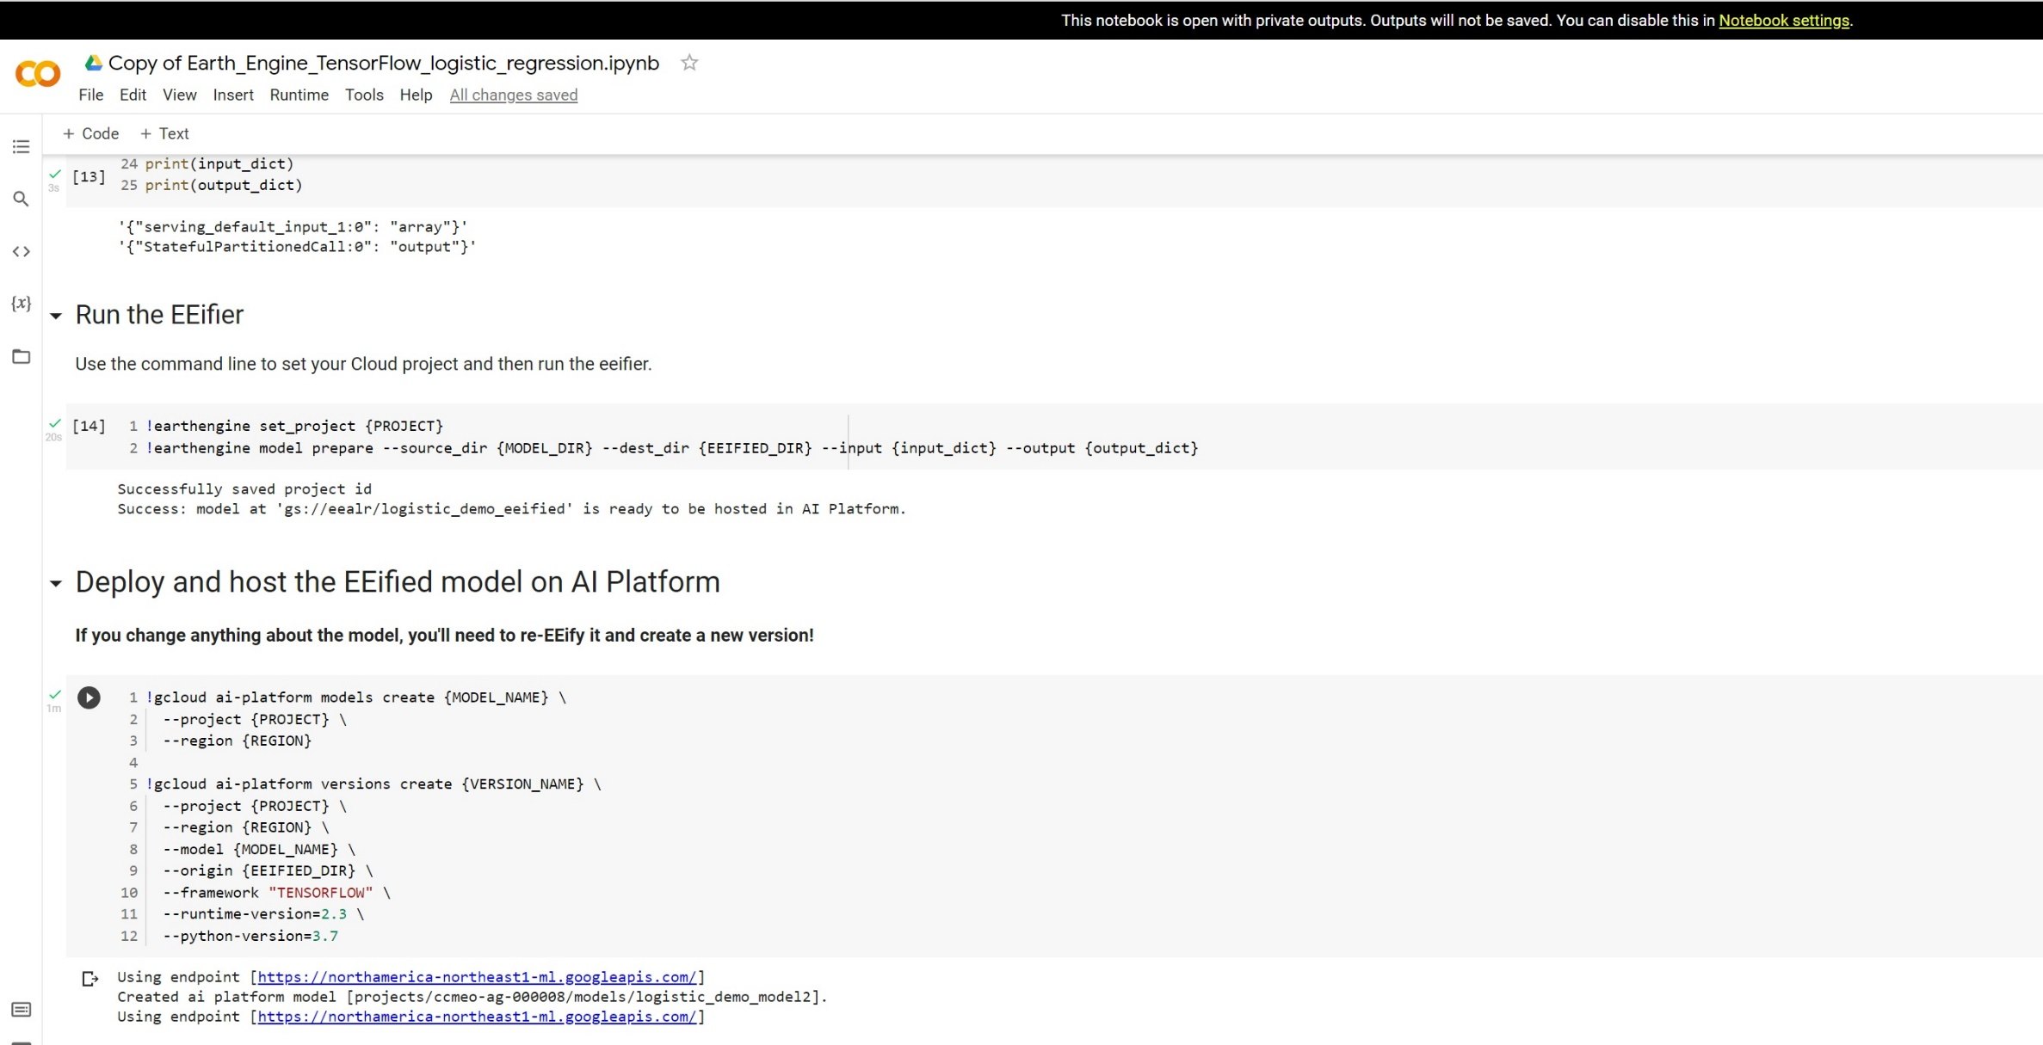
This slide shows the model deployed.

Slide 3
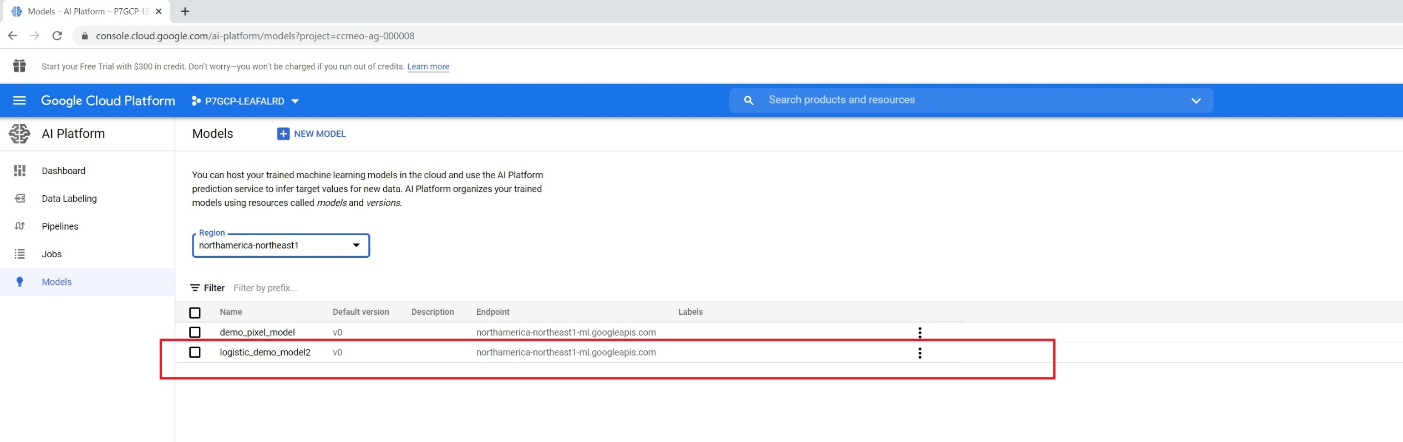
The model highlighted shows the model exsists

Slide 4
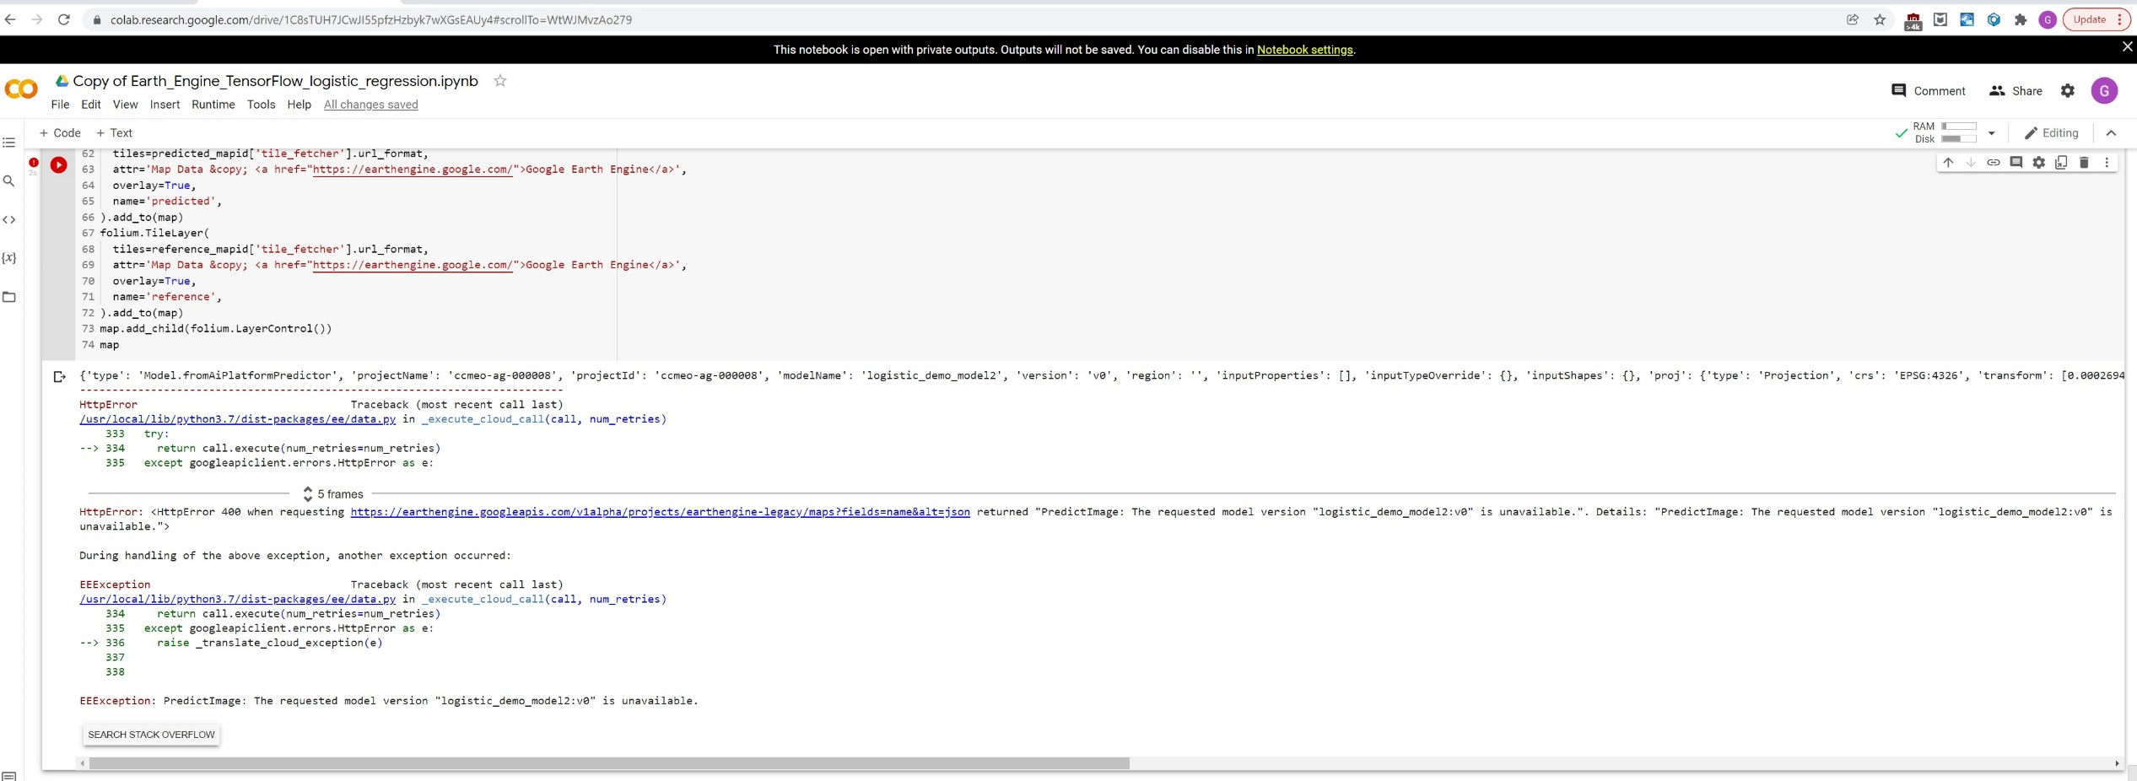
The problem is the same as the one in Question 2

Slide 5
Question 2
Testing code: Copy of Earth_Engine_TensorFlow_AI_Platform.ipynb
https://github.com/hongirsa/ALR/blob/main/development/Copy%20of%20Earth_Engine_TensorFlow_AI_Platform.ipynb

Slide 6
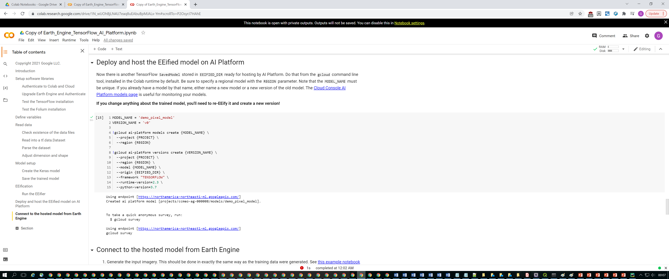
This slides shows model deployed successuflly

Slide 7
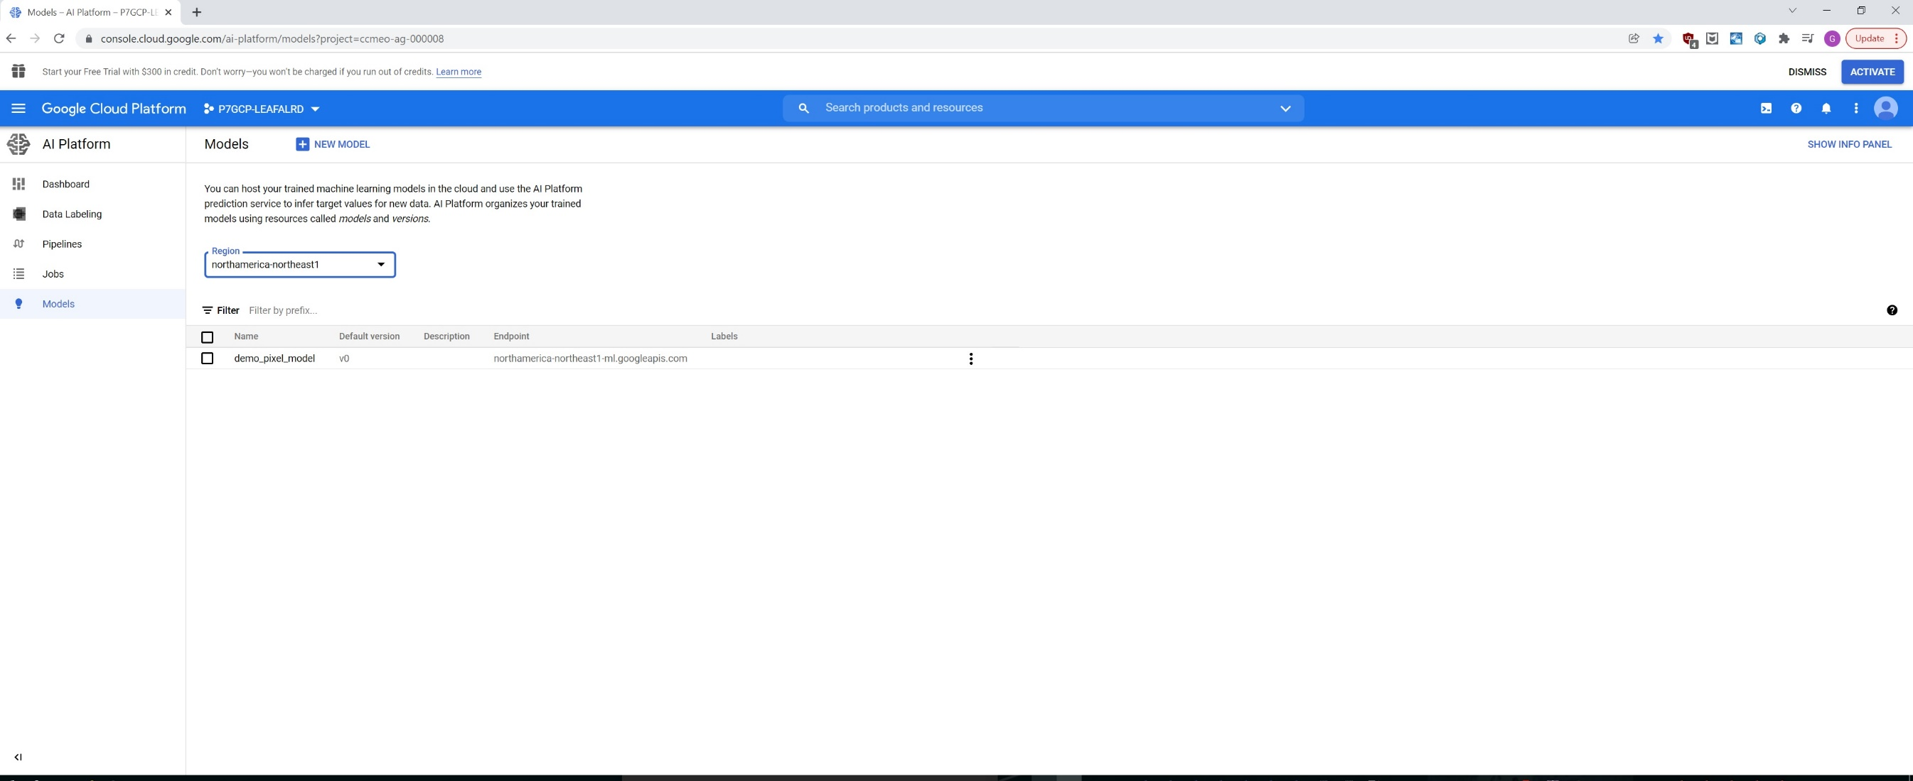
This slide shows model does exist

Slide 8
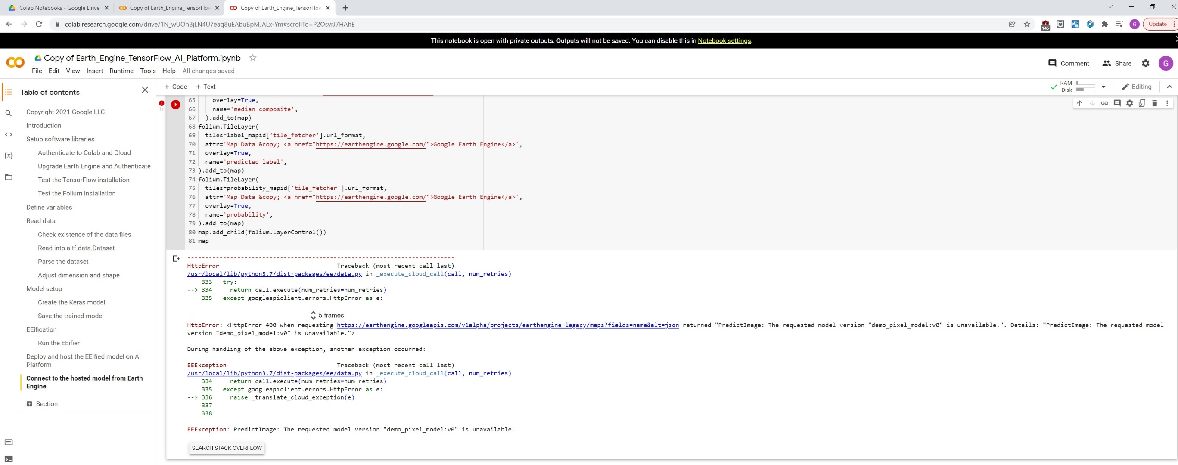
But the error shows the model does not exist

Slide 9
Question 3
Test code Copy of AI_platform_demo.ipynb

Slide 10
