Slide 1
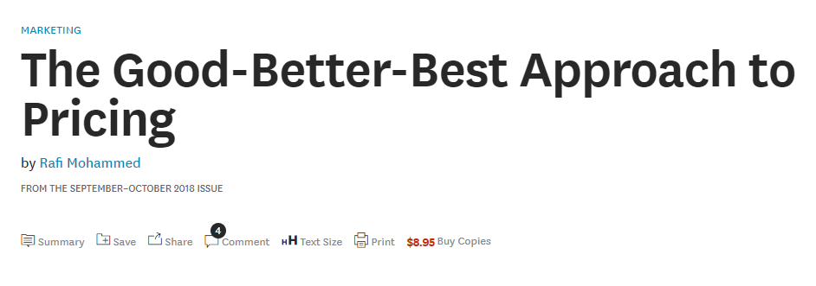

Slide 2
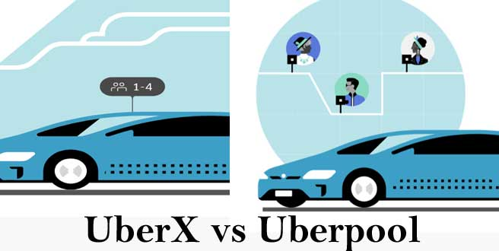
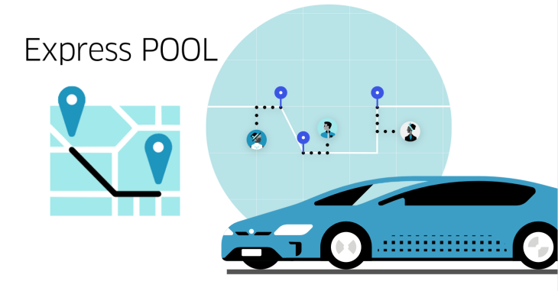
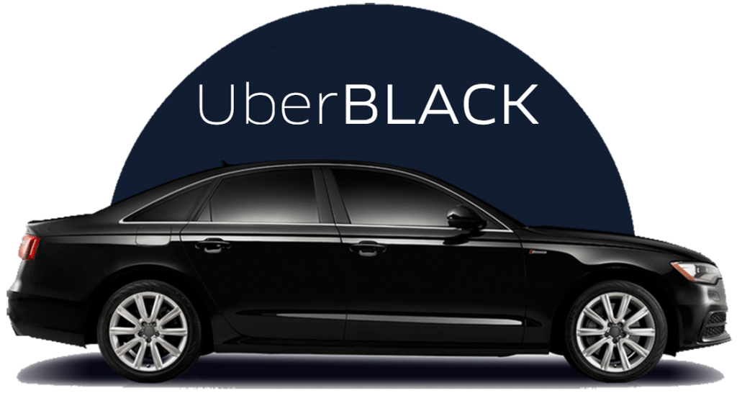
Uber case
Uber has shown continued creativity and success with its Good versions. The company began in 2010 as a black-car luxury service, and it still offers several high-end options. But in 2014, hoping to lure price-sensitive riders, it launched uberPOOL, in which riders share a car with strangers going in the same general direction. Unlike the traditional uberX service (in which riders have a midsize sedan to themselves and go directly to their destination), uberPOOL trips involve multiple pickups and drop-offs of other passengers, so there’s additional travel time; in exchange, the service is priced as much as 50% below uberX. UberPOOL now accounts for 20% of all Uber rides—and in some cities it accounts for more than half of all trips. The company has begun experimenting with Express POOL, which costs 30% to 50% less than uberPOOL and requires riders to walk a few blocks to a central pickup location.

Slide 3


Goldilocks effect

Slide 4
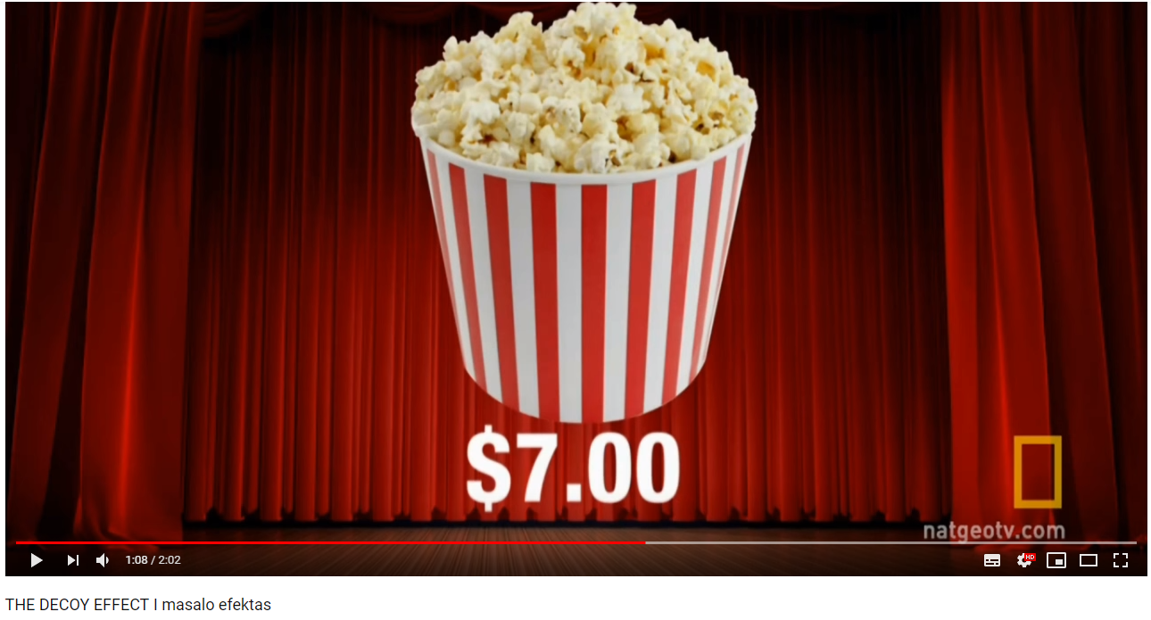
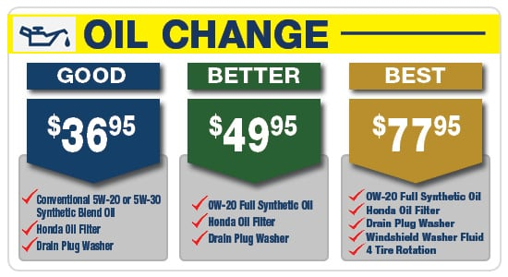
Popcorn example

Slide 5
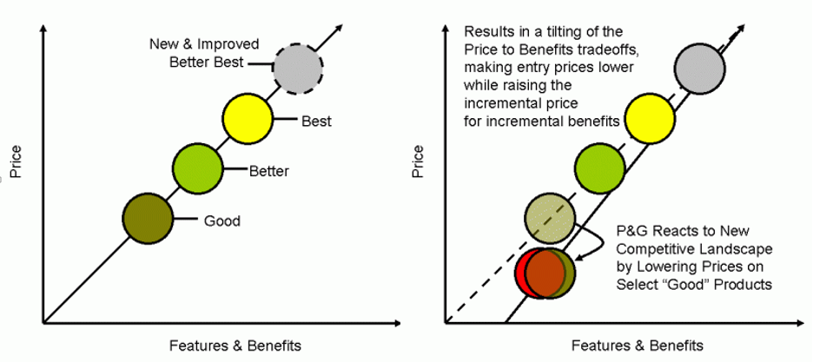
P&G’s product strategy
인구, 경제구조의 변화에 따라 가격/편익 비율의 포지셔닝 변화 (예: 소득불평등 확대와 중산층 몰락)
출처: https://www.wiglafjournal.com/pricing/2010/09/pg-shifts-pricing-strategy-to-meet-post-recession-market/

Slide 6
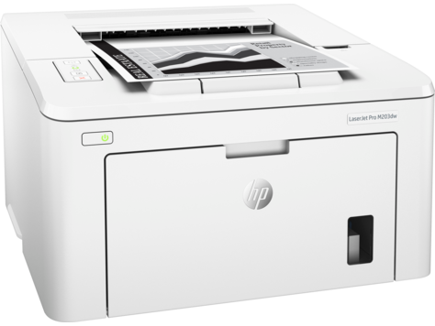

Versioning (1)
 | Laser-X | Laser-E
ppm (속도) | 20 | 10
기타 spec | 동일
cost | $200 | $210 (delay chip 포함)
Price | $500 | $300
가격차별에 대한 소비자의 저항
멀쩡한 제품에 스크래치를 내서 제품차별화

Slide 7

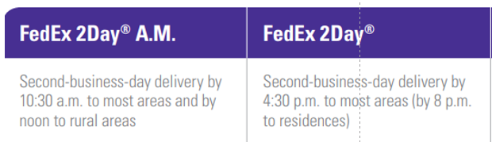
Versioning (2)
하루 한번만 배달하는 게 비용이 적게 든다.
실제로 하루 한번 배달하고 지연(오후) 배달을 위해 근처 창고에 보관
왜 이렇게 stupid 한 일을 하는 것일까?

Slide 8

Versioning (3)
광고를 붙이면, 조회수가 줄어들 수 있다.
Version 1 (광고 add) 무료
Version 2 (광고 free) 유료
광고 브레이크의 수에 따라 추가적인 Versioning 가능

