Slide 1
From CNN-LSTM to VLM:
A Comparative Analysis on Med-VQA with SLAKE
Team: jherng
Hong Jia Herng (U2005313)

Slide 2
Background
Med-VQA enables models to answer complex, image-grounded questions, providing interactive decision support and clarifying radiological findings.
Investigating performance gaps between traditional multimodal deep learning models and Large Vision-Language Models (VLMs).
  A.K.A. MedVQA as a classification problem vs. text generation problem
Benchmark Dataset: Evaluation conducted using the SLAKE dataset (Liu et al., 2021).

Slide 3
Objectives
To build and evaluate a classical multimodal baseline using a CNN for image encoding and an LSTM for question encoding.
To benchmark a modern pretrained Vision–Language Model (BLIP-VQA) on the same dataset.
To compare the strengths, limitations, and performance of both approaches on the SLAKE Med-VQA dataset.
To identify which modelling approach is more suitable for medical VQA problems at small data scales.
Prelim: Partially trained CNN-LSTM vs. Zero-shot BLIP-VQA (Will attempt to finetune BLIP-VQA for final submission)

Slide 4
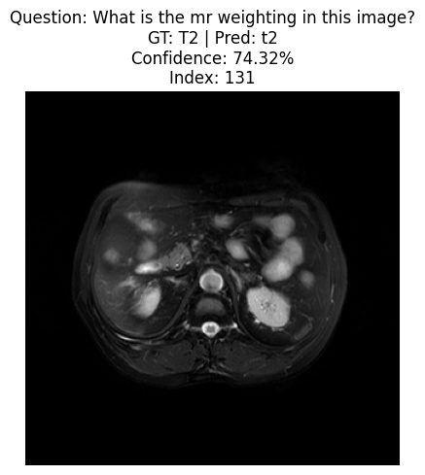
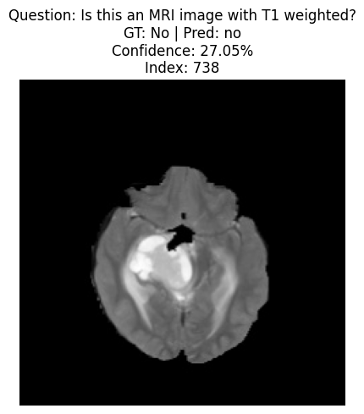
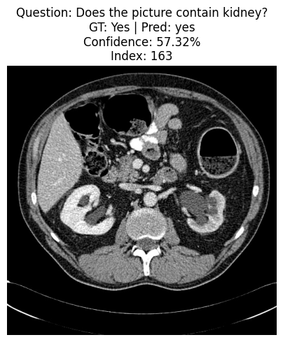
Methods: Dataset
SLAKE (Semantically-Labeled Knowledge-Enhanced) dataset (Liu et al., 2021)
  Medical images (e.g., CT, MRI, X-ray, etc.)
  Both closed-ended questions (Yes/No, modality type, organ identification)
  And open-ended factual questions (e.g., “What organ is enlarged?”)

Slide 5
Methods: Data Preprocessing
Image Preprocessing
1. Image resize to 224 x 224 (for it to work with ImageNet’s pretrained ResNet)
2. Convert to RGB (align with ImageNet’s pretrained ResNet)
3. Normalized using ImageNet mean (0.485, 0.456, 0.406) and standard deviation (0.229, 0.224, 0.225)

Slide 6
Methods: Data Preprocessing
Question Preprocessing
1. Lowercase
2. Tokenisation with NLTK
3. Convert each token to a hash value modulo 5000, so they’ll span within 0-4999
4. Take the ID (0 – 4999) as input to the word embedding layer
5. Word embedding via learnable embedding matrix in the network

Slide 7
Methods: Data Preprocessing
Answer Preprocessing
1. Extract all answers from the training set.
2. Lowercase and normalise text (remove punctuation).
3. Build an answer vocabulary of the top K most frequent answers (e.g., K=222 in our experiment, <UNK> class included).
4. Map all rare answers to an <UNK> token.

Slide 8
Methods: Model Architectures
Baseline: CNN+LSTM
CNN: ResNet-18 pretrained on ImageNet
  To extract global image features
  Producing a 512-D feature vector for each image
Convert question token to embeddings
  A learnable embedding layer (Embedding(5000, 300)) that maps discrete tokens into 300-dimensional embeddings.
LSTM
  A single-layer LSTM with hidden size 256 that processes the token sequence.
Fusion & Classification
  Concat the results from ResNet-18 and LSTM (512 + 300)
  1-Layer FC to map to 222 classes
Training:
  CrossEntropyLoss
  13,418,622 trainable parameters

Slide 9
Methods: Model Architectures
Baseline: BLIP-VQA
BLIP (Bootstrapping Language Image Pretraining) is a pretrained Vision–Language Model designed for VQA, captioning, and image–text matching. The version that we’re using “blip-vqa-base” has a total of 361,230,140 trainable parameters.
BLIP-VQA consists of:
  A ViT-based image encoder
  A Transformer-based text encoder
  A multimodal fusion encoder
  A generation-based decoder that produces the answer token by token
Unlike the baseline, BLIP-VQA:
  Is pretrained on 129M image–text pairs (combination of COCOO, VG, CC3M, CC12M, SBU Captions, LAION-400M)
  Has strong zero-shot VQA ability (but not on medical diagnosis)
  Generates answers in natural language form, not from a fixed vocabulary

Slide 10
Methods: Model Architectures
Baseline: BLIP-VQA
For this round, we map the natural language output of BLIP to our vocab (so fair comparison is possible with CNN+LSTM)
  Take the processed output and compared with the ground truth vocab.
  Calculate accuracy

Slide 11
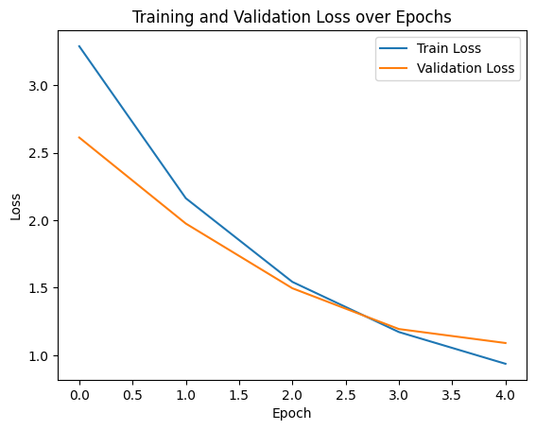
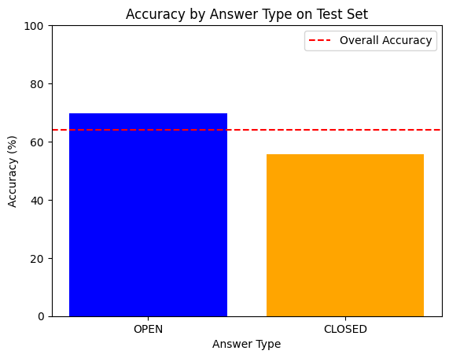
Preliminary Results - Baseline
We trained the baseline for 5 epochs
Test accuracy:
  OVERALL: 64.10%
  OPEN: 69.73%
  CLOSED: 55.69%
Interpretation:
  For closed question, slightly better than random guess (50%), the model is learning
  For open question, higher accuracy probably due to mapping to <UNK> token

Slide 12
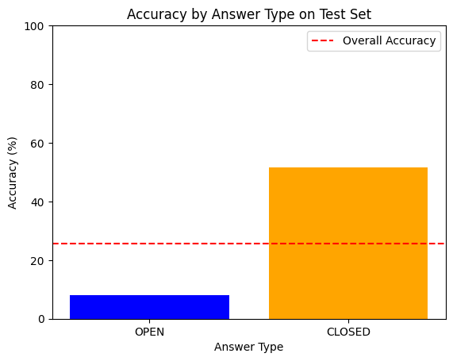
Preliminary Results – Zero-shot BLIP-VQA
No training
Test accuracy:
  OPEN: 8.08%
  CLOSED: 51.66%
  OVERALL: 25.55%
Interpretation:
  For closed question, BLIP is probably doing random guess (more training needed)
  For open question, low accuracy is fair, as the BLIP is not pretrained on medical data
  Finetuning needed (or find another Medical data pretrained BLIP)

Slide 13
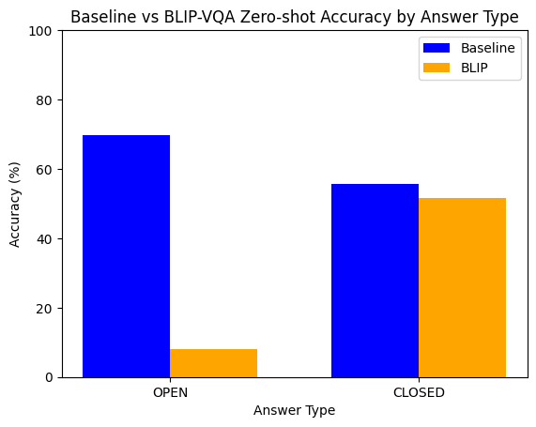
Preliminary Results – Side-by-side Comparison
Baseline works better now (as expected) with a bit of training.
Zero-shot BLIP doesn’t work well (fine-tuning needed)

Slide 14
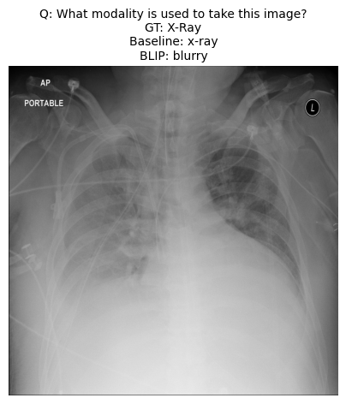
Preliminary Results – Inspect the Samples
Result of CNN+LSTM
Result of BLIP-VQA

Slide 15
Thank You

