Slide 1
C Tutorial
Ross Shaull
cs146a
2011-09-21

Slide 2
Why C
Standard systems language
Historical reasons (OS have historically been written in C, so libraries written in C were the easiest to integrate and usually had performance advantage)
Useful skill
C is still useful in the real world, both for interfacing with legacy systems and for producing performance-critical new code
Builds character
You will learn about your OS and the tools used to develop your OS

Slide 3
Writing a C Program
We'll use a text editor in this class
I recommend Emacs
You can use an IDE if you want

Slide 4
Compiling a C Program
We'll use gcc from the command line in this tutorial
We'll also learn a little about GNU Make (an age old tool to save you from typing stuff)
Notes:
Make has been around since the late 70's

Slide 5
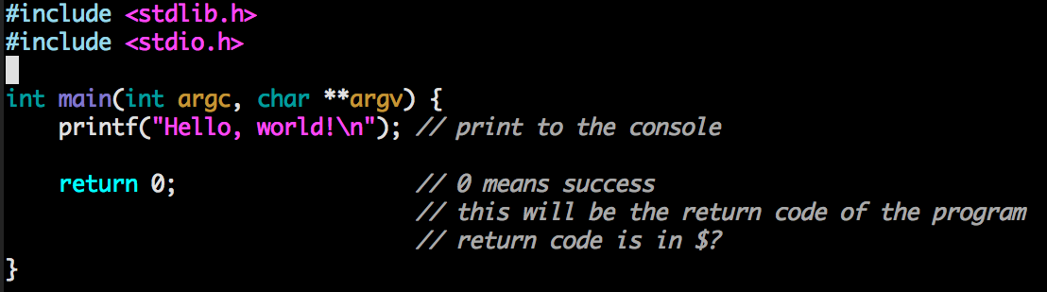
Hello World in C
arguments to the program when it is executed
serves same function as System.out.print in Java

Slide 6
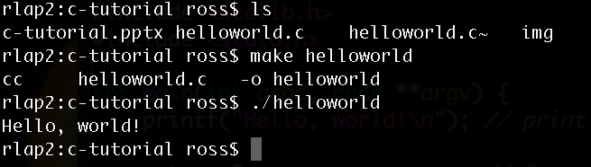
Compiling helloworld

Slide 7
How did Make do that?
Make knows how to compile simple C programs all by itself
It figured out from `make helloworld` that I want to compile helloworld.c into a binary called helloworld
It invoked gcc for me
But we can make a Makefile ourselves and customize the behavior a bit

Slide 8
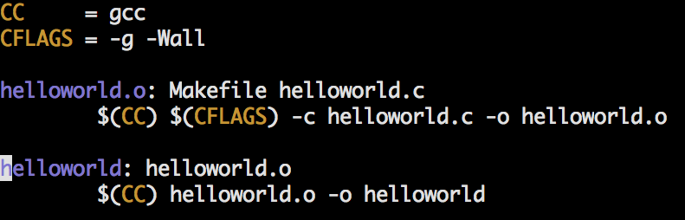
Things it was doing automatically

Slide 9
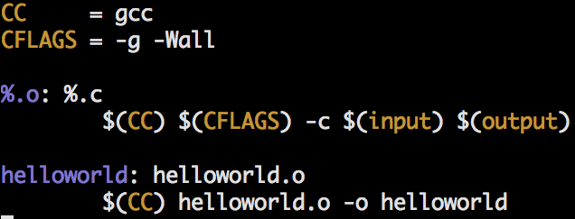
You can leave some things out

Slide 10
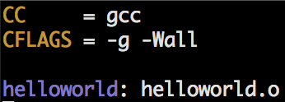
We can just customize CFLAGS

Slide 11
Is C Like Prog Lang X?
Your basic Java skills (or any ALGOL-like programming language skills) will translate
variables, assignment, arithmetic
if statements and boolean expressions
while loops, for loops, do-while loops
functions and function parameters
Some things are different
memory management feels very different from modern languages, and there is no garbage collector!
no OO
pointers!
If you are used to higher order programming languages, you will miss those features in C, don't try to replicate them

Slide 12
Memory
Linear array of "cells"
Each cell stores a machine word (4 bytes in 32-bit machine, 8 bytes in 64-bit machine)
address | value (byte)
0 | 0
1 | 0
2 | 0
3 | 0
4 | 0
5 | 0
6 | 0
7 | 0
8 | 0

Slide 13
Memory
Machine code might contain an "immediate mode" store command to put the value 42 into the byte at address 3
A byte can represent 2⁸ = 256 numbers (0 – 255)
address | value (byte)
0 | 0
1 | 0
2 | 0
3 | 42
4 | 0
5 | 0
6 | 0
7 | 0
8 | 0

Slide 14
Memory
In C we don't put memory addresses directly in our program text, but we can see the address of variables at runtime printf("%p\n", &var);
address | value (byte)
0 | 0
1 | 0
2 | 0
3 | 42
4 | 0
5 | 0
6 | 0
7 | 0
8 | 0

Slide 15
Memory is on the stack or heap
In Java, you get heap memory with new and the rest of variables are on the stack
This doesn't matter to you as the programmer
In C, you get heap memory with malloc and you give it back with free
Match your mallocs with frees or you will leak memory

Slide 16
Allocating
Telling the compiler you need space on the stack for an integer:
int i;
Telling the compiler you need space on the stack for a pointer to an integer:
int *ip;
Telling the operating system at runtime that you need space on the heap for an integer:
ip = malloc(sizeof(int));

Slide 17
Allocating
You should check for errors (always)
if((ip = malloc(sizeof(int))) == NULL) { fprintf(stderr, "Out of memory\n"); exit(1); }

Slide 18
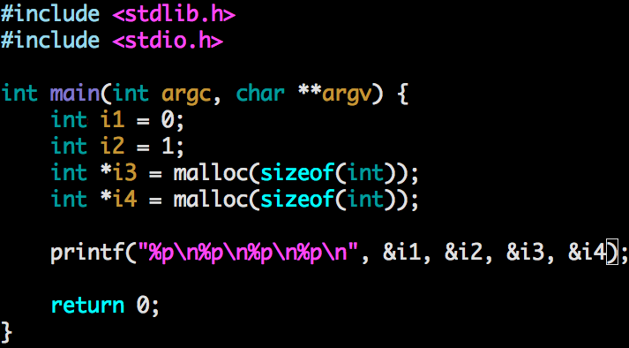
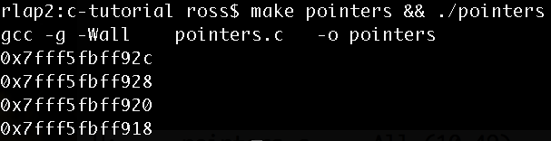
Pointers are abstraction of memory addresses

Slide 19
But not the real memory
virtual address | value (byte)
0 | 0
1 | 0
2 | 0
3 | 42
4 | 0
5 | 0
6 | 0
7 | 0
8 | 0
address | value (byte)
0 | 0
1 | 0
2 | 0
… | …
4000 | 0
4001 | 0
4002 | 0
4003 | 0
4004 | 3

Slide 20
But not the real memory
virtual address | value (byte)
0 | 0
1 | 0
2 | 0
3 | 42
4 | 0
5 | 0
6 | 0
7 | 0
8 | 0
address | value (byte)
0 | 0
1 | 0
2 | 0
… | …
4000 | 0
4001 | 0
4002 | 0
4003 | 0
4004 | 3
Virtual memory!

Slide 21
Memory abstraction
We'll treat pointers as though they are pointers to real memory, because that's what the virtual memory abstraction gives us (the illusion that we own the machine)
Just don't forget that we still have isolation, paging, and all the other good stuff we get from virtual memory

Slide 22
Types
C is weakly typed
You can cast any pointer to any other pointer
Feel free to try weird stuff like casting an integer to a string, the worst that will happen is segfault or bus error (because of isolation nothing will be harmed)

Slide 23
Types
int
double
long
char
there's more…

Slide 24
Arrays
Multiple cells next to each other int nums[10]; nums[0] = 42; nums[9] = 100; nums[10] = 1; // UH OH this is a bug
These arrays contain garbage not zeros!!!
The length is not stored with the array
If you are making an array for convenience you can initialize it right away int nums[] = {1, 2, 4, 8, 16, 32, 64, 128};
These are on the stack. You can put arrays in the heap int *nums = malloc(10 * sizeof(int)); nums[0] = 42;

Slide 25
Strings
Pointer to one or more characters char *s = malloc(20); char *s = malloc(20 * sizeof(char)); char s[20];
You can address strings like arrays: s[0] = 'a'
By the way, strings in the text of your code are typically stored in the code section of the compiled binary

Slide 26
Strings
"Strings" are arrays of chars
Arrays don't carry their length around with them
By convention, strings in C end with a NULL byte '\0' (called NULL-terminated strings)
You can find the length of a NULL-terminated string by counting bytes until you find \0
That's what strlen does:
strlen(s)
Only do this with strings you created because it's a place where you can get buffer overruns and segfaults

Slide 27
Structs
Records, not objects (no methods) struct record_t { char name[255]; int age; };
It's name is "struct record_t" struct record_t record = {.name = "Bob", .age = 21}; struct record_t *recordp; recordp = malloc(sizeof(record_t));
I use typedef and a semi-idosyncratic style typedef struct record_t { char name[255]; int age; } RECORD; RECORD record;

Slide 28
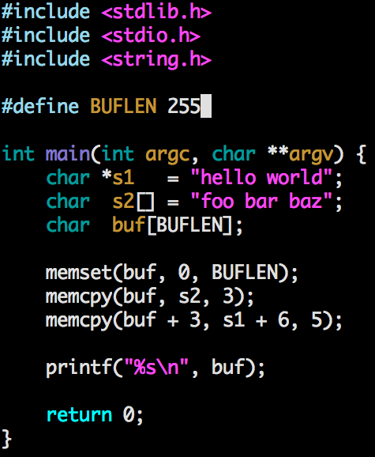
C moves memory around efficiently

Slide 29
System Calls
We'll use them a lot
They are special addresses (set up when the OS is starting up) that trigger a switch to kernel mode, and then jump to a special function
If your OS can do it, you can ask your OS to do it from C (in higher level languages the features may not be available, because somebody has to write that code)

Slide 30
System Calls
(although actually we'll be using very standard syscalls that are available in virtually every programming language)

Slide 31
System Calls
printf – yes
read file – yes
write file – yes
malloc – yes
memcpy – no!
free – yes
strlen – no!
starting a (kernel) thread – yes!

Slide 32
For your project
compiling (gcc and Make)
basic programming stuff
basic pointers
console output (printf)
sockets (up next)
threads
we assume you have seen thread before
we will give you a recipe for starting and joining threads in C using pthreads

Slide 33
By the way
You'll want to use multiple files to make it easier to understand your code and to start to visualize how it is modularized
In C we have header files and source files
header files define prototypes (names and signatures of functions)
source files implement those prototypes
we include the header file
we'll give you an example

