Slide 1
Sockets Tutorial
Ross Shaull
cs146a
2011-09-21

Slide 2
What we imagine
request…
The packets that comprise your request are orderly and all arrive
1
2
3
Network
response…

Slide 3
In reality…
Packets can arrive out of order
3
2
Network
Maybe a packet gets deleted and needs to be resent
1
3

Slide 4
Hide the reality with abstraction
TCP/IP is the network transport protocol which gives you reliable, stream-oriented delivery
We'll learn about it in class!
We want an even easier abstraction built on top of TCP/IP
Sockets

Slide 5
Borrows from file abstraction
open
read
write
close

Slide 6
But sockets aren't files
Can't "create" or "delete" them
Can't "seek" inside them

Slide 7
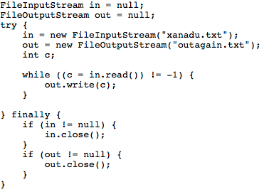
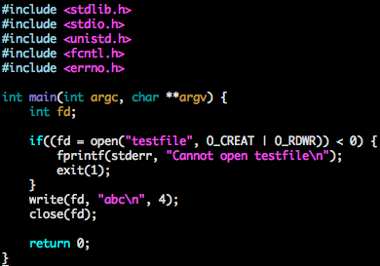
So File I/O…

Slide 8
First Example
A client written using sockets
Fetch a web page and print it to the console
Besides the socket code, take note of
We will use a header file
We will compile a binary from two object files
We do some error handling (needs more, though!)
This code will be supplied, so don't feel like you have to memorize it now

Slide 9
Servers
Servers can also be written using sockets
Server sockets listen for incoming connections
Servers accept incoming connections
this creates another socket, the client socket
The general strategy is to create a server socket, listen, accept, and spawn a thread to do whatever work you need to do for the client, then close the client socket
Notes:
You don't have to use threads just because this is a server, but we will (for a variety of reasons).

Slide 10
Servers (in the software sense)
Listening on socket 1

Slide 11
Servers
Listening on socket 1
Establishes a new socket for communicating with client 1
Client 1 on socket 2

Slide 12
Servers
Listening on socket 1
Client 1 on socket 2
Client 2 on socket 3

Slide 13
Servers
Listening on socket 1
Client 1 on socket 2
Client 2 on socket 3
Client 3 on socket 4

Slide 14
Ports
Every socket is associated with a port
Ports are how the network layer knows which application should handle a particular packet
Ports are not like real world "portholes", they are like addresses on an envelope
You will think about ports in the context of servers, they have to listen at a particular port

Slide 15
Ports
Certain ports are "well-defined" in that there are conventional kinds of servers that listen at them
web servers listen at port 80
ssh servers listen at port 22
imap servers listen at port 443
Low-numbered ports are protected by the OS; unless you are root you can't use them
We'll use high numbered ports like 8000 or 8080 or whatever
Notes:
low numbered means first 1024 ports

Slide 16
Second Example: Yelling Server
A yelling server is a very annoying kind of echo server that repeats back whatever you just said, but it yells it at you
that means it makes the letters upper case
Okay, it's not a useful server
We can test it with telnet
Learn telnet!
We can also test it with our little web page fetcher

Slide 17
Blocking I/O
When you read from disk with file I/O, you usually do what is called blocking I/O
What we have been doing with sockets so far is also blocking I/O

Slide 18
Blocking I/O
User program
Operating System
read(fd, buf, len)
Wait until there is data to read, then copy it into buf
Function returns

Slide 19
Blocking I/O
This model is easy to program with, system calls that do I/O look like normal function calls (you call them, they do something, then return)
The problem: reading from a socket that will never produce data can cause your program to block forever

Slide 20
Non-blocking socket I/O (not for files)
User program
Operating System
Does fd have data to read?
Yes
read(fd, buf, len)
copy to buf

Slide 21
Non-blocking socket I/O
The real benefit comes from being able to ask about multiple sockets at the same time
Let's say you have two sockets and you have to respond to both of them (maybe with yelling)
The client communicating on socket A crashed or is doing something else, so it doesn't say anything to you for a long time

Slide 22
Blocking I/O and Multiple Sockets
Server
read(A, buf, len)
read(A, buf1, BUFLEN);
read(B, buf2, BUFLEN);
Never returns because socket A never sends anything for us to read

Slide 23
Solution is with select()
Allows you to package up multiple sockets and ask if any of them are ready for read or write
We call this the ready state of the sockets
Basically, we are asking "can I read from any of these sockets without blocking?"
There won't be time tonight to go through the code for using select(), so we will look at it conceptually, don't worry we'll give you code showing exactly how to use it

Slide 24
select
Make an fd_set
array of file descriptors
Pass it to select
Select blocks until at least one is ready (or there is an error)
Then you check every entry in the fd_set to see which one(s) are ready

Slide 25
select
Client 1 on socket 2
Client 2 on socket 3
pseudocode: ready = select(2, 3, 4)
Client 3 on socket 4
Blocks until at least one is ready or there is an error
2 and 4 are ready
pseudocode: loop over [2, 3, 4]
if socket is ready,
read from it

Slide 26
Notes
man pages are your friend
man 2 will have most of the socket stuff
e.g., `man 2 read`, `man 2 write`, etc.
man 3 has core library stuff like memcpy
e.g., `man 3 memcpy`

