Slide 1
Review

Slide 2
期末考试
时间：2022年12月27日周三1-2节，8:00-9:50
地点：上课教室（仙II-110）
闭卷
总成绩
不参加考试的同学无成绩，请及时联系教务员退选
参加考试的同学：作业40% + 考试60%

Slide 3
阅读理解&写作
If I show you a formal system, can you apply it to examples?
Given a small-step operational semantics, write down the execution paths of a configuration
Given a big-step operational semantics, write down the derivation of a big-step transition
Given a program logic, write down the proof of a specification
Given a definition of a property, tell whether it holds
If I tell you the informal meaning of a property, can you formalize it?
Please do not use natural language in your formalization.

Slide 4
What is a programming language
Syntax
Operational semantics
Small-step operational semantics
Big-step operational semantics
----------------------------------------------------
Ensuring correctness: type system / program logic
Typing rules / logic rules
Soundness

Slide 5
Course Contents
Lambda Calculus
Untyped
Simply typed
Imperative languages
Operational semantics
Hoare logic
Separation logic

Slide 6

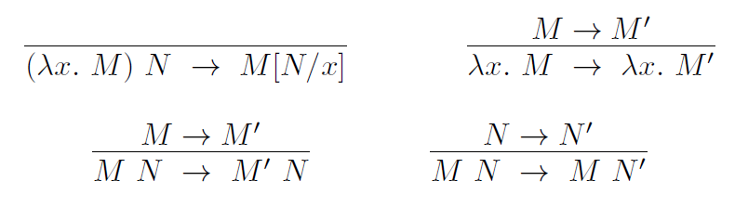
Untyped lambda calculus
Syntax
Semantics (reduction rules)

Slide 7
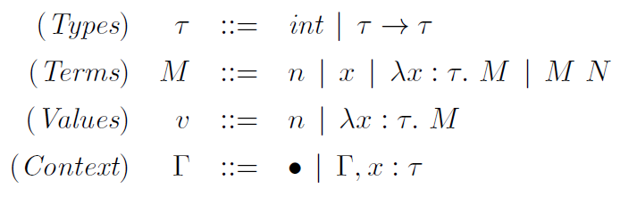
Simply-typed lambda calculus
Syntax
Reduction rules

Slide 8
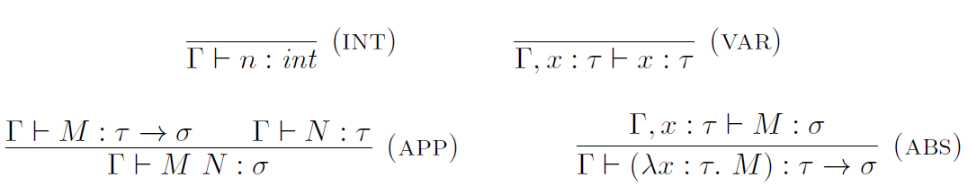
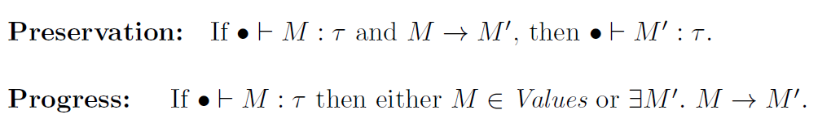
Simply-typed lambda calculus
Typing rules

Slide 9
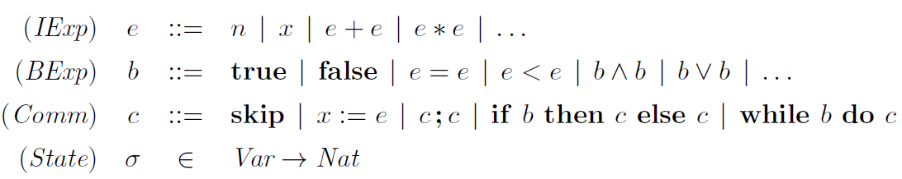
A simple imperative language
Syntax

Slide 10
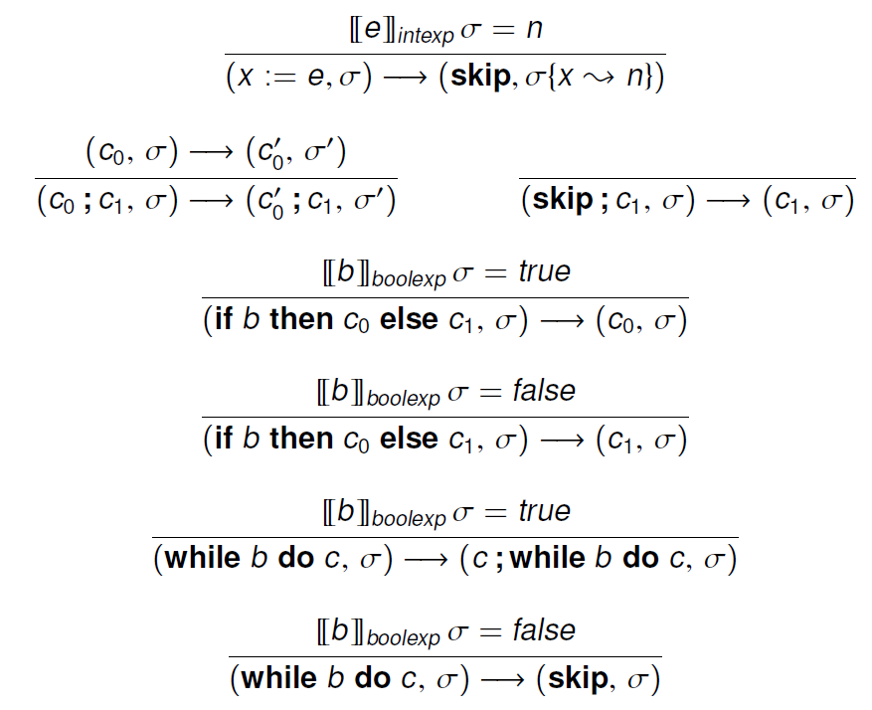
Operational semantics
Small-step

Slide 11
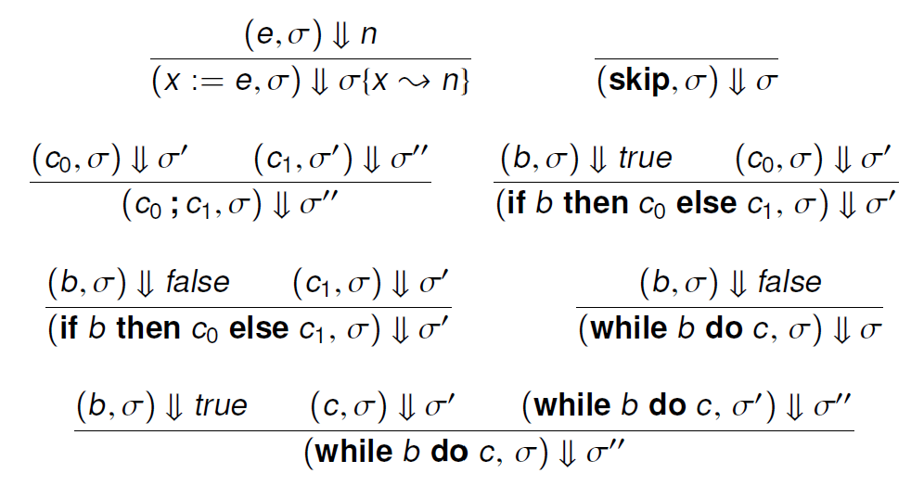
Operational semantics
Big-step

Slide 12

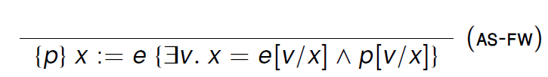

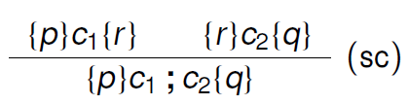
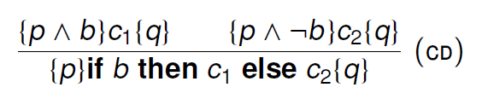
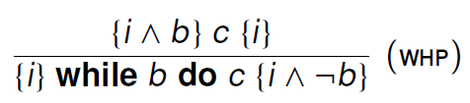
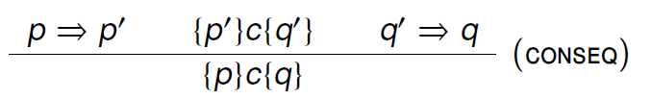
Hoare logic
Inference rules for partial correctness
Judgement semantics (validity of Hoare triples)
Soundness theorem

Slide 13
Formal Semantics of Prog. Lang.
Lambda Calculus
Untyped
Reduction
Simply typed
Reduction vs typing : progress & preservation
Imperative languages
Operational semantics
Small-step & big-step
Hoare logic
Users: reasoning using logic rules; Designers: logic soundness
Separation logic
Assertion semantics & locality

