Slide 1
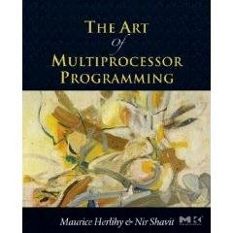
Review of Concurrent Algorithms
The Art of Multiprocessor Programming
by Maurice Herlihy & Nir Shavit

Slide 2
What we have learned
Model for concurrent computation
Correctness for concurrent objects
Algorithms

Slide 3
Concurrent Computation
threads
memory
object
object
Notes:
3

Slide 4
Bus-Based Architectures
cache
cache
cache
Bus
memory
Notes:
We are going to do yet another review of multiprocessor architecture.

Slide 5
Interleaving Semantics
T1
T2
…
||
=
Program
Possible executions

Slide 6
Quick quiz
C++ Program
#include <thread>
#include <assert.h>
int x = 0;
void foo() {
while (true) {
x = 1;
x = 0;
assert(x == 0);
}
}
int main() {
std::thread t(foo);
std::thread t2(foo);
t.join();
t2.join();
}
Will the assertion fail?

Slide 7
Objects + Clients
T1
T2
T3
A concurrent program =
concurrent objects + their clients
push() {
…
}
…
…
s.push(7);
x = s.pop();
…
…
s.push(6);
…
void push(int v) {
…
}
int pop() {
…
}
Concurrent object
Client code

Slide 8
What we have learned
Model for concurrent computation
Correctness for concurrent objects
Algorithms

Slide 9
Correctness
Linearizability, linearization points

Slide 10
Linearizability
History H is linearizable if it can be extended to G by
Appending zero or more responses to pending invocations
Discarding other pending invocations
So that G is equivalent to
Legal sequential history S
where ➔_{G} ⊆ ➔_{S}

Slide 11
Example
not linearizable
q.enq(x)
q.deq(y)
q.enq(y)
time

Slide 12
Talking About Executions
Why?
Can’t we specify the linearization point of each operation without describing an execution?
Not Always
In some cases, linearization point depends on the execution

Slide 13
Correctness & Progress
Linearizability, linearization points
Progress: Lock-freedom, Wait-Freedom, Deadlock-freedom, Starvation-Freedom

Slide 14
Progress Conditions
Non-Blocking
Blocking
Everyone
makes
progress
Wait-free
Starvation-free
Someone
makes
progress
Lock-free
Deadlock-free

Slide 15
Correctness & Progress
Linearizability
Progress: Lock-freedom, Wait-Freedom, Deadlock-freedom, Starvation-Freedom
For locks: Mutual Exclusion, Deadlock-freedom, Starvation-Freedom, First-Come-First-Served

Slide 16
Mutual Exclusion
Let CS_{i}^{k} be thread i’s k-th critical section execution
And CS_{j}^{m} be j’s m-th execution
Then either
or
CS_{i}^{k} ➔ CS_{j}^{m}
CS_{j}^{m} ➔ CS_{i}^{k}

Slide 17
Deadlock-Free
If some thread calls lock()
And never returns
Then other threads must complete lock() and unlock() calls infinitely often
System as a whole makes progress
Even if individuals starve
Notes:
At least one other thread is completing infinitely often, since there are only a finite number of threads.

Slide 18
Starvation-Free
If some thread calls lock()
It will eventually return
Individual threads make progress
Notes:
We assume that no thread is in the critical section forever.

Slide 19
First-Come-First-Served
Divide lock() method into 2 parts:
Doorway interval:
Written D_{A}
always finishes in finite steps
Waiting interval:
Written W_{A}
may take unbounded steps

Slide 20
First-Come-First-Served
For threads A and B:
If D_{A}^{k} ➔ D_{B} ^{j}
A’s k-th doorway precedes B’s j-th doorway
Then CS_{A}^{k} ➔ CS_{B}^{j}
A’s k-th critical section precedes B’s j-th critical section
B cannot overtake A

Slide 21
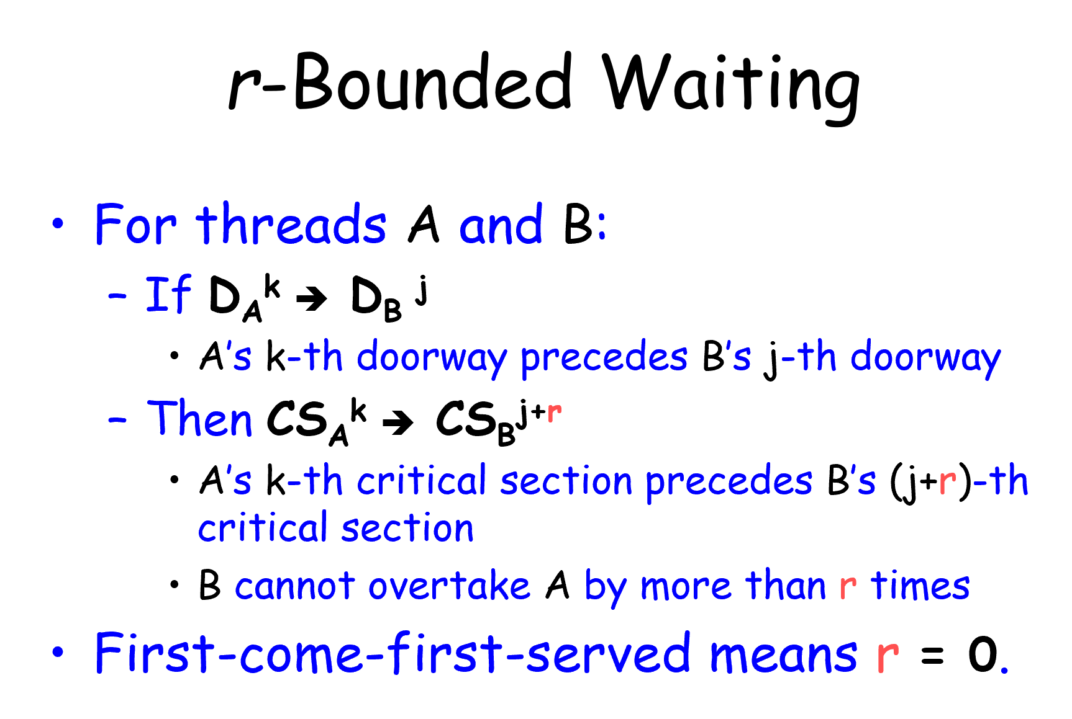

Slide 22
What we have learned
Model for concurrent computation
Correctness for concurrent objects
Algorithms

Slide 23
Algorithms
Locks
List-Based Sets
Queues and Stacks

Slide 24
Locks
Peterson Lock (for two threads)
Filter Lock
Lamport’s Bakery Lock
Test-And-Set Lock
Test-Test-And-Set Lock
Exponential Backoff Lock
Anderson’s Array-Based Queue Lock
CLH Queue Lock
MCS Queue Lock

Slide 25
List-Based Sets
Lock-Coupling List
Optimistic List
Lazy List
Lock-Free List

Slide 26
Queues and Stacks
Queues
Two-Lock Queue
Lock-Free Queue
Stacks
Treiber’s Lock-Free Stack (Exponential Backoff)
Elimination Backoff Stack

Slide 27
Reminder: Course Report

