Slide 1
Memory Models

Slide 2
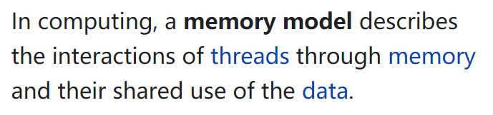
Memory Models
https://en.wikipedia.org/wiki/Memory_model_(programming)

Slide 3
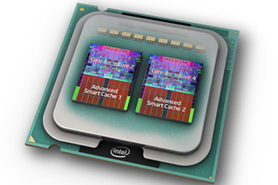
Memory Models
C1 || C2
Compiler
Result
Memory

Slide 4
Memory Models
C1 || C2
Compiler
Result
Which reads see which write?
Memory

Slide 5
Sequential Consistency (SC) Model
[Lamport 1979]
Interleaving semantics:
. . .
P1
P2
P3
Pn
Memory

Slide 6
Sequential Consistency (SC) Model
[Lamport 1979]
Interleaving semantics:
☹ No muticore processor implements SC
☹ Compiler optimizations invalidate SC

Slide 7
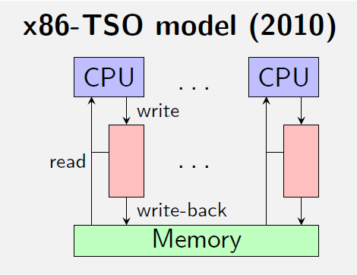
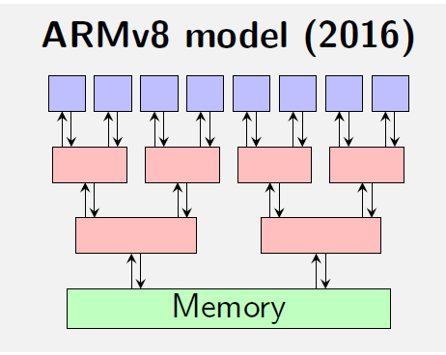
Weak/Relaxed Memory Models
Every hardware architecture has its own WMM
x86-TSO memory model
ARMv8 memory model
…

Slide 8
Store buffering (SB)
Initially: x = y = 0
x = 1;
r1 = y;
y = 1;
r2 = x;
r1 = r2 = 0?
Load buffering (LB)
Initially: x = y = 0
r1 = x;
y = 1;
r2 = y;
x = 1;
r1 = r2 = 1?

Slide 9
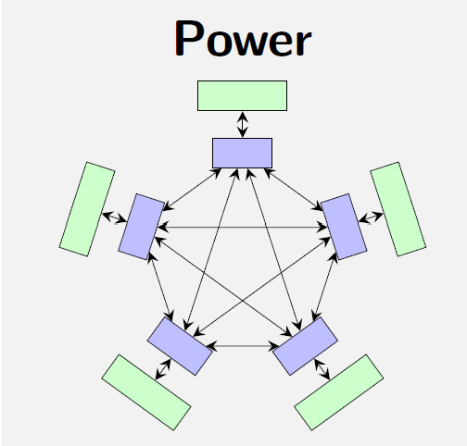
More than just reorderings [FM’16]
Independent reads of independent writes (IRIW)
Initially: x = y = 0
r1 = x;
lwsync;
r2 = y;
r3 = y;
lwsync;
r4 = x;
x = 1;
y = 1;
r1 = 1, r2 = 0, r3 = 1, r4 = 0?
Because of the lwsync fences, no reorderings are possible!

Slide 10
SC model prohibits many optimizations
Initially: x = y = 0
x = 1;
r1 = y;
y = 1;
r2 = x;
r1 = y;
x = 1
y = 1;
r2 = x;
r1 = r2 = 0?
Impossible in SC model, but allowed in x86 or Java.
Weak memory model allow more behaviors.
Notes:
Store buffering

Slide 11
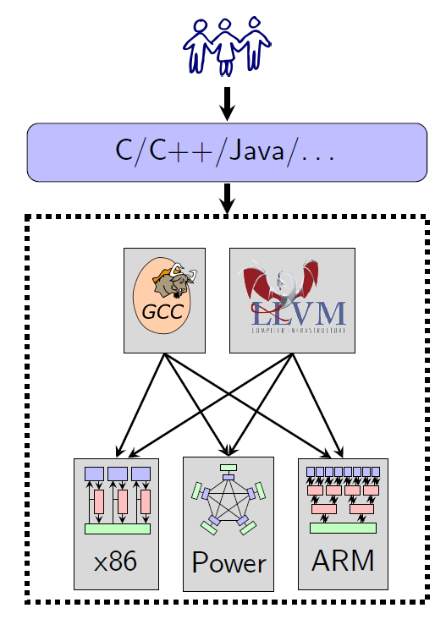
WMM for High-Level Languages

Slide 12
Design Criteria
Usability: DRF guarantee
DRF programs have the same behaviors as in SC model

Slide 13
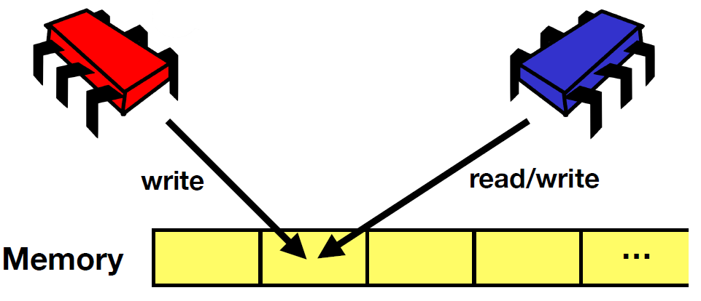
Data-Race-Freedom (DRF)
Data-race: read-write / write-write conflicts

Slide 14
Data-Race-Freedom (DRF)
A data race occurs when we have two concurrent conflicting operations
Conflicting: the two operations both access the same memory location and at least one is a write
Concurrent ?
Differs across memory models
Java: the two operations are not ordered by “happens-before”

Slide 15
DRF Guarantee
DRF programs have the same behaviors as in SC model
For DRF programs, the programmer does not need to worry that reorderings will affect her code.

Slide 16
Design Criteria
Usability: DRF guarantee
DRF programs have the same behaviors as in SC model
Not too strong
Allow common optimization techniques
Allow standard compilation schemes to major modern architectures
In some sense hijacked by the mainstream compiler
Preserve type-safety and security guarantee
Cannot be too weak
Very challenging to satisfy all the requirements!

Slide 17
Compiler Optimization Can Be Smart
Initially: x = 0, y = 1
r1 = x;
r2 = x;
if (r1 == r2)
y = 2;
y = 2;
r1 = x;
r2 = r1;
if (true)
r3 = y;
x = r3;
r1 = r2 = r3 = 2?
Redundant read elim.
Must be allowed!

Slide 18
Efforts for Java Memory Model (JMM)
First edition in Java Language Spec
Fatally flawed, not support key optimizations [Pough 2000]
Current JMM [Manson et al. 2005]
Based on 5-year discussion and many failed proposals
“very complex” [Adve & Boehm 2010]
Surprising behaviors and bugs [Aspinall & Sevcik 2007]
Next generation: JEP 188, Dec. 2013

Slide 19
Happens-Before Order
[Lamport 1978]
Program execution: a set of events, and some orders between them.
rel
acq
T1
T2
acq
rel
Time
po:
sw:
Happens-before order (hb): transitive closure of po∪sw

Slide 20
Happens-Before Order
hb
hb
w1
w2
w1
r
hb
hb
Not:
w2
r
r
w2
rel
acq
T1
w1
w2
r
T2
acq
rel
Time
po:
sw:
Happens-before order (hb): transitive closure of po∪sw

Slide 21
Happens-Before Memory Model (HMM)
Read can see
(1) the most recent write that happens-before it, or
(2) a write that has no happens-before relation.
rel
acq
T1
w1
w2
r
T2
acq
rel
Time
r could see both w1 (which happens-before it) and w2 (with which there is no happens-before relation)

Slide 22
HMM – Relaxed Ordering
Initially: x = y = 0
x = 1;
r1 = y;
y = 1;
r2 = x;
r1 = r2 = 0?
Allowed in HMM

Slide 23
HMM – Examples with Global Analysis
Initially: x = 0, y = 1
Speculation: r3 reads 2
Justified!
r1 = x;
r2 = x;
if (r1 == r2)
y = 2;
r3 = y;
x = r3;
r1 = r2 = r3 = 2?
Allowed in HMM!

Slide 24
HMM – Out-of-Thin-Air Read
Initially: x = y = 0
Speculation: r1 will get 42
Justified!
r1 = x;
y = r1;
r2 = y;
x = r2;
r1 = r2 = 42?
May break the security and type-safety of Java!
Allowed in HMM!

Slide 25
Speculation: r3 reads 2
r1 = x;
r2 = x;
if (r1 == r2)
y = 2;
r3 = y;
x = r3;
Good speculation. Should allow!
r1 = r2 = r3 = 2?
Speculation: r1 will get 42
r1 = x;
y = r1;
r2 = y;
x = r2;
Bad speculation. Disallow!
r1 = r2 = 42?

Slide 26
JMM
Take HMM as the core, and try hard to distinguish good speculation from bad speculation!
Introduce 9 axioms to constrain causality.
Very complex, with surprising results and bugs.

Slide 27
JMM – Surprising Results
lock l;
C1;
C2;
unlock l;
C3
C1;
lock l;
C2;
unlock l;
C3
lock l;
C1;
unlock l;
lock l;
C2;
unlock l;
C3
Adding more synchronization may increase behaviors!

Slide 28
JMM – Surprising Results (2)
C1;
C2;
C1;
C2;
C3
C3;
Inlining threads may increase behaviors!
More:
Re-ordering independent operations may change behaviors.
Adding/removing redundant reads may change behaviors.

Slide 29
Reading
http://www.cs.umd.edu/~pugh/java/memoryModel/
http://openjdk.java.net/jeps/188

Slide 30
More Examples (1)
Load buffering (LB)
Initially: x = y = 0
r1 = x;
y = 1;
r2 = y;
x = 1;
r1 = r2 = 1?
(Compare it to the earlier OOTA example)

Slide 31
More Examples (2)
Independent reads of independent writes (IRIW)
Initially: x = y = 0
r1 = x;
r2 = y;
r3 = y;
r4 = x;
x = 1;
y = 1;
r1 = 1, r2 = 0, r3 = 1, r4 = 0?

Slide 32
More Examples (3)
Out-of-thin-air read
Initially: x = y = z = 0
r1 = x;
y = r1;
r2 = y;
x = r2;
z = 1;
r3 = z;
x = r3;
r1 = r2 = 1, r3 = 0?
Allowed in HMM!

Slide 33
More Examples (4)
Out-of-thin-air read
Initially: x = y = z = 0
r1 = x;
if (r1 == 1)
y = 1;
r2 = y;
if (r2 == 1)
x = 1;
r3 = z;
if (r3 == 1)
x = 1;
z = 1;
r1 = r2 = 1, r3 = 0?
Allowed in HMM!

Slide 34
More Examples (5)
HMM does not have DRF-guarantee
Initially: x = y = 0
r1 = x;
if (r1 != 0)
y = 42;
r2 = y;
if (r2 != 0)
x = 42;
r1 = r2 = 42?
Allowed in HMM!

Slide 35
More Examples (6)
Initially: x = 0
r1 = x;
x = 1;
r1 = 1?
Initially: x = y = 0
r1 = x;
x = 1;
y = x;
x = y;
r1 = 1?

Slide 36
Summary
Why need weak memory models
Design criteria of weak memory models
The happens-before memory model
Out-of-thin-air read

