Slide 1
Memory Models

Slide 2
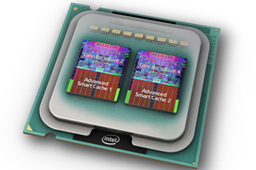
Why Memory Models
C1 || C2
Compiler
Result
Memory

Slide 3
Why Memory Models
C1 || C2
Compiler
Result
Which reads see which write?
Memory

Slide 4
Sequential Consistency (SC) Model
[Lamport 1979]
Interleaving semantics:
. . .
P1
P2
P3
Pn
Memory

Slide 5
The need of weak memory models
SC model prohibits many optimization:
Initially: x = y = 0
x = 1;
r1 = y;
y = 1;
r2 = x;
r1 = y;
x = 1
y = 1;
r2 = x;
r1 = r2 = 0?
Impossible in SC model, but allowed in x86 or Java.
Weak memory model allow more behaviors.
Notes:
Store buffering

Slide 6
Design Criteria
Usability: DRF guarantee
DRF programs have the same behaviors as in SC model

Slide 7
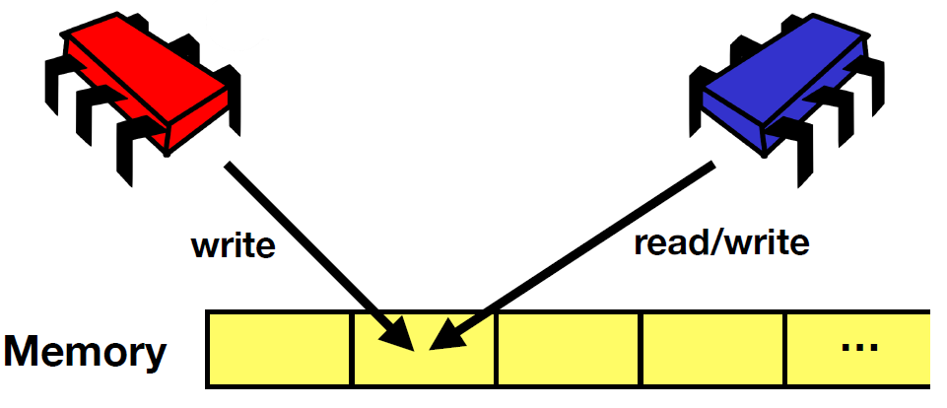
Data-Race-Freedom (DRF)
Data-race: read-write / write-write conflicts

Slide 8
Data-Race-Freedom (DRF)
A data race occurs when we have two concurrent conflicting operations
Conflicting: the two operations both access the same memory location and at least one is a write
Concurrent ?
Differs across memory models
Java: the two operations are not ordered by “happens-before”

Slide 9
DRF Guarantee
DRF programs have the same behaviors as in SC model
For DRF programs, the programmer does not need to worry that reorderings will affect her code.

Slide 10
Design Criteria
Usability: DRF guarantee
DRF programs have the same behaviors as in SC model
Not too strong
Allow common optimization techniques
Allow standard compilation schemes to major modern architectures
In some sense hijacked by the mainstream compiler
Preserve type-safety and security guarantee
Cannot be too weak
Very challenging to satisfy all the requirements!

Slide 11
Compiler Optimization Can Be Smart
Initially: x = 0, y = 1
r1 = x;
r2 = x;
if (r1 == r2)
y = 2;
y = 2;
r1 = x;
r2 = r1;
if (true)
r3 = y;
x = r3;
r1 = r2 = r3 = 2?
Redundant read elim.
Must be allowed!

Slide 12
Efforts for Java Memory Model (JMM)
First edition in Java Language Spec
Fatally flawed, not support key optimizations [Pough 2000]
Current JMM [Manson et al. 2005]
Based on 5-year discussion and many failed proposals
“very complex” [Adve & Boehm 2010]
Surprising behaviors and bugs [Aspinall & Sevcik 2007]
Next generation: JEP 188, Dec. 2013

Slide 13
Happens-Before Order
[Lamport 1978]
Program execution: a set of events, and some orders between them.
rel
acq
T1
T2
acq
rel
Time
po:
sw:
Happens-before order (hb): transitive closure of po∪sw

Slide 14
Happens-Before Order
hb
hb
w1
w2
w1
r
hb
hb
Not:
w2
r
r
w2
rel
acq
T1
w1
w2
r
T2
acq
rel
Time
po:
sw:
Happens-before order (hb): transitive closure of po∪sw

Slide 15
Happens-Before Memory Model (HMM)
Read can see
(1) the most recent write that happens-before it, or
(2) a write that has no happens-before relation.
rel
acq
T1
w1
w2
r
T2
acq
rel
Time
r could see both w1 (which happens-before it) and w2 (with which there is no happens-before relation)

Slide 16
HMM – Relaxed Ordering
Initially: x = y = 0
x = 1;
r1 = y;
y = 1;
r2 = x;
r1 = r2 = 0?
Allowed in HMM

Slide 17
HMM – Examples with Global Analysis
Initially: x = 0, y = 1
Speculation: r3 reads 2
Justified!
r1 = x;
r2 = x;
if (r1 == r2)
y = 2;
r3 = y;
x = r3;
r1 = r2 = r3 = 2?
Allowed in HMM!

Slide 18
HMM – Out-of-Thin-Air Read
Initially: x = y = 0
Speculation: r1 will get 42
Justified!
r1 = x;
y = r1;
r2 = y;
x = r2;
r1 = r2 = 42?
May break the security and type-safety of Java!
Allowed in HMM!

Slide 19
Speculation: r3 reads 2
r1 = x;
r2 = x;
if (r1 == r2)
y = 2;
r3 = y;
x = r3;
Good speculation. Should allow!
r1 = r2 = r3 = 2?
Speculation: r1 will get 42
r1 = x;
y = r1;
r2 = y;
x = r2;
Bad speculation. Disallow!
r1 = r2 = 42?

Slide 20
JMM
Take HMM as the core, and try hard to distinguish good speculation from bad speculation!
Introduce 9 axioms to constrain causality.
Very complex, with surprising results and bugs.

Slide 21
JMM – Surprising Results
lock l;
C1;
C2;
unlock l;
C3
C1;
lock l;
C2;
unlock l;
C3
lock l;
C1;
unlock l;
lock l;
C2;
unlock l;
C3
Adding more synchronization may increase behaviors!

Slide 22
JMM – Surprising Results (2)
C1;
C2;
C1;
C2;
C3
C3;
Inlining threads may increase behaviors!
More:
Re-ordering independent operations may change behaviors.
Adding/removing redundant reads may change behaviors.

Slide 23
Reading
http://www.cs.umd.edu/~pugh/java/memoryModel/
http://openjdk.java.net/jeps/188

Slide 24
More Examples (1)
Load buffering (LB)
Initially: x = y = 0
r1 = x;
y = 1;
r2 = y;
x = 1;
r1 = r2 = 1?
(Compare it to the earlier OOTA example)

Slide 25
More Examples (2)
Independent reads of independent writes (IRIW)
Initially: x = y = 0
r1 = x;
r2 = y;
r3 = y;
r4 = x;
x = 1;
y = 1;
r1 = 1, r2 = 0, r3 = 1, r4 = 0?

Slide 26
More Examples (3)
Out-of-thin-air read
Initially: x = y = z = 0
r1 = x;
y = r1;
r2 = y;
x = r2;
z = 1;
r3 = z;
x = r3;
r1 = r2 = 1, r3 = 0?
Allowed in HMM!

Slide 27
More Examples (4)
Out-of-thin-air read
Initially: x = y = z = 0
r1 = x;
if (r1 == 1)
y = 1;
r2 = y;
if (r2 == 1)
x = 1;
r3 = z;
if (r3 == 1)
x = 1;
z = 1;
r1 = r2 = 1, r3 = 0?
Allowed in HMM!

Slide 28
More Examples (5)
HMM does not have DRF-guarantee
Initially: x = y = 0
r1 = x;
if (r1 != 0)
y = 42;
r2 = y;
if (r2 != 0)
x = 42;
r1 = r2 = 42?
Allowed in HMM!

Slide 29
More Examples (6)
Initially: x = 0
r1 = x;
x = 1;
r1 = 1?
Initially: x = y = 0
r1 = x;
x = 1;
y = x;
x = y;
r1 = 1?

Slide 30
Summary
Why need weak memory models
Design criteria of weak memory models
The happens-before memory model
Out-of-thin-air read

