Slide 1
Progress of Concurrent Objects with Partial Methods
Hongjin Liang and Xinyu Feng
Nanjing University & USTC

Slide 2

What are good locks?
lock_acquire() {
…
}
lock_release() {
…
}
as objects with partial methods?
Safety & Functionality: linearizability

Progress:
Wait-freedom (WF)
Lock-freedom (LF)
Starvation-freedom (SF)
None applies!
Deadlock-freedom (DF)
...

Slide 3
Not all locks are equally good!

Slide 4
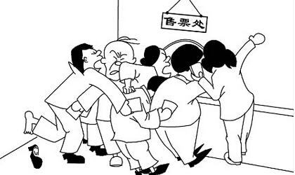
Example: Test-and-Set (TAS) locks
TAS locks
acq() {
local succ;
succ := false;
while( ! succ ) {
succ := cas(L, 0, 1);
}
}
rel() {
L := 0;
}
Tickets
Unfair!

Slide 5
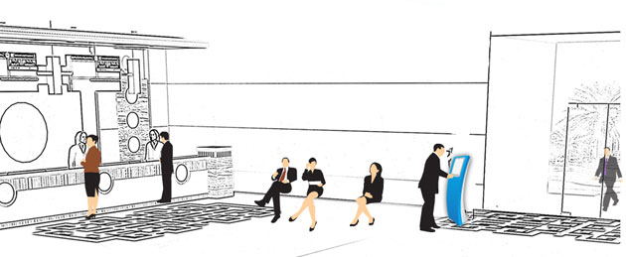
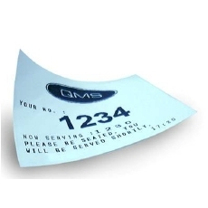

Example: Ticket locks
acq() {
local i;
i := getAndInc( next );
while( i != serving ) {} ;
}
rel() { serving := serving + 1; }
Fair!
Ticket locks
i
next
serving
Queue management in banks

Slide 6
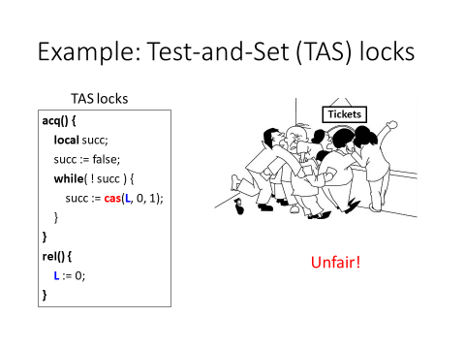
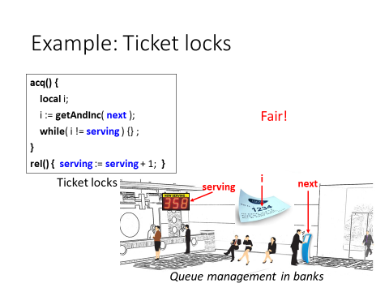
Not all locks are equally good!
How to distinguish them?
What are the progress-aware abstractions?

Slide 7
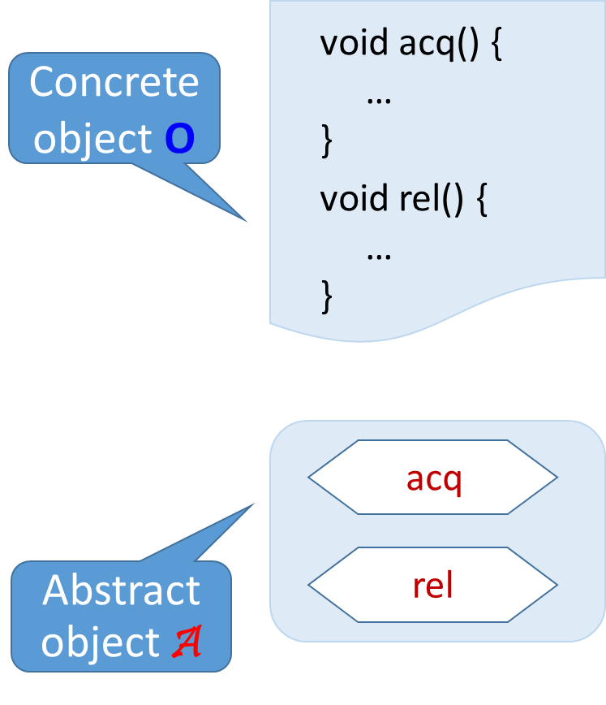
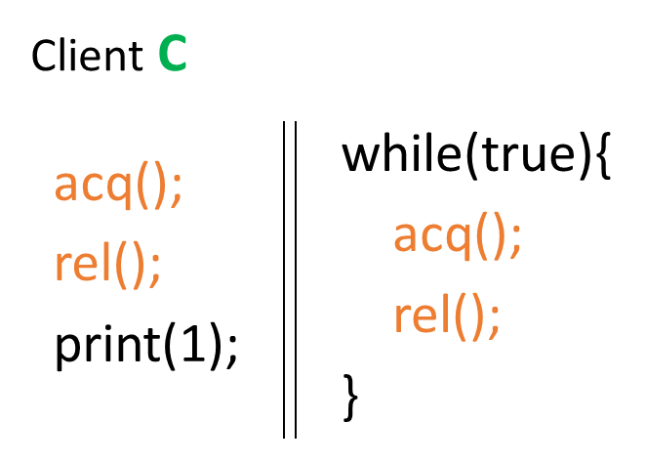
Abstractions & Contextual Refinements
Contextual Refinement (CR):
O ⊆_{ctxt} A iff ∀C. ObsBeh(C[O]) ⊆ ObsBeh(C[A])
Is O as good as A, from C’s point of view?

Slide 8
Abstractions & Contextual Refinements
Abstraction for linearizable objects: atomic specs
[Filipović et al. 2009]
O lin. w.r.t. atomic A ⇔ O ⊆_{ctxt} A
Similar equiv. results hold for WF/LF/SF/DF objects:
[Gotsman & Yang 2011; Liang et al. 2013, 2016]
O lin. + progress P ⇔ O ⊆_{ctxt} A_{P}
P ∈ {WF, LF, SF, DF}
progress-aware abstractions for progress P

Slide 9
Abstractions & Contextual Refinements
Abstraction for linearizable objects: atomic specs
[Filipović et al. 2009]
O lin. w.r.t. atomic A ⇔ O ⊆_{ctxt} A
Similar equiv. results hold for WF/LF/SF/DF objects:
[Gotsman & Yang 2011; Liang et al. 2013, 2016]
O lin. + progress P ⇔ O ⊆_{ctxt} A_{P}
No known results for locks!
or, in general, objects with partial methods
O lin. + progress P ⇔ O ⊆_{ctxt} A_{P}
?
??

Slide 10
Why is this bad?
SF or DF? Depends on lock impl.!
Lock-based counter
Compositional progress verification of lock-based objects?
Redo the verification of acq() and rel() in different obj.
int cnt;
inc() {
acq();
cnt := cnt + 1;
rel();
}
[Liang & Feng 2016]
No known results for locks!
or, in general, objects with partial methods
O lin. + progress P ⇔ O ⊆_{ctxt} A_{P}
?
??

Slide 11
Our contributions
O lin. + progress P ⇔ O ⊆_{ctxt} A_{P}
?
??
P ∈ {PSF/PDF}
New prog. properties for obj. with partial methods
Partial starvation-freedom (PSF)
Partial deadlock-freedom (PDF)
SF and DF are specializations of PSF and PDF

Slide 12
Our contributions
O lin. + progress P ⇔ O ⊆_{ctxt} A_{P}
??
P ∈ {PSF/PDF}
New prog. properties for obj. with partial methods
Abstractions to establish contextual refinements (CR)

Slide 13
Our contributions
O lin. + progress P ⇔ O ⊆_{ctxt} A_{P}
P ∈ {PSF/PDF}
New prog. properties for obj. with partial methods
Abstractions to establish contextual refinements (CR)
Equivalence result (Abstraction Theorem)

Slide 14
Our contributions
O lin. + progress P ⇔ O ⊆_{ctxt} A_{P}
P ∈ {PSF/PDF}
New prog. properties for obj. with partial methods
Abstractions to establish contextual refinements (CR)
Equivalence result (Abstraction Theorem)
Program logic for Progress Reasoning
Linearizability + PSF/PDF

Slide 15
New progress properties
Different impl exhibit different progress properties
How to distinguish them?

Slide 16
New progress properties
TAS lock
client:
acq() {
local succ;
succ := false;
while( ! succ ) {
succ := cas(L, 0, 1);
}
}
rel() {
L := 0;
}
while(true){
acq();
rel();
}
acq();
rel();
print(1);
It may not print 1 (even with fair scheduling).
Deadlock-freedom
But there always exists a method call that returns, unless the lock is never released.

Slide 17
New progress properties
TAS lock
client:
acq() {
local succ;
succ := false;
while( ! succ ) {
succ := cas(L, 0, 1);
}
}
rel() {
L := 0;
}
while(true){
acq();
rel();
}
acq();
rel();
print(1);
It may not print 1 (even with fair scheduling).
But there always exists a method call that returns, unless the lock is never released.
Rule out non-termination caused by “bad” clients

Slide 18
New progress properties
May never terminate
TAS lock
client:
acq() {
local succ;
succ := false;
while( ! succ ) {
succ := cas(L, 0, 1);
}
}
rel() {
L := 0;
}
acq();
…
rel();
acq();
while(true) skip;
Should blame client instead of obj.
But there always exists a method call that returns, unless the lock is never released.
Rule out non-termination caused by “bad” clients

Slide 19
New progress properties
May never terminate
TAS lock
client:
acq() {
local succ;
succ := false;
while( ! succ ) {
succ := cas(L, 0, 1);
}
}
rel() {
L := 0;
}
acq();
…
rel();
acq();
while(true) skip;
Need to generalize this for all objects with partial methods
Should blame client instead of obj.
But there always exists a method call that returns, unless the lock is never released.
Partial Deadlock-Freedom (PDF)

Slide 20
New progress properties
acq() {
local i;
i := getAndInc( next );
while( i != serving ) {} ;
}
rel() { serving := serving + 1; }
client:
while(true){
acq();
rel();
}
acq();
rel();
print(1);
Ticket lock
It must print 1
under fair scheduling
Starvation-freedom
Every method must return (under fair scheduling), unless the lock is never released.

Slide 21
New progress properties
May never terminate
acq() {
local i;
i := getAndInc( next );
while( i != serving ) {} ;
}
rel() { serving := serving + 1; }
client:
acq();
…
rel();
acq();
while(true) skip;
Ticket lock
Should blame client instead of obj.
Rule out non-termination caused by “bad” clients
Every method must return (under fair scheduling), unless the lock is never released.

Slide 22
New progress properties
May never terminate
acq() {
local i;
i := getAndInc( next );
while( i != serving ) {} ;
}
rel() { serving := serving + 1; }
client:
acq();
…
rel();
acq();
while(true) skip;
Ticket lock
Should blame client instead of obj.
Every method must return (under fair scheduling), unless the lock is never released.
Partial Starvation-Freedom (PSF)

Slide 23
New progress properties
Different impl exhibit different progress properties
PDF
PSF

Slide 24
New progress properties
Different impl exhibit different progress properties
What are the abstractions for locks?

Slide 25
Progress-aware abstractions for locks?
Contextual Refinement (CR):
O ⊆_{ctxt} A iff ∀C. ObsBeh(C[O]) ⊆ ObsBeh(C[A])

Slide 26
Progress-aware abstractions for locks?
Atomic Partial Spec (APS): await(B) { C }
If B is false, waits until B becomes true; otherwise executes C atomically
It is called “disabled” / “enabled” if B is false/true.
Atomic block <C> can be viewed as await(true) { C }

Slide 27
Progress-aware abstractions for locks?
Atomic Partial Spec (APS): await(B) { C }
Spec for locks?
ACQ(){ await(L=0){ L := 1 }; } REL() { L := 0; }

Slide 28
Progress-aware abstractions for locks?
Atomic Partial Spec (APS): await(B) { C }
More generally:
O lin. + progress P ⇔ O ⊆_{ctxt} await(B) { C }
??
P ∈ {PSF/PDF}

Slide 29
Progress-aware abstractions for locks?
Atomic Partial Spec (APS): await(B) { C }
More generally:
O lin. + progress P ⇔ O ⊆_{ctxt} await(B) { C }
P ∈ {PSF/PDF}
Atomic: to capture linearizability

Slide 30
Progress-aware abstractions for locks?
Atomic Partial Spec (APS): await(B) { C }
More generally:
O lin. + progress P ⇔ O ⊆_{ctxt} await(B) { C }
P ∈ {PSF/PDF}
Atomic: to capture linearizability
Partial: to capture progress

Slide 31
Progress-aware abstractions for locks?
Atomic Partial Spec (APS): await(B) { C }
Insufficient to serve as abstractions
More generally:

O lin. + progress P ⇔ O ⊆_{ctxt} await(B) { C }
P ∈ {PSF/PDF}
Atomic: to capture linearizability
Partial: to capture progress

Slide 32
Atomic partial specs insufficient as abstractions
Problem #1: it is sensitive to fairness of scheduling
e.g., strong fairness vs. weak fairness

Slide 33
Atomic partial specs insufficient as abstractions
Problem #1: it is sensitive to fairness of scheduling
client:
Atomic partial spec:
while(true){
acq();
rel();
}
ACQ(){ await(L=0){ L := 1 }; }
REL() { L := 0; }
acq();
rel();
print(1);
Weak fairness
It may not print 1 if left thread is always scheduled when await is disabled (lock unavailable)

Slide 34
Atomic partial specs insufficient as abstractions
Problem #1: it is sensitive to fairness of scheduling
client:
Atomic partial spec:
while(true){
acq();
rel();
}
ACQ(){ await(L=0){ L := 1 }; }
REL() { L := 0; }
acq();
rel();
print(1);
Strong fairness: if the await block is enabled infinitely many times, the thread will be scheduled when await is enabled.
It must print 1 with strong fairness

Slide 35
Atomic partial specs insufficient as abstractions
Compare it with other lock implementations:
client:
Atomic partial spec:
while(true){
acq();
rel();
}
ACQ(){ await(L=0){ L := 1 }; }
REL() { L := 0; }
acq();
rel();
print(1);
TAS locks
Ticket locks

Slide 36
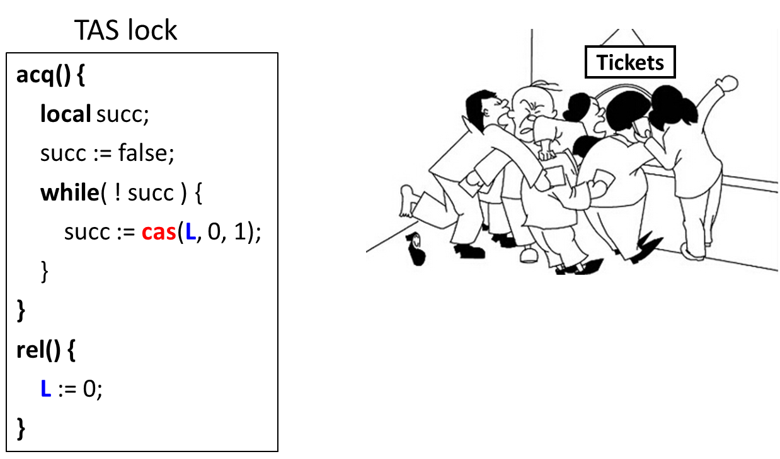
Atomic partial specs insufficient as abstractions
Compare it with other lock implementations:
client:
Atomic partial spec:
while(true){
acq();
rel();
}
ACQ(){ await(L=0){ L := 1 }; }
REL() { L := 0; }
acq();
rel();
print(1);
TAS locks
Behaviors are the same under strong & weak fairness
It may not print 1.

Slide 37
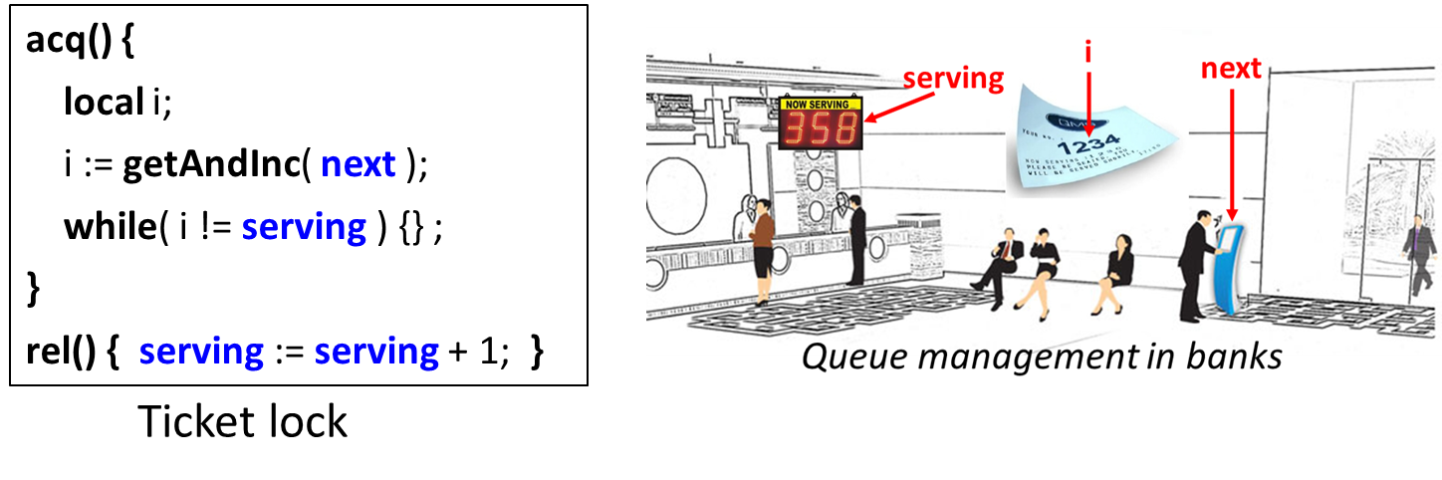
Consider the client behaviors with the three locks:
client:
Atomic partial spec:
while(true){
acq();
rel();
}
ACQ(){ await(L=0){ L := 1 }; }
REL() { L := 0; }
acq();
rel();
print(1);
TAS locks
Ticket locks
It must print 1
under strong/weak fairness

Slide 38
APS insufficient as abstractions
while(true){
acq();
rel();
}
acq();
rel();
print(1);
 | Atomic partial spec | Ticket lock | TAS lock
Strong fairness | Must print 1 | Must print 1 | May not print 1
Weak fairness | May not print 1 | Must print 1 | May not print 1
Problem #1: await blocks cannot be abstraction for the same impl. under different fairness

Slide 39
APS insufficient as abstractions
while(true){
acq();
rel();
}
acq();
rel();
print(1);
PSF
PDF
 | Atomic partial spec | Ticket lock | TAS lock
Strong fairness | Must print 1 | Must print 1 | May not print 1
Weak fairness | May not print 1 | Must print 1 | May not print 1
Problem #1: await blocks cannot be abstraction for the same impl. under different fairness
Problem #2: await blocks cannot serve as abstraction for different implementations, which exhibit different progress

Slide 40
APS insufficient as abstractions
while(true){
acq();
rel();
}
acq();
rel();
print(1);
PSF
PDF
 | Atomic partial spec | Ticket lock | TAS lock
Strong fairness | Must print 1 | Must print 1 | May not print 1
Weak fairness | May not print 1 | Must print 1 | May not print 1
We need more than one abstraction!
2 progress (PSF vs. PDF) x 2 fairness (Strong vs. Weak)
Can we systematically generate all of them?

Slide 41
Our solution
Code wrappers: syntactic transformations that turn await(B){C} to proper (possibly non-atomic) specs
Extend spec lang. with atomic partial specs (APS):
(APS) A ::= await(B){C}
(Spec) S ::= … | A | S;S | S+S | …
P-χ-Wrapper : APS → Spec
P ∈ {PSF, PDF}
χ ∈ {Strong / Weak Fairness}

Slide 42

Our solution
Code wrappers: syntactic transformations that turn await(B){C} to proper (possibly non-atomic) specs
O ⊆_{ctxt}
??
Captures linearizability Simple & Intuitive
But insufficient for CR
P-χ-Wrapper
P ∈ {PSF, PDF}
χ ∈ {Strong, Weak}
await(B){C}
Obj. Impl. O

Slide 43
Our solution
Code wrappers: syntactic transformations that turn await(B){C} to proper (possibly non-atomic) specs
O ⊆_{ctxt}
P-χ-Wrapper( await(B){ C } )
P-χ-Wrapper
P ∈ {PSF, PDF}
χ ∈ {Strong, Weak}
await(B){C}
Obj. Impl. O

Slide 44
Code wrappers
Code wrappers: syntactic transformations that turn await(B){C} to proper (possibly non-atomic) specs
P-χ-Wrapper(await(B){C})
P ∈ {PSF, PDF}
χ ∈ {Strong / Weak Fairness}
 | PSF | PDF
Strong fairness | ? | ?
Weak fairness | ? | ?

Slide 45
Code Wrappers
PSF-sfair-wrapper(await(B){C}) = ?
await(B){C}
 | PSF | PDF
Strong fairness | ? | ?
Weak fairness | ? | ?

Slide 46
Code Wrappers
needs more progress than await(B){C} under weak fairness
PSF-wfair-wrapper(await(B){C}) = ?
listid := listid ++ [(cid, ‘B’)];
await(B ∧ cid = enhd(listid)){ C; listid := listid\cid; }
a waiting queue
 | PSF | PDF
Strong fairness | ? | ?
Weak fairness | ? | ?

Slide 47
Code Wrappers
await(B){C} provides more progress than needed (for PDF)
PDF-wfair-wrapper(await(B){C}) = ?
done: auxiliary Boolean var, initialized to false
await(B ∧ ¬done){ C; done := true; };
done := false;
await(¬done){ };
 | PSF | PDF
Strong fairness | ? | ?
Weak fairness | ? | ?

Slide 48
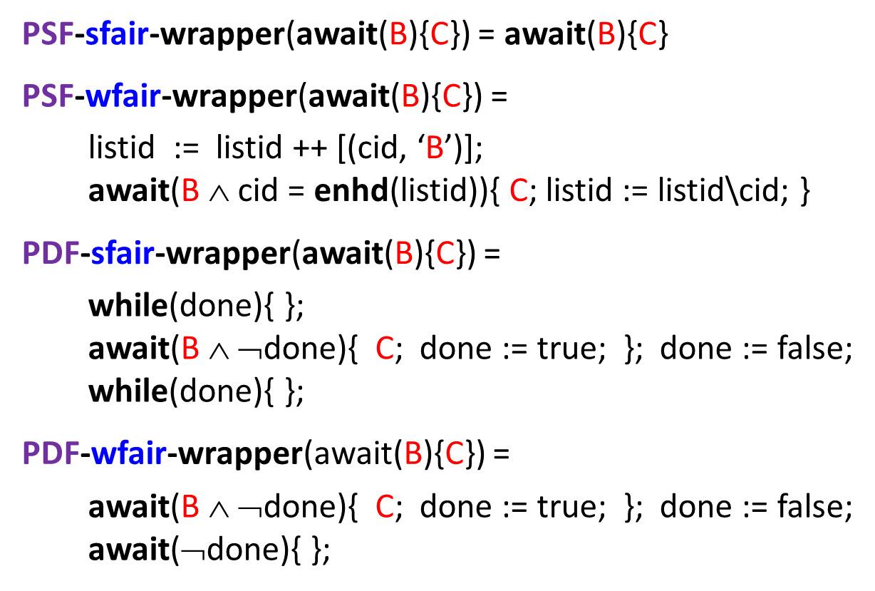
Code wrappers in summary
 | PSF | PDF
Strong fairness |  | 
Weak fairness |  | 

Slide 49
Our solution
Code wrappers: syntactic transformations that turn await(B){C} to proper (possibly non-atomic) specs
O lin. + progress P ⇔ O ⊆_{ctxt} P-χ-Wrapper( await(B){ C } )
P-χ-Wrapper
P ∈ {PSF, PDF}
χ ∈ {Strong, Weak}
await(B){C}
Obj. Impl. O

Slide 50
Our solution
Code wrappers: syntactic transformations that turn await(B){C} to proper (possibly non-atomic) specs
O lin. + progress P ⇔ O ⊆_{ctxt} P-χ-Wrapper( await(B){ C } )
P ∈ {PSF, PDF}
χ ∈ {Strong, Weak}
Abstraction Theorem
to establish equiv.
Justifies wrappers: abstractions NOT too weak
Justifies P (PSF/PDF): implies CR

Slide 51
Program logic
Extension of LiLi [Liang & Feng 2016] for SF & DF
Program logic:
D, R, G
{p} O : A
(P, χ)
A ::= await(B){C}
Soundness
O lin. + progress P ⇔ O ⊆_{ctxt} P-χ-Wrapper( await(B){ C } )
P ∈ {PSF, PDF}
χ ∈ {Strong, Weak}
Allows us to verify linearizability and PSF/PDF

Slide 52
Conclusion
Study progress of objects with partial methods
2 new progress properties: PSF & PDF
4 wrappers to generate abstractions
for PSF/PDF objects under strongly/weakly fair scheduling
Abstraction Theorem
A new program logic for Linearizability + PSF / PDF
O lin. + progress P ⇔ O ⊆_{ctxt} P-χ-Wrapper( await(B){C} )
P ∈ {PSF, PDF}
χ ∈ {Strong, Weak}

Slide 53
Thank you!

