Slide 1
并发算法与理论 Concurrency: Algorithms and Theories
梁红瑾

Slide 2
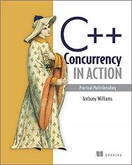
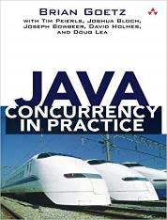
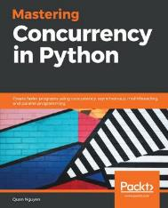
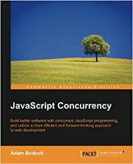
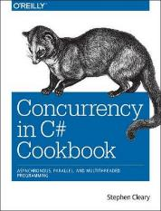

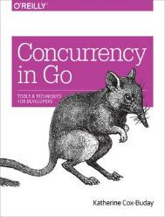
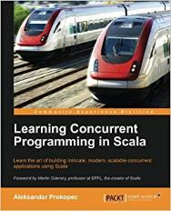
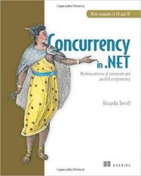
Programmers’ View
…

Slide 3
C++ Programmers’ View
#include <iostream>
#include <thread>
void hello()
{
std::cout<<"Hello Concurrent World\n";
}
int main()
{
std::thread t(hello);
t.join();
return 0;
}

Slide 4
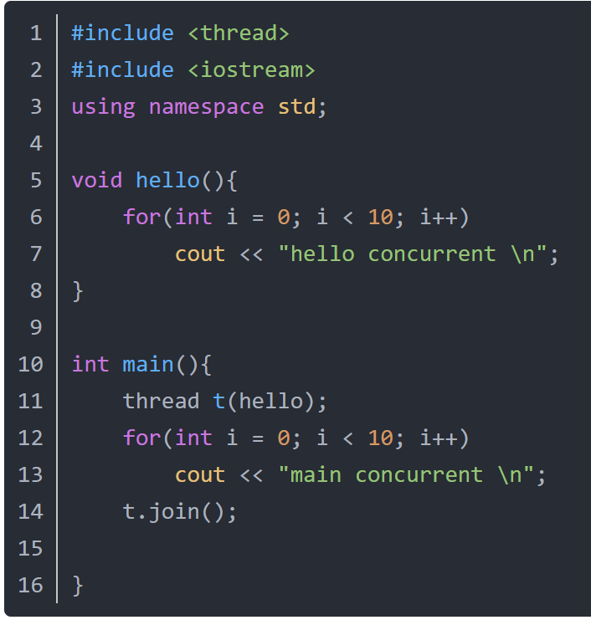
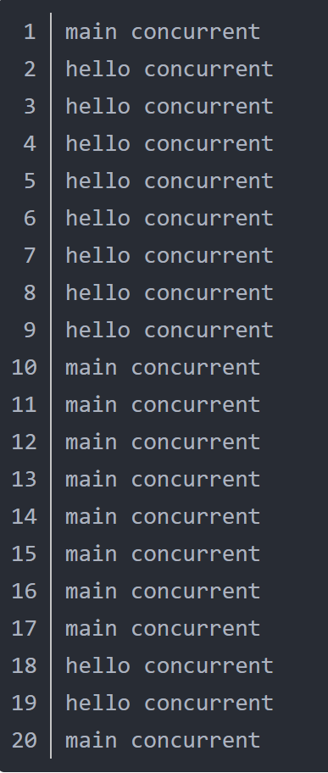
C++ Programmers’ View
Outputs

Slide 5
Taking a More Abstract View
Parallel composition
C1 || C2
for(int i=0; i < 10; i++) {
cout<<“main concurrent\n";
}
for(int i=0; i < 10; i++) {
cout<<“hello concurrent\n";
}

Slide 6
Taking a More Abstract View
Shared memory & interleaving semantics
. . .
T1
T2
T3
Tn
Memory

Slide 7
Taking a More Abstract View
Shared memory & interleaving semantics
for(int i=0; i < 10; i++) {
cout<<“main concurrent\n";
}
for(int i=0; i < 10; i++) {
cout<<“hello concurrent\n";
}
T1
T2
Memory (e.g. cout)

Slide 8
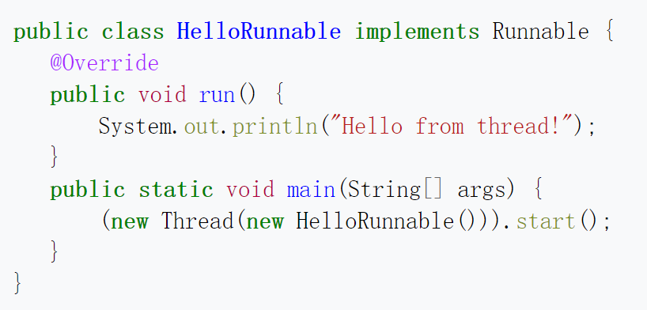
Java Threads
Notes:
The Runnable interface defines a single method, run, meant to contain the code executed in the thread.

Slide 9
Java Threads
public class MyRunnable implements Runnable{
@Override
public void run(){
for(int i = 0; i < 10; i++){
System.out.println(i);
}
}
}
public class MyRunnableTest{
public static void main(String[] args){
MyRunnable mr1 = new MyRunnable();
MyRunnable mr2 = new MyRunnable();
Thread t1 = new Thread(mr1);
Thread t2 = new Thread(mr2);
t1.start();
t2.start();
}
}

Slide 10
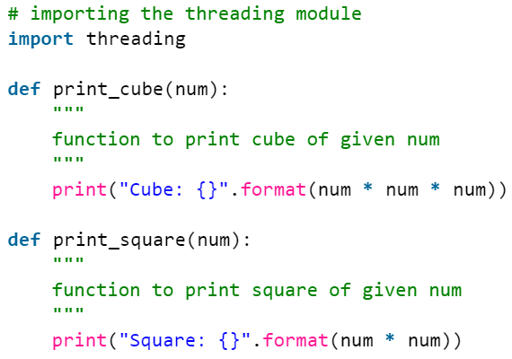
Python Threads

Slide 11
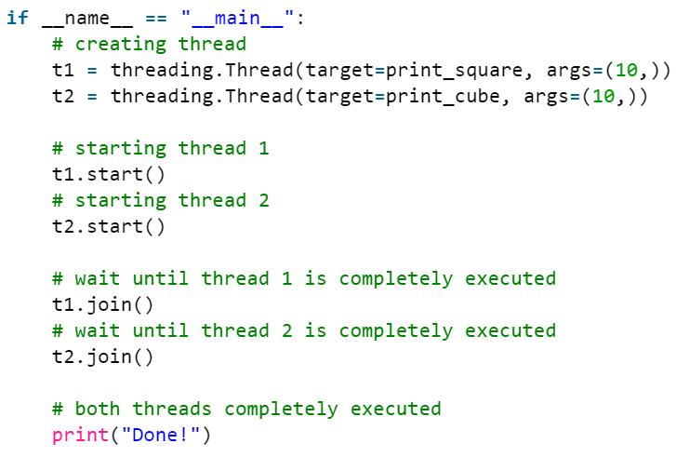
Python Threads

Slide 12
Problems with Concurrency
Nondeterministic!
Recall: interleaving semantics
T1
T2
T3
Tn
Memory

Slide 13
Problems with Concurrency
Nondeterministic!
Recall: interleaving semantics
T1
T2
…
||
=
Program
Possible executions
☹ Difficult to find a bug
☹ Difficult to reproduce a bug

Slide 14
More C++
thread function: main thread: 0
main thread: 1
main thread: 2
main thread: 3
-100
thread function: -99main thread: 4
main thread: 5
main thread: 6
#include <iostream>
#include <thread>
void thread_function()
{
for (int i = -100; i < 0; i++)
std::cout << "thread function: " << i << "\n";
}
int main()
{
std::thread t(thread_function);
for (int i = 0; i < 100; i++)
std::cout << "main thread: " << i << "\n";
t.join();
return 0;
}
Notes:
std::cout << "thread function: " << i << "\n“: it is not one std::cout function call; it's three separate calls.

Slide 15
Using Locks
#include <iostream>
#include <thread>
#include <string>
#include <mutex>
std::mutex mu;
void shared_cout(std::string msg, int id)
{
mu.lock();
std::cout << msg << ":" << id << std::endl;
mu.unlock();
}

Slide 16
Using Locks
#include <iostream>
#include <thread>
#include <string>
#include <mutex>
std::mutex mu;
void shared_cout(std::string msg, int id)
{
mu.lock();
std::cout << msg << ":" << id << std::endl;
mu.unlock();
}
void thread_function()
{
for (int i = -100; i < 0; i++)
shared_cout("thread function", i);
}
int main()
{
std::thread t(thread_function);
for (int i = 100; i > 0; i--)
shared_cout("main thread", i);
t.join();
return 0;
}

Slide 17
More Locks in C++
#include <iostream>
#include <thread>
#include <string>
#include <mutex>
std::mutex mu;
void shared_cout(std::string msg, int id)
{
std::lock_guard<std::mutex> guard(mu);
std::cout << msg << ":" << id << std::endl;
}

Slide 18
More Locks in C++
#include <list>
#include <mutex>
#include <algorithm>
std::list<int> some_list;
std::mutex some_mutex;
void add_to_list(int new_value) {
std::lock_guard<std::mutex> guard(some_mutex);
some_list.push_back(new_value);
}
bool list_contains(int value_to_find) {
std::lock_guard<std::mutex> guard(some_mutex);
return std::find(some_list.begin(),some_list.end(),value_to_find)
!= some_list.end();
}

Slide 19
Taking a More Abstract View
Synchronization operations
lock/unlock, acq/rel
for (int i=-100; i<0; i++){
mu.lock();
std::cout << "thread function: "
<< i << "\n";
mu.unlock();
}
for (int i=100; i>0; i--){
mu.lock();
std::cout << " main thread: "
<< i << "\n";
mu.unlock();
}

Slide 20
But wait…
for (int i=-100; i<0; i++){
mu.lock();
std::cout << "thread function: "
<< i << "\n";
mu.unlock();
}
for (int i=100; i>0; i--){
mu.lock();
std::cout << " main thread: "
<< i << "\n";
mu.unlock();
}
How are lock() and unlock() implemented?
Are there interleavings between the threads when executing the implementations of lock()/unlock()?

Slide 21
Programmers’ View
T1
T2
T3
lock() {
…
}
A concurrent program =
concurrent objects + their clients
…
mu.lock();
…
mu.unlock();
…
…
mu.lock();
…
mu.unlock();
…
void lock() {
…
}
void unlock() {
…
}
Concurrent object
Client code

Slide 22
Programmers’ View
T1
T2
T3
A concurrent program =
concurrent objects + their clients
push() {
…
}
…
…
s.push(7);
x = s.pop();
…
…
s.push(6);
…
void push(int v) {
…
}
int pop() {
…
}
Concurrent object
Client code

Slide 23
Concurrent Objects
threads
memory
object
object

Slide 24
Programmers’ View
Parallel composition, shared memory & interleaving semantics
Locks & synchronization operations
Concurrent objects and their clients

Slide 25
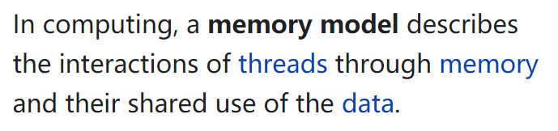
Memory Models
https://en.wikipedia.org/wiki/Memory_model_(programming)

Slide 26
Memory Models
Interleaving semantics
– Sequential Consistency (SC) model
T1
T2
T3
Tn
Memory

Slide 27
(Weak/Relaxed) Memory Models
Java memory model
C/C++11 memory model
x86-TSO memory model
ARMv8 memory model
…

Slide 28
C++ Program 1
#include <thread>
#include <assert.h>
int x = 0;
void foo() {
while (true) {
x = 1;
x = 0;
assert(x == 0);
}
}
int main() {
std::thread t(foo);
std::thread t2(foo);
t.join();
t2.join();
}
Will the assertion fail?

Slide 29
C++ Program 2
#include <thread>
#include <assert.h>
int x = 0;
void foo() {
for ( int i = 0; i < 10000000; i++ ) {
x = x + 1;
}
}
int main() {
std::thread t1(foo);
std::thread t2(foo);
t1.join();
t2.join();
assert(x == 20000000);
}
Will the assertion
fail?

Slide 30
Course Overview

Slide 31
Goals of the Course
Understanding concurrent programs
Interleaving semantics
Some feelings of weak memory models
Understanding concurrent objects (algorithms)
Correctness criteria
Design ideas
Why they are correct
Some impossibility results

Slide 32
Preliminary Syllabus
Weak memory models
Java, C11
Locks Implemented by Read/Write
Peterson Lock, Filter Lock, Lamport’s Bakery Lock
Linearizability
Synchronization Operations
Practical Locks
TAS Lock, Queue Locks
List-Based Sets
Concurrent Queues and Stacks
Snapshot

Slide 33
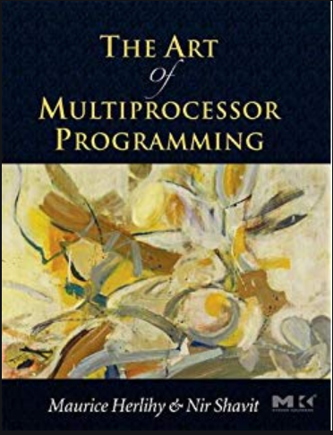
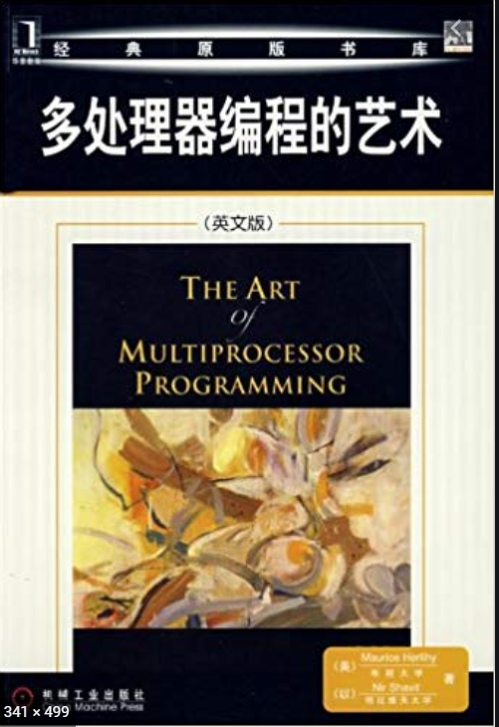
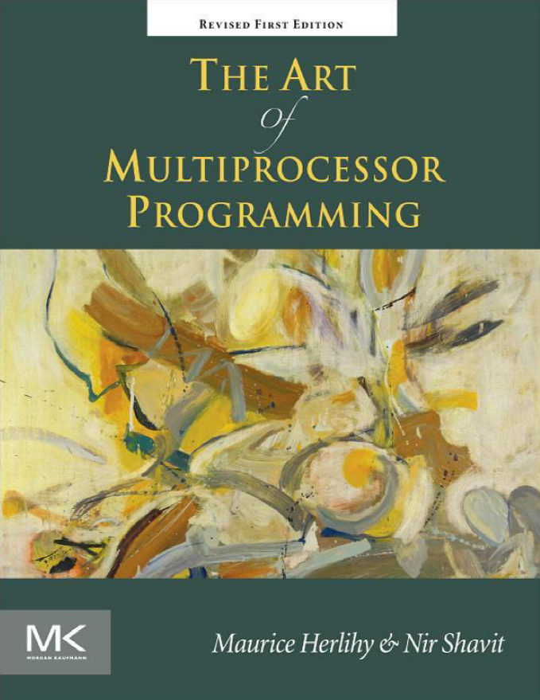
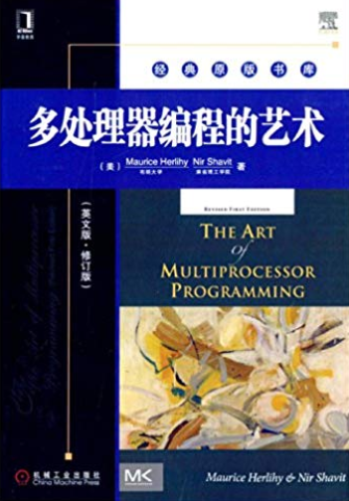
References
Maurice Herlihy and Nir Shavit. The Art of Multiprocessor Programming. Morgan Kaufmann. 2008 / 2012.

Slide 34
Course Webpage:
https://cs.nju.edu.cn/hongjin/teaching/concurrency/
QQ Group: 813314572
Lecture notes, homework and notifications will be posted on the course webpage.
You can ask questions in QQ group, or email me your questions.
Please pay attention to the updates.

Slide 35
Course Requirements
Grading
40% attendance and homework
60% final exam (in the last class)
Class attendance is highly recommended
Homework: Problem sets
No cheating!
No late (unless special reasons provided)

