Slide 1
Review

Slide 2
考试
时间：2021年12月22日周三1-2节，8:00-9:50
地点：上课教室（仙II-306）
闭卷
总成绩：作业40% + 考试60%
答疑：不统一安排，可发邮件或QQ群讨论

Slide 3
After the class, you should …
Understand basic concepts
Be able to understand concurrent algorithms
Given a (new) concurrent algorithm, you can
explain the intuition on why XXX properties hold
construct example executions showing that XXX properties do not hold
Not require you to memorize existing algorithms
Not require you to design new algorithms

Slide 4
Weak memory models
Happens-before memory model
C/C++11 memory model
memory orders

Slide 5
Concepts in interleaving semantics
Linearizability, linearization points

Slide 6
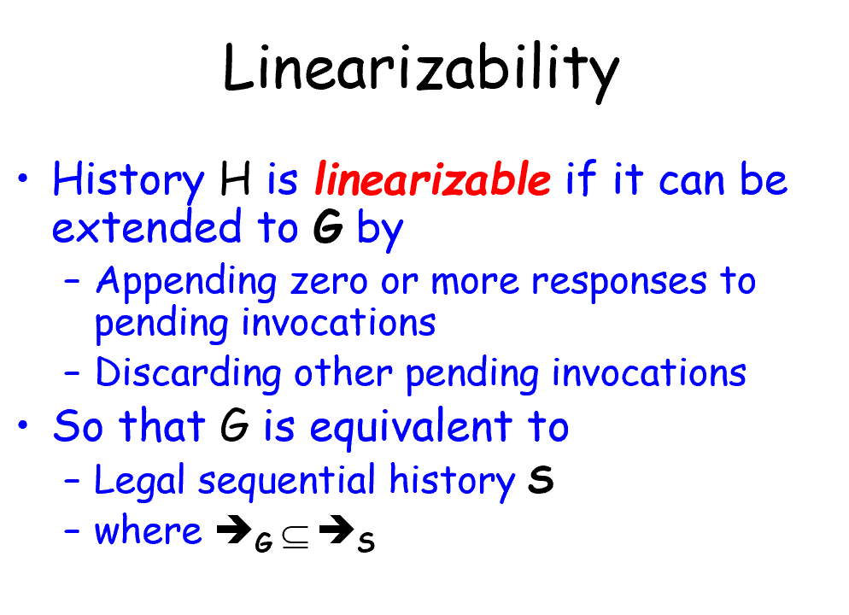

Slide 7
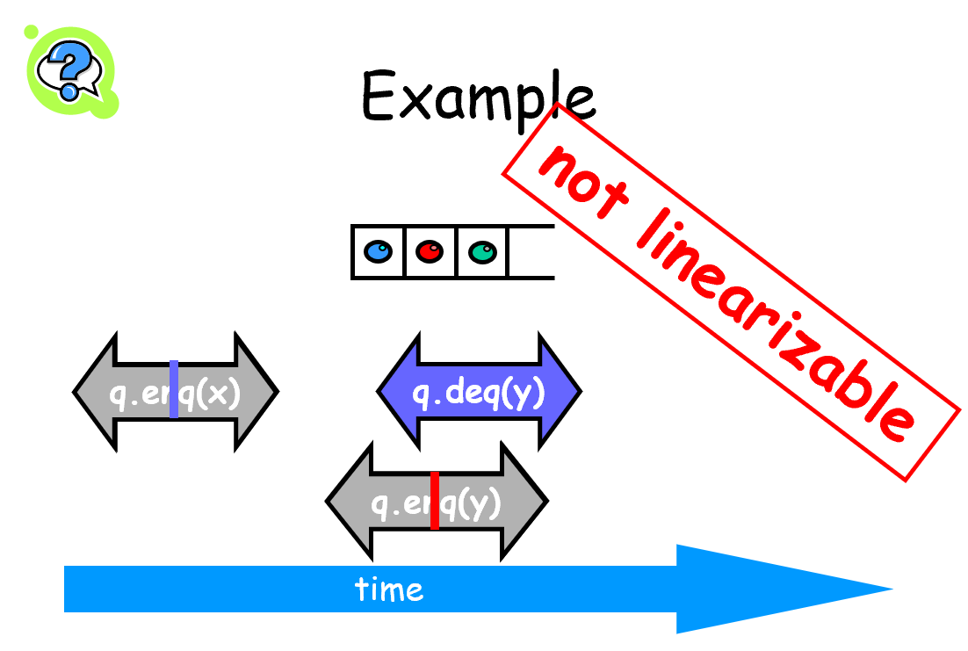

Slide 8
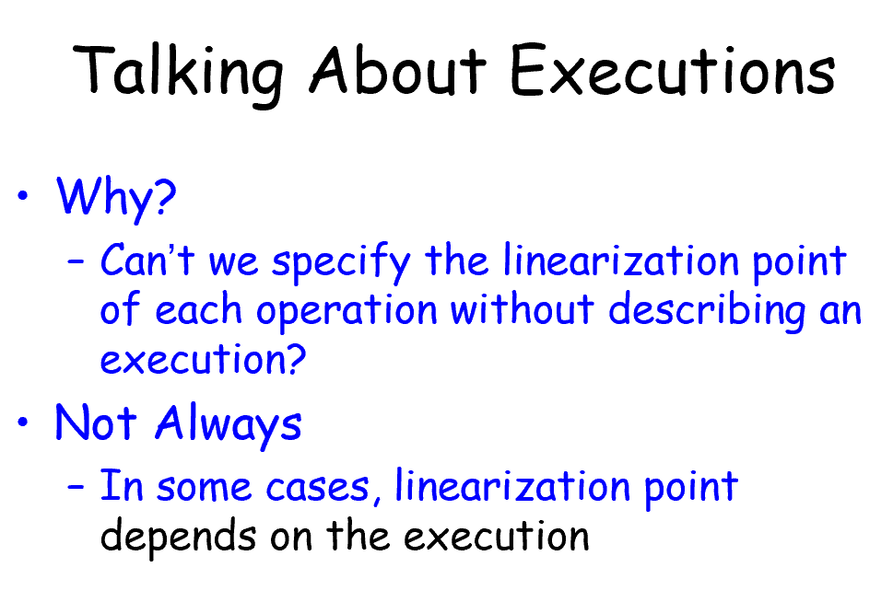

Slide 9
Concepts
Linearizability, linearization points
Progress: Lock-freedom, Wait-Freedom, Deadlock-freedom, Starvation-Freedom

Slide 10
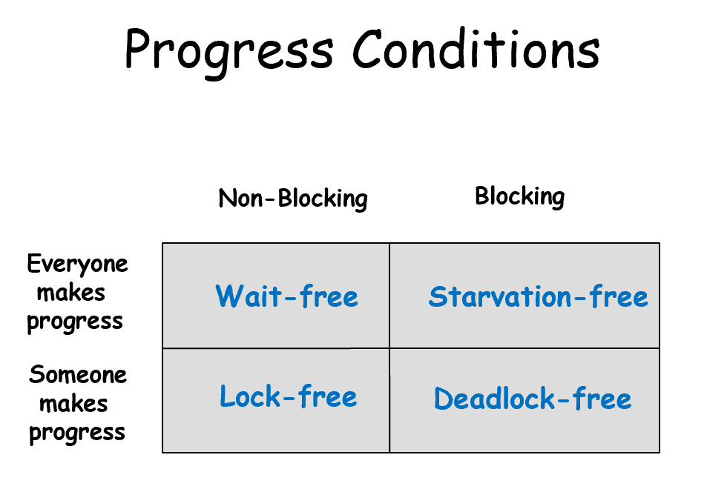

Slide 11
Concepts
Linearizability
Progress: Lock-freedom, Wait-Freedom, Deadlock-freedom, Starvation-Freedom
For locks: Mutual Exclusion, Deadlock-freedom, Starvation-Freedom, r-bounded waiting

Slide 12
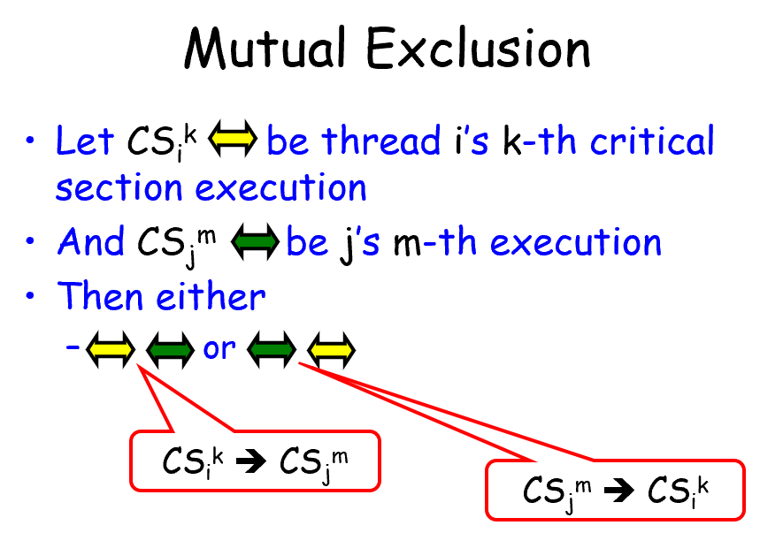

Slide 13
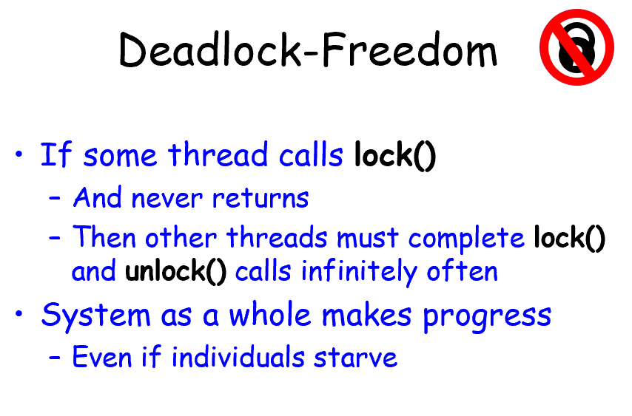

Slide 14
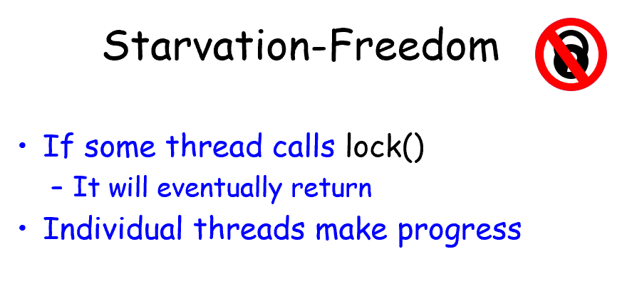

Slide 15
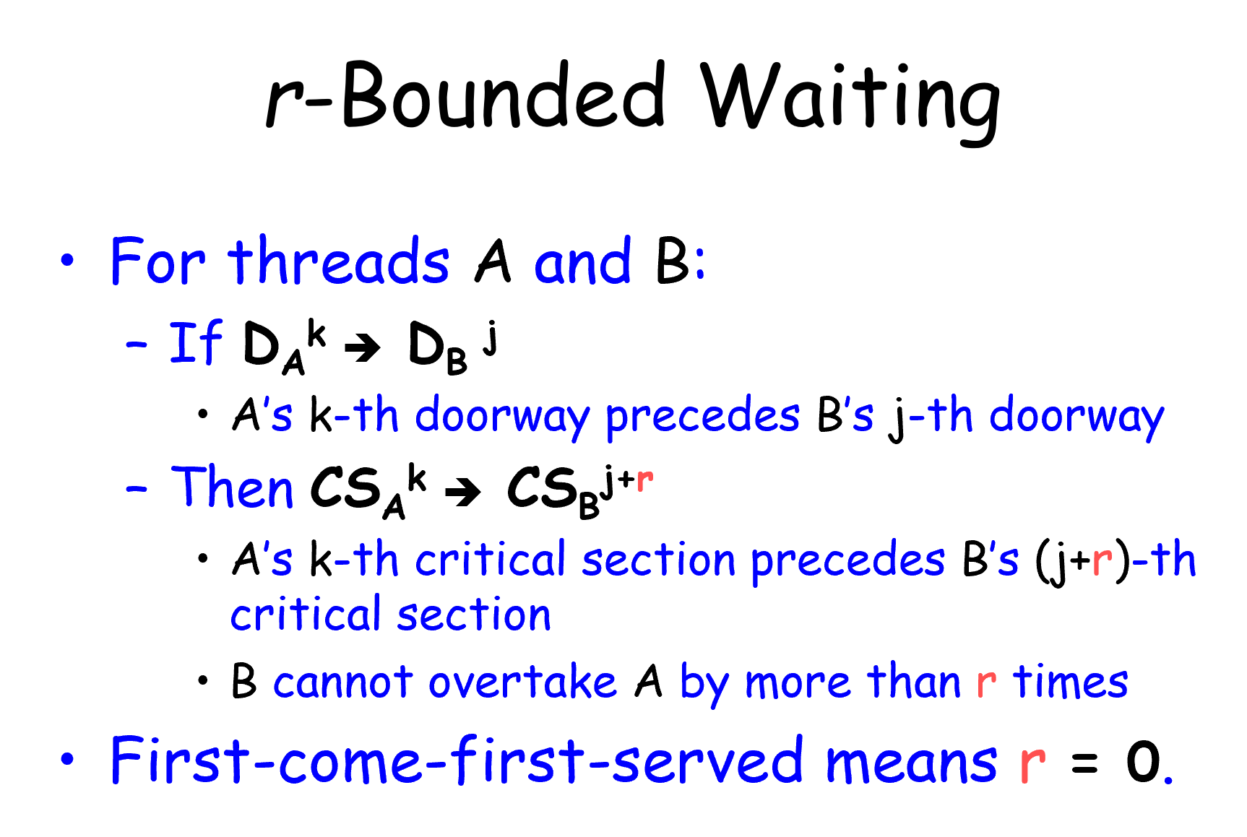

Slide 16
Algorithms
Locks
List-Based Sets

Slide 17
Locks
Peterson Lock (for two threads)
Filter Lock
Lamport’s Bakery Lock
Test-And-Set Lock
Test-Test-And-Set Lock
Exponential Backoff Lock
Anderson’s Array-Based Queue Lock
CLH Queue Lock
MCS Queue Lock

Slide 18
List-Based Sets
Lock-Coupling List
Optimistic List
Lazy List
Lock-Free List (Not require you to understand this)

