Slide 1
Review

Slide 2
期末考试
时间：2021年12月23日周四1-2节，8:00-9:50
地点：上课教室（逸B-205）
闭卷
总成绩：作业40% + 考试60%
答疑：不统一安排，可发邮件或QQ群讨论

Slide 3
Formal Semantics of Programming Languages
Lambda Calculus
Untyped
Simply typed
Imperative languages
Operational semantics
Hoare logic
Separation logic

Slide 4

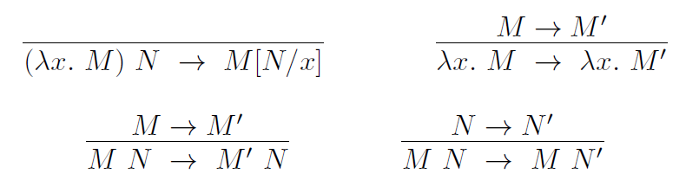
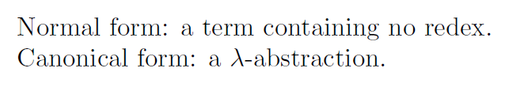
Untyped lambda calculus
Syntax
Semantics (reduction rules)

Slide 5
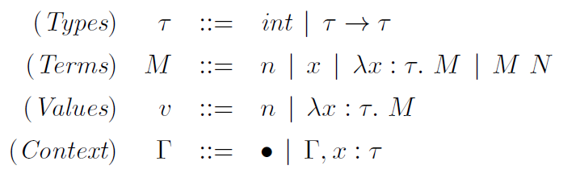
Simply-typed lambda calculus
Syntax
Reduction rules

Slide 6
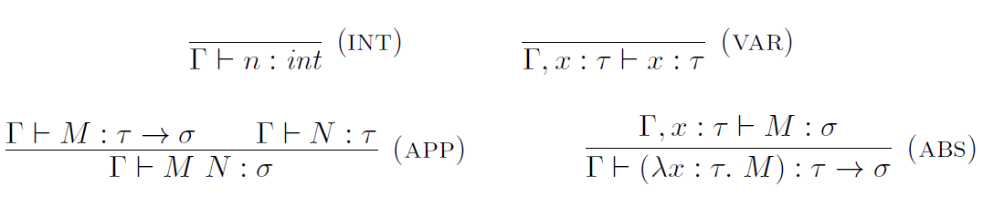
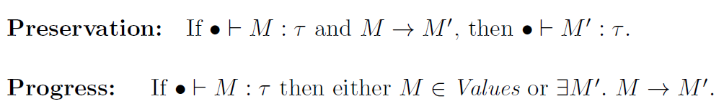
Simply-typed lambda calculus
Typing rules

Slide 7
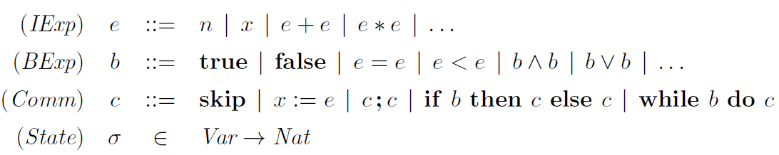
A simple imperative language
Syntax

Slide 8
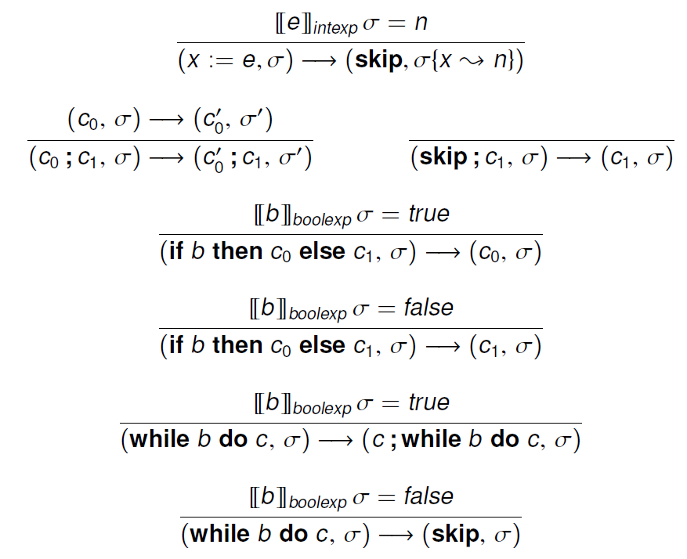
Operational semantics
Small-step

Slide 9
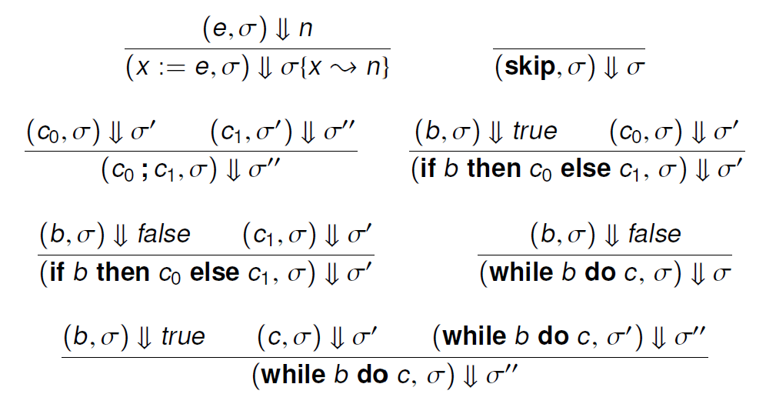
Operational semantics
Big-step

Slide 10
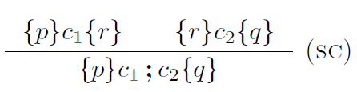


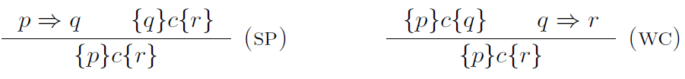
Hoare logic
Hoare triple validity
Inference rules for partial correctness

Slide 11
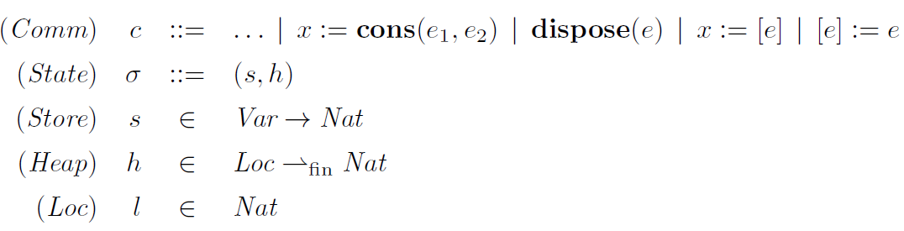
Separation logic
The extended programming language
Syntax & operational semantics

Slide 12

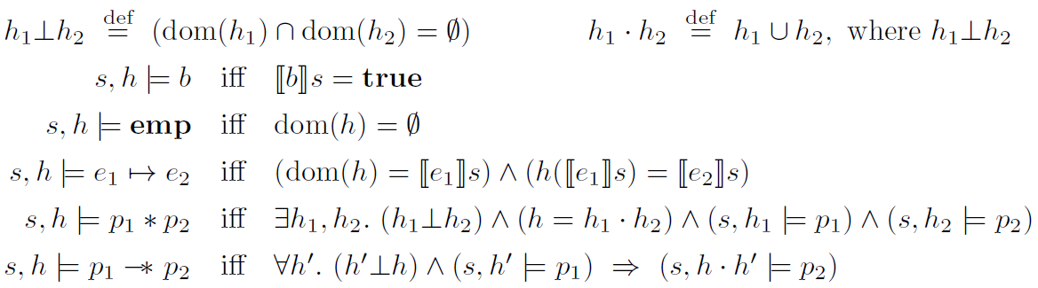
Separation logic
The assertion language

Slide 13
Separation logic
Locality
Safety monotonicity
Frame property

Slide 14
Formal Semantics of Prog. Lang.
Lambda Calculus
Untyped
Reduction
Simply typed
Reduction vs typing : progress & preservation
Imperative languages
Operational semantics
Small-step & big-step
Hoare logic
Reasoning using Hoare logic
Separation logic
Assertion semantics & locality

