Slide 1
并发算法与理论 Concurrency: Algorithms and Theories
梁红瑾
TexPoint fonts used in EMF.
Read the TexPoint manual before you delete this box.: AAAA
Notes:
1

Slide 2

Course Webpage:
https://hongjin-liang.github.io/teaching/concurrency/
QQ Group: 915483415
Lecture notes and homework will be posted on the course webpage.
You can ask questions in QQ group, or email me your questions.
Please pay attention to the updates.
TexPoint fonts used in EMF.
Read the TexPoint manual before you delete this box.: AAAA
Notes:
2

Slide 3
Course Requirements
Grading
60% homework
40% final report (see the course webpage)
Class attendance is highly recommended
Homework: Problem sets
No cheating!
No late (unless special reasons provided)
TexPoint fonts used in EMF.
Read the TexPoint manual before you delete this box.: AAAA
Notes:
3

Slide 4

Introduction
Modified from companion slides for
The Art of Multiprocessor Programming
by Maurice Herlihy & Nir Shavit
TexPoint fonts used in EMF.
Read the TexPoint manual before you delete this box.: AAAA
Notes:
4

Slide 5
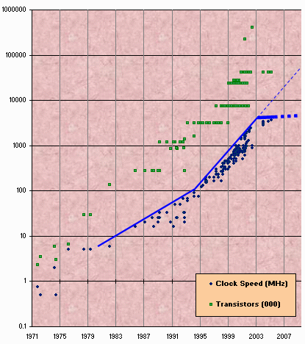
Moore’s Law
Transistor count still rising
Clock speed flattening sharply
5
Notes:
5
摩尔定律（绿点）：一块集成电路板上可容纳的晶体管的数目，每2年翻一番。
但是自21世纪初开始，受热量的所限，时钟速度基本上保持不变，每个处理器核心的性能只得到了很少的提升

Slide 6
Nearly Extinct: the Uniprocesor
cpu
memory
6
Notes:
6
几近灭绝：过去我们用的是单处理器系统，一块芯片上有一个处理器和一块内存

Slide 7
Endangered: The Shared Memory Multiprocessor (SMP)
cache
cache
cache
Bus
Bus
shared memory
7
Notes:
7
濒危：多处理器芯片。
共享内存的多处理器结构：多个CPU通过总线连接共享同一块物理内存

Slide 8
The New Boss: The Multicore Processor (CMP)
All on the
same chip
cache
cache
cache
Bus
Bus
shared memory
8
Notes:
8
现在，我们的电脑也变成多处理器的了。这种系统称为 a multicore machine 或 a system-on-a-chip 或 a chip multiprocessor (CMP)。
芯片Sun T2000 Niagara CMP：8核，共享cache和内存

Slide 9
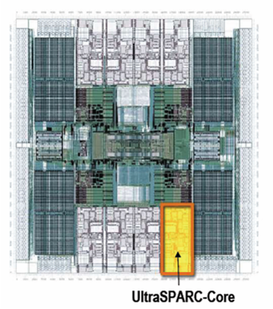
The New Boss: The Multicore Processor (CMP)
All on the
same chip
Sun T2000
Niagara
cache
cache
cache
Bus
Bus
shared memory
9
Notes:
9
现在，我们的电脑也变成多处理器的了。这种系统称为 a multicore machine 或 a system-on-a-chip 或 a chip multiprocessor (CMP)。
芯片Sun T2000 Niagara CMP：8核，共享cache和内存

Slide 10
Traditional Scaling Process
7x
Speedup
3.6x
1.8x
User code
Traditional
Uniprocessor
Time: Moore’s law
10
Notes:
10
过去的软件加速的方式：write it once, trust Intel to make the CPU faster to improve performance.

Slide 11
Ideal Scaling Process
7x
3.6x
Speedup
1.8x
User code
Multicore
Unfortunately, not so simple…
11
Notes:
11
多核时代软件加速：we will have to parallelize the code to make software faster, and we cannot do this automatically (except in a limited way on the level of individual instructions).

Slide 12
Actual Scaling Process
Speedup
2x
2.9x
1.8x
User code
Multicore
Parallelization and Synchronization
require great care…
12
Notes:
12
This is because splitting the application up to utilize the cores is not simple, and coordination among the various code parts requires care.

Slide 13
Course Overview
Fundamentals
Models, algorithms, correctness, impossibility
Real-world programming
Architectures, techniques
13
Notes:
13

Slide 14
Sequential Computation
thread
memory
object
object
14
Notes:
14

Slide 15
Concurrent Computation
threads
memory
object
object
15
Notes:
15

Slide 16
Asynchrony
Sudden unpredictable delays
Cache misses (short)
Page faults (long)
Scheduling quantum used up (really long)
16
Notes:
16

Slide 17
Model Summary
17
Multiple threads
Sometimes called processes
Single shared memory
Objects live in memory
Unpredictable asynchronous delays
Notes:
17

Slide 18
Road Map
18
We are going to focus on principles first, then practice
Start with idealized models
Look at simplistic problems
Emphasize correctness over pragmatism
“Correctness may be theoretical, but incorrectness has practical impact”
Notes:
18

Slide 19
Concurrency Jargon
19
Hardware
Processors
Software
Threads, processes
Sometimes OK to confuse them, sometimes not.
Notes:
19
We will use the terms above, even though there are also terms like strands, CPUs, chips etc also…

Slide 20
Parallel Primality Testing
20
Challenge
Print primes from 1 to 10¹⁰
Given
Ten-processor multiprocessor
One thread per processor
Goal
Get ten-fold speedup (or close)
Notes:
20

Slide 21
Load Balancing
1
10⁹
2·10⁹
…
10¹⁰
P₀
P₁
…
P₉
Split the work evenly
Each thread tests range of 10⁹
21
Notes:
21
Split the range ahead of time

Slide 22
Procedure for Thread i
void primePrint {
int i = ThreadID.get(); // IDs in {0..9}
for (j = i*10⁹+1, j<(i+1)*10⁹; j++) {
if (isPrime(j))
print(j);
}
}
22
Notes:
22
The use of isPrime() is a bit artificial since it makes sense to use earlier numbers detected as prime in testing whether a later number is prime.

Slide 23
Issues
23
Higher ranges have fewer primes
Yet larger numbers harder to test
Thread workloads
Uneven
Hard to predict
Notes:
23

Slide 24
Issues
rejected
24
Higher ranges have fewer primes
Yet larger numbers harder to test
Thread workloads
Uneven
Hard to predict
Need dynamic load balancing
Notes:
24

Slide 25
Shared Counter
19
each thread takes a number
18
17
25
Notes:
25

Slide 26
Procedure for Thread i
int counter = new Counter(1);
void primePrint {
long j = 0;
while (j < 10¹⁰) {
j = counter.getAndIncrement();
if (isPrime(j))
print(j);
}
}
26
Notes:
26

Slide 27
Procedure for Thread i
Counter counter = new Counter(1);
void primePrint {
long j = 0;
while (j < 10¹⁰) {
j = counter.getAndIncrement();
if (isPrime(j))
print(j);
}
}
Shared counter
object
27
Notes:
27

Slide 28
Where Things Reside
void primePrint {
int i = ThreadID.get(); // IDs in {0..9}
for (j = i*10⁹+1, j<(i+1)*10⁹; j++) {
if (isPrime(j))
print(j);
}
}
Local
variables
code
cache
cache
cache
Bus
Bus
shared
memory
1
shared counter
28
Notes:
28

Slide 29
Procedure for Thread i
Counter counter = new Counter(1);
void primePrint {
long j = 0;
while (j < 10¹⁰) {
j = counter.getAndIncrement();
if (isPrime(j))
print(j);
}
}
Stop when every value taken
29
Notes:
29

Slide 30
Procedure for Thread i
Counter counter = new Counter(1);
void primePrint {
long j = 0;
while (j < 10¹⁰) {
j = counter.getAndIncrement();
if (isPrime(j))
print(j);
}
}
Increment & return each new value
30
Notes:
30

Slide 31
Counter Implementation
public class Counter {
private long value;
public long getAndIncrement() {
return value++;
}
}
31
Notes:
31

Slide 32
Counter Implementation
public class Counter {
private long value;
public long getAndIncrement() {
return value++;
}
}
OK for single thread,
not for concurrent threads
32
Notes:
32

Slide 33
What It Means
public class Counter {
private long value;
public long getAndIncrement() {
return value++;
}
}
33
Notes:
33

Slide 34
What It Means
public class Counter {
private long value;
public long getAndIncrement() {
return value++;
}
}
temp = value;
value = temp + 1;
return temp;
34
Notes:
34

Slide 35
Not so good…
temp = value;
value = temp + 1;
return temp;
Value… 1
2
3
2
read
1
write
2
read
2
write
3
read
1
write
2
time
35
Notes:
35

Slide 36
Is this problem inherent?
!!
!!
write
read
read
write
If we could only glue reads and writes together…
36
Notes:
36
问题的核心：getAndIncrement需要两步不同的操作（read & write）。

Slide 37
Challenge
public class Counter {
private long value;
public long getAndIncrement() {
temp = value;
value = temp + 1;
return temp;
}
}
37
Notes:
37

Slide 38
Challenge
public class Counter {
private long value;
public long getAndIncrement() {
temp = value;
value = temp + 1;
return temp;
}
}
Make these steps atomic (indivisible)
38
Notes:
38

Slide 39
Hardware Solution
public class Counter {
private long value;
public long getAndIncrement() {
temp = value;
value = temp + 1;
return temp;
}
}
ReadModifyWrite()
instruction
39
Notes:
39
We will see later that modern multiprcessors provide special types of readModiftWrite() instructions to allow us to overcome the problem at hand. But how do we solve this problem in software?

Slide 40
An Aside: Java™
public class Counter {
private long value;
public long getAndIncrement() {
synchronized {
temp = value;
value = temp + 1;
}
return temp;
}
}
40
Notes:
40

Slide 41
An Aside: Java™
public class Counter {
private long value;
public long getAndIncrement() {
synchronized {
temp = value;
value = temp + 1;
}
return temp;
}
}
Synchronized block
41
Notes:
41

Slide 42
An Aside: Java™
public class Counter {
private long value;
public long getAndIncrement() {
synchronized {
temp = value;
value = temp + 1;
}
return temp;
}
}
Mutual Exclusion
42
Notes:
42
Java provides us with a solution: mutual exclusion in software…lets try and understand how this is done

Slide 43
Mutual Exclusion, or “Alice & Bob share a pond”
A
B
43
Notes:
43
故事：Alice和Bob共有一个池塘

Slide 44
Alice has a pet
A
B
44
Notes:
44

Slide 45
Bob has a pet
A
B
45
Notes:
45

Slide 46
The Problem
A
B
The pets don’t
get along
46
Notes:
46
需要一个协议，使得两只宠物不会同时出现在池塘里。

Slide 47
Formalizing the Problem
47
Two types of formal properties in asynchronous computation:
Safety Properties
Nothing bad happens ever
Liveness Properties
Something good happens eventually
Notes:
47

Slide 48
Formalizing our Problem
48
Mutual Exclusion
Both pets never in pond simultaneously
This is a safety property
No Deadlock
if only one wants in, it gets in
if both want in, one gets in.
This is a liveness property
Notes:
48

Slide 49
Simple Protocol
49
Idea
Just look at the pond
Gotcha
Not atomic
Trees obscure the view
Notes:
49
In the following versions of the protocol, we try and show which solutions will not work.

Slide 50
Interpretation
50
Threads can’t “see” what other threads are doing
Explicit communication required for coordination
Notes:
50

Slide 51
Cell Phone Protocol
51
Idea
Bob calls Alice (or vice-versa)
Gotcha
Bob takes shower
Alice recharges battery
Bob out shopping for pet food …
Notes:
51

Slide 52
Interpretation
52
Message-passing doesn’t work
Recipient might not be
Listening
There at all
Communication must be
Persistent (like writing)
Not transient (like speaking)
Notes:
52
Transient: 瞬变的

Slide 53
Can Protocol
cola
cola
53
Notes:
53
可乐罐协议：在对方的窗台上放置几个可乐罐

Slide 54
Bob conveys a bit
A
B
cola
54
Notes:
54
Bob想给Alice发信号时，就拉一下绳子，弄倒一个可乐罐

Slide 55
Bob conveys a bit
A
B
cola
55
Notes:
55

Slide 56
Can Protocol
56
Idea
Cans on Alice’s windowsill
Strings lead to Bob’s house
Bob pulls strings, knocks over cans
Gotcha
Cans cannot be reused
Bob runs out of cans
Notes:
56

Slide 57
Interpretation
Cannot solve mutual exclusion with interrupts
Sender sets fixed bit in receiver’s space
Receiver resets bit when ready
Requires unbounded number of interrupt bits
57
Notes:
57
Interrupts: 操作系统中，A想引起B的注意，就给B发一个中断
Notice that the point here is that it can be used as a solution but takes an unbounded number of interrupt bits. This is not the case with the next solution

Slide 58
Flag Protocol
A
B
58
Notes:
58
信号旗协议：避免前面所有问题。每人设立一个旗杆，可以被对方看见。

Slide 59
Alice’s Protocol (sort of)
A
B
59
Notes:
59
Alice想把宠物放入池塘时，先升自己的旗，然后等到Bob降下旗，之后把宠物放入池塘。宠物回归后，降下自己的旗。

Slide 60
Bob’s Protocol (sort of)
A
B
60
Notes:
60
Bob想把宠物放入池塘时，先升自己的旗，然后等到Alice降下旗，之后把宠物放入池塘。宠物回归后，降下自己的旗。

Slide 61
Alice’s Protocol
61
Raise flag
Wait until Bob’s flag is down
Unleash pet
Lower flag when pet returns
Notes:
61

Slide 62
Bob’s Protocol
62
Raise flag
Wait until Alice’s flag is down
Unleash pet
Lower flag when pet returns
Notes:
62
Does not meet our requirement of no deadlock. Need to improve the protocol. Can ask students for help.

Slide 63
Deadlock
danger!
63
Alice raises flag
Bob raises flag
Alice waits until Bob’s flag is down
Bob waits until Alice’s flag is down
Notes:
63

Slide 64
Bob’s Protocol (2nd try)
64
Raise flag
While Alice’s flag is up
Lower flag
Wait for Alice’s flag to go down
Raise flag
Unleash pet
Lower flag when pet returns
Notes:
64

Slide 65
Bob’s Protocol
Bob defers to Alice
65
Raise flag
While Alice’s flag is up
Lower flag
Wait for Alice’s flag to go down
Raise flag
Unleash pet
Lower flag when pet returns
Notes:
65
Bob听从Alice

Slide 66
The Flag Principle
66
Raise the flag
Look at other’s flag
Flag Principle:
If each raises and looks, then
Last to look must see both flags up
Notes:
66
顺序很重要：先升自己的旗，再看对方的旗。
如果都这样做，最后一个看的一定会看见两面旗都升起来了，就不会放出宠物
=> mutual exclusion？

Slide 67
Proof of Mutual Exclusion
67
Assume both pets in pond
Derive a contradiction
By reasoning backwards
Consider the last time Alice and Bob each looked before letting the pets in
Without loss of generality assume Alice was the last to look…
Notes:
67
Why not lose generality: They both have different protocols but the part of the protocols that raises the flag for the last time and looks if the other’s flag is raised is the same.

Slide 68
Proof
Bob last raised flag
Alice last raised her flag
Alice’s last look
Bob’s last look
QED
time
Alice must have seen Bob’s Flag. A Contradiction
68
Notes:
68

Slide 69
Proof of No Deadlock
69
If only one pet wants in, it gets in.
Notes:
69

Slide 70
Proof of No Deadlock
70
If only one pet wants in, it gets in.
Deadlock requires both continually trying to get in.
Notes:
70

Slide 71
Proof of No Deadlock
QED
71
If only one pet wants in, it gets in.
Deadlock requires both continually trying to get in.
If Bob sees Alice’s flag, he gives her priority (a gentleman…)
Notes:
71

Slide 72
Remarks
72
Protocol is unfair
Bob’s pet might never get in
Starvation
Protocol uses waiting
If Bob is eaten by his pet, Alice’s pet might never get in
Notes:
72

Slide 73
Moral of Story
Mutual Exclusion cannot be solved by
transient communication (cell phones)
interrupts (cans)
It can be solved by
one-bit shared variables
that can be read or written
73
Notes:
73

Slide 74
The Arbiter Problem (an aside)
Pick a point
Pick a point
74
Notes:
74
Notice that when Alice or Bob look at the other’s flag, it might be in the process of being raised, which means we need to decide from what point on the flag is up or down. We essentially want to turn a continuous process of raising the flag into a discrete process in which it only has two states and we never have an intermediate “undefined” state.
The same issue arises in memory.

Slide 75
The Fable Continues
75
Alice and Bob fall in love & marry
Notes:
75

Slide 76
The Fable Continues
76
Alice and Bob fall in love & marry
Then they fall out of love & divorce
She gets the pets
He has to feed them
Notes:
76

Slide 77
The Fable Continues
77
Alice and Bob fall in love & marry
Then they fall out of love & divorce
She gets the pets
He has to feed them
Leading to a new coordination problem: Producer-Consumer
Notes:
77

Slide 78
Bob Puts Food in the Pond
A
78
Notes:
78

Slide 79
Alice releases her pets to Feed
mmm…
B
mmm…
79
Notes:
79

Slide 80
Producer/Consumer
80
Alice and Bob can’t meet
Each has restraining order on other
So he puts food in the pond
And later, she releases the pets
Avoid
Releasing pets when there’s no food
Putting out food if uneaten food remains
Notes:
80
要求：Alice和Bob之间有禁令，不能见面；且双方都不想浪费时间。（假设食物总是一次吃光）
Many coordination problems are producer consumer problems.

Slide 81
Producer/Consumer
81
Need a mechanism so that
Bob lets Alice know when food has been put out
Alice lets Bob know when to put out more food
Notes:
81

Slide 82
Surprise Solution
A
B
cola
82
Notes:
82
可乐罐协议

Slide 83
Bob puts food in Pond
A
B
cola
83
Notes:
83

Slide 84
Bob knocks over Can
A
B
cola
84
Notes:
84

Slide 85
Alice Releases Pets
yum…
A
B
B
yum…
cola
85
Notes:
85

Slide 86
Alice Resets Can when Pets are Fed
A
B
cola
86
Notes:
86

Slide 87
Pseudocode
while (true) {
while (can.isUp()){};
pet.release();
pet.recapture();
can.reset();
}
Alice’s code
87
Notes:
87

Slide 88
Pseudocode
while (true) {
while (can.isUp()){};
pet.release();
pet.recapture();
can.reset();
}
Bob’s code
while (true) {
while (can.isDown()){};
pond.stockWithFood();
can.knockOver();
}
Alice’s code
88
Notes:
88

Slide 89
Correctness
Mutual Exclusion
Pets and Bob never together in pond
89
Notes:
89

Slide 90
Correctness
Mutual Exclusion
Pets and Bob never together in pond
No Starvation
if Bob always willing to feed, and pets always famished, then pets eat infinitely often.
90
Notes:
90

Slide 91
Correctness
safety
Mutual Exclusion
Pets and Bob never together in pond
No Starvation
if Bob always willing to feed, and pets always famished, then pets eat infinitely often.
Producer/Consumer
The pets never enter pond unless there is food, and Bob never provides food if there is unconsumed food.
liveness
safety
91
Notes:
91

Slide 92
Could Also Solve Using Flags
A
B
92
Notes:
92

Slide 93
Waiting
93
Both solutions use waiting
while(mumble){}
In some cases waiting is problematic
If one participant is delayed
So is everyone else
But delays are common & unpredictable
Notes:
93
Again, waiting si problematic as one delays all causing the computation to proceed in a sequential manner.

Slide 94
The Fable drags on …
94
Bob and Alice still have issues
Notes:
94

Slide 95
The Fable drags on …
95
Bob and Alice still have issues
So they need to communicate
Notes:
95

Slide 96
The Fable drags on …
96
Bob and Alice still have issues
So they need to communicate
They agree to use billboards …
Notes:
96
Billboard: 告示牌

Slide 97
Billboards are Large
B
D
Letter
Tiles
From Scrabble™ box
A
C
2
3
E
1
3
1
97
Notes:
97
一次放一个字母块

Slide 98
Write One Letter at a Time …
W
A
S
4
1
1
H
4
B
D
A
C
2
3
E
1
3
1
98
Notes:
98

Slide 99
To post a message
W
A
S
H
T
H
E
C
A
R
4
1
1
4
1
4
1
3
1
1
whew
99
Notes:
99

Slide 100
Let’s send another message
L
A
S
E
L
L
L
A
V
A
1
1
S
1
1
1
1
1
1
4
1
M
P
3
3
1
100
Notes:
100

Slide 101
Uh-Oh
S
E
L
L
T
H
E
C
A
R
1
1
1
1
1
4
1
3
1
1
L
1
OK
101
Notes:
101

Slide 102
Readers/Writers
102
Devise a protocol so that
Writer writes one letter at a time
Reader reads one letter at a time
Reader sees “snapshot”
Old message or new message
No mixed messages
Notes:
102

Slide 103
Readers/Writers (continued)
103
Easy with mutual exclusion
But mutual exclusion requires waiting
One waits for the other
Everyone executes sequentially
Remarkably
We can solve R/W without mutual exclusion
Notes:
103

Slide 104
Why do we care?
104
We want as much of the code as possible to execute concurrently (in parallel)
A larger sequential part implies reduced performance
Amdahl’s law: this relation is not linear…
Notes:
104
This relation is not linear: if 25% of the code is sequential, it does not mean that on a ten processor machine we will see a 25% loss of speedup…

Slide 105
Amdahl’s Law
1-thread execution time
Speedup=
n-thread execution time
105
Notes:
105
Define the \emph{speedup} $S$ of a job to be the ratio between the time it takes one processor to complete the job (as measured by a wall clock) versus the time it takes $n$ concurrent processors to complete the same job.

Slide 106
Amdahl’s Law
Speedup=
106
Notes:
106
Assume, for simplicity, that it takes (normalized) time 1 for a single processor to complete the job.

Slide 107
Amdahl’s Law
Parallel fraction
Speedup=
107
Notes:
107
AVOID USING THE WORD “CODE”, P is not a fraction of the code but the execution time of the solution algorithm. It could be that 5% of the code are executed in a loop and account for 90% of the execution time.

Slide 108
Amdahl’s Law
Sequential fraction
Parallel fraction
Speedup=
108
Notes:
108

Slide 109
Amdahl’s Law
Sequential fraction
Parallel fraction
Speedup=
Number of threads
109
Notes:
109

Slide 110
Example
Ten processors
60% concurrent, 40% sequential
How close to 10-fold speedup?
110
Notes:
110

Slide 111
Example
Ten processors
60% concurrent, 40% sequential
How close to 10-fold speedup?
Speedup = 2.17=
111
Notes:
111
You work really hard and parallelize 60% of the applications execution (NOT ITS CODE, its EXECUTION)
and get little for your money

Slide 112
Example
Ten processors
80% concurrent, 20% sequential
How close to 10-fold speedup?
112
Notes:
112

Slide 113
Example
Ten processors
80% concurrent, 20% sequential
How close to 10-fold speedup?
Speedup = 3.57=
113
Notes:
113
Even with 80% we are only 2/5 utilization, we paid for 10 CPUs and got 4…

Slide 114
Example
Ten processors
90% concurrent, 10% sequential
How close to 10-fold speedup?
114
Notes:
114
With 90% parallelized we are using only half our computing capacity…

Slide 115
Example
Ten processors
90% concurrent, 10% sequential
How close to 10-fold speedup?
Speedup = 5.26=
115
Notes:
115
With 99% parallelized we are now utilizing 9 out of 10. What does this say to us?

Slide 116
Example
Ten processors
99% concurrent, 01% sequential
How close to 10-fold speedup?
116
Notes:
116

Slide 117
Example
Ten processors
99% concurrent, 01% sequential
How close to 10-fold speedup?
Speedup = 9.17=
117
Notes:
117

Slide 118
Back to Real-World Multicore Scaling
Speedup
2x
2.9x
1.8x
User code
Multicore
Not reducing sequential % of code
Notes:
118

Slide 119
Shared Data Structures
Coarse
Grained
Fine
Grained
25%
Shared
25%
Shared
75%
Unshared
75%
Unshared

Slide 120
Shared Data Structures
Honk!
Honk!
Honk!
Why only 2.9 speedup
Coarse
Grained
Fine
Grained
25%
Shared
25%
Shared
75%
Unshared
75%
Unshared

Slide 121
Shared Data Structures
Honk!
Honk!
Why fine-grained parallelism matters
Honk!
Coarse
Grained
Fine
Grained
25%
Shared
25%
Shared
75%
Unshared
75%
Unshared

Slide 122
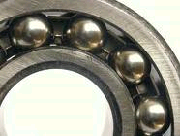
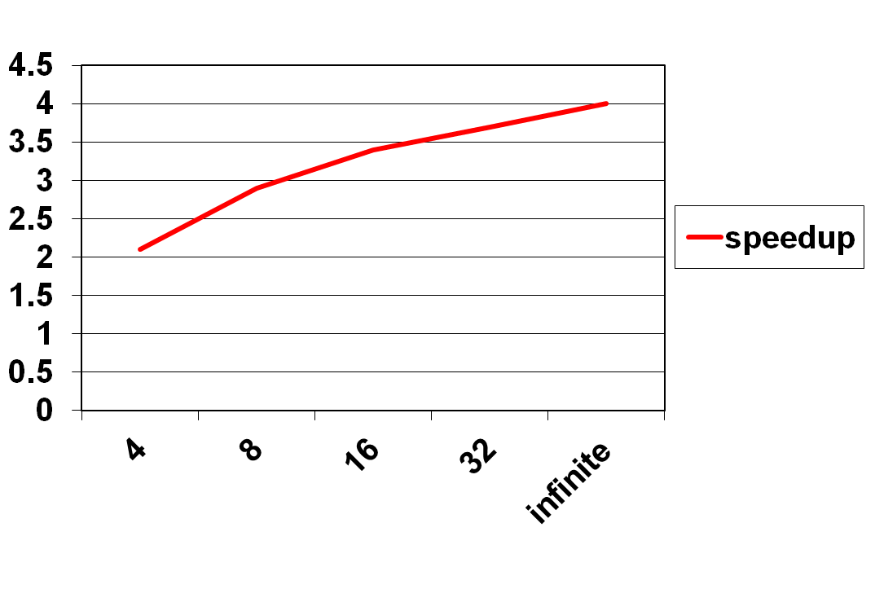
Diminishing Returns
This course is about the parts that
are hard to make concurrent …
but still have a big influence on speedup!
Notes:
With 25% sequential, cannot do more than

Slide 123
This work is licensed under a Creative Commons Attribution-ShareAlike 2.5 License.
You are free:
to Share — to copy, distribute and transmit the work
to Remix — to adapt the work
Under the following conditions:
Attribution. You must attribute the work to “The Art of Multiprocessor Programming” (but not in any way that suggests that the authors endorse you or your use of the work).
Share Alike. If you alter, transform, or build upon this work, you may distribute the resulting work only under the same, similar or a compatible license.
For any reuse or distribution, you must make clear to others the license terms of this work. The best way to do this is with a link to
http://creativecommons.org/licenses/by-sa/3.0/.
Any of the above conditions can be waived if you get permission from the copyright holder.
Nothing in this license impairs or restricts the author's moral rights.
123
Notes:
123

