Slide 1
Generational Garbage Collection in Python and Java
Yikun Su

Slide 2
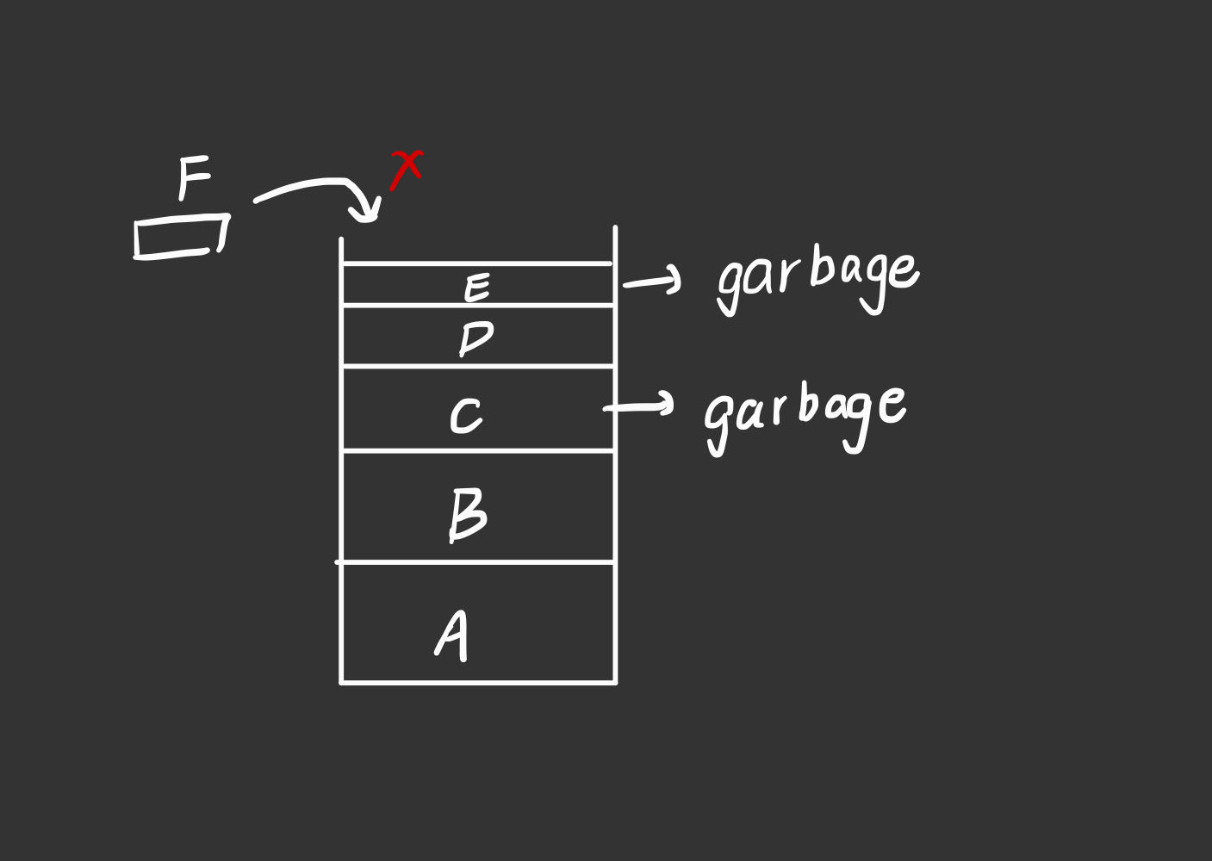
Garbage Collection(GC) significant in saving memory space and improving computers’ efficiency
too much garbage —> breakdown !

Slide 3
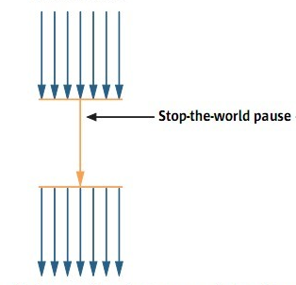
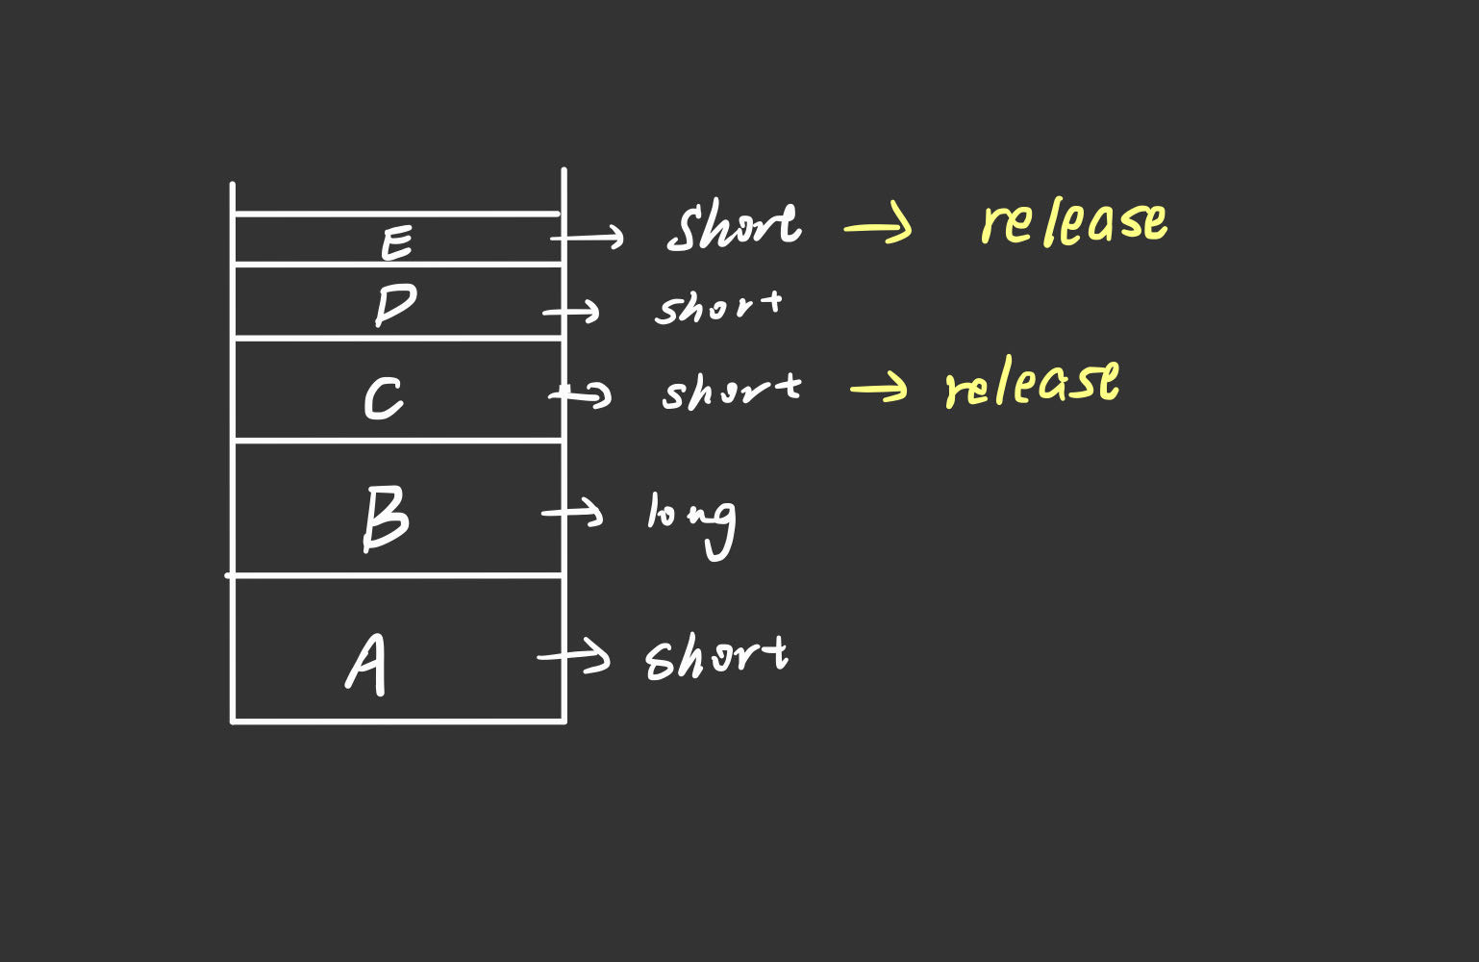
how objects are stored in memory space
so we need GGC!
http://www.51hei.com/bbs/dpj-55977-1.html

Slide 4
Why do we use GGC in Python?
In Python, Generational Garbage Collection(GGC) is used to solve the problem of circular reference which may happen in Reference Counting Algorithm.

Slide 5
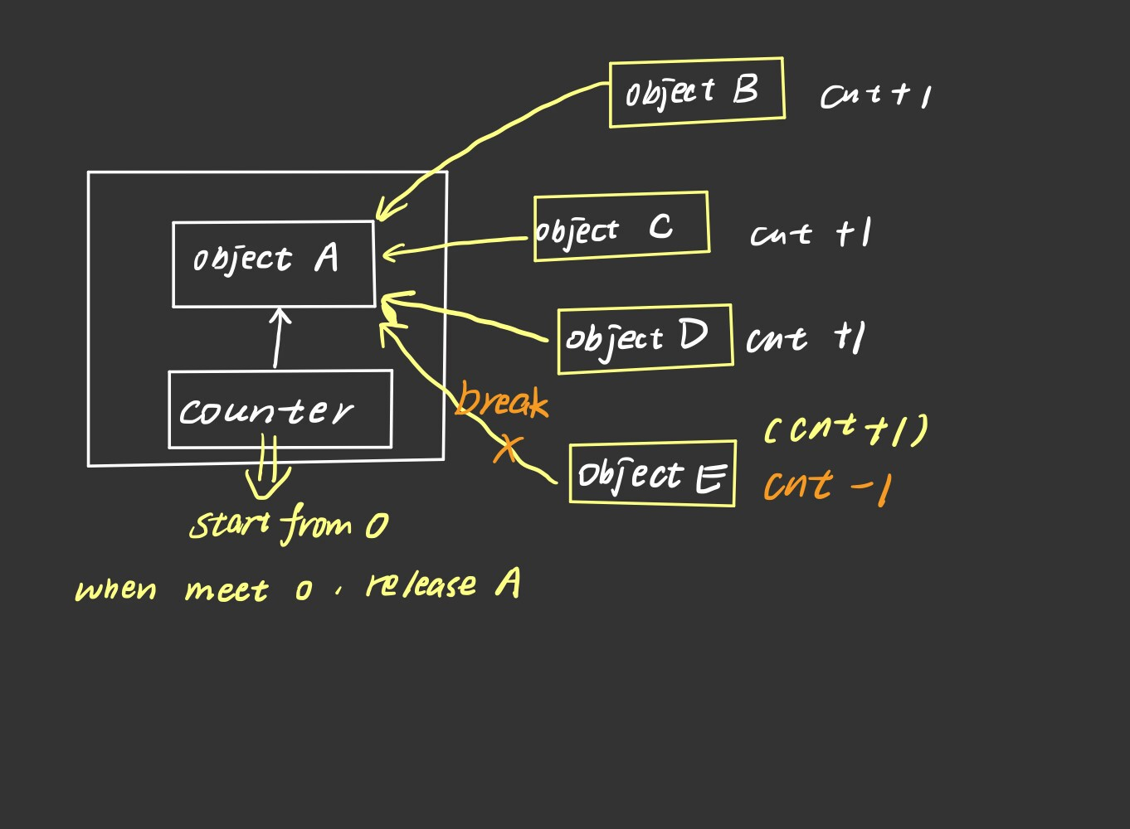
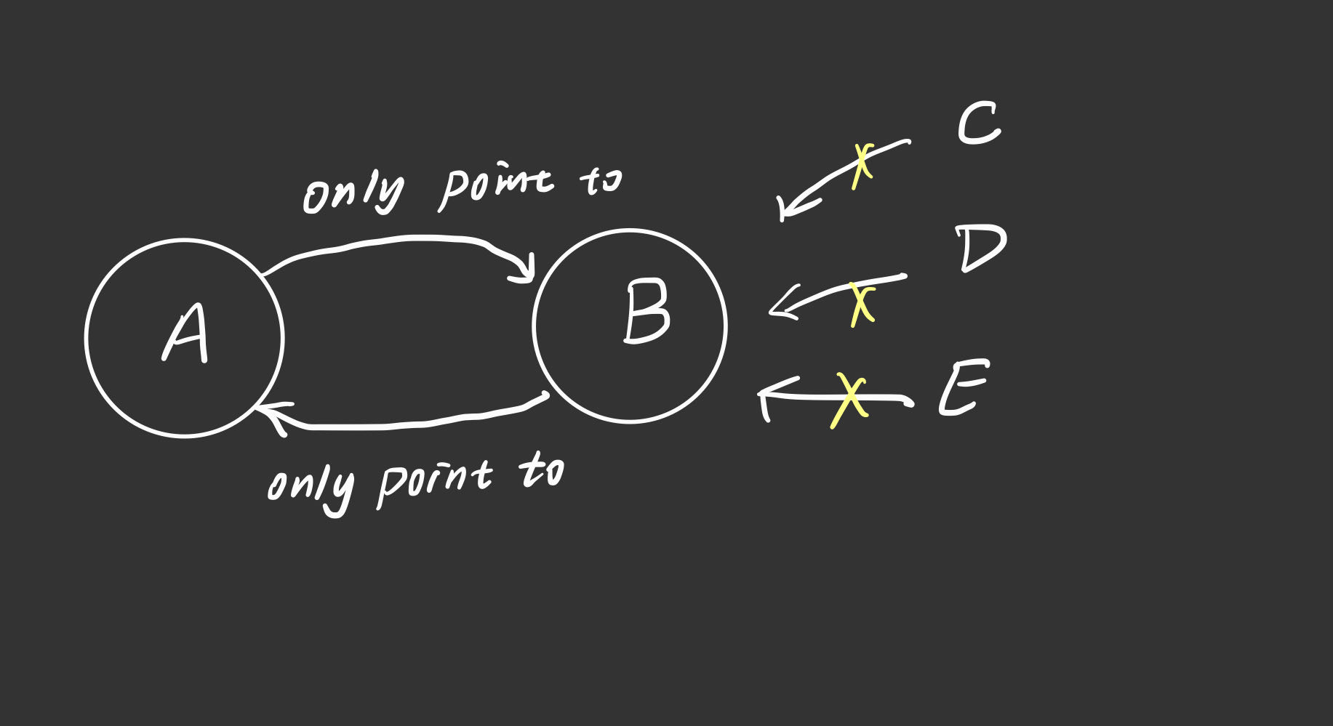
Reference Counting Algorithm. (introduction and circular reference problem) reason: easy and high efficiency
circular reference unsolved

Slide 6
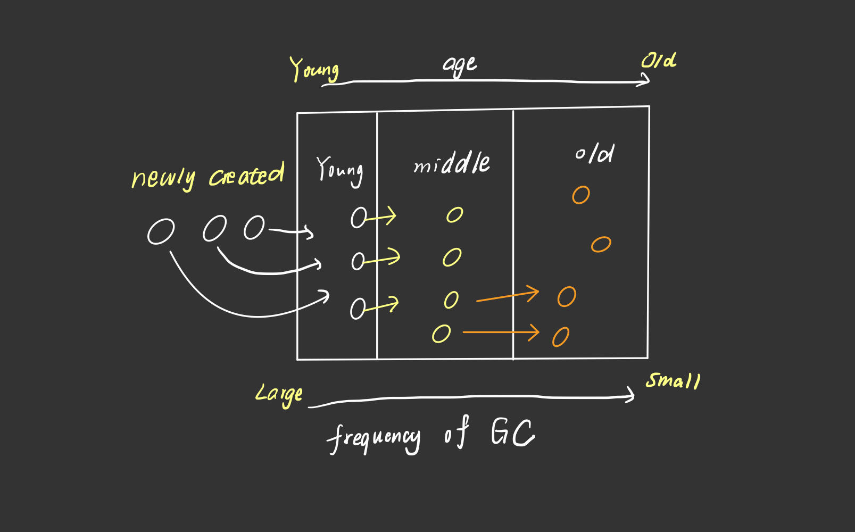
GGC in Python
3 parts
The frequency of GC in the three generations would decrease as the life of objects become longer.
reach the threshold and transfer

Slide 7
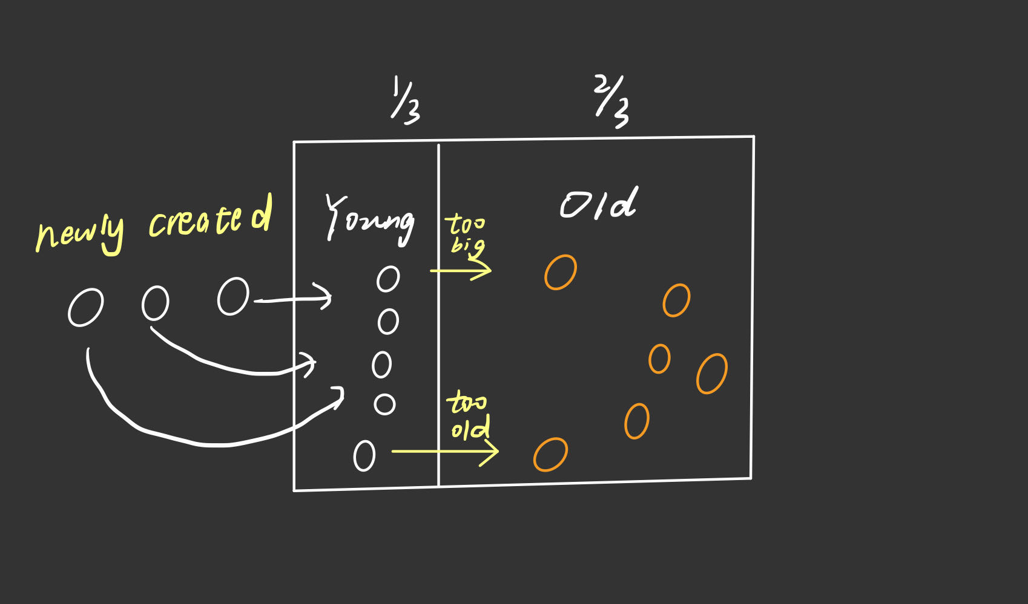
GGC for Java
2 parts
live long enough and transfer

Slide 8
Other differences between Python and Java
 | Python | Java
On the method | combination of Reference Counting Algorithm and Generational Garbage Collection | Generational Garbage Collection directly
On the solutions of circular reference | Generational Garbage Collection | simply get rid of it by not using Reference Counting Algorithm
On the specific Generational Garbage Collection | divides memory into 3 parts, simple but might have trouble with large data sets | divides memory into 2 parts, doing well in programs which requires high-performance more complicated algorithms whose problems are difficult to solve.

Slide 9
Conclusion
The growing concern about memory safety and more efficient programs,
more advanced: Parallel and concurrent garbage collection mechanism in Python, G1, CMS, and ZGC in Java...

Slide 10
Thanks!

