Slide 1
Statically typing and dynamically typing
Ziming Ren

Slide 2
Contents
Introduction
Definition
Advantages and disadvantages
Application

Slide 3
Introduction
What is the basis for classifying dynamically and statically typed languages?

Slide 4
Introduction
A data type in a programming language refers to a characteristic that defines the nature of the value that a data element has.
Every programming language has a system of checking that values have been assigned their correct types, which is known as type checking.

Slide 5
Introduction
What is the basis for classifying dynamically and statically typed languages?
Compile time
Runtime
code
Static type checking
Dynamic type checking

Slide 6
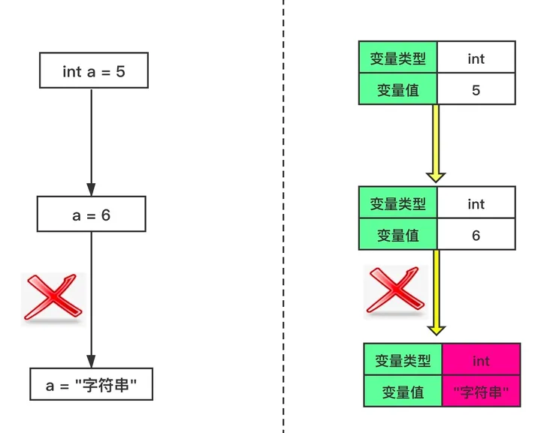
Definition: statically typing
Type checking occurs at compile time.
The type of variable will not change.
Examples: Java, C, C++, C#, Go

Slide 7
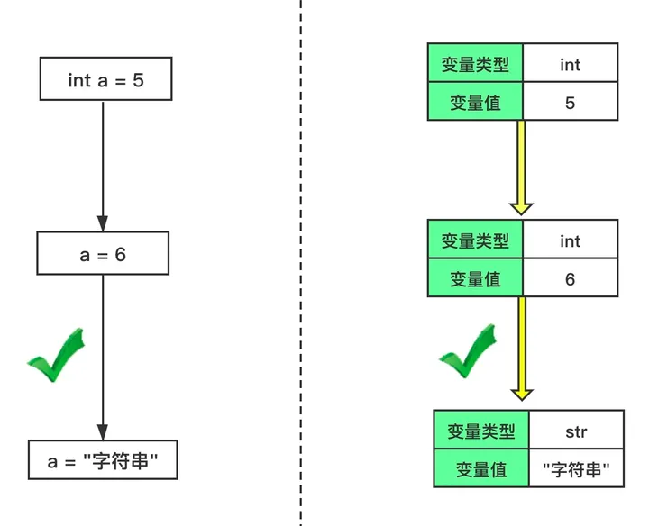
Definition: dynamically typing
a = 5
Type checking takes place at runtime or execution time
The type of variable can be changed.
Examples: JavaScript, PHP, Python, Ruby

Slide 8
Advantages and disadvantages
Amount of code: Dynamically typing is less than statically typing
Statically typing needs type declarations.
In some cases, type declarations may appear redundant.
int[ ] a = new int[size]

Slide 9
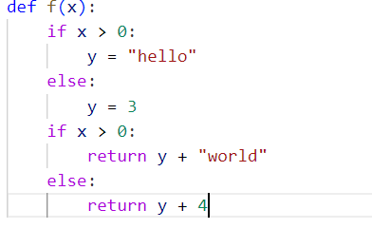
Advantages and disadvantages
Dynamically typed languages have fewer constraints
free
may have some unknown errors

Slide 10
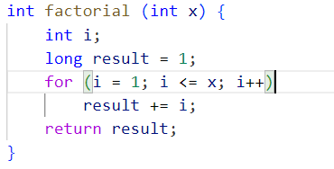
Advantages and disadvantages
Statically typed languages have more constraints
secure
distractive

Slide 11
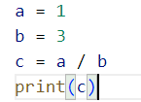

Advantages and disadvantages
Dynamically typed languages are easier to learn
0
0.33333333333

Slide 12
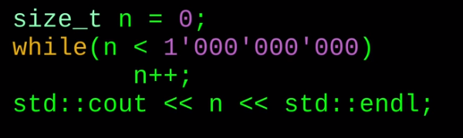
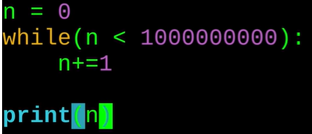
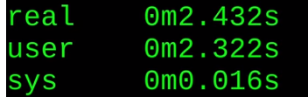
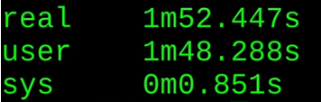
Advantages and disadvantages
Performance: Statically typing is quicker
C++
Python

Slide 13
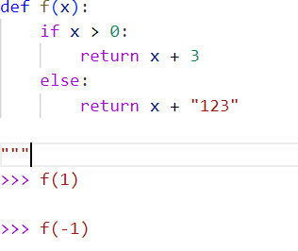
Advantages and disadvantages
Statically typed languages catch bugs earlier than dynamically typed languages
Error in Statically typing
No error
Error in Dynamically typing

Slide 14
Advantages and disadvantages
Evolution & Maintenance: Statically typing is easier
Compilers can help find errors.

Slide 15
Advantages and disadvantages
Dynamically typed languages may be hard to understand.
Statically typed languages’ development speed is slower.

Slide 16
Applications
Deciding which language to use is usually dependent on both the programmer and the purpose of the program.
Project scale
Development team experience and habits
Special needs
Exploit strengths and avoid weaknesses

Slide 17
Thanks!

