Slide 1
Decorators in Python
231220003 徐梓鸣

Slide 2
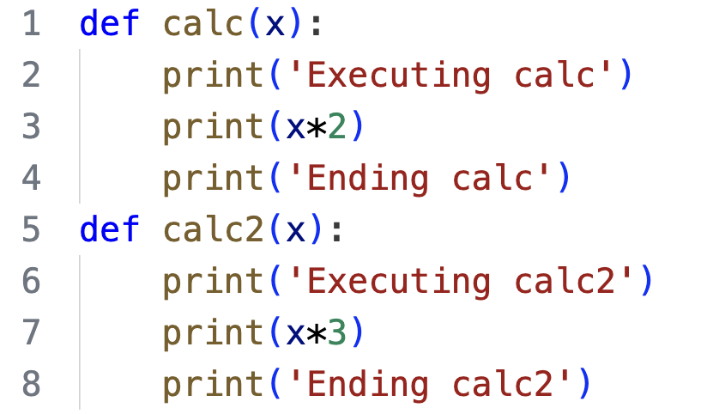
Introduction
Necessary to add certain behaviors like logging, timing or authorization
Directly adding these behaviors is dumb.
Add code complexity
Bad for further adaptation
Repetitive Work!
How to add behaviors?
An example of adding behaviors directly

Slide 3
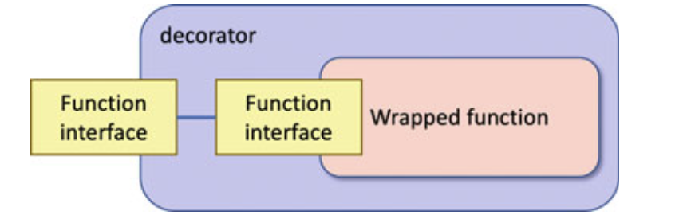
Introduction
Decorator pattern is wise.
creates a new function:
execute the behaviors that decorate the original function
execute the original function.
How decorator works
Why wise?
Adaptable
Won’t change original function’s behavior.

Slide 4
Applications
Logging and Timing
Authorization
Flask

Slide 5
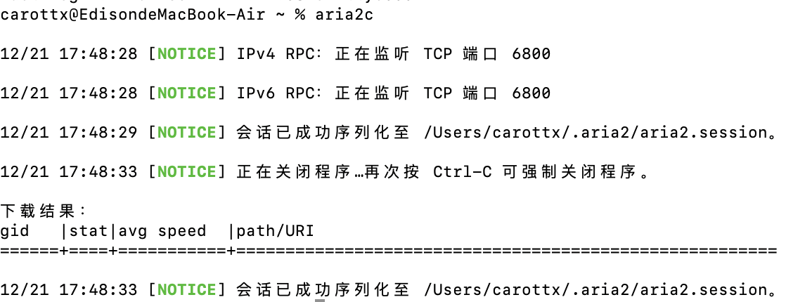
Logging and Timing
Provide history for debugging
Provide real-time information
Why decorator?

Slide 6
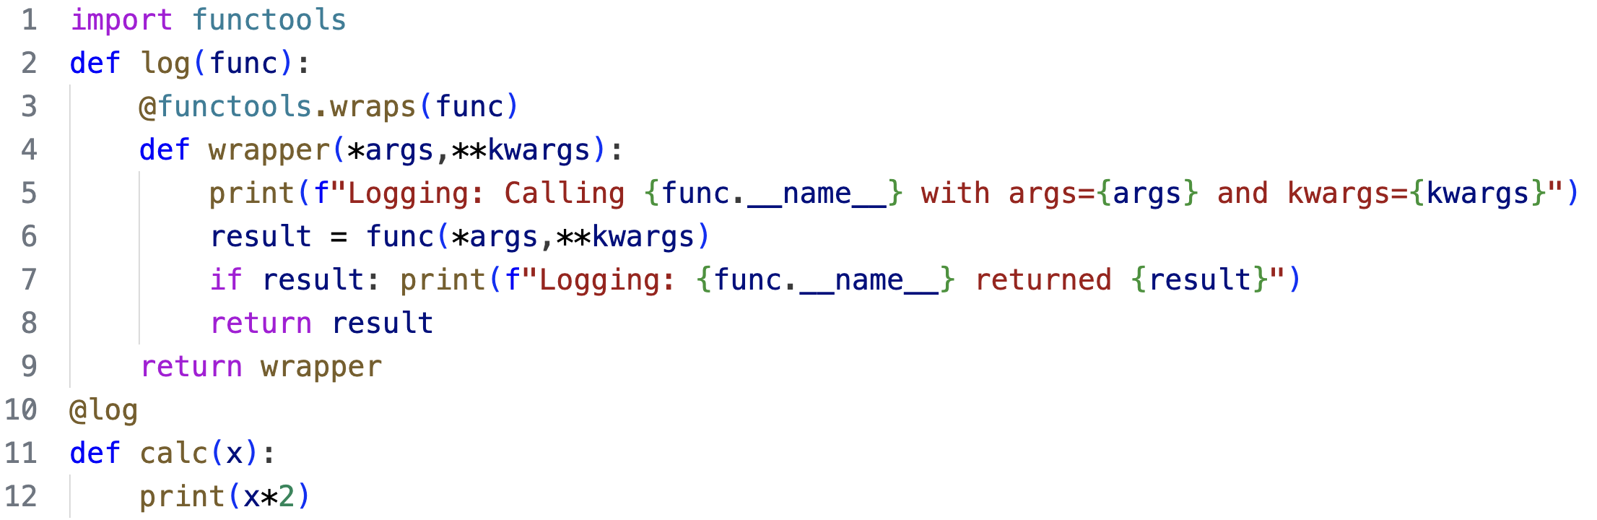
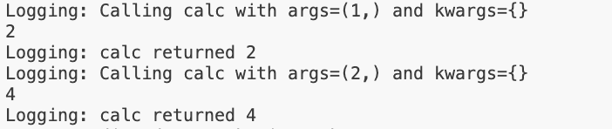
Logging and Timing
Keep the original function’s attributes
Result:

Slide 7
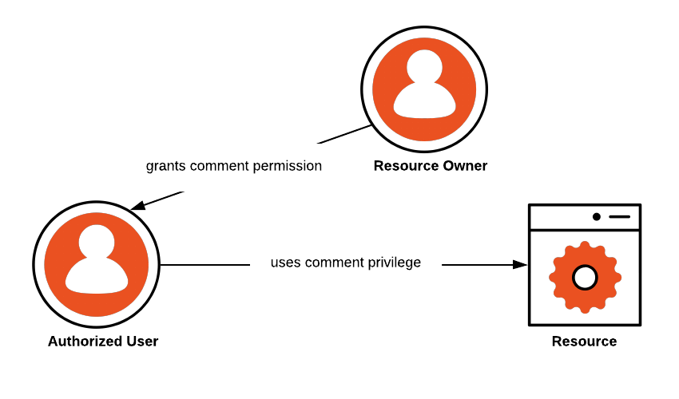
Authorization
Different users have different access to resources, e.g. read, write
When visiting resources, the program need to check the user’s authorization.
Every function’s behavior to the resource is different.

Slide 8
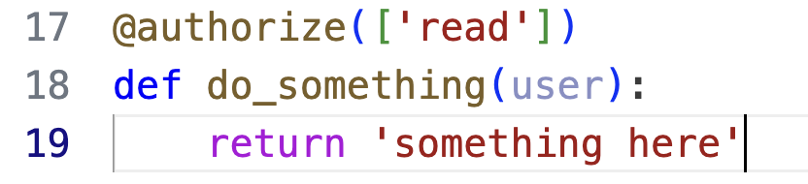
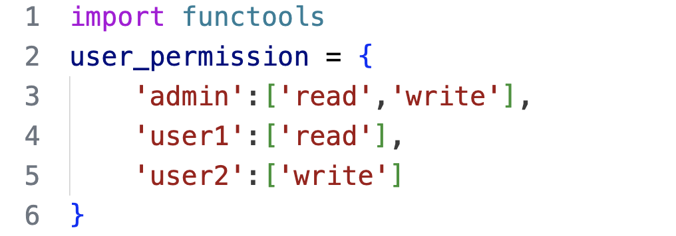
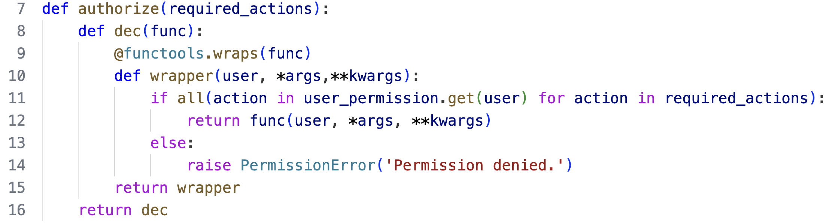
Authorization

Slide 9
Flask
A lightweight web framework
Decorators are widely used in it, e.g. @app.route(url) where app is a Flask object. When url is visited, the function decorated by @app.route(url) is executed.
Find more here: https://flask.palletsprojects.com/en/3.0.x/

Slide 10
Flask
from flask import *
app = Flask(__name__)
@app.route('/’)
def index():
return 'Welcome to my Flask application!’
@app.route('/submit', methods=['GET', 'POST’])
def submit():
if request.method == 'POST’:
username = request.form['username’]
return f'Thank you, {username}!’
return render_template('form.html’)
if __name__ == '__main__':
app.run(debug=True)

Slide 11
Thanks for watching!

