Slide 1
Building Better Concurrency with Kotlin Coroutine
Wenqing Ge 231502002

Slide 2
What is concurrency?
In short, concurrent means doing multiple things “together”.
Example: Assume a task requires completion of both task A and task B
A
B
Require A,B
Non-concurrent
Time
B
A
Require A,B
Concurrent
Time

Slide 3
What is concurrency?
Lower execution time
Resource-efficient
Different from traditional programming
(includes not only sequential order)
Need a good solution/design pattern/framework…

Slide 4
Metric for a “concurrency solution”
Aka. How to write concurrency “elegantly”?
Light-weight (not consuming much resource)
Intuitive (not twist or tangle our brain)
Memory-safe (not cause memory leaks)
…

Slide 5
Solutions
Threads
✔ Intuitive
× Memory-unsafe
× Cost-heavy
Cause: On system level
Callback functions
✔ Light-weight
✔ Memory-safe
× Unintuitive
Cause: “hell of callback chain”
Primitive Libraries
(Generators / Fibers)
✔ Intuitive
✔ Light-weight
× Memory-unsafe
Cause: Easy to forget closing
Kotlin Coroutines
✔ Light-weight
✔ Intuitive
✔ Memory-safe

Slide 6
Light-weight
Threads:
Directly managed by OS (Operating System)
Need many extra information & care (e.g. PCB, context, etc) from OS
→ High cost to startup and maintain
Kotlin Coroutine
Compiled into Normal Functions
Managed by JVM (Java Virtual Machine, Application level)
Same process, same thread → less extra information
→ Lower cost to startup and maintain

Slide 7
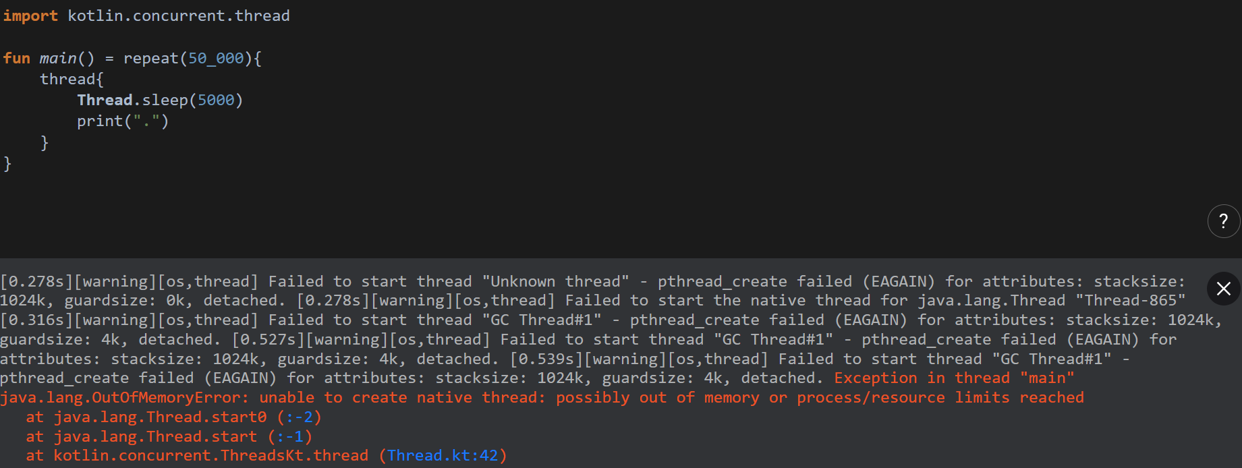
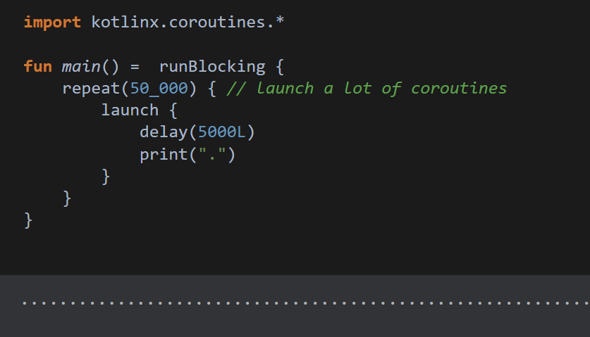
Light-weight
Compare the memory of two code with thread/coroutine:
Thread:
Crashed due to Out Of Memory
Coroutine:
No problem!

Slide 8
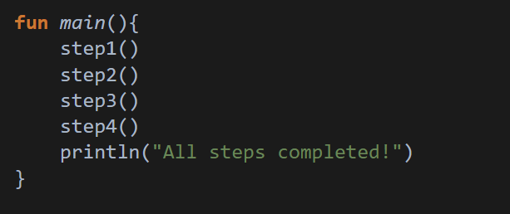
Intuitive
Suppose an operation: Step 1 → Step 2 → Step 3 → Step 4
In traditional sequential order we have:
We want concurrent operations to be similar!

Slide 9
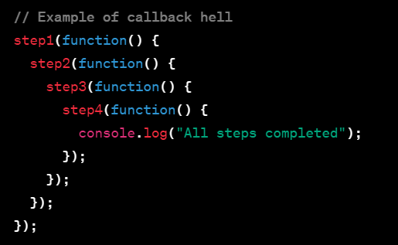
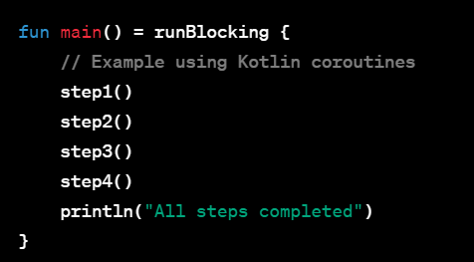
Intuitive
Compare solution:
Similar to traditional solution!
Javascript – Callback style
Kotlin – Coroutine style

Slide 10
Memory-safe
Some user operation requires the assistance of “background worker” that works somehow independently (e.g. download process, asset import)
The user operation usually “tracks” the state/progress of the worker (e.g. display percentage accordingly, feed/fetch data)
If a background worker is not tracked, the state of it cannot be changed(e.g. cannot running state → termination state), the data of it cannot be accessed.
Waste memory/CPU
not “memory-safe”.

Slide 11
Memory-safe
If a background worker is not tracked, the state of it cannot be changed(e.g. cannot running state → termination state), the data of it cannot be accessed.
Waste memory/CPU
not “memory-safe”.
Recall: when no pointer points to an address, the address is “lost”.
Too much “lost” stuff will occupy the space for new allocations.
Similar in nature.

Slide 12
Memory-safe
An real-life example
User Action
Background Worker

Slide 13
Memory-safe
An real-life example
User Action
Background Worker
Lost track!
Cancel!
Forgot manual termination

Slide 14
Memory-safe
A more complicated situation
Subtasks
User Action
Background Worker
Subtasks
Subtasks
Subtasks
Complicated!
Easy to forget!

Slide 15
Memory-safe
In Kotlin…
Subtasks
User Action
Background Worker
Subtasks
Subtasks
Subtasks

Slide 16

Memory-safe
In Kotlin…
Subtasks
User Action
Background Worker
Subtasks
Cancel!
Subtasks
Automatic termination
Subtasks
Detected!
Structured Concurrency

Slide 17
Conclusion
Coroutine vs Thread → Light-weight
Coroutine vs Callback function → Intuitive
Coroutine vs Primitive Libraries → Memory-safe

Slide 18
Thank you!
Reference: JetBrains - Introduction of Kotlin Coroutine

