Slide 1
Why Do We Need the Object-oriented Programming?
Zhihui Yin

Slide 2
Outline
The problems we meet when we coding.
The advantages of OOP.
An instance of a game program fragment.
Conclusion.

Slide 3
The problems we meet when we coding
Structured Programming (Process-Oriented Programming)
Difficult to understand and maintain
Not conducive to modification and expansion
Not conducive to the reuse of code
Labor intensive
Difficult to adapt to the needs of software development

Slide 4
The advantages of OOP
Algorithms that tightly connect data and manipulate data
Ordered scope of access
Low coupling
High scalability, high modifiability, and high reusability

Slide 5
An instance of a game program fragment
Might and Magic
A wide variety of characters: dragon, wolf, ghost……
Interactions between characters: attack, hurt, fightback……

Slide 6
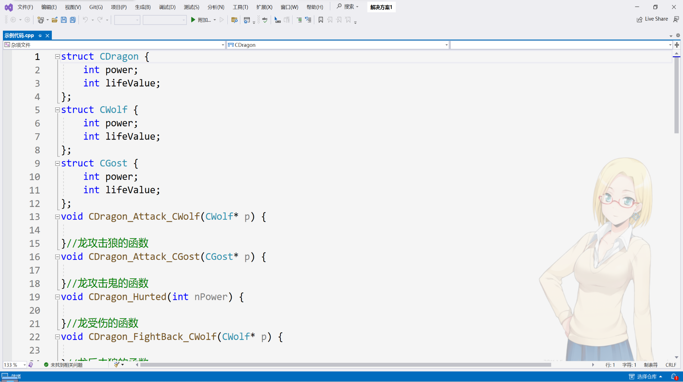
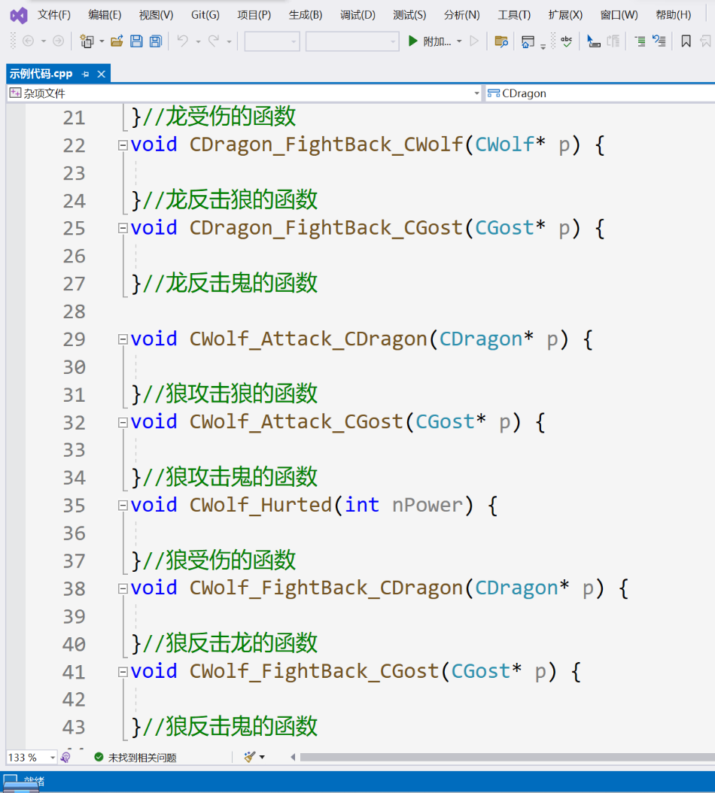
An instance of a game program fragment:C

Slide 7
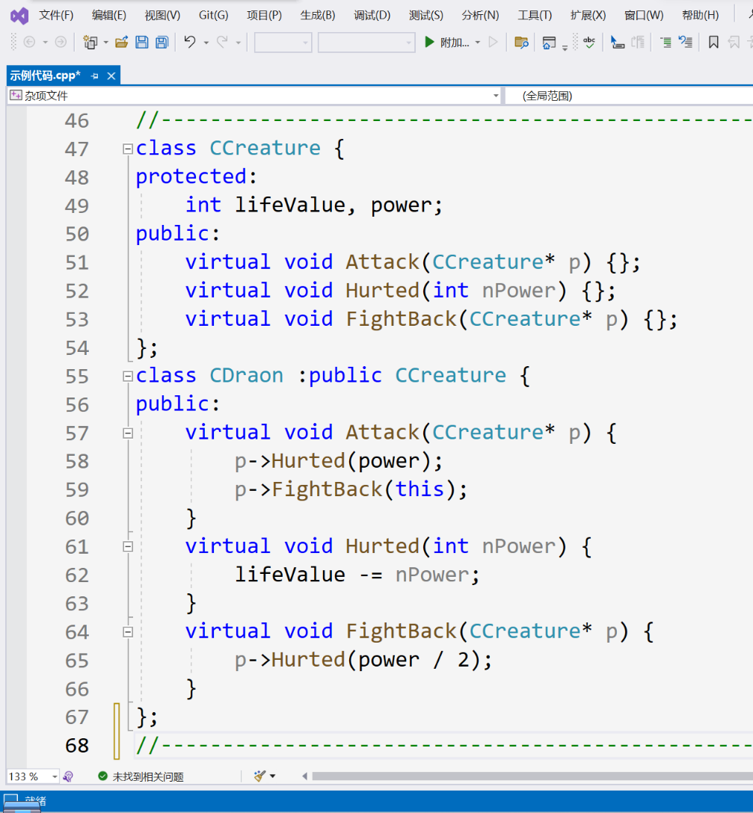
An instance of a game program fragment:C++
Class
On the basis of structs, it supports member functions, methods that represent objects.
Inheritance and derivation
When defining a new class B, use A as the base class, and expand and modify it to get B on top of that.

Slide 8
An instance of a game program fragment:C++
Virtual functions
A virtual member function is preceded by a declaration.
Polymorphism
In the example, CCreture defines three virtual functions: attack, damage, and counterattack, so that different subclasses can directly call the corresponding functions of the required object during compilation through the base class pointer parameters.

Slide 9
Conclusion
New tools and concepts solve the problems.
With many advantages.
We need OOP!

Slide 10
Thanks

