Slide 1




The
Evolution of C++:
A Comparative Study with C and its Futuristic Development
汇报人/Yinhao Fang

Slide 2
Introduction
The evolution of C++ includes significant shifts, primarily driven by the transition from procedural to OOP.
Evaluates the semantic differences of code written in C++ as compared with C and sheds light on the transition and advancements in programming paradigms.
Aims to explore the trend of C++’s future development.

Slide 3

目 录
CONTENT
Distinctions between C and C++
Innovations from C++98 to C++11
Understanding ’Object-Oriented Programming’
Future Trends for C++

Slide 4
Distinctions between C and C++

Slide 5

Distinctions between C and C++
The compiler decorates different function names with different argument types, such as void func (). The compiler might change the function name to _func, and when the compiler hits void func (int x), the compiler might change the function name to _func_int, and when the compiler hits void func (int x, char c), The compiler may decorate the function name with _func_int_char as a distinction.
A reference variable is an alias; that is, it's another name for an existing variable. Once you have initialized a reference to a variable, you can refer to the variable using either the reference name or the variable name.
The encapsulation of data and functions into objects in C++ sets it apart from C significantly.
By encapsulating data and operations in a class only a limited interface is exposed to interact with the outside, so as to protect the internal state of the class object from being modified by the outside

Slide 6
Innovations from C++98 to C++11

Slide 7
点击此处输入标题
Initialize the form
Constant
01
New in C++11: Brace initialization
When initialized with curly braces, the assignment symbol is optional.
ii, when using curly braces for initialization, some unintended implicit conversions can be disallowed (for example, disallowing truncation from floating-point numbers to integers).
New in C++11: The use of constexpr to modify the type of the entity is the programmer’s suggestion to "calculate the value of the entity at compile time", which helps the compiler to take some optimization strategies for "reading the value of the entity in the process".
02
Null pointer
Etc.
03
C++98 supports: 0, NULL
New in C++11: All pointer types share the same nullptr. Unlike 0 or NULL, nullptr cannot be implicitly converted to integer type.
04

Slide 8
Understanding ’Object-Oriented Programming’
C++, being an extension of the C programming language, introduces powerful features for object-oriented programming.
Notes:
更多精美模板欢迎访问 WWW.33PPT.COM

Slide 9
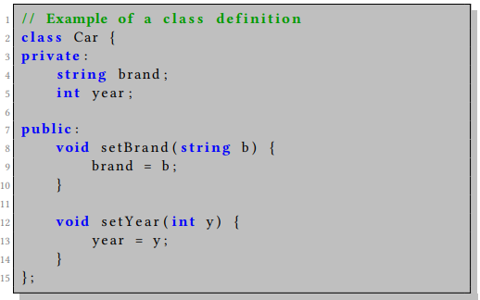
01
Class and Object
At the core of C++ OOP is the concept of a "class." A class is a blueprint for creating objects, defining their properties (data members) and behaviors (member functions/methods). An "object" is an instance of a class.

Slide 10
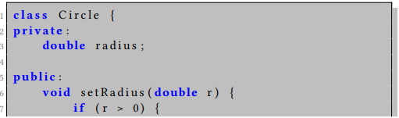
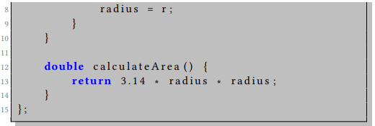
02
Encapsulation
C++ supports encapsulation, which means bundling the data (attributes) and methods (functions) that operate on the data within a single unit, i.e., the class. Access specifiers (public, private, protected) control the visibility of members.

Slide 11
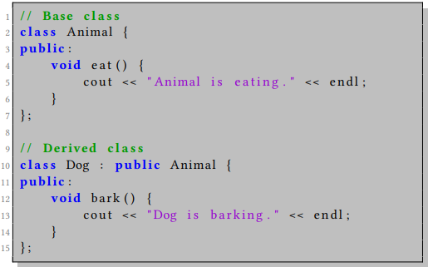
03
Inheritance
Inheritance allows a class to inherit the properties and behaviors of another class. This promotes code reusability and establishes an "is-a" relationship between classes.

Slide 12
Future Trends for C++
Notes:
更多精美模板欢迎访问 WWW.33PPT.COM

Slide 13

Historical baggage
The absence of a special identifier for function calls in C++ passing by reference is a notable language design flaw. This flaw can be attributed to the reuse of the address operator during the development of reference syntax. It is one of the early design flaws in C++, and its complexity arises from both its reluctance to introduce new keywords and its attempt to maintain compatibility with C. It is worth noting that every programming language carries historical baggage.

Slide 14

Future
Given the paradigmatic differences and independent challenges posed by languages like C and Java, it becomes crucial to critically examine the future prospects of C++. However, we cannot underestimate the robustness and extensibility of C++, which makes its disappearance highly improbable but rather points towards an evolution into a more sophisticated toolset.

Slide 15
Thanks for Listening!

