Slide 1
The Programming Languages of Vim and Emacs: Advantages and Disadvantages
Long Ling

Slide 2


What are Vim and Emacs
Emacs:
It is a useful text editor.
Configuration language: Elisp(Emacs lisp).
Vim:
It is another useful text editor.
Configuration languages: Vimscript and Lua.

Slide 3
What are the advantages and disadvantages of their programming languages?

Slide 4
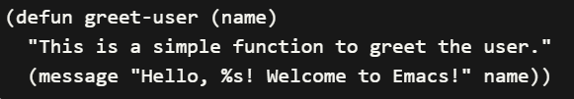

Elisp: a dialect of lisp
(defun greet-user (name) ...): define a function
2. "This is a simple function to greet the user.": easy to read
3.(message "Hello, %s! Welcome to Emacs!" name): body of the function
4. Call the function

Slide 5
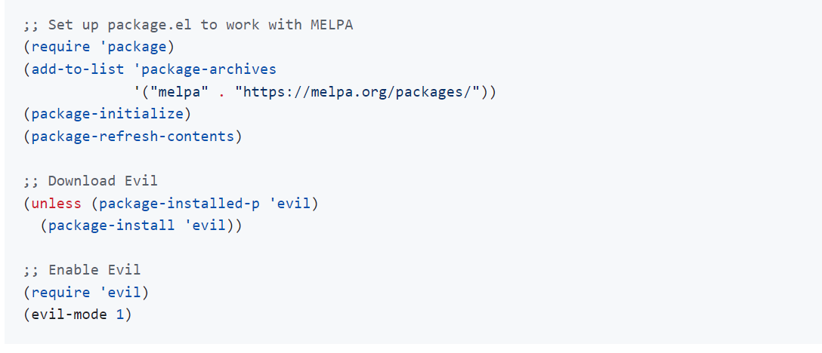
Advantages of Elisp
Extensive Configuration Capabilities.
It provides a wide range of features and APIs that allow users to customize almost every aspect of Emacs.
You can even use vim in emacs using the package of “evil”

Slide 6
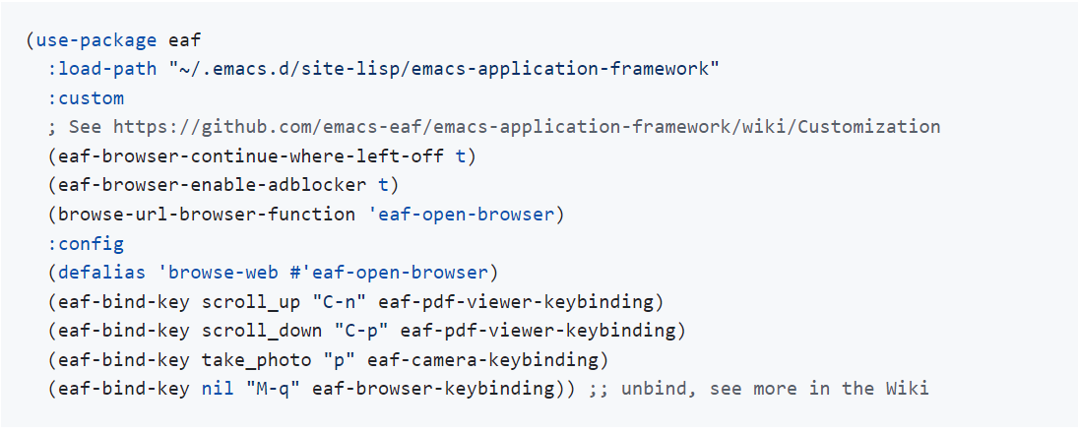
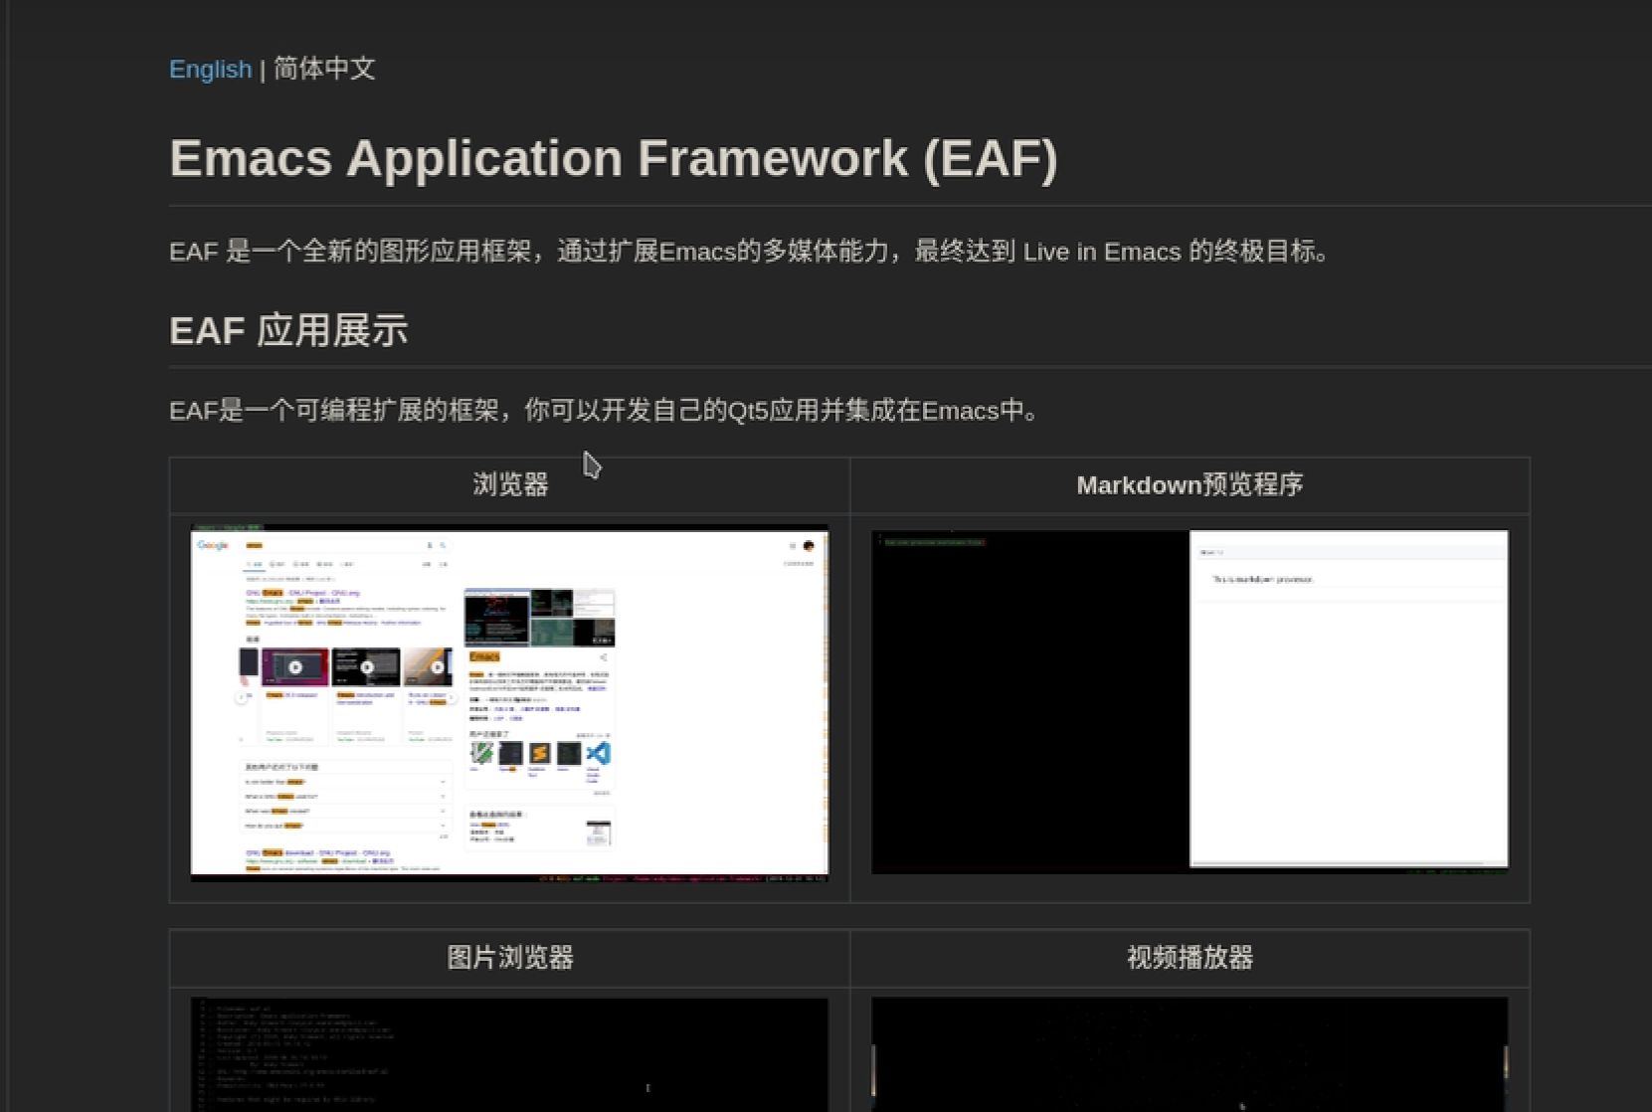
Advantages of Elisp
System-like Configuration
𝐸𝑙𝑖𝑠𝑝’s configurability resembles that of an operating system.

Slide 7
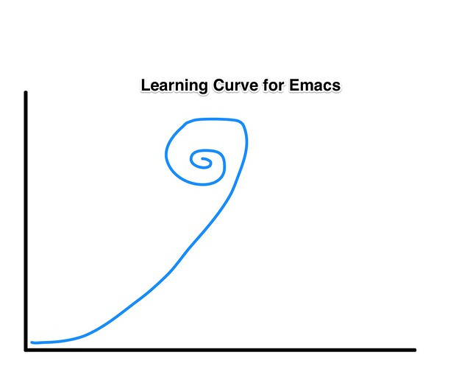
Disadvantages of Elisp
Learning Curve for Modern Programmers
Its syntax, concepts, and programming style may differ significantly from more modern programming languages

Slide 8
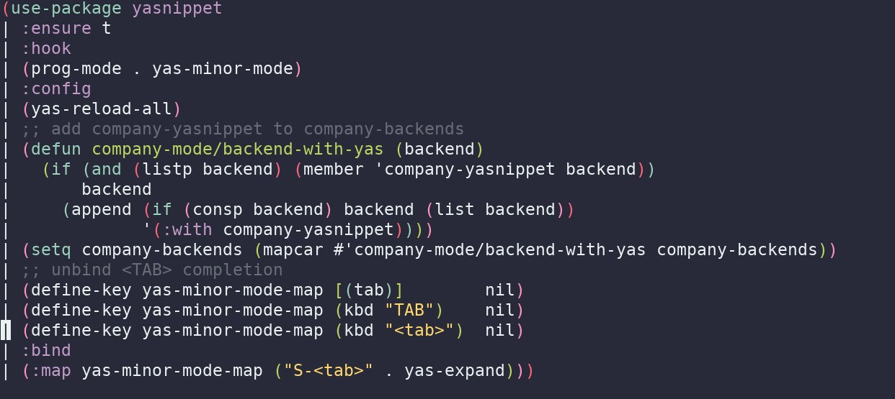
Disadvantages of Elisp
Obscurity and Complexity.
Too many brackets!

Slide 9
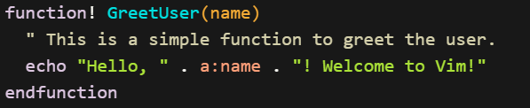

Vimscript: a scripting language specifically designed for Vim
Define a function
Function body
Call the function

Slide 10
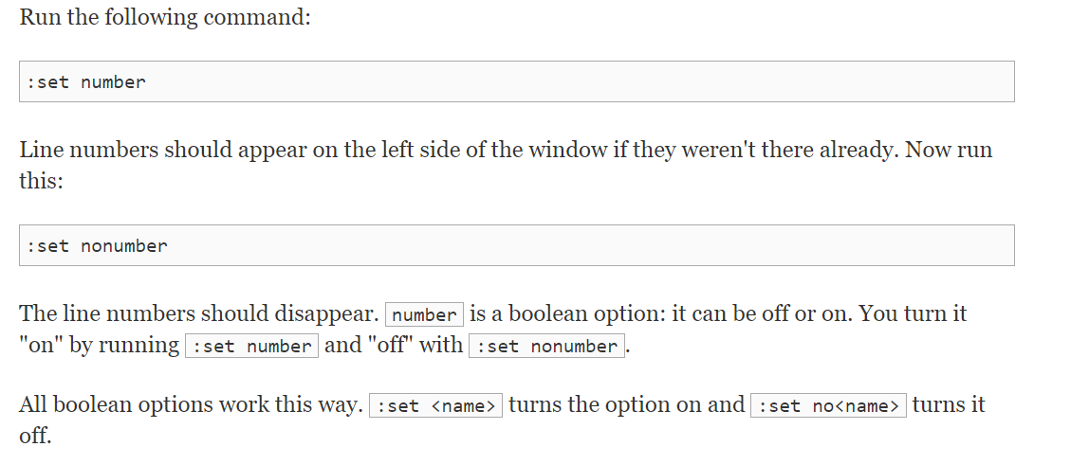
Advantages of Vimscript
Simplicity and Minimalism.
focusing on providing basic functionality and customization options

Slide 11
Disadvantages of Vimscript
Lack of Advanced Data Structures.
𝑉𝑖𝑚𝑠𝑐𝑟𝑖𝑝𝑡 lacks advanced data structures like arrays, dictionaries
It can just do some simple thing like:
1. Keybindings
2. Control different modes

Slide 12
Disadvantages of Vimscript
Lack of Standard Libraries
Too light weight
𝑉𝑖𝑚𝑠𝑐𝑟𝑖𝑝𝑡 just has a limited set of built-in functions and commands.

Slide 13
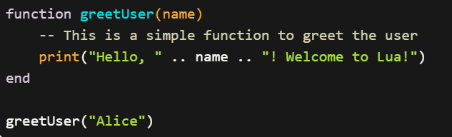
Lua: a configuring language in Neovim
Define a function
Function body
Call the function

Slide 14
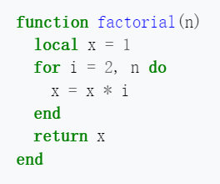
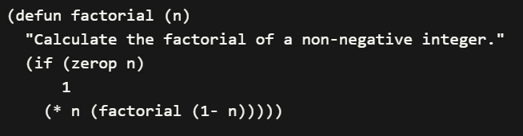
Advantages of Lua
Simplicity and Ease of Learning
Which one do you want to use and read?
Lua
Elisp

Slide 15
Advantages of Lua
Versatile Configuration Capabilities
Lua providing a small set of general features that can be extended to fit different problem types.
1. Extensibility through Modules
2. embedded within other applications and systems

Slide 16
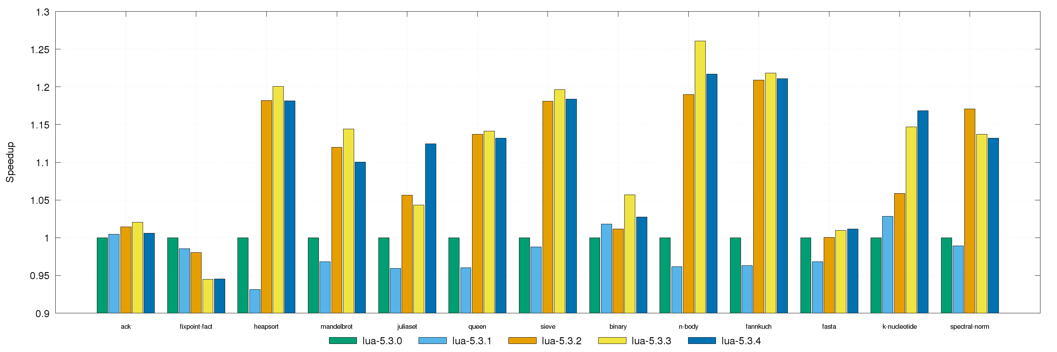
Disadvantages of Lua
Instability and Rapid Updates

Slide 17
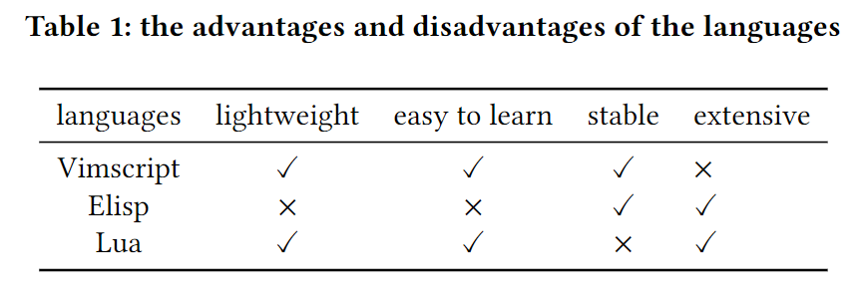
Conclusion:

