Slide 1
Ending merge sort halfway can improve its efficiency
231870201 黄致敦

Slide 2
目录
01
Introduction
02
Key Ideas
CONTENTS
03
Technical Meat

Slide 3
INTRODUCTION
01

Slide 4
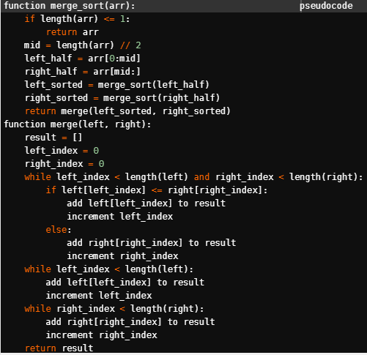
Merge Sort
Dividing Part
Merging Part
Much greater efficiency when dealing with large scale data

Slide 5
KEY IDEAS
02

Slide 6
Is it necessary to use merge sort when the data scale is sufficiently small?
The dividing part ends when each sub array has the size one.
When dealing with data with size that is sufficiently small
Is it necessary to divide and solve the question
Rather than directly sort it out?

Slide 7
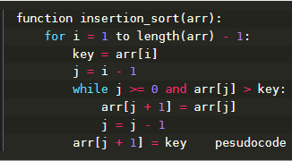
Insertion Sort For substitution
When the array is sufficientlly short

Slide 8
TECHNICAL MEAT
03

Slide 9
Till now, we’ve been talking about the vague concept of fast and slow.
Introduce three new terms
Define and quantify “efficiency”

Slide 10
Big O notation
Let 𝐹 and 𝐺 be functions.
We say that 𝐹 (𝑥) is 𝑂(𝐺(𝑥)) if there are constants 𝐶 and 𝑘 such that
|𝐹 (𝑥)| ≤ |𝑘𝐺(𝑥)| whenever 𝑥> 𝑘.
As you can see, the big o notation 𝑂 is only useful when dealing with sufficiently large n for it only cares about situations when 𝑥> 𝑘.

Slide 11

Time Complexity
This only cares about the term in a polynomial which has the highest power exponent of n, also ignoring the coefficient before it.
$f(x) = 3n^{2}$ +$2n + 1$ has the time complexity of $n^{2} .$
So we say it has the time complexity of O($n^{2}$).

Slide 12
Worst Case Analysis
To analyaze the worst case that would happen in an algorithm.
When your algorithm is designed to sort an array in decreasing order, than in the worst case should give you an array that is in increasing order.
Useful to check how your algorithm will work theoretically.

Slide 13
Efficiency Evaluation
Part I
Use time complexity the prove that merge sort has greater efficiency when dealing with large scale date rather than insertion sort.
Part II
Analyze step by step to induct that it’s possible for insertion sort to use less time to sort out an array than merge sort when encountering specific data.

Slide 14
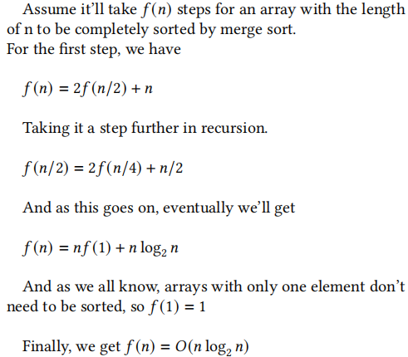
Merge sort

Slide 15

Insertion Sort

Slide 16
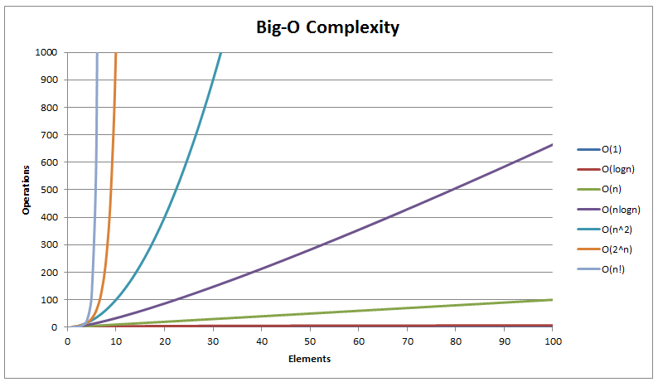
Insertion Sort
Merge sort

Slide 17
Assumptions
Assume each assignment will take time t1
Each comparison statement will take time t2
Each return statement will take time t3

Slide 18
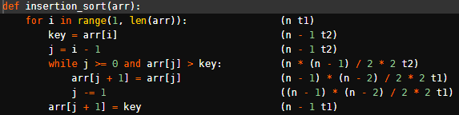
Details(Worst Case Analysis)
assignment statement | comparison statement | return statement
t1 | t2 | t3

Slide 19
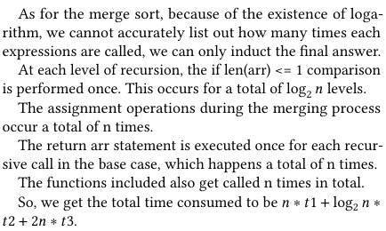
Details(Worst Case Analysis)
assignment statement | comparison statement | return statement
t1 | t2 | t3

Slide 20

Possibility?
t1 t2 t3
storing one variable
<
<
function call
creates a new frame
taking two variables out and compare

Slide 21
THANK YOU

