Slide 1
Hoare Logic
231220030 Junshu Xing

Slide 2
Some preliminary preparations
01.
Outline
02.
The basic idea of Hoare Logic
03.
The fundamental principles of Hoare Logic
The limitations of Hoare Logic
04.

Slide 3
Some preliminary preparations
01

Slide 4
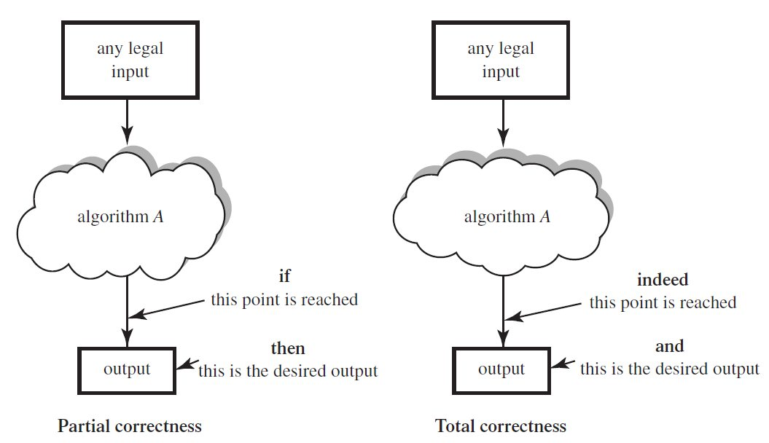
Partial and Complete Correctness of Algorithms

Slide 5

Reasoning axiom

Slide 6
The basic idea of Hoare Logic
02

Slide 7
The basic idea of Hoare Logic
By partitioning a program S into different segments, proving the correctness of these segments serves as evidence for the correctness of the program S.

Slide 8
The basic components of Hoare Logic
Hoare triple {P} S {Q}
P is the precondition
S is the program segment
Q is the post-condition
Assuming that the preconditions P are valid, then after the execution of program C, the postconditions Q will be valid.

Slide 9
The fundamental principles of Hoare Logic
03

Slide 10
Skip principle
If P holds before the execution of a skip statement,it continues to hold true after the execution.
The execution of an empty statement does not alter the value of P.

Slide 11
Skip principle
Why necessary?
Using a null statement, we can express a single-branch if statement using the standard if branching syntax.
e.g
if(A){B}⇒if(A){B} else{skip}

Slide 12
Assign principle
P[x ↦a] denotes replacing occurrences of x in P with a.
If P is true after the execution of the assignment statement x = a, then P[x ↦a] is true before the assignment, where x is a free variable.

Slide 13

Sequence principle
{P} S1; S2 {R} holds if {P} S1 {Q} and {Q} S2 {R} are both true.

Slide 14

If principle
If S1 is executed, then P and b are true before execution, and if S2 is executed, then P is true, and b is false before execution.
Starting from the validity of P, after the entire if statement, the formula Q remains valid.

Slide 15
If principle
This inference rule has stringent requirements for the conditions of the premise, making it challenging to apply directly.
As a result, we will later introduce strengthening and weakening rules to broaden the applicability of the inference rule.

Slide 16

While principle
If P and b are true, execute S.
After the execution of S, b is false, and P is true.
P represents the loop invariant that must be maintained as true throughout the loop.

Slide 17

Cons principle
If a Hoare triple is true, strengthening the pre-condition or weakening the post-condition also holds true.

Slide 18
One simple example
We want to verify the following program:
if(x<y){x=x+y;y=x-y;x=x-y;}
First,we can change the program into a Hoare triple:
{true}
if(x<y){x=x+y;y=x-y;x=x-y;}
else{skip;}
{x>=y}

Slide 19
One simple example
To use the fundamental principles to verify the Hoare triple ahead,we can transfer it into the following form:
{true}
if(x0<y0){x1=x0+y0;y1=x1-y0;x2=x1-x0;}
else{x2=x0;y1=y0;}
{x2>=y1}

Slide 20
One simple example
So using the fundamental principles,we have:
{x1>=2y1}x2=x1-y1{x2>=y1}
{x1<=2y0}y1=x1-y0{x1>=2y1}
{x0<=y0}x1=x0+y0{x1<=2y0}
{true ⋀x0<y0}x1=x0+y0{x1<=2y0}

Slide 21
One simple example
Then combining all the things ahead and using the assign principle,we can verify the if branch statement.
Similarly, we can verify the else branch statement.
Thus, the whole program is proved to be true.

Slide 22
The limitations of Hoare Logic
04

Slide 23
The limitations of Hoare Logic
Hoare logic struggles with handling complex aliasing relationships in pointer programs.
Hoare logic also encounters difficulties when it comes to verifying programs involving manipulable data structures.

Slide 24
Thank you for listening!

