Slide 1

The automatic generation of loop invariants using SMT solver
Haoran Ni

Slide 2

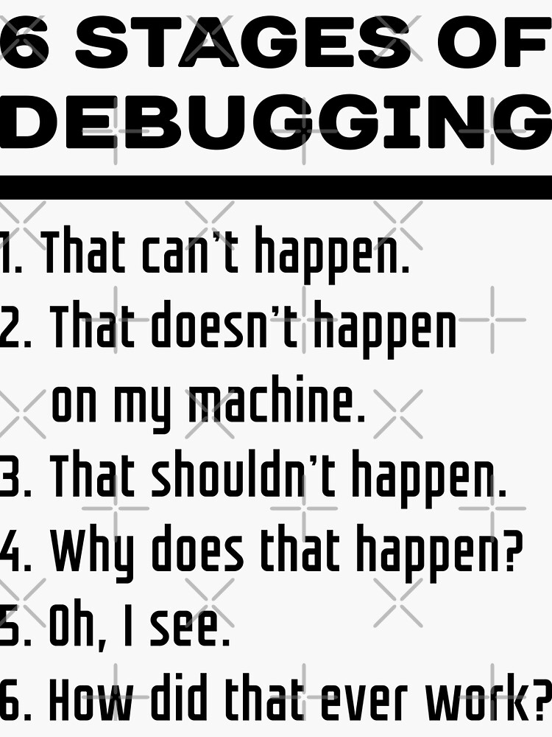
CODING WITHOUT BUGS FOREVER?

Slide 3

Program verification
We can create other programs to verify programs!

Slide 4

How does program verify our codes
Remember how do we human debug our codes?
Step 1: we will regard some lines of code as a whole and abstract its functionality
1
Step 2:Then, we will do some logic reasoning based on the functionality of code blocks.
2
Step 3: If there’s nothing wrong, then we will look at thing in detail.
3

Slide 5
That’s the basic idea of how does program verify our codes
Abstraction: using properties to abstract our program (they are often expressed in mathematical form.
Logic reasoning: the correctness of our program is replaced by the validity of the logic reasoning.
Approximation: appearing together with abstraction. For many verification algorithms, if we can’t infer the consequence from the given condition, then the algorithm will use some “smaller” approximation (and do the reasoning again)
too abstract!

Slide 6
The reason for choosing this topic
I try my best not to be too abstract.
(I think nobody would like that)
Luckily, I found something illustrative, interesting and meaningful.
I hope you will think so as well.

Slide 7
This small talk’s aim
Introduce a way of automatically generating loop invariants using SMT solvers.
You would ask: Why do I care about that?
Well, after my presentation, if you still have no interest in that.
I hope you will learn some other things.

Slide 8
After this presentation, you will learn:
A fundamental and important concept of program verification
A different perspective of reasoning about your algorithm
Two useful tools for further learning (and for fun)
Busting a myth about industrial algorithm design
A proactive mindset

Slide 9

Content
Loop invariants
SMT solver
Motivation of Automatically generating loop invariants
Automatic generation of loop invariants using SMT solver

Slide 10
What is a loop invariant
One sentence explanation:
Mathematical expressions representing certain properties that are maintained throughout the execution of the loop
A property is something that will not change over time or space or some other variables.
For example: “Ripe bananas are yellow.”(No matter the time or space, if there is still a ripe banana, it must be yellow)

Slide 11
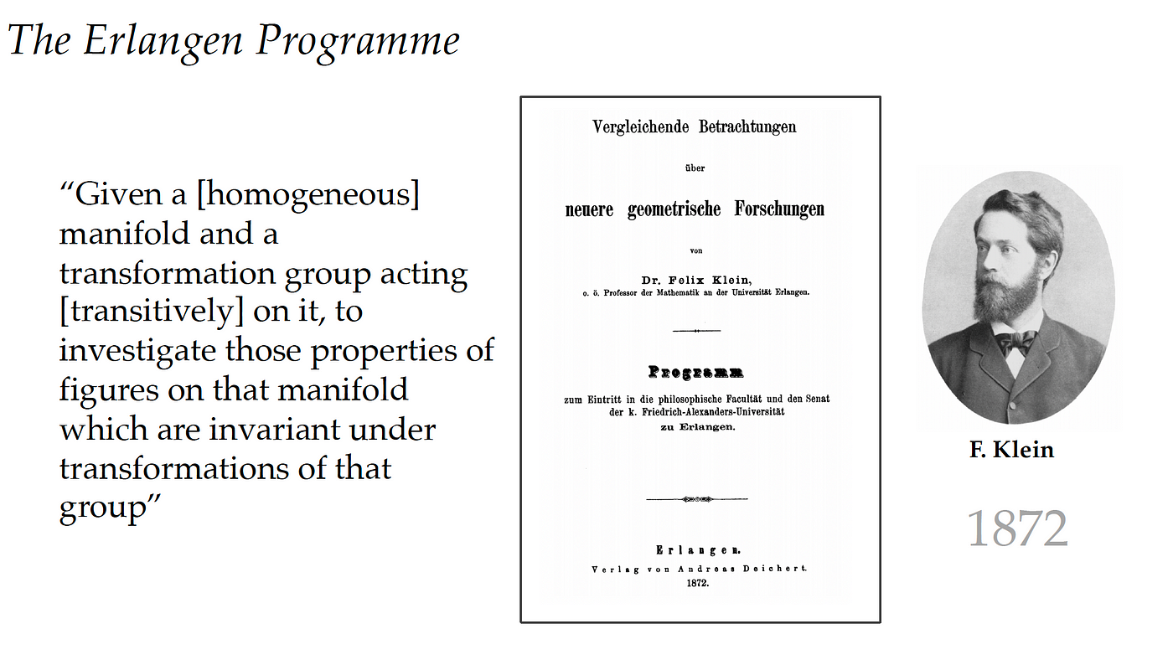
Something more about loop invariants.
“Invariant” is the synonym of “essence”

Slide 12

Something more about loop invariants.
That’s just a beautiful dream
(In my humble opinion) loop invariant has only little relationship with “essence”
Loop invariants can be regarded as “a kind of approximation”

Slide 13
Content
Loop invariants
SMT solver
Motivation of Automatically generating loop invariants
Automatic generation of loop invariants using SMT solver

Slide 14
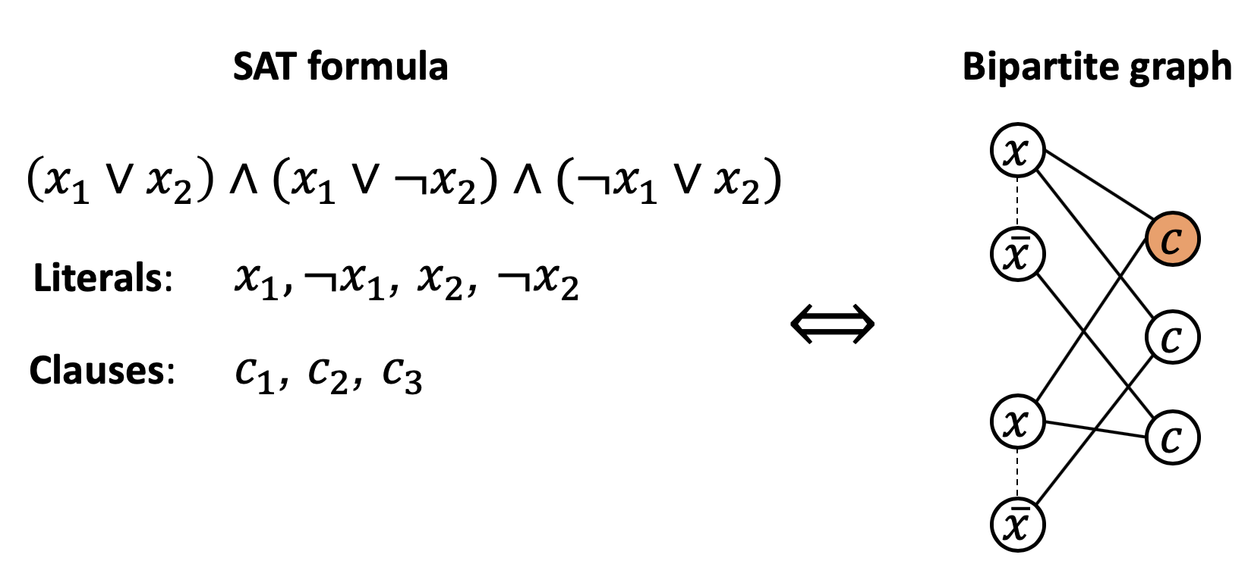
What is SAT(Boolean Satisfiability problem)

Slide 15
What is a SMT solver
A SAT solver is a solver that can solve SAT problem (good explanation)
A SMT solver is the Pro Max Ultra version of SAT solver.

Slide 16
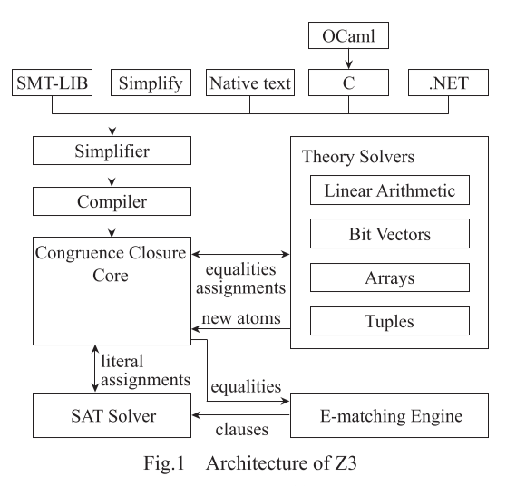

Pro Max Ultra version of SAT solver
Note: Z3 is a well-known SMT solver from Microsoft Research
This is a SMT solver

Slide 17
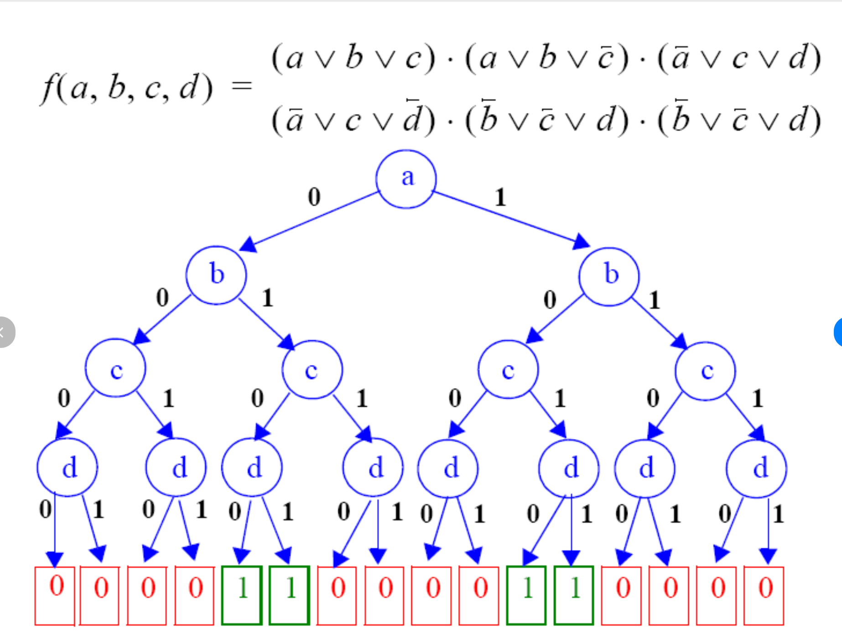
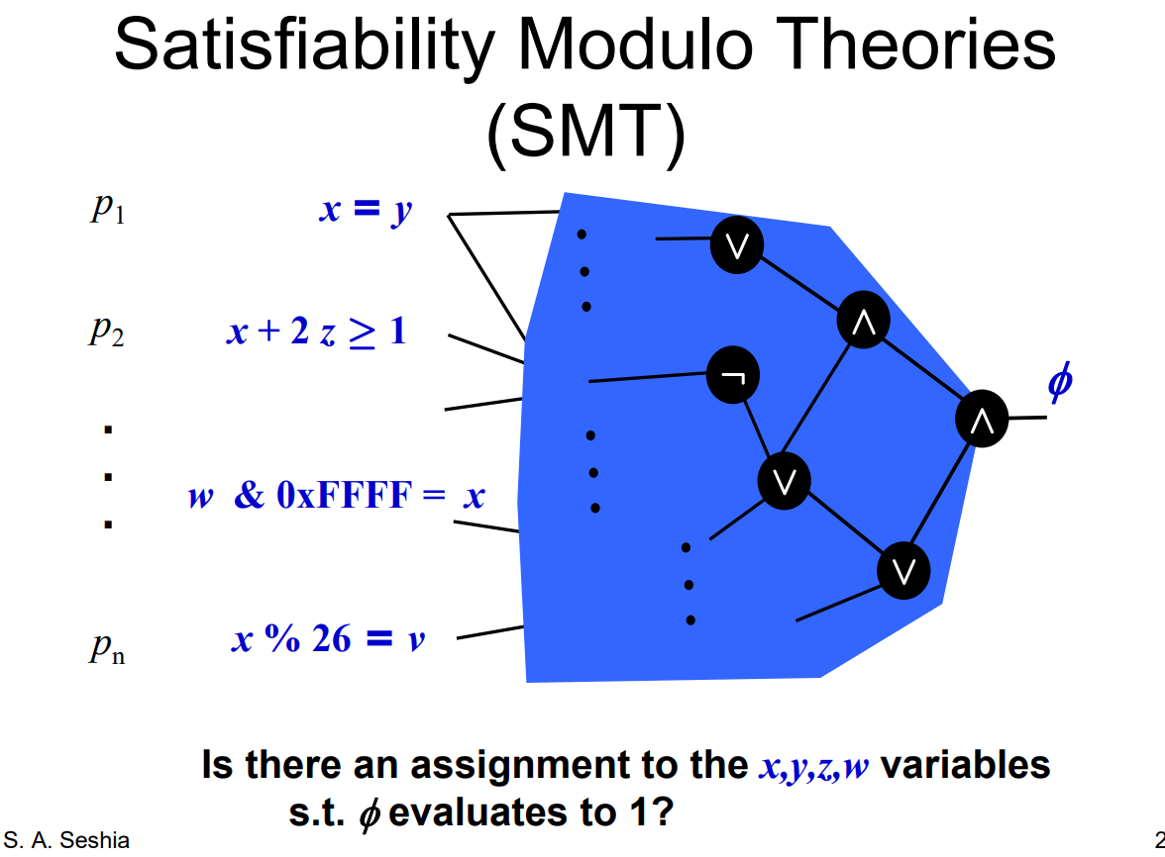
An analogy about SMT solver
A bare steam game
After buying brilliant DLCs

Slide 18
Content
Loop invariants
SMT solver
Motivation of Automatically generating loop invariants
Automatic generation of loop invariants using SMT solver

Slide 19

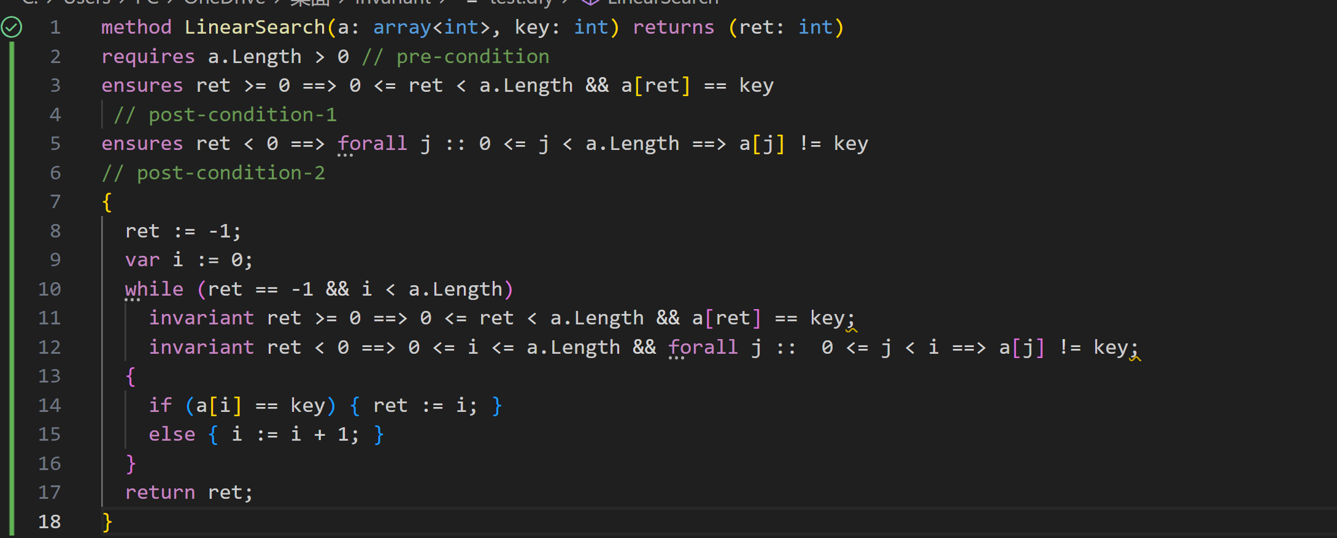
Why do we care about automatic generation?
We already have some tools that can verify your program.

Slide 20
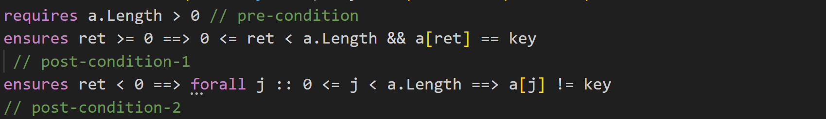
Semi-automatic
“Semi-automatic” means that we need to tell the tool what we want our program to do manually, then it will check automatically for us. (for example the pre-condition and the post-condition)

Slide 21
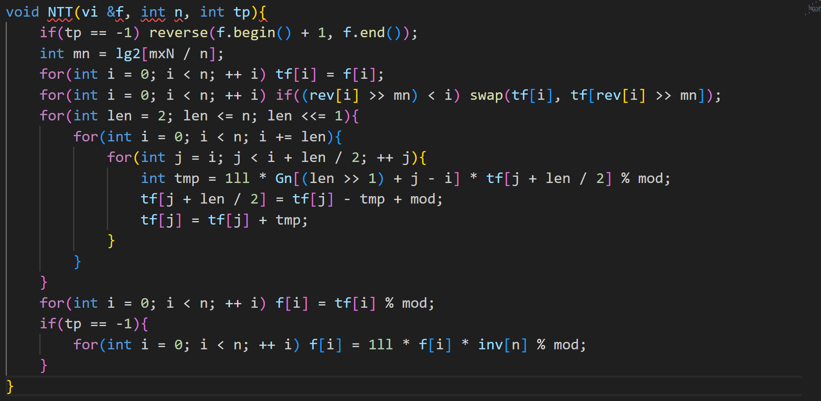
But there is a problem …
Why there are
For each loop, I need to type in at least 3 condition expressions!
so many loops ??

Slide 22

There is a problem…
We have some basic and general requests for every program.
Also take the array out of bound for example.
We don’t want to give those conditions and invariants for every loop, that’s disgusting
We want to automatically verify these basic properties.

Slide 23

Automatic generation
And a voice from heaven said, “This is My beloved Automatic generation, in whom I am well pleased”
Adapted from Matthew 3:17

Slide 24
Content
Loop invariants
SMT solver
Motivation of Automatically generating loop invariants
Automatic generation of loop invariants using SMT solver

Slide 25
What is “Automatic generation of loop invariants using SMT solver”
first denote Inv(x) as an unknown function which is the loop invariant.
Next translate “It is maintained before and after each iteration of the loop” from natural language into logic expressions.
Then throw those expressions into SMT solvers
Finally get the expression of Inv(x), and that’s the loop invariant.

Slide 26
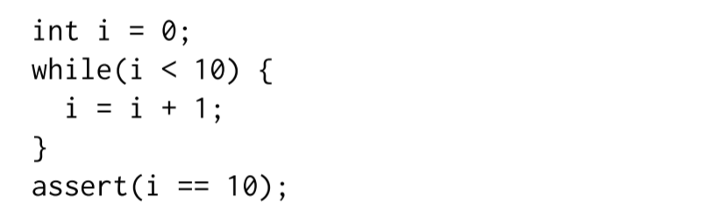
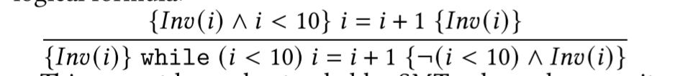
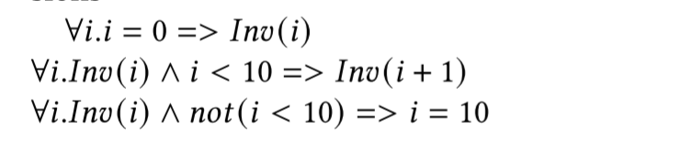
Talk is cheap, show me the code
target loop
The conditions that a loop invariant must satisfy
Translate that into Boolean expressions

Slide 27
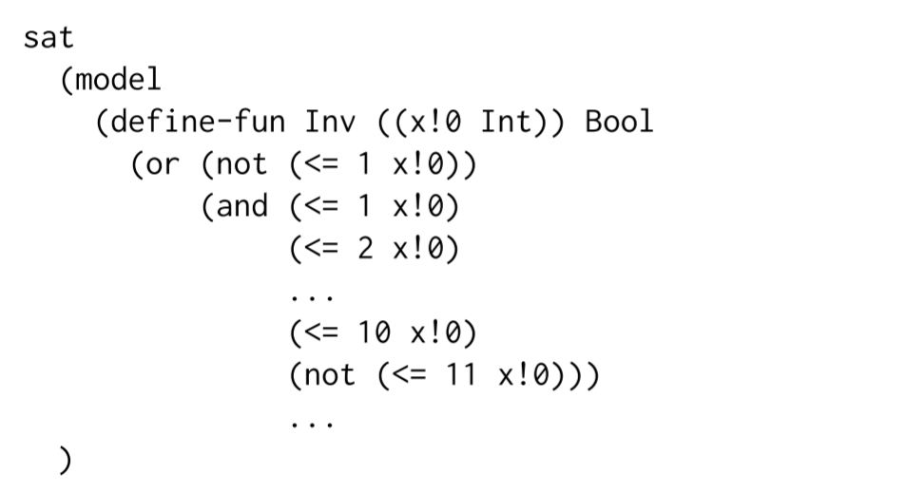


The output of the Z3-solver
Simplify that, and we can get the invariant $x≤10$

Slide 28
More is on my paper
Due to the limitation of time, I can’t explain the method behind the magic process.
If you have interest, you can read my paper.
(Although that is still a very brief introduction)
Something is better than nothing.

Slide 29
A review
A fundamental and important concept of program verification
A different perspective of reasoning about your algorithm
Two useful tools for further learning (and for fun)
Busting a myth about industrial algorithm design
A proactive mindset

Slide 30

Thank you for listening

