Slide 1

Decoding Python Memory Management: Navigating Dynamic Allocation and Cycle Garbage Collection
Zi Li

Slide 2


Motivation
Memory Management is of great significance(sometimes)

Slide 3
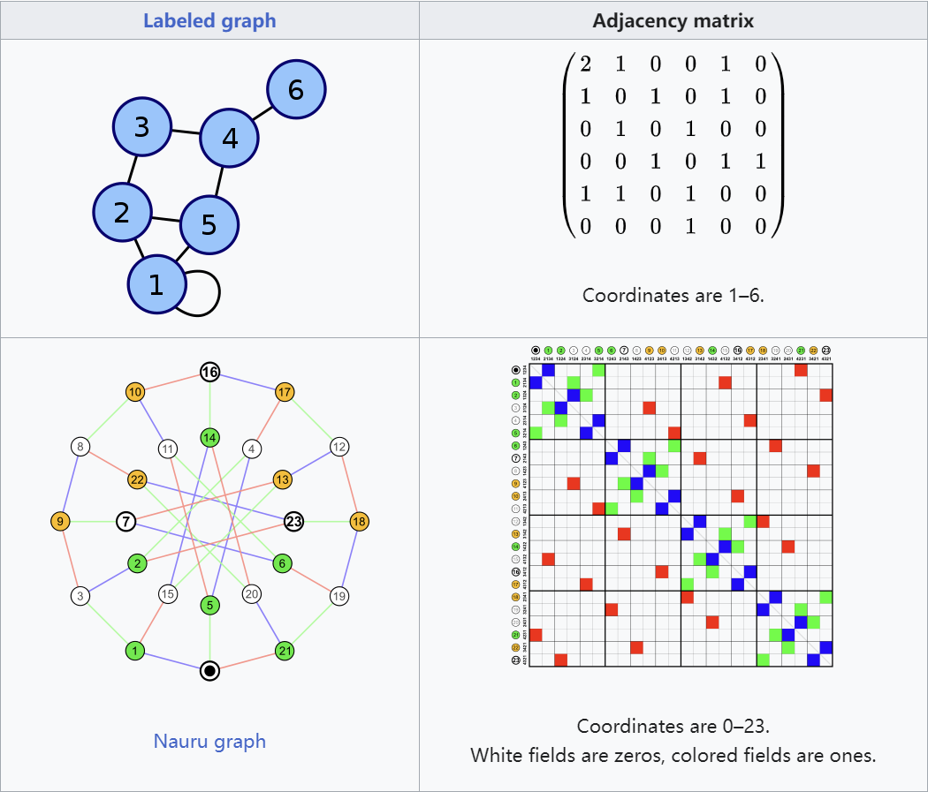
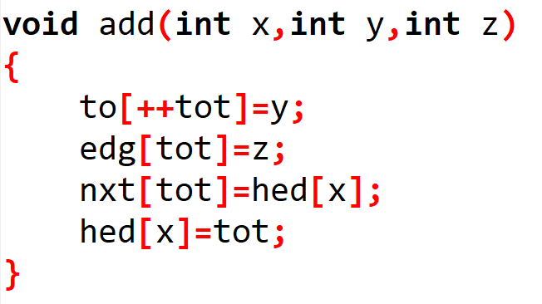
Motivation
Sometimes we have to solve the problem by ourselves…
From adjacency matrix
To adjacency list/链式前向星

Slide 4
Motivation
When it comes to a list…
How to prevent memory conflicts when appending a new element to a list?
In C++, we have vector.
In Python, the list itself can handle that. (Automatically!)

Slide 5
Motivation
So sometimes, Python can implement memory management automatically.
We’re going to introduce two ways of this.
Dynamic memory allocation
Cycle Garbage Collection Mechanism

Slide 6
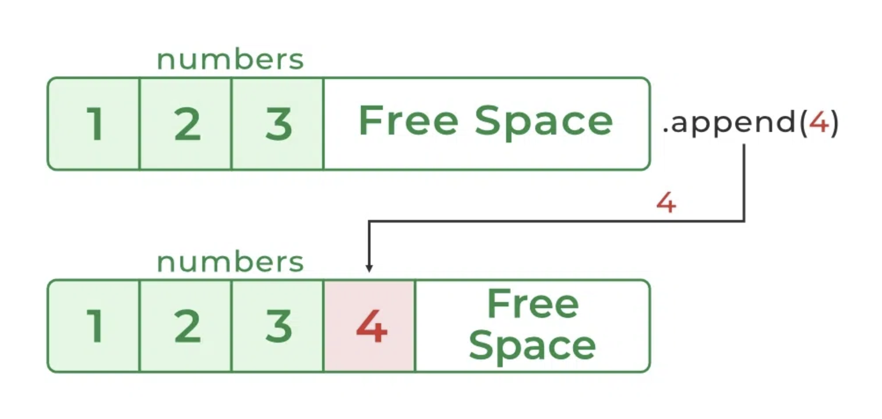
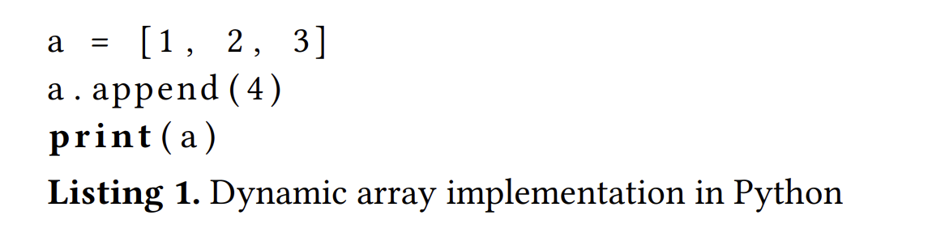
Dynamic Memory Allocation
Dynamic arrays serve as a key example to explore dynamic allocation in Python’s memory management, particularly during operations like appending elements.

Slide 7
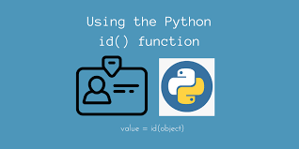
Dynamic Memory Allocation
The ‘id()‘ function in Python helps us understand this process by revealing the memory address of an object.

Slide 8
Dynamic Memory Allocation
If the current memory block can handle the growing list, the ‘id(a)‘ remains the same.
Otherwise a new block with a different address may be created.(Seldomly)

Slide 9
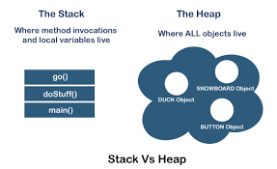
Dynamic Memory Allocation
There are two parts of memory: stack memory and heap memory.
List object is stored in heap memory.

Slide 10

Cycle Garbage Collection Mechanism
Circular references occur when a group of objects references each other, forming a cycle.
Traditional methods may struggle.

Slide 11
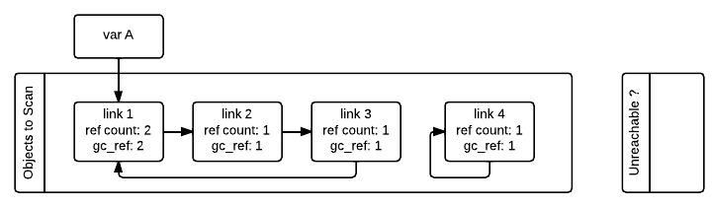
Cycle Garbage Collection Mechanism
Tracking objects that are "containers“, and determining what objects in them can't be reached anywhere else.
(containers are things like lists, dictionaries and custom class instances)

Slide 12
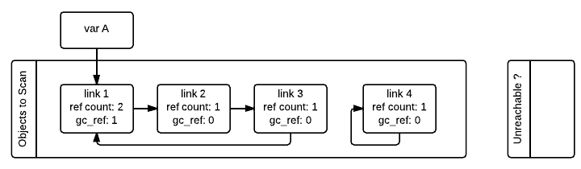
Cycle Garbage Collection Mechanism
Tracking objects that are "containers“, and determining what objects in them can't be reached anywhere else.

Slide 13
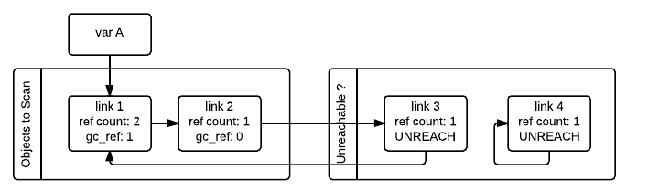
Cycle Garbage Collection Mechanism
Tracking objects that are "containers“, and determining what objects in them can't be reached anywhere else.

Slide 14
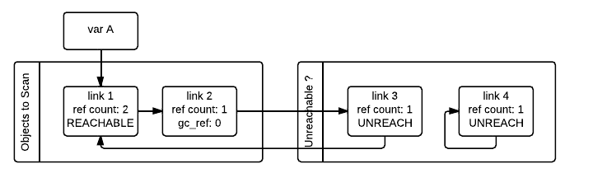
Cycle Garbage Collection Mechanism
Tracking objects that are "containers“, and determining what objects in them can't be reached anywhere else.

Slide 15
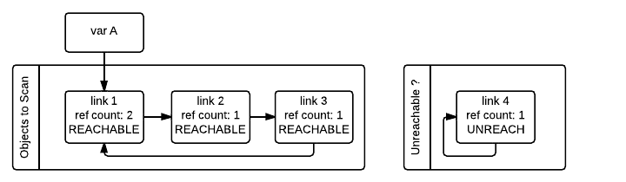
Cycle Garbage Collection Mechanism
Tracking objects that are "containers“, and determining what objects in them can't be reached anywhere else.

Slide 16

Python Memory management
Two ways of implementation
Enhanced efficiency and peak performance
Address the challenge of optimal memory utilization

Slide 17


THANKS!

